Slide 1
Darolutamide in mHSPC (NUBEQA®)
PP-NUB-CH-0215-2 / 2024.06

Slide 2
Disclaimer
The following has been developed in response to an unsolicited request for slides for a scientific presentation, is for scientific information purposes only and does not represent promotion of a non-licensed indication
NUBEQA, in combination with docetaxel and androgen deprivation therapy (ADT), is indicated for the treatment of adult patients with metastatic hormone-sensitive prostate cancer (mHSPC), for whom docetaxel therapy is indicated.¹
Darolutamide is approved in combination with androgen deprivation therapy (ADT), is indicated for the treatment of adult patients with non-metastatic, castration-resistant prostate cancer (NM-CRPC) who are at high risk of developing metastases (especially PSADT ≤ 10 months).¹
This presentation may not be duplicated or distributed
Bayer (Schweiz) AG does not take any responsibility for any misuse of this information
1. Professional Information NUBEQA; www.swissmedicinfo.ch

Slide 3
Table of Content
What is Darolutamide?
ARASENS: Phase 3 Study in mHSPC

Slide 4
What is darolutamide?

Slide 5
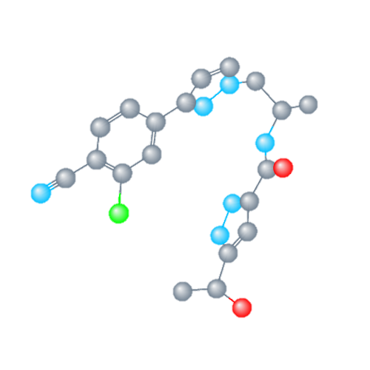
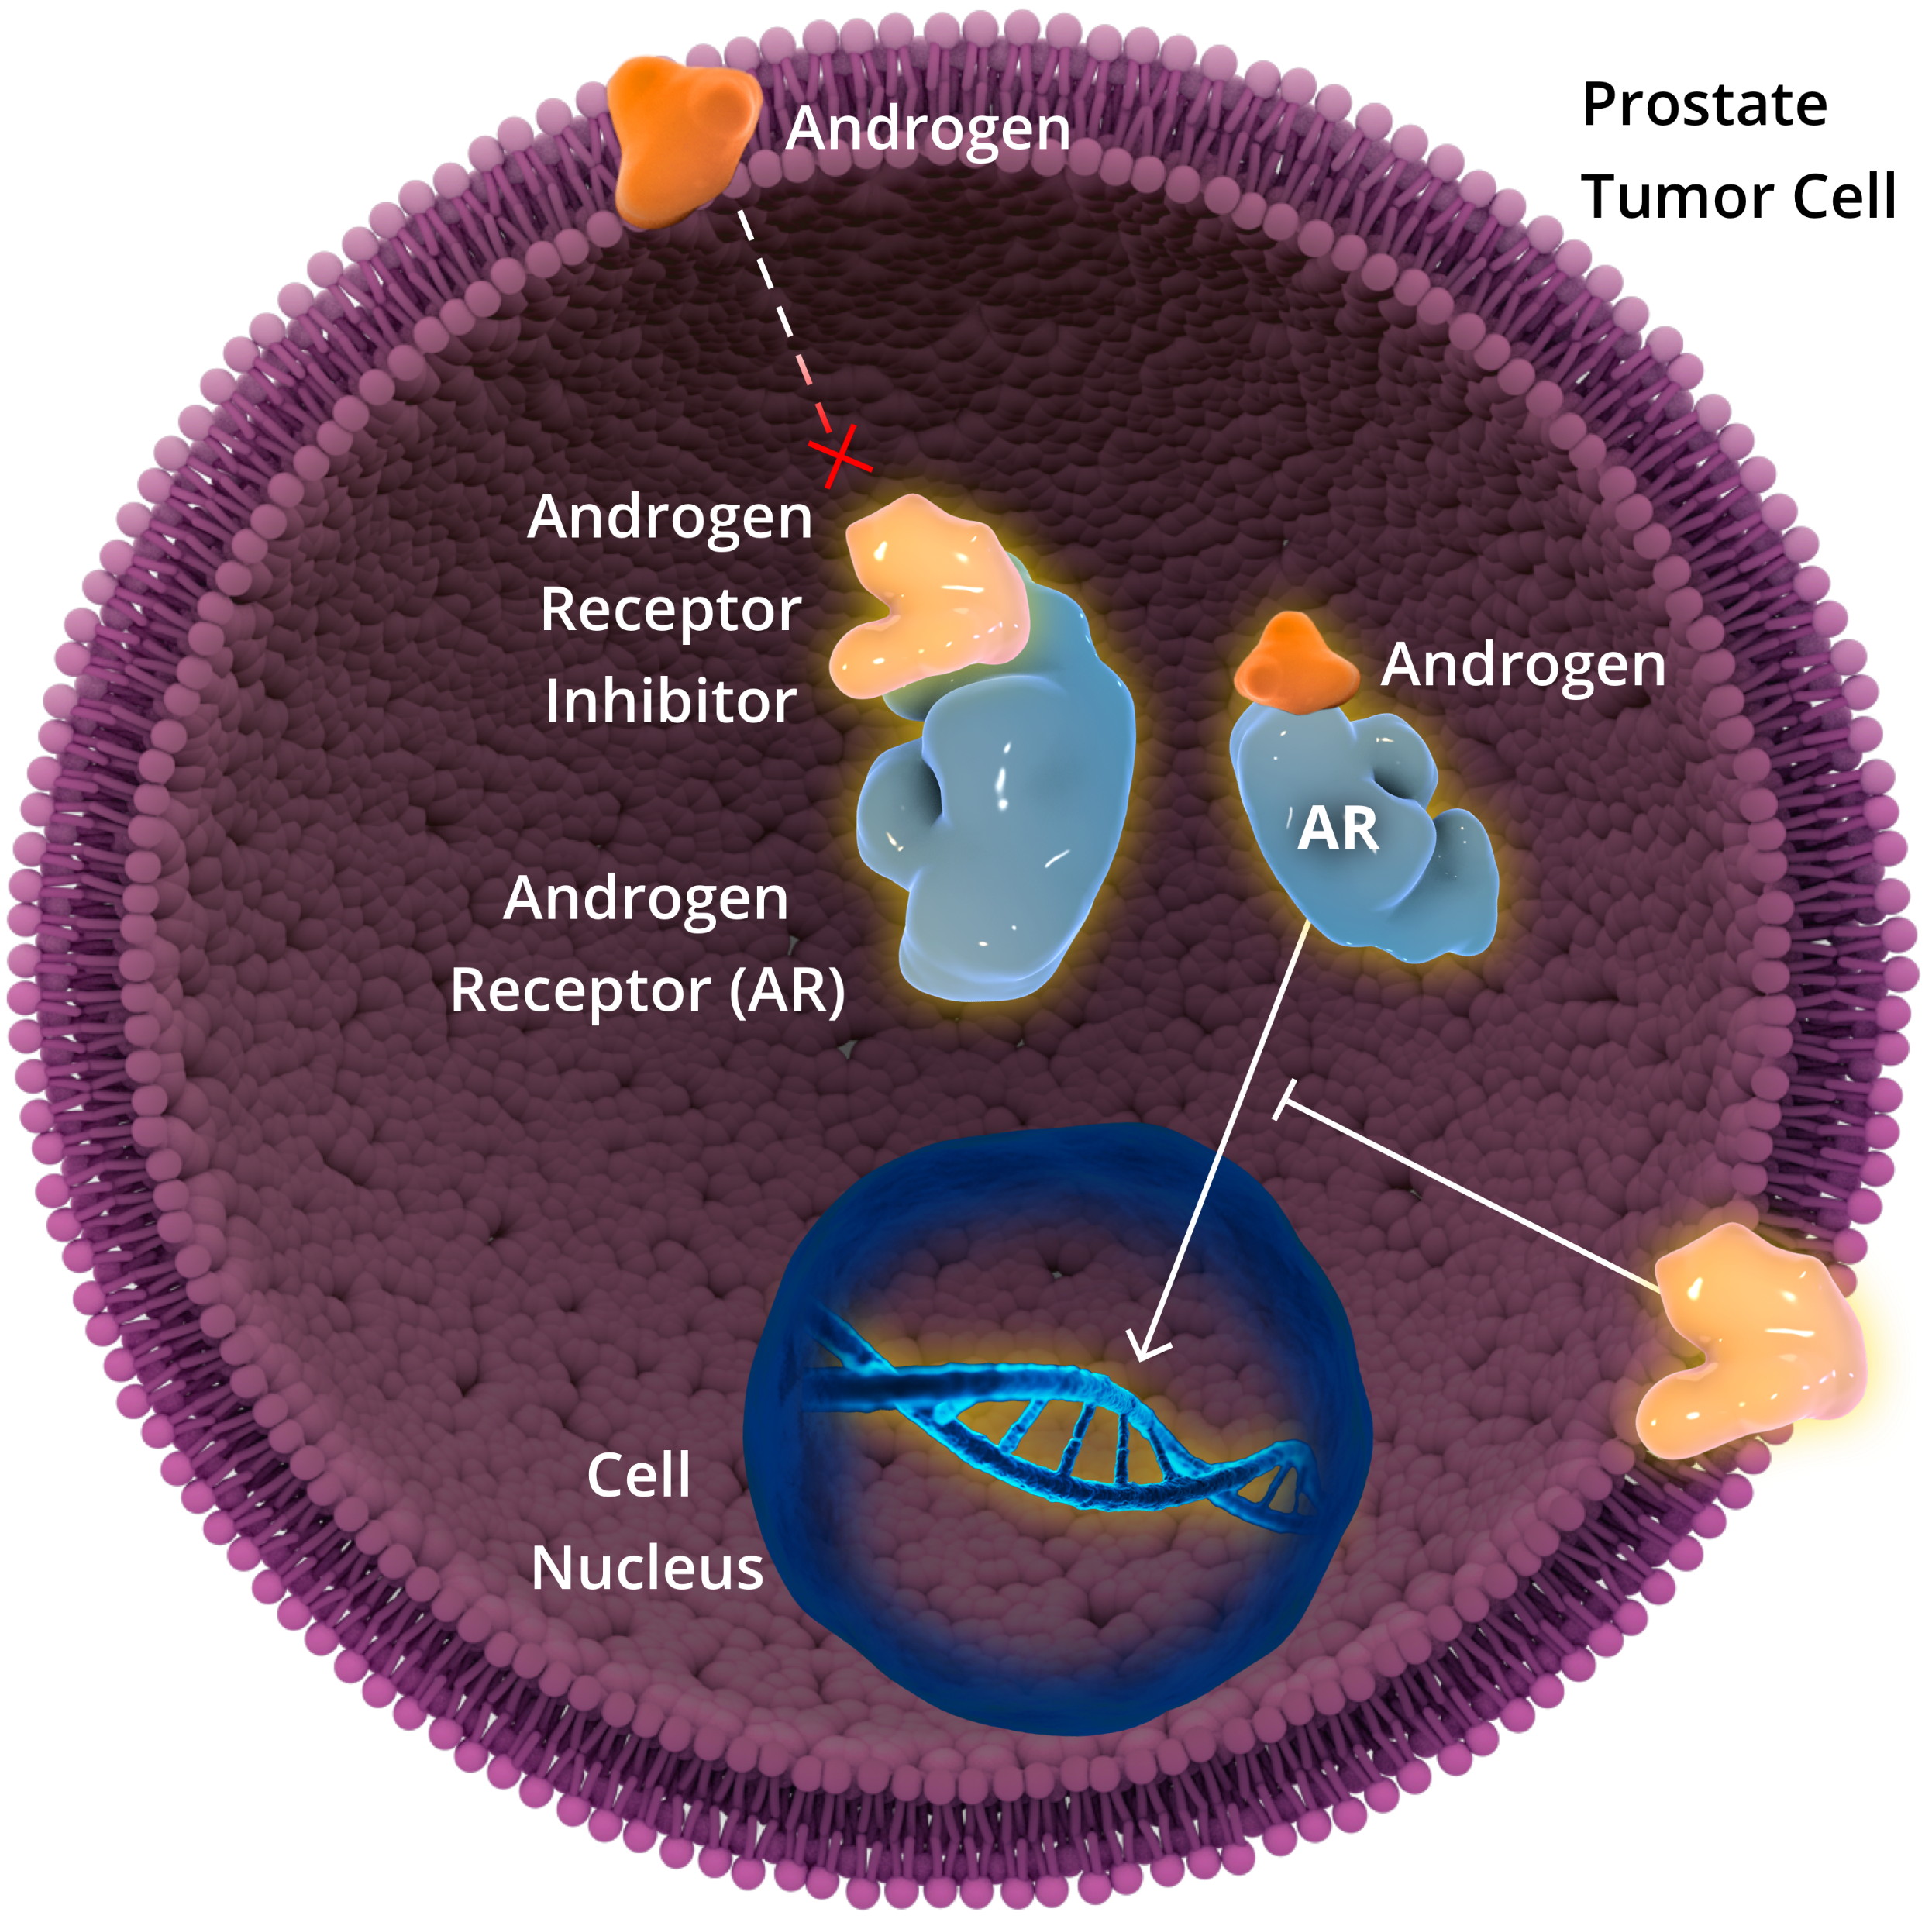

Darolutamide is a potent Androgen Receptor Inhibitor with an established Efficacy Profile and Favorable Tolerability Profile across indications
Darolutamide Mechanism of Action
Darolutamide Is a Potent Androgen Receptor Inhibitor With¹:
Darolutamide is a potent androgen receptor inhibitor¹
AR inhibition blocks nuclear translocation of the AR, preventing growth and promoting apoptosis of prostate cancer cells¹⁻⁴
Preclinical models have demonstrated targeting the AR can enhance taxane-induced cellular apoptosis⁵
A strong efficacy profile in patients with nmCRPC, significantly prolonging overall survival and delaying development of metastases and disease progression⁶
A favorable safety profile, with most AEs commonly associated with ARis showing a <2% difference between darolutamide and placebo in patients with nmCRPC^{6,7}
Limited potential for DDIs with medications commonly taken by patients with prostate cancer^{8,9}
Inhibits PSA
Expression
Darolutamide
Notes:
Abbreviations
AE, adverse event; AR, androgen receptor; ARi, androgen receptor inhibitor; DDI, drug-drug interaction; nmCRPC, nonmetastatic castration-resistant prostate cancer.

Slide 6
ARASENS: Phase 3 Study in mHSPC

Slide 7



ARASENS Study Design
Global, randomized, double-blind, placebo-controlled phase 3 study (NCT02799602)^{1,2}
The primary analysis was conducted after 533 deaths
Secondary efficacy endpoints were tested hierarchically
Endpoints
Primary: OS
Secondary
Time to castration-resistant prostate cancer
Time to pain progression
Symptomatic skeletal event-free survival (SSE-FS)
Time to first symptomatic skeletal event (SSE)
Time to initiation of subsequent antineoplastic therapy
Time to worsening of physical symptoms of disease
Time to initiation of opioid use for ≥7 consecutive days
Safety
Docetaxel × 6*
Patients (N=1306)
mHSPC
ECOG PS ≤1
Candidates for ADT and docetaxel
Stratification
Extent of disease: M1a vs M1b vs M1c
Alkaline phosphatase levels < vs ≥ ULN
Darolutamide (600 mg bid) + ADT#
1:1 Randomization (N=1305†)
Placebo + ADT#
FPFV: Nov 2016
LPFV: Jun 2018
Docetaxel × 6*
Data cutoff: Oct. 25, 2021
*Starting ≤6 weeks after start of study drug at 75 mg/m² / 3 weeks, 6 cycles (in combination with prednisone/prednisolone at the discretion of the investigator). #Investigators’ choice (including orchiectomy) starting ≤12 weeks before randomization †One enrolled patient was excluded from all analysis sets because of Good Clinical Practice violations.
‡One patient randomized to the placebo group but who received darolutamide was included in the placebo group for the full analysis set and in the darolutamide group for the safety analysis set.
1. Smith MR, et al. Darolutamide and Survival in Metastatic, Hormone-Sensitive Prostate Cancer. N Engl J Med. 2022 Mar 24;386(12):1132-1142. doi: 10.1056/NEJMoa2119115 2. ClinicalTrials.gov identifier: NCT0279960. Accessed January 2022. https://clinicaltrials.gov/ct2/show/NCT02799602.
Notes:
Abbreviations:
ADT, androgen deprivation therapy; bid, twice a day; ECOG PS, Eastern Cooperative Oncology Group performance status; mHSPC, metastatic hormone-sensitive prostate cancer; ULN, upper limit of normal.
The first cycle of docetaxel was administered within 6 weeks after the start of study drug at the discretion of the investigator

Slide 8
ARASENS: Patient Demographics I
Characteristic | Darolutamide + ADT + Docetaxel (N=651) | Placebo + ADT + Docetaxel (N=654)
Median age (range) — year | 67 (41-89) | 67 (42-86)
ECOG performance status — no. (%)
0 | 466 (71.6) | 462 (70.6)
1 | 185 (28.4) | 190 (29.1)
Race — no. (%)
White | 345 (53.0) | 333 (50.9)
Asian | 230 (35.3) | 245 (37.5)
Black or African American | 26 (4.0) | 28 (4.3)
Other | 7 (1.1) | 2 (0.3)
Not reported | 43 (6.6) | 46 (7.0)
Region — no. (%)
North America | 125 (19.2) | 119 (18.2)
Asia Pacific | 229 (35.2) | 244 (37.3)
Rest of the World | 297 (45.6) | 291 (44.5)
Gleason score at initial diagnosis — no. (%)
<8 | 122 (18.7) | 118 (18.0)
≥8 | 505 (77.6) | 516 (78.9)
Missing | 24 (3.7) | 20 (3.1)
Metastatic stage at initial diagnosis— no. (%)
M1 (de novo) | 558 (85.7) | 566 (86.5)
M0 (recurrent) | 86 (13.2) | 82 (12.5)
Mx | 7 (1.1) | 6 (0.9)
Metastatic stage at screening— no. (%)
M1a | 23 (3.5) | 16 (2.4)
M1b | 517 (79.4) | 520 (79.5)
M1c | 111 (17.1) | 118 (18.0)
Median serum PSA concentration at baseline (range) — ng/mL* | 30.3 (0.0-9219.0) | 24.2 (0.0-11,947.0)
Median serum ALP level (range) at baseline — U/L* | 148 (40-4885) | 140 (36-7680)
Alkaline phosphatase category at baseline — no. (%)
<upper limit of normal* | 290 (44.5) | 291 (44.5)
≥upper limit of normal* | 361 (55.5) | 363 (55.5)
Smith MR, et al. Darolutamide and Survival in Metastatic, Hormone-Sensitive Prostate Cancer. N Engl J Med. 2022 Mar 24;386(12):1132-1142. doi: 10.1056/NEJMoa2119115.
Notes:
Abbreviations
ADT, androgen deprivation therapy; ECOG, Eastern Cooperative Oncology Group.
The ARASENS study was a global study including patients from 23 countries

Slide 9
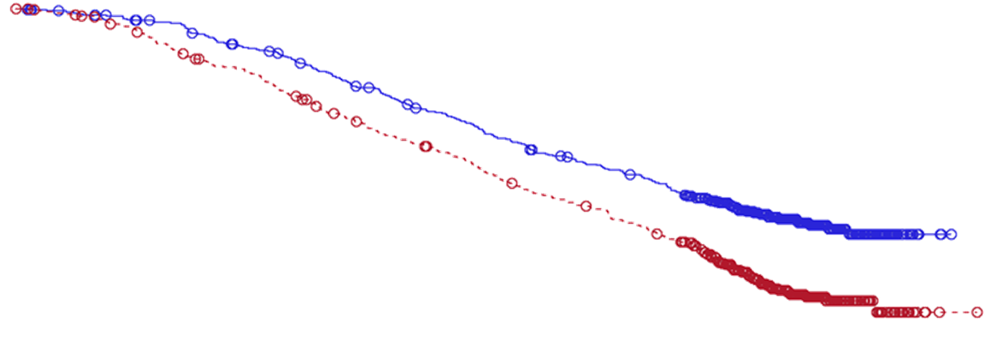


ARASENS: Overall Survival
1.0
Primary endpoint
Hazard ratio for overall survival,
0.68 (95% CI, 0.57-0.80)
P<0.001
0.9
Darolutamide + ADT + docetaxel
Median NE (95% CI, NE-NE)
0.8
0.7
0.6
Survival Probability
0.5
Patients’ 4-year survival rate increased from 50.4 % with docetaxel + ADT to 62.7 % with the combination of darolutamide + ADT with docetaxel
Placebo + ADT + docetaxel
Median 48.9 months (95% CI, 44.4-NE)
0.4
0.3
0.2
0.1
OS by Stratification Factors (EAU 22)
0.0
0
3
6
9
12
15
18
21
24
27
30
33
36
39
42
45
48
51
54
57
60
Number of patients at risk
Months
Darolutamide
651 | 645 | 637 | 627 | 608 | 593 | 570 | 548 | 525 | 509 | 486 | 468 | 452 | 436 | 402 | 267 | 139 | 56 | 9 | 0 | 0
654 | 646 | 630 | 607 | 580 | 565 | 535 | 510 | 488 | 470 | 441 | 424 | 402 | 383 | 340 | 218 | 107 | 37 | 6 | 1 | 0
Placebo
Smith MR, et al. Darolutamide and Survival in Metastatic, Hormone-Sensitive Prostate Cancer. N Engl J Med. 2022 Mar 24;386(12):1132-1142. doi: 10.1056/NEJMoa2119115
Notes:
ADT, androgen deprivation therapy; CI, confidence interval; HR, hazard ratio; NE, not estimable.
Darolutamide + ADT With Docetaxel Significantly Reduced the Risk of Death by 32.5% When Compared to Docetaxel + ADT
ARASENS was designed as an event-driven trial which was completed after 533 events (deaths). In the final analysis, after median follow up of 43.7 months, the number of events required for the calculation of the median OS was reached in placebo arm (48.9m) but not in darolutamide arm
When assessing the clinical benefit of therapies in mHSPC, it is important to remember that the ARASENS study included docetaxel + ADT as a comparator arm, which is a current guideline-recommended standard of care¹⁻³

Slide 10
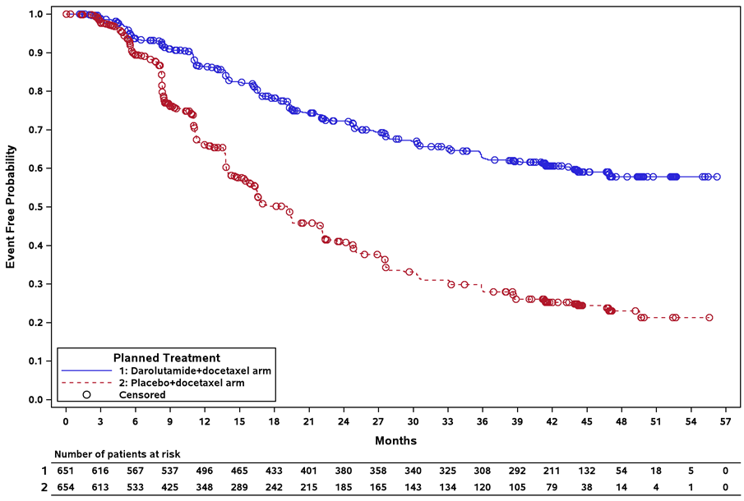
ARASENS: Time to CRPC
Secondary endpoint
Darolutamide + ADT + docetaxel
Median NE (95% CI, NE-NE)
Hazard ratio for time to CRPC, 0.36 (95% CI, 0.30-0.42)
P<0.001
Placebo + ADT + docetaxel
Median 19.1 months (95% CI, 16.5-21.8)
Darolutamide
Smith M, et al. N Engl J Med. 2022; DOI: 10.1056/NEJMoa2119115.
Placebo
Notes:
Abbreviations
ADT, androgen deprivation therapy; CI, confidence interval; CRPC, castration-resistant prostate cancer; NE, not estimable.
Darolutamide + ADT With Docetaxel Significantly Delayed Time to CRPC Compared to Docetaxel + ADT

Slide 11

ARASENS: Secondary Endpoints
Secondary endpoints
Endpoint | Darolutamide + ADT + Docetaxel (N=651) |  | Placebo + ADT + Docetaxel (N=654) |  | Hazard Ratio (95% CI) | 2-sided P Value
 | Median | Events | Median | Events
 | Month | n (%) | Month | n (%)
Time to castration-resistant prostate cancer | NE | 225 (35) | 19.1 | 391 (60) | 0.36 (0.30-0.42) | <0.001
Time to pain progression | NE | 222 (34) | 27.5 | 248 (38) | 0.79 (0.66-0.95) | 0.01
Symptomatic skeletal event (SSE)-free survival | 51.2 | 257 (40) | 39.7 | 329 (50) | 0.61 (0.52-0.72) | 0.02
Time to first SSE | NE | 95 (15) | NE | 108 (17) | 0.71 (0.54-0.94) | <0.001
Time to initiation of subsequent systemic antineoplastic therapy | NE | 219 (34) | 25.3 | 395 (60) | 0.39 (0.33-0.46) | <0.001
Time to worsening of disease-related physical symptoms | 19.3 | 351 (54) | 19.4 | 308 (47) | 1.04 (0.89-1.22) | 0.59
Time to initiation of opioid use for ≥7 consecutive days | NE | 92 (14) | NE | 117 (18) | 0.69 (0.52-0.91) | NA
Secondary endpoints were evaluated using the hierarchical gatekeeping procedure. When time to worsening of disease-related physical symptoms was not significant, subsequent analyses were stopped and considered exploratory.
Smith MR, et al. Darolutamide and Survival in Metastatic, Hormone-Sensitive Prostate Cancer. N Engl J Med. 2022 Mar 24;386(12):1132-1142. doi: 10.1056/NEJMoa2119115
Notes:
Abbreviations
ADT, androgen deprivation therapy; CI, confidence interval; NA, not applicable; NE, not estimable.

Slide 12
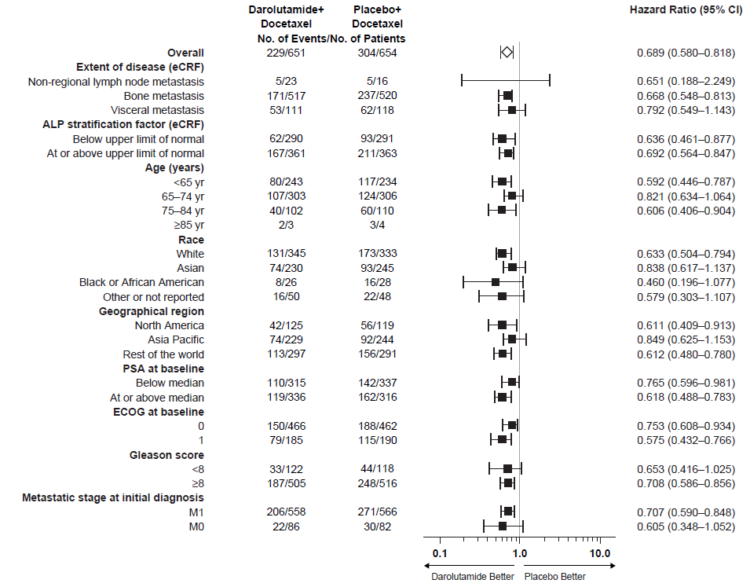
ARASENS: Overall Survival in Subgroups
Darolutamide + ADT + Docetaxel
Placebo + ADT + Docetaxel
Smith MR, et al. Darolutamide and Survival in Metastatic, Hormone-Sensitive Prostate Cancer. N Engl J Med. 2022 Mar 24;386(12):1132-1142. doi: 10.1056/NEJMoa2119115
Notes:
Abbreviations
ADT, androgen deprivation therapy; ALP, alkaline phosphatase; CI, confidence interval; ECOG, Eastern Cooperative Oncology Group; eCRF, electronic case report form; PSA, prostate-specific antigen.
The Overall Survival Benefit With Darolutamide + ADT With Docetaxel Was Consistent Across Subgroups
When designing the ARASENS study, TNM staging was implemented to characterize extent of disease.
Alkaline phosphatase (ALP) is a well established, clinically relevant, and easily assessable way to characterize disease burden and prognosis in patients with mHSPC^{1,2}

Slide 13
ARASENS: Safety
Adverse Event | Darolutamide + ADT + Docetaxel (N=652*) | Placebo + ADT + Docetaxel (N=650*)
Any — no. of patients (%) | 649 (99.5) | 643 (98.9)
Worst grade
Grade 1 | 28 (4.3) | 35 (5.4)
Grade 2 | 162 (24.8) | 169 (26.0)
Grade 3 | 248 (38.0) | 232 (35.7)
Grade 4 | 183 (28.1) | 181 (27.8)
Grade 5 | 27 (4.1) | 26 (4.0)
Serious | 292 (44.8) | 275 (42.3)
Adverse event leading to permanent treatment discontinuation — no. of patients (%)
Darolutamide/placebo | 88 (13.5) | 69 (10.6)
Docetaxel | 52 (8.0) | 67 (10.3)
*Three randomized patients were never treated; all 3 were in the placebo group. One patient was randomized in the placebo group, but received darolutamide. The patient was included in the darolutamide group for the safety analysis set.
Smith MR, et al. Darolutamide and Survival in Metastatic, Hormone-Sensitive Prostate Cancer. N Engl J Med. 2022 Mar 24;386(12):1132-1142. doi: 10.1056/NEJMoa2119115.
Notes:
Abbreviations
ADT, androgen deprivation therapy; TEAE, treatment-emergent adverse event.
The Incidences of Any-Grade Events, Grade 3 to 5 Events, Serious Adverse Events, and Discontinuations Due to TEAEs Were Similar in Both Arms

Slide 14
ARASENS: Adverse Events
Adverse Event* | Darolutamide + ADT + Docetaxel (N=652) | Placebo + ADT + Docetaxel (N=650)
 | No. of patients (%) | No. of patients (%)
Alopecia | 264 (40.5) | 264 (40.6)
Neutropenia† | 256 (39.3) | 252 (38.8)
Fatigue | 216 (33.1) | 214 (32.9)
Anemia | 181 (27.8) | 163 (25.1)
Arthralgia | 178 (27.3) | 174 (26.8)
Peripheral edema | 173 (26.5) | 169 (26.0)
Diarrhea | 167 (25.6) | 156 (24.0)
Constipation | 147 (22.5) | 130 (20.0)
Hot flush | 124 (19.0) | 122 (18.8)
Back pain | 123 (18.9) | 123 (18.9)
Decreased appetite | 121 (18.6) | 85 (13.1)
Increased weight | 116 (17.8) | 102 (15.7)
Nausea | 115 (17.6) | 133 (20.5)
Increased alanine aminotransferase | 102 (15.6) | 84 (12.9)
Pain in extremity | 98 (15.0) | 78 (12.0)
Increased aspartate aminotransferase | 91 (14.0) | 68 (10.5)
Pyrexia | 86 (13.2) | 90 (13.8)
Hypertension | 85 (13.0) | 59 (9.1)
Cough | 84 (12.9) | 73 (11.2)
Bone pain | 81 (12.4) | 84 (12.9)
Peripheral neuropathy | 76 (11.7) | 67 (10.3)
Insomnia | 74 (11.3) | 81 (12.5)
Hyperglycemia | 74 (11.3) | 61 (9.4)
Myalgia | 73 (11.2) | 63 (9.7)
Dysgeusia | 69 (10.6) | 80 (12.3)
Asthenia | 68 (10.4) | 65 (10.0)
Stomatitis | 66 (10.1) | 57 (8.8)
Peripheral sensory neuropathy | 65 (10.0) | 67 (10.3)
Urinary tract infection | 61 (9.4) | 67 (10.3)
Dyspnea | 59 (9.0) | 71 (10.9)
Malaise | 57 (8.7) | 66 (10.2)
The incidences of the most common adverse events, many of which are known toxicities of docetaxel, were highest during the docetaxel treatment period for both groups and progressively decreased thereafter.
*Patients may have had more than 1 treatment-emergent adverse event. Adverse events are described using the Medical Dictionary for Regulatory Activities preferred terms.
†Neutropenia includes preferred terms of leukopenia, neutropenia, decreased neutrophil count, and decreased white blood cell count.
Smith MR, et al. Darolutamide and Survival in Metastatic, Hormone-Sensitive Prostate Cancer. N Engl J Med. 2022 Mar 24;386(12):1132-1142. doi: 10.1056/NEJMoa2119115
Notes:
Abbreviations
ADT, androgen deprivation therapy.
The Combination of Darolutamide + ADT With Docetaxel Resulted in Minimal Additional Toxicity Compared to Docetaxel + ADT

Slide 15
ARASENS: Adverse Events of Interest
Adverse Event | Darolutamide + ADT + Docetaxel (N=652) | Placebo + ADT + Docetaxel (N=650)
 | No. of patients (%) | No. of patients (%)
Events commonly associated with ADT or ARPI therapy
Fatigue | 216 (33.1) | 214 (32.9)
Vasodilatation and flushing | 133 (20.4) | 141 (21.7)
Rash* | 108 (16.6) | 88 (13.5)
Diabetes mellitus and hyperglycemia | 99 (15.2) | 93 (14.3)
Hypertension† | 89 (13.7) | 60 (9.2)
Cardiac disorder | 71 (10.9) | 76 (11.7)
Cardiac arrhythmia† | 52 (8.0) | 55 (8.5)
Coronary artery disorder† | 19 (2.9) | 13 (2.0)
Heart failure† | 4 (0.6) | 13 (2.0)
Bone fracture‡ | 49 (7.5) | 33 (5.1)
Falls, including accident | 43 (6.6) | 30 (4.6)
Mental-impairment disorder† | 23 (3.5) | 15 (2.3)
Weight decreased | 22 (3.4) | 35 (5.4)
Depressed-mood disorder† | 21 (3.2) | 24 (3.7)
Breast disorders/gynecomastia† | 21 (3.2) | 10 (1.5)
Cerebral ischemia | 8 (1.2) | 8 (1.2)
Seizure | 4 (0.6) | 1 (0.2)
In ARASENS, the low rates of AEs typically associated with AR pathway inhibitors are consistent with the favorable safety profile of darolutamide in patients with nmCRPC.
Incidences of rash and hypertension were higher in the darolutamide arm than in the placebo arm.
Smith MR, et al. Darolutamide and Survival in Metastatic, Hormone-Sensitive Prostate Cancer. N Engl J Med. 2022 Mar 24;386(12):1132-1142. doi: 10.1056/NEJMoa2119115
Notes:
*This category combines the following MedDRA terms: rash, maculopapular rash, drug eruption, pruritic rash, erythematous rash, macular rash, papular rash, follicular rash, pustular rash, and vesicular rash.
†This category is a MedDRA High-Level Group Term.
‡Excluding pathologic fractures. This category combines the following MedDRA terms: any fractures and dislocations, limb fractures and dislocations, pelvic fractures and dislocations, skull fractures, facial bone fractures and dislocations, spinal fractures and dislocations, and thoracic cage fractures and dislocations.
Abbreviations
ADT, androgen deprivation therapy; AE, adverse event; AR, androgen receptor; ARPI, androgen receptor pathway inhibitor; MedDRA, Medical Dictionary for Regulatory Activities; nmCRPC, nonmetastatic castration-resistant prostate cancer.
The Incidences of Adverse Events of Interest Were Generally Similar Between Treatment Arms

Slide 16
ARASENS: Adverse Events by time interval
1.Crawford et al. LBA01-07OVERALL SAFETY AND INCIDENCES OF ADVERSE EVENTS BY TIME INTERVAL WITH DAROLUTAMIDE PLUSANDROGEN-DEPRIVATION THERAPY AND DOCETAXEL IN THEPHASE 3 ARASENS TRIAL. THE JOURNAL OF UROLOGY (2022) Vol. 207, No. 5S, Supplement

Slide 17
ARASENS: Adverse Events by time interval
1.Crawford et al. LBA01-07OVERALL SAFETY AND INCIDENCES OF ADVERSE EVENTS BY TIME INTERVAL WITH DAROLUTAMIDE PLUSANDROGEN-DEPRIVATION THERAPY AND DOCETAXEL IN THEPHASE 3 ARASENS TRIAL. THE JOURNAL OF UROLOGY (2022) Vol. 207, No. 5S, Supplement

Slide 18
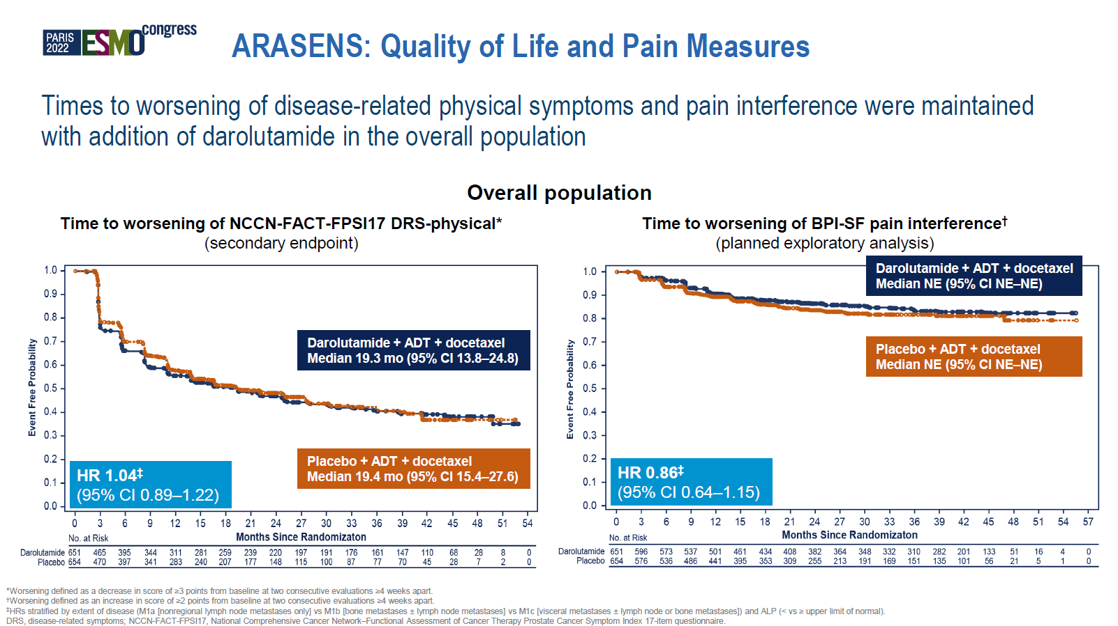
Fizazi et al., Quality of life and patient-relevant endpoints with darolutamide in the phase III ARASENS study. Annals of Oncology (2022) 33 (suppl_7): S616-S652. 10.1016/annonc/annonc1070

Slide 19
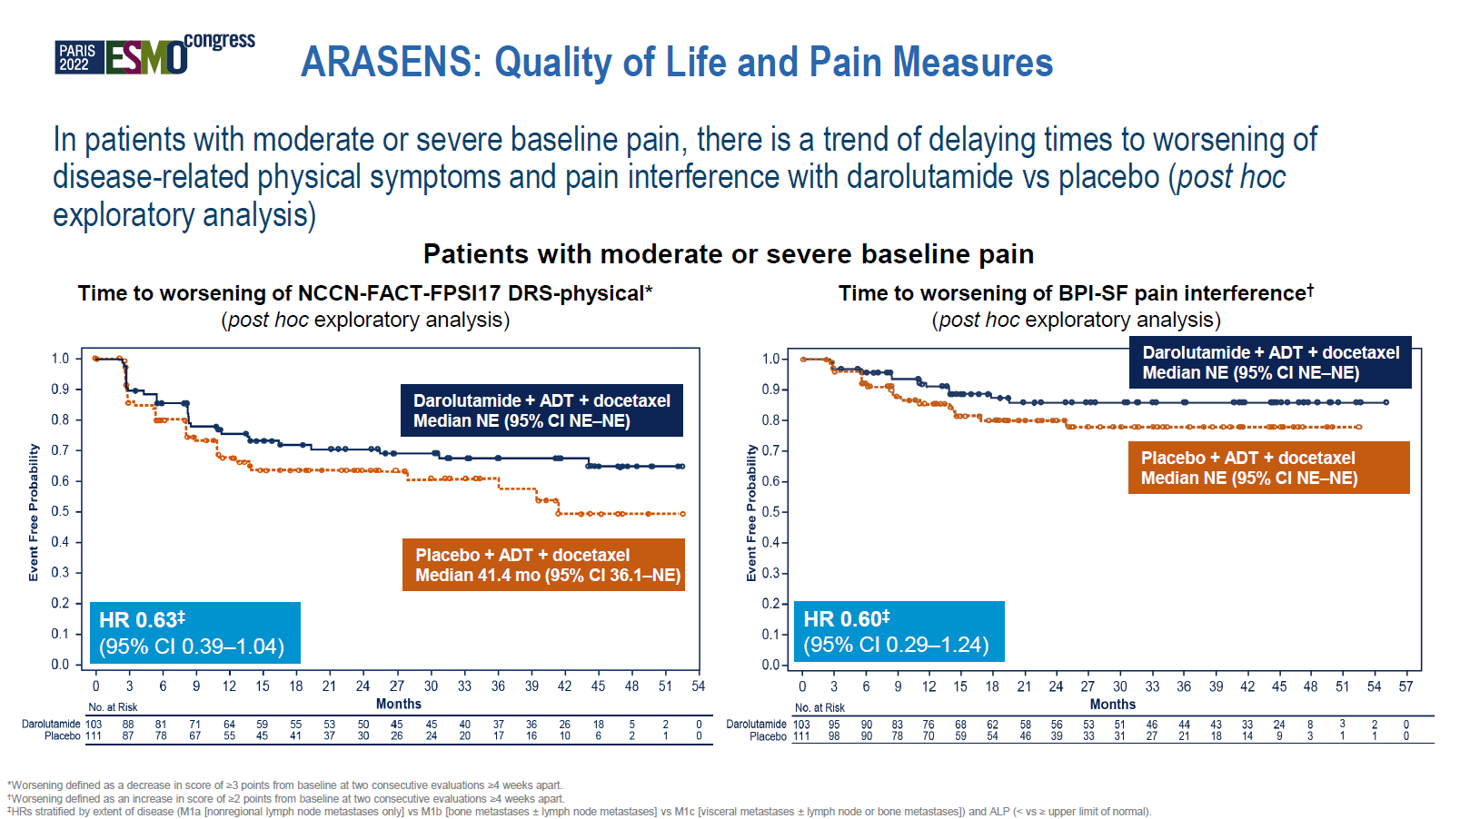
Fizazi et al., Quality of life and patient-relevant endpoints with darolutamide in the phase III ARASENS study. Annals of Oncology (2022) 33 (suppl_7): S616-S652. 10.1016/annonc/annonc1070

Slide 20
ARASENS Trial: Conclusions
Efficacy
Safety
The combination of darolutamide + ADT with docetaxel significantly improved overall survival by reducing the risk of death by 32.5% (HR=0.68) compared to docetaxel + ADT
This effect was consistent across most subgroups and other clinically relevant endpoints, including time to CRPC and time to pain progression
The combination of darolutamide + ADT with docetaxel resulted in minimal additional toxicity compared with docetaxel + ADT
The incidences of the most common adverse events, many of which are known toxicities of docetaxel, were highest during the docetaxel treatment period for both groups and progressively decreased thereafter
Smith MR, et al. Darolutamide and Survival in Metastatic, Hormone-Sensitive Prostate Cancer. N Engl J Med. 2022 Mar 24;386(12):1132-1142. doi: 10.1056/NEJMoa2119115
Notes:
Abbreviations
ADT, androgen deprivation therapy; CRPC, castration-resistant prostate cancer; HR, hazard ratio; mHSPC, metastatic hormone-sensitive prostate cancer.

Slide 21
Short Professional Information
▼ This medicinal product is subject to additional monitoring. For further information, see Summary of Product Characteristics/Patient Information Leaflet for NUBEQA® at www.swissmedicinfo.ch.
Short product information NUBEQA®
Active substance: Darolutamide. Indication: NUBEQA, in combination with docetaxel and androgen deprivation therapy (ADT), is indicated for the treatment of adult patients with metastatic hormone-sensitive prostate cancer (mHSPC), for whom docetaxel therapy is indicated. NUBEQA, in combination with ADT, is indicated for the treatment of adult patients with non-metastatic, castration-resistant prostate cancer (nmCRPC), for those who are at high risk of developing metastases (especially with a PSADT ≤ 10 months). Dosage/Administration: 600 mg (two 300-mg film-coated tablets) taken twice daily with a meal (total daily dose of 1200 mg). Patients receiving NUBEQA should also receive an LHRH analogue concurrently or have had a bilateral orchiectomy. Patients with mHSPC should start treatment with NUBEQA in combination with six cycles of docetaxel. Contraindications: Hypersensitivity to the active pharmaceutical ingredient or to one of the excipients. Women who are pregnant or of childbearing potential. Special warnings/precautions for use: Renal/hepatic impairment: Closely monitor patients with severe renal impairment or moderate/severe hepatic impairment for adverse reactions. Hepatotoxicity: In case of liver function test abnormalities suggestive of idiosyncratic DILI, NUBEQA must be permanently discontinued. ADT can prolong the QT interval: In case of risk factors or concomitant medication that prolong the QT interval, ECG monitoring should be considered. Contraception: Sexually active patients must use a highly effective form of contraception. Bone density: may be affected during treatment with NUBEQA due to long-term testosterone suppression. Recent cariovascular disease: The safety of NUBEQA in patients with a clinically relevant cardiovascular disease in the last six months has not been proven, follow current guidelines. The prescribed dose is practically “sodium free”. Do not take if you have hereditary galactose intolerance, total lactase deficiency, or glucose-galactose malabsorption. Adverse effects: NUBEQA: Very common: Neutrophil count decreased, AST increased, bilirubin increased, fatigue. Common: Ischaemic heart disease, cardiac failure, rash, pain in extremities, musculoskeletal pain, fractures. NUBEQA in combination with docetaxel: Very common: Hypertension including occasional hypertensive emergency, AST increased, ALT increased, bilirubin increased, rash. Interactions: BCRP inhibitor, OATP 1B1 and 1B3, in the case of concurrent use with corresponding substrates, follow the recommendations in the respective prescribing information. Weak CYP3A4 inducer. Substrate of CYP3A4, P-gp, and BCRP. Use of strong CYP3A4 inducers and P-gp inducers during treatment with NUBEQA should be avoided. Dispensing category: B. Authorization holder: Bayer (Schweiz) AG, Uetlibergstrasse 132, 8045 Zurich. For detailed information, please refer to the published medicinal product information at www.swissmedicinfo.ch.
MA-M_DAR-CH-0198-3 12/23

