Slide 1
Darolutamide (NUBEQA®)
in mHSPC
The ARANOTE Trial
MA-M_DAR-CH-0331-1 09/2025

Slide 2
Disclaimer
The following has been developed in response to an unsolicited request for slides for a scientific presentation, is for scientific information purposes only and does not represent promotion of a non-licensed indication
Darolutamide is indicated¹:
in combination with androgen deprivation therapy (ADT), for the treatment of adult patients with non metastatic castration resistant prostate cancer (NMCRPC) who are at high risk of developing metastases (especially PSADT ≤10 months).
in combination with docetaxel and androgen deprivation therapy (ADT), is indicated for the treatment of adult patients with metastatic hormone sensitive prostate cancer ( mHSPC ) for whom docetaxel therapy is indicated.
in combination with androgen deprivation therapy (ADT) for the treatment of adult patients with metastatic hormone-sensitive prostate cancer (mHSPC).
Darolutamide is reimbursed as follows: Following approval of the assumption of costs by the health insurance provider with prior consultation with the trusted medical consultant. Darolutamide in combination with docetaxel and androgen deprivation therapy (ADT) is covered by health insurance for the treatment of adult patients with high volume/high risk metastatic hormone-sensitive prostate cancer (mHSPC) in whom docetaxel therapy is indicated (Eastern Cooperative Oncology Group (ECOG) performance-status score of 0 or 1). As maximum cover, reimbursement can be continued until disease progression or the onset of unacceptable toxicity.²
This presentation may not be duplicated or distributed
Bayer (Schweiz) AG does not take any responsibility for any misuse of this information
1. Darolutamide (NUBEQA) professional information on www.swissmedicinfo.ch; 2. Spezialitätenliste in www.spezialitaetenliste.ch

Slide 3
Table of Content
Darolutamide in metastatic hormonesensitive Prostate Cancer (mHSPC)
The ARANOTE Trial
Post-hoc analysis: Disease volume
Post-hoc analysis: PSA response
Post-hoc analysis: Health-related quality of life (HRQoL)

Slide 4
Darolutamide in hormonesensitive Prostate Cancer (mHSPC)

Slide 5
Prostate Cancer
In metastatic hormone-sensitive prostate cancer, the disease responds to androgen deprivation therapy and patients have 1 or more metastases on conventional imaging¹⁻³
nmHSPC
Local disease
nmCRPC
Patients with mHSPC can be classified as having either de novo or recurrent disease⁵⁻⁷
Incidences of de novo or recurrent disease vary based on country-specific guidelines for prostate cancer screening⁵⁻⁷
Recent evidence suggests that the incidence of patients presenting with de novo mHSPC is rising in the United States⁸
~75% of patients⁴
Diagnosis
Nonmetastatic (M0)
nmHSPC
Locoregional disease
Diagnosis
mHSPC
Metastatic disease
~25% of patients⁴
Metastatic (M1)
mCRPC
Metastatic disease, resistant to ADT

Slide 6




Each mHSPC patient is different and requires an individual therapeutic approach
Patient characteristics
Age
Health status
Comorbidities
Genomic profile
Characteristics of carcinoma
Disease localization
Disease burden / volume
De novo/recurrent
Laboratory values (e.g. PSA)
Gleason
Score
Treatment
Decisions
Clinical evidence
Clinical efficacy in studies
Safety and compatibility
Interactions of the substances
Patient preferences
Milestones in life
Supporting systems
Medication preferences
Socioeconomic factors
Insurance
Availability
Health system requirement

Slide 7
The Standard of Care in mHSPC Has Evolved Beyond ADT Alone Based on Multiple Phase 3 Trials
CHAARTED²
Docetaxel + ADT
ENZAMET¹⁴ Enzalutamide + ADT ± docetaxel
TITAN¹² Apalutamide + ADT
CHAARTED¹
Docetaxel + ADT
LATITUDE⁶
Abiraterone + ADT
LATITUDE⁵
Abiraterone + ADT
ARASEC¹⁸ Darolutamide + ADT
ENZAMET¹³ Enzalutamide + ADT ± docetaxel
PEACE-1¹⁵ Abiraterone + ADT ± docetaxel ± RXT
2015
2016
2017
2018
2019
2020
2021
2022
2023
2024
2025
Data Published
ARCHES¹⁰ Enzalutamide + ADT
STAMPEDE ARM C³ Docetaxel + ADT
STAMPEDE ARM C⁴ Docetaxel + ADT
ARANOTE¹⁷ Darolutamide + ADT
ARCHES⁹ Enzalutamide + ADT
STAMPEDE ARM G⁸ Abiraterone + ADT
Primary analysis
STAMPEDE ARM G⁷ Abiraterone + ADT
Final analysis
TITAN¹¹ Apalutamide + ADT
ARASENS¹⁶ Darolutamide + ADT + docetaxel

Slide 8
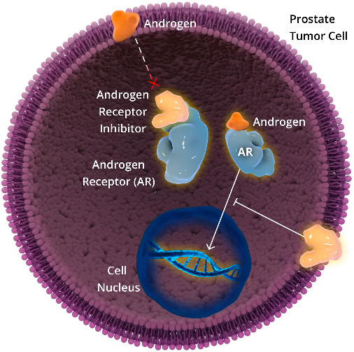
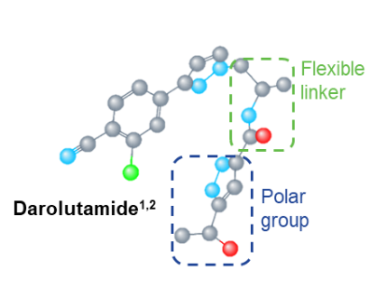
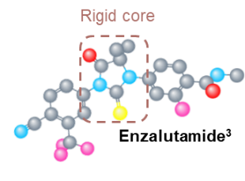
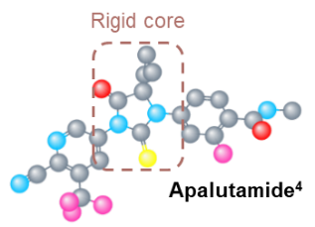
Darolutamide is a potent androgen receptor inhibitor
Mechanism of action of darolutamide
Potent androgen receptor inhibitor ¹ :
Androgen receptor (AR) inhibition blocks nuclear translocation of the AR, preventing growth and promoting apoptosis of prostate cancer cells¹⁻⁴
Structurally distinct from apalutamide and enzalutamide ^{1,5-7}
High binding affinity and selectivity for the AR ¹
Low penetration of the blood-brain barrier in preclinical studies ⁸
Limited potential for interactions with co-medications commonly used by patients with prostate cancer^{1,4,8,9}
Androgen
Prostate cancer cell
Androgen
Receptor
Inhibitor
Androgen
Androgen
Receptor (AR)
AR
Cell nucleus
Inhibits PSA
Expression

Slide 9
Drug-Drug Interactions of ARPIs with Clinically Relevant Co-medications*
DRUG CLASS | ACTIVE SUBSTANCE | INTERACTION
 |  | DARO [1,6] | ABI [2,6] | APA [3,6] | ENZA [4,6]
ADT | Relugolix⁵
Anticoagulants | Apixaban
 | Dabigatran
 | Edoxaban
 | Rivaroxaban
Antiplatelets | Clopidogrel
 | Prasugrel
 | Ticagrelor
Betablocker | Bisoprolole
 | Carvedilole
 | Metoprolole
 | Nebivolole
Antiinfectives | Ciprofloxacine
 | Clarithromycine
 | Rifampicine
 | Fluconazole
 | Voriconazole
DRUG CLASS | ACTIVE SUBSTANCE | INTERACTION
 |  | DARO [1,6] | ABI [2,6] | APA [3,6] | ENZA [4,6]
Lipid lowering drugs | Gemfibrozil
 | Atorvastatin
 | Simvastatin
 | Rosuvastatin
 | Ezetimibe
Antiepileptics | Carbamazepine
 | Valproate
Antidepressants | Escitalopram
 | Duloxetine
 | Venlafaxine
Proton Pump Inhibitors | Pantoprazole
 | Omeprazole
Green – no restrictions for concommitant use
Yellow – with caution, need for dose adaptation possible
Red – contraindication / avoid concommitant use / consider change of treatment
ADT: Androgen Deprivation Therapy; ARPIs: Androgen Receptor Pathway Inhibitors
Daro: Darolutamide; Abi: Abirateron; Apa: Apalutamide; Enza: Enzalutamide
* The following tables contain medication commonly prescribed in patients with prostate cancer. The listing is not exhaustive. For further information, please consult the respective drug product information.

Slide 10

Drug-Drug Interactions of ARPIs with Clinically Relevant Co-medications*
WIRKSTOFFKLASSE | WIRKSTOFF | WECHSELWIRKUNG
 |  | DARO [1,6] | ABI [2,6] | APA [3,6] | ENZA [4,6]
Hypnotics | Diazepame
 | Midazolame
 | Zopiclon
Analgetics | Diclofenac
 | Fentanyl
 | Morphium
 | Oxycodone
 | Tramadole
Antitussives | Codeine
 | Dextromethorphane
Antihypertensives | Amlodipine
 | Hydrochlorothiazid
 | Valsartan
Publikation§
Androgen receptor pathway inhibitors and drug-drug interactions in prostate cancer von ESMO Open Review^{§,6} Review article designed to help recognize potential drug-drug interactions between ARPIs and commonly used drugs
Green – no restrictions for concommitant use
Yellow – with caution, need for dose adaptation possible
Red – contraindication / avoid concommitant use / consider change of treatment
ADT: Androgen Deprivation Therapy; ARPIs: Androgen Receptor Pathway Inhibitors
Daro: Darolutamide; Abi: Abirateron; Apa: Apalutamide; Enza: Enzalutamide
* The following tables contain medication commonly prescribed in patients with prostate cancer. The listing is not exhaustive. For further information, please consult the respective drug product information.
§ The link above leads to an external website. Bayer (Schweiz) AG has no influence on design and content of the site and disclaims any respnsibility for the content and any consequences arising therefrom.
Fachinformation Schweiz Nubeqa (Darolutamide): www.swissmedicinfo.ch
Fachinformation Schweiz Zytiga (Arbirateron): www.swissmedicinfo.ch
Fachinformation Schweiz Erleada (Apalutamid): www.swissmedicinfo.ch
Fachinformation Schweiz Xtandi (Enzalutamid): www.swissmedicinfo.ch
Fachinformation Schweiz Orgovyx (Relugolix): www.swissmedicinfo.ch
Bolek H, et al. Androgen receptor pathway inhibitors and drug-drug interactions in prostate cancer. ESMO Open 2024;9(11):103736.

Slide 11
Darolutamide timeline Switzerland
Swissmedic approval of Darolutamide for high-risk nmCRPC
June 2020
Swissmedic approval of Darolutamide for mHSPC in combination with Docetaxel + ADT
January 2023
Swissmedic approval of Darolutamide for mHSPC in combination mit ADT
Juli 2025
2019
2020
2021
2022
2023
2024
2025
Publication
ARAMIS-Trial
February 2019
Publication
ARASENS-Trial
February 2022
Publication
ARANOTE-Trial
September 2024

Slide 12
Darolutamide Is a Guideline Recommended Standard of Care for Patients With Either nmCRPC or mHSPC
North America |  | Europe
NCCN (April 2025)¹ | AUA (2023)² | ESMO (Mar 2023)³ | EAU (2025)⁴
All mHSPC Abiraterone^{b} + ADT Apalutamide + ADT Enzalutamide + ADT | All mHSPC Abiraterone^{b} + ADT Apalutamide + ADT Enzalutamide + ADT Docetaxel + ADT | All mHSPC Abiraterone^{b,f} + ADT Apalutamide + ADT Enzalutamide + ADT Docetaxel ± pred + ADT | All mHSPC Abiraterone + ADT Apalutamide + ADT Enzalutamide + ADT
High-volume^{c} Low-volume + de novo Abiraterone^{b} + ADT with docetaxel^{d} Apalutamide + ADT with docetaxel^{e} Enzalutamide + ADT with docetaxel^{e} | de novo Darolutamide + ADT + docetaxel Abiraterone^{b} + ADT with docetaxel | de novo Abirateroneª + ADT with docetaxel | Fit for docetaxel Abiraterone + ADT with docetaxel
PSADT >10 months ADT | PSADT >10 months ADT | Low risk No guidance | PSADT >10 months No guidance
PSADT ≤10 months Apalutamide + ADT Enzalutamide + ADT | PSADT ≤10 months Apalutamide + ADT Enzalutamide + ADT | High risk Apalutamide + ADT Enzalutamide + ADT | PSADT ≤10 months Apalutamide + ADT Enzalutamide + ADT
Darolutamide + ADTª
Darolutamide + ADT with docetaxel
Darolutamide + ADT^{i}
mHSPC
Darolutamide + ADT with docetaxel^{d}
Darolutamide + ADT with docetaxel
nmCRPC
Darolutamide + ADT
Darolutamide + ADT
Darolutamide + ADT
Darolutamide + ADT
Notes:
1. Referenced with permission from the NCCN Clinical Practice Guidelines in Oncology (NCCN Guidelines®) for Prostate Cancer V.2.2025. © National Comprehensive Cancer Network, Inc. 2024. All rights reserved. Accessed December 19, 2024. To view the most recent and complete version of the guideline, go online to NCCN.org. 2. Lowrance W, et al. J Urol. 2023;209(6):1082-1090. 3. Fizazi K, et al. Ann Oncol. 2023;34(6):557-563. 4. EAU Guidelines. Edn. presented at the EAU Annual Congress Madrid 2025. http://uroweb.org/guidelines/compilations-of-all-guidelines/

Slide 13
ARANOTE
Phase 3 study in mHSPC

Slide 14
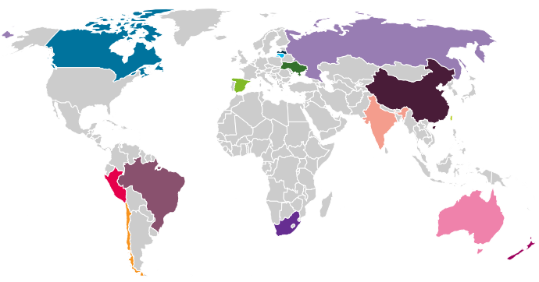
ARANOTE Is a Global Trial Conducted Across 15 Regions, Representing a Diverse Population of Patients
Trial Sites
Australia
New Zealand
Brazil
Peru
Canada
Russian Federation
Chile
South Africa
China
Spain
India
Taiwan
Latvia
Ukraine
Lithuania
Notes:
Areas that are usually not involved in clinical trials
Done in countries where there was no access to a doublet therapy
Full DC
Haresh_ASCO-GU 2022_abstr TPS200_Poster
Map, legend
p1D

Slide 15




ARANOTE Study Design^{1,2}
Double-blind phase – until primary analysis
Open-label phase – until final analysis
Patients (N=665)
mHSPCª
Histologically or cytologically confirmed adenocarcinoma of the prostate
ECOG PS: 0-2
Stratification Factors:
Visceral metastases (accessed by central review): present/absent
Prior local therapy: Yes/No
Primary Endpoint:
rPFS
Secondary Endpoints:
OS (key secondary endpoint)
Time to initiation of subsequent antineoplastic therapy
Time to CRPC
Time to PSA progression
Rates of undetectable PSA (<0.2 ng/mL)
Time to pain progression (BPI-SF)
Safety (AE using NCI-CTCAE v5.0)
Other Prespecified Endpoints:
PFS2
Time to SSE
Time to deterioration of FACT-P total
Time to first prostate cancer-related invasive procedure
Selected Endpoints:
OS
Safety
N=446
Darolutamide 600 mg bid + ADT
Open-label darolutamide
2:1 randomization
N=223
Placebo + ADT
Crossover to open-label darolutamide
ClinicalTrials.gov: NCT04736199
Data Cutoff: June 7, 2024
Median follow-up:
- darolutamide group 25.3 months;
- placebo group 25.0 months
ªrPFS assessed by central review based on RECIST v 1.1 criteria for soft tissue metastases and PCWG3 criteria for bone metastases.
1. ClinicalTrials.gov identifier: NCT04736199. August 2024. https://clinicaltrials.gov/ct2/show/NCT04736199. 2. Saad F, et al. J Clin Oncol 2024; 42:4271-4281. ​
Notes:
Script Note:
ARANOTE was designed to establish darolutamide + ADT as an efficacious option with a differentiated tolerability and low potential for drug-drug interactions, without docetaxel for patients with mHSPC.
This regimen could provide physicians and patients the option to tailor their use of darolutamide with and without docetaxel to meet patient needs and preferences
Following the positive results of the primary analysis, the open label phase of the study commenced
Study participants who are on study treatment (either darolutamide or placebo), were offered the opportunity to receive darolutamide in the open-label phase of the study until final analysis which will assess OS and safety.
+++++
ªMetastatic disease confirmed by conventional imaging method either by a positive ^{99m}Tc-phosphonate bone scan, or soft tissue or visceral metastases, either by contrast-enhanced abdominal/pelvic/chest CT or MRI scan assessed by central review.
ADT, androgen deprivation therapy; AE, adverse event; bid, twice a day; BPI-SF, Brief Pain Inventory-Short Form; CRPC, castration-resistant prostate cancer; CT, computed tomography; ECOG PS, Eastern Cooperative Oncology Group performance status; FACT-P, Functional Assessment of Cancer Therapy – Prostate; mHSPC, metastatic hormone-sensitive prostate cancer; MRI, magnetic resonance imaging; NCI-CTCAE, National Cancer Institute-Common Terminology Criteria for Adverse Events; OS, overall survival; PFS2, progression-free survival 2; PSA, prostate-specific antigen; rPFS, radiographic progression-free survival; SSE, symptomatic skeletal event.
1. Clinicaltrials.gov identifier: NCT04736199. Accessed June 2024. https://clinicaltrials.gov/ct2/show/NCT04736199. 2. Haresh KP, et al. Poster presented at: American Society of Clinical Oncology Genitourinary Cancers Symposium; February 17-19, 2022. Abstract TPS200. 3. Saad F, et al. J Clin Oncol. 2024. doi:10.1200/JCO-24-01798. ​

Slide 16


ARANOTE Key Eligibility Criteria^{1,2}
Inclusion Criteria
Documented metastatic disease confirmed by conventional imaging method - central reviewª
Started ADT (LHRH agonist/antagonist or orchiectomy) with or without first-generation anti-androgen (≤12 weeks before randomization)
ECOG performance status 0, 1, or 2
Adequate bone marrow, liver, and renal function
Included both de novo and recurrent disease
Exclusion Criteria
Regional lymph node metastases only (N1, below the aortic bifurcation)
Baseline superscan
Prior treatment with:
LHRH agonist or antagonist started >12 weeks before study treatment starts except neoadjuvant and/or adjuvant therapy for a duration of ≤24 months and completed ≥12 months prior to randomization
Second-generation ARIs or other investigational ARis
CYP17 enzyme inhibitors as antineoplastic treatment
Chemotherapy (docetaxel or immunotherapy for PC)
Radiotherapy in the 2 weeks prior to randomization

Slide 17
ARANOTE: Patient demographics and baseline characteristics
 |  | Darolutamide + ADT (N = 446) | Placebo + ADT (N = 223)
Age, median (measurement range), years |  | 70 (43–93) | 70 (45–91)
Ethnicity, n (%) | White | 251 (56.3) | 125 (56.1)
 | Asian | 144 (32.3) | 65 (29.1)
 | Black | 41 (9.2) | 24 (10.8)
 | Other | 10 (2.2) | 9 (4.0)
Region, n (%) | Asian | 141 (31.6) | 63 (28.3)
 | Latin America | 119 (26.7) | 72 (32.3)
 | Europe and the rest of the world | 186 (41.7) | 88 (39.5)
EGOG PS, n (%) | 0 | 235 (52.7) | 98 (43.9)
 | 1-2 | 211 (47.3) | 125 (56.1)
Gleason score ≥ 8 at initial diagnosis, n (%) |  | 311 (69.7) | 146 (65.5)
Serum PSA, median (range), ng/ml |  | 21.4 (0.02–15,915) | 21.2 (0.02–8533)
Metastases at initial diagnosis , n (%) | Yes – De novo | 317 (71.1) | 168 (75.3)
 | No – recurrent | 100 (22.4) | 45 (20.2)
Disease volume, n (%) ª | High | 315 (70.6) | 157 (70.4)
 | Low | 131 (29.4) | 66 (29.6)
Visceral metastases, n (%) | Yes | 53 (11.9) | 27 (12.1)
 | No | 393 (88.1) | 196 (87.9)
Previous local therapy, n (%) | Yes | 80 (17.9) | 40 (17.9)
 | No | 366 (82.1) | 183 (82.1)

Slide 18
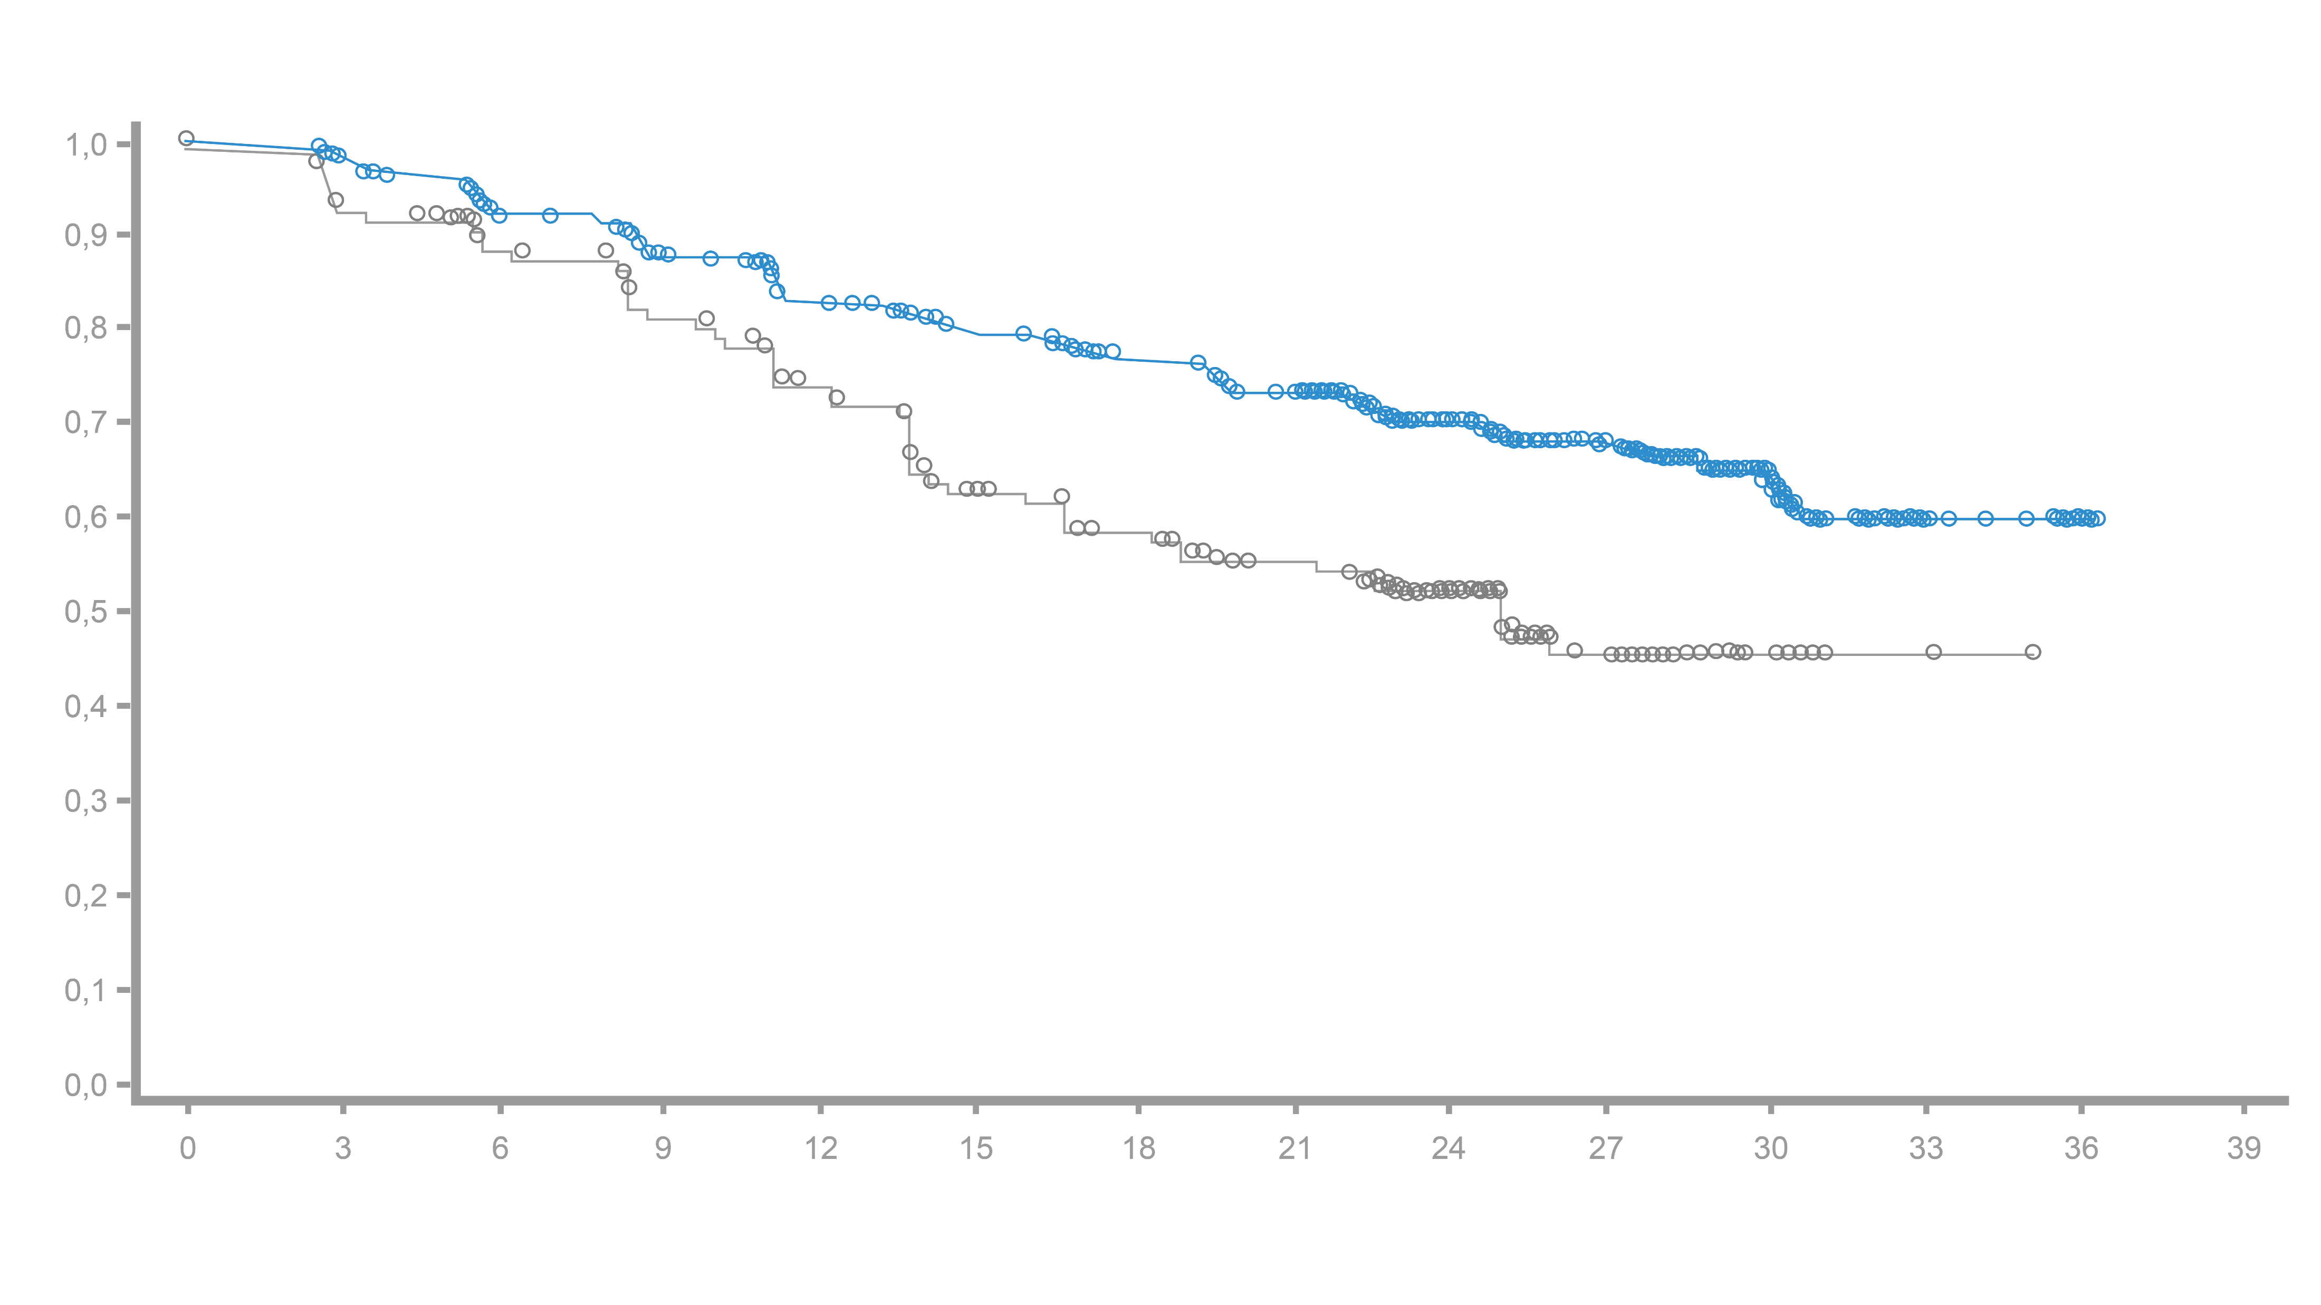
ARANOTE: Radiographic Progression-free Survival
Primary endpoint
Time to radiographic progression
70.3
Darolutamide + ADT
Median, NR (95% CI: NR–NR)
Probability of rPFS
52.1
Placebo + ADT
Median 25.0 months (95% CI: 19.0–NR)
HR for rPFSª
0.54 (95% CI: 0.41–0.71)^{b}
p < 0.0001
Number of patients
at risk
Months since randomization
Darolutamide
Placebo
446
223
422
197
388
178
358
158
330
137
309
109
285
96
262
83
186
58
113
32
54
12
9
2
1
0
0
0
Median Follow up: Darolutamide 25.3 months; Placebo: 25.0 months

Slide 19
Triple or doublet therapy in mHSPC: A Network Meta-analysis
PFS analysis: total cohort
Treatment | Hazard Ratio | HR | 95% KI | Weighting | p-value
Darolutamide + docetaxel |  | 0.27 | (0.18; 0.41) | 12.2% | 0.96
Abiraterone + Docetaxel + ADT |  | 0.33 | (0.20; 0.55) | 9.8% | 0.86
Enzalutamide + ADT |  | 0.50 | (0.39; 0.65) | 16.8% | 0.58
Abiraterone + ADT |  | 0.52 | (0.41; 0.66) | 17.2% | 0.54
Darolutamide* + ADT |  | 0.54 | (0.36; 0.81) | 12.2% | 0.49
Apalutamide + ADT |  | 0.63 | (0.44; 0.90) | 13.7% | 0.32
Docetaxel + ADT |  | 0.66 | (0.54; 0.82) | 18.2% | 0.25
ADT |  | 1.00 |  | 0.0 % | 0.00
0.1 0.5 1 2

Slide 20
ARANOTE: Radiografic Progression-free Survival Subgroup analysis
Primary endpoint
 |  | Darolutamide* (n = 446) |  | Placebo (n = 223) |  | Stratified HR (95% CI)
 |  | Events/Patients, n/N | Median, Months | Events/Patients, n/N | Median, Months
Total population |  | 128/446 | NR | 94/223 | 25.0 |  | 0,54 (>= 0,41; <=0,71)
Age subgroups, years | < 65 | 37/118 | NR | 32/65 | 14.2 |  | 0,44 (>= 0,27; <=0,71)
 | 65–74 | 53/193 | NR | 35/96 | NR |  | 0,64 (>= 0,41; <=0,98)
 | 75–84 | 29/117 | NR | 22/52 | NR |  | 0,48 (>= 0,27; <=0,83)
 | ≥ 85 | 9/18 | 27.4 | 5–10 | 19.2 |  | 0,51 (>= 0,16; <=1,66)
Baseline PSA values | < Median | 58/216 | NR | 44/111 | 26.0 |  | 0.55 (0.37–0.81)
 | ≥ Median | 67/220 | NR | 47/108 | 22,9 |  | 0.55 (0.38–0.80)
ECOG PS at baseline | 0 | 61/235 | NR | 37/98 | NR |  | 0.55 (0.37–0.83)
 | ≥1 | 67/211 | NR | 57/125 | 22.6 |  | 0.56 (0.39–0.79)
Gleason score at initial diagnosis | Missing/not examined | 5/13 | NR | 4/10 | 13.8
 | < 8 | 32/122 | NR | 30/67 | 22,9 |  | 0.46 (0.28–0.75)
 | ≥ 8 | 91/311 | NR | 60/146 | 25.1 |  | 0.58 (0.42–0.81)
Disease volume | High volume | 113/315 | 30.2 | 75/157 | 19.2 |  | 0.60 (0.44–0.80)
 | Low volume | 15/131 | NR | 19/66 | NR |  | 0.30 (0.15–0.60)
Ethnicity | White | 76/251 | NR | 55/125 | 22.2 |  | 0.52 (0.36–0.73)
 | Asian | 38/144 | NR | 24/65 | 25.0 |  | 0.59 (0.35–0.98)
 | Black | 10/41 | NR | 10/24 | NR |  | 0.51 (0.21–1.23)
 | Other | 4/10 | NR | 5/9 | 13.7
Geographical region | Europe and the rest of the world | 56/186 | NR | 39/88 | 22.6 |  | 0.50 (0.33–0.75)
 | Asia | 37/141 | NR | 23/63 | 25.0 |  | 0.60 (0.35–1.01)
 | Latin America | 35/119 | NR | 32/72 | 25.1 |  | 0.56 (0.35–0.90)
Visceral metastases | Yes | 21/53 | NR | 13/27 | 25.0 |  | 0.71 (0.35–1.41)
 | No | 107/393 | NR | 81/196 | 25.0 |  | 0.52 (0.39–0.69)
Previous local therapy | Yes | 19/80 | NR | 18/40 | 19.5 |  | 0.34 (0.17–0.66)
 | No | 109/366 | NR | 76/183 | 25.0 |  | 0.59 (0.44–0.79)
0.1
1
10
Darolutamide preferred
HR (95% CI)
Placebo preferred

Slide 21
ARANOTE: Secondary Endpoints
Secondary endpoints
Endpoint | Darolutamide (n = 446) |  | Placebo (n = 223) |  | Stratified HR (95% KI)
 | n (%) | Median, months | n (%) | Median, months
OS* | 115 (26) | NR | 70 (31) | NR |  | 0.78 (0.58–1.05)
Time to mCRPC | 154 (34.5) | NR | 143 (64.1) | 13.8 |  | 0.40 (0.32–0.51)
Time until PSA progress | 93 (20.9) | NR | 108 (48.4) | 16.8 |  | 0.31 (0.23–0.41)
Time to start of systemic follow-up therapy for prostate cancer | 68 (15.2) | NR | 74 (33.2) | NR |  | 0.40 (0.29–0.56)
Time until pain progression | 124 (27.8) | NR | 79 (35.4) | 29.9 |  | 0.72 (0.54–0.96)
Darolutamide preferred
HR (95% CI)
Placebo preferred
*Final OS analysis after 185 events; mCRPC, metastatic castration-resistant prostate cancer; OS, overall survival; PSA, prostate-specific antigen; NR, not reached;
Final OS data: Nubeqa FDA prescribing information on https://www.fda.gov/drugsatfda (accessed: 06.2025)
Saad F, et al. J Clin Onc 2024; 42:4271-4281. ​

Slide 22
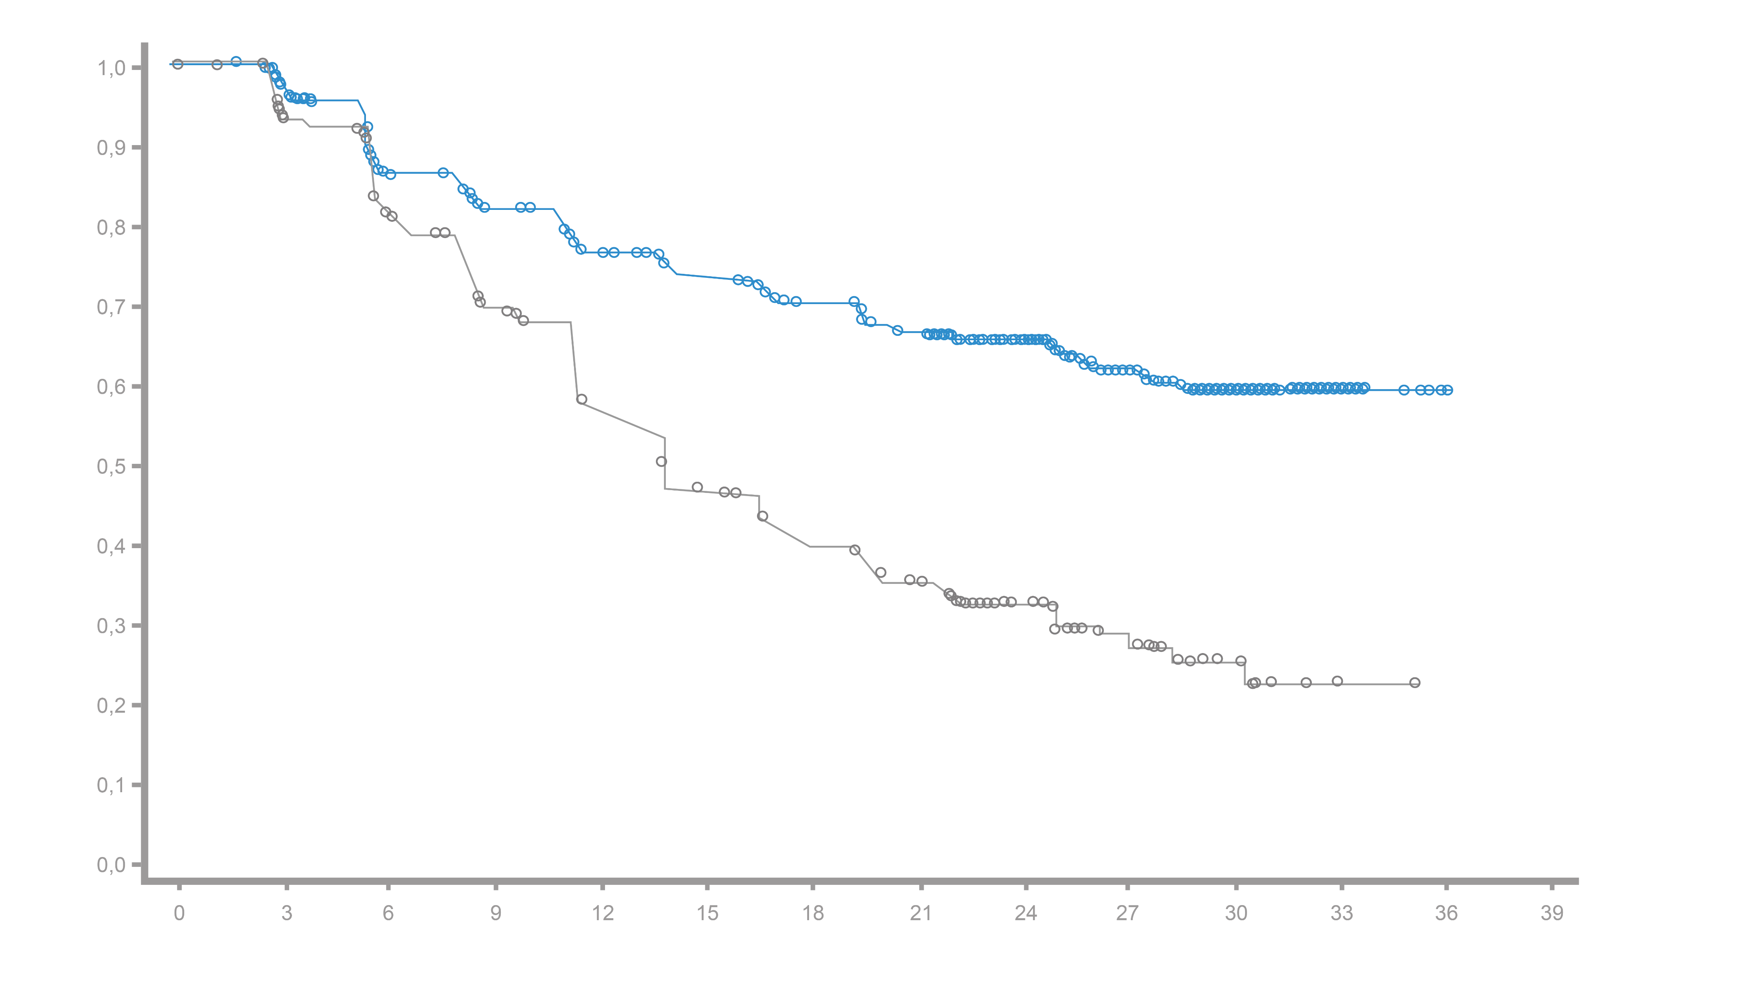
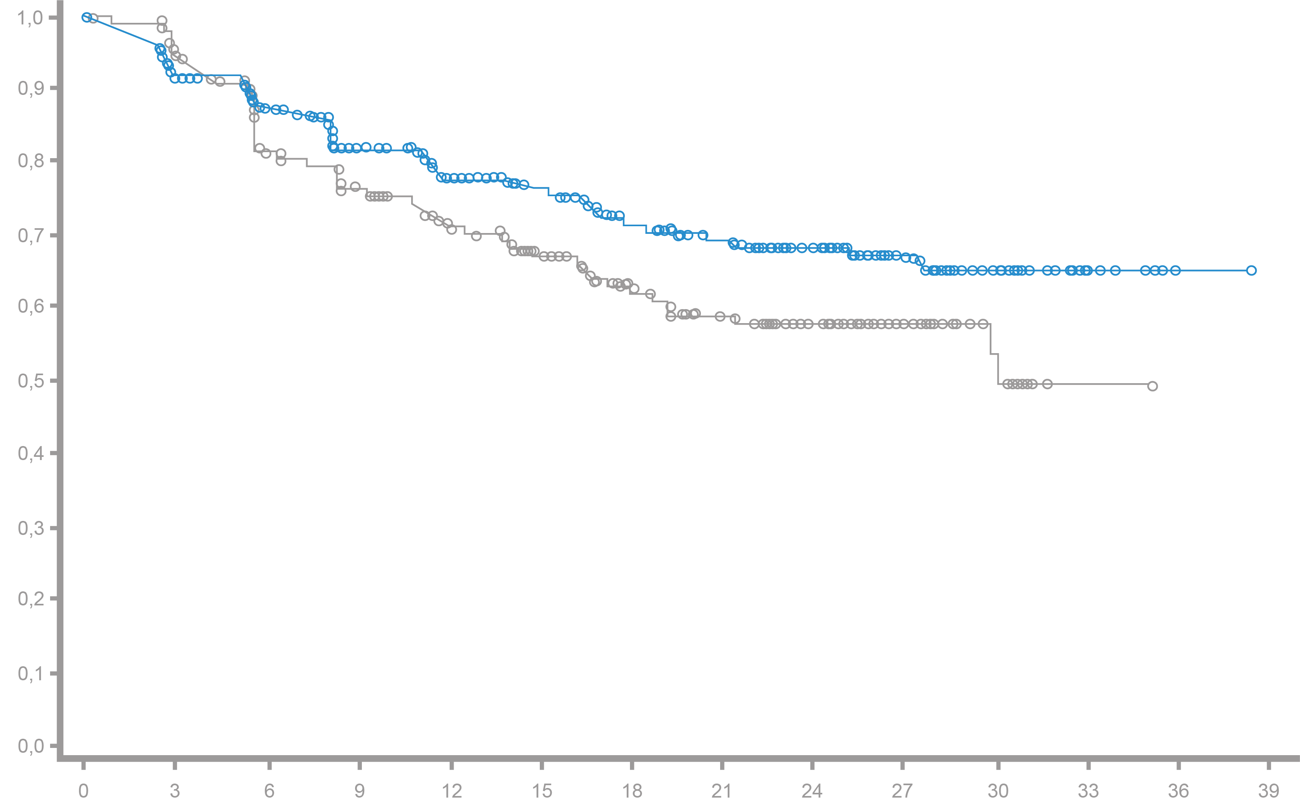
ARANOTE: Time to CRPC and Time to Pain Progression^{1,2}
Secondary endpoints
Time to mCRPC ^{1.2}
Time to pain progression²
Darolutamide + ADT
Median NR (95% CI: NR–NR)
Darolutamide + ADT
Median NR (95% CI: NR–NR)
Event-free probability
Placebo + ADT
Median 13.8 months (95% CI: 12.0–16.8)
Event-free probability
Placebo + ADT
Median 29.9 months (95% CI: 29.7–NR)
HR 0.40 (95% CI: 0.32–0.51)
HR 0.72 (95% CI: 0.54–0.96)
Months
Months
Number of patients at risk
Number of patients at risk
Darolutamide
Placebo
446
223
417
197
364
167
339
139
312
110
293
88
268
73
245
61
177
42
110
25
51
25
14
2
2
0
0
0
Darolutamide
Placebo
446
223
385
195
349
159
310
146
278
127
254
106
225
87
209
74
150
55
90
31
36
11
7
1
1
0
0
0

Slide 23
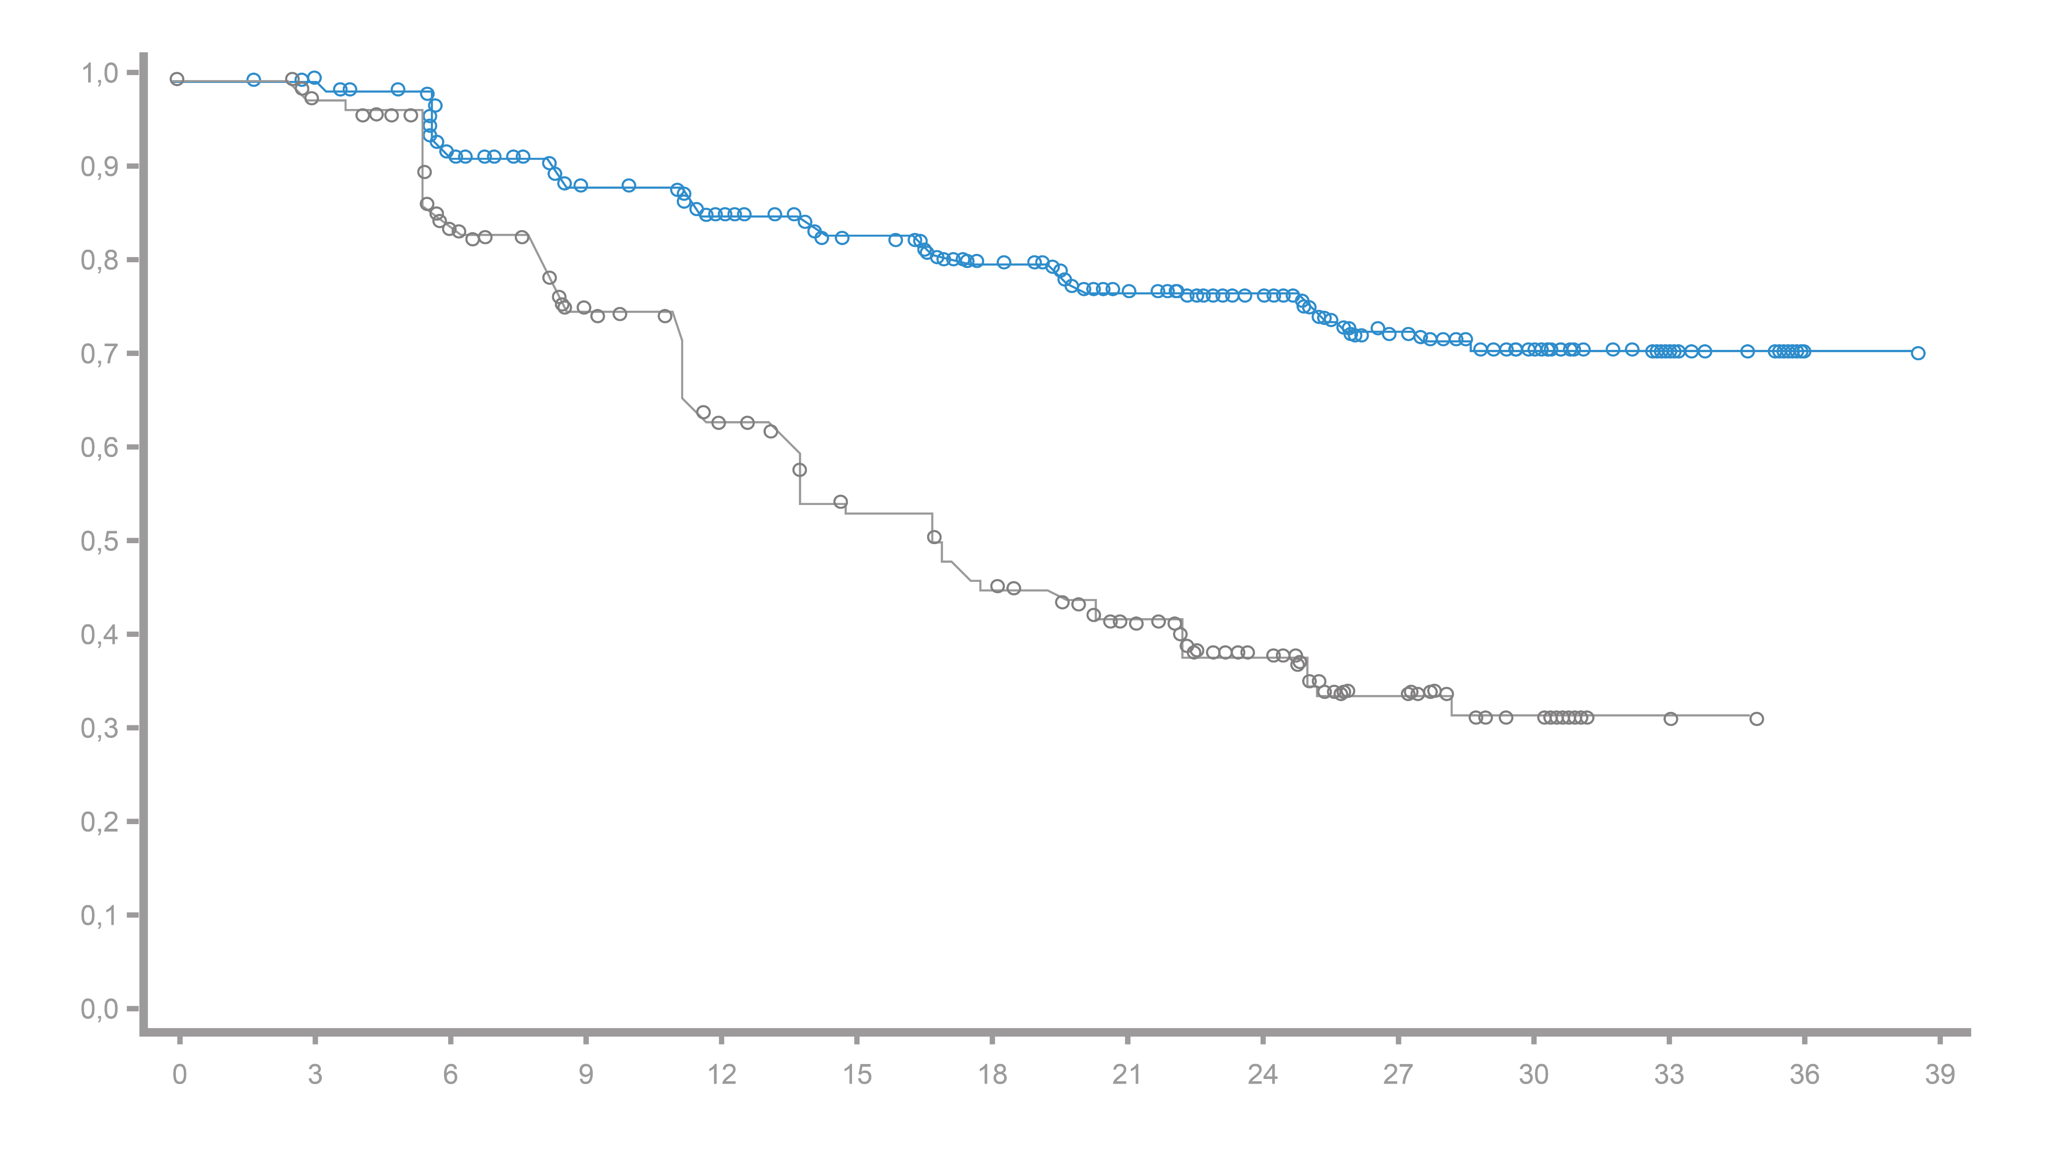
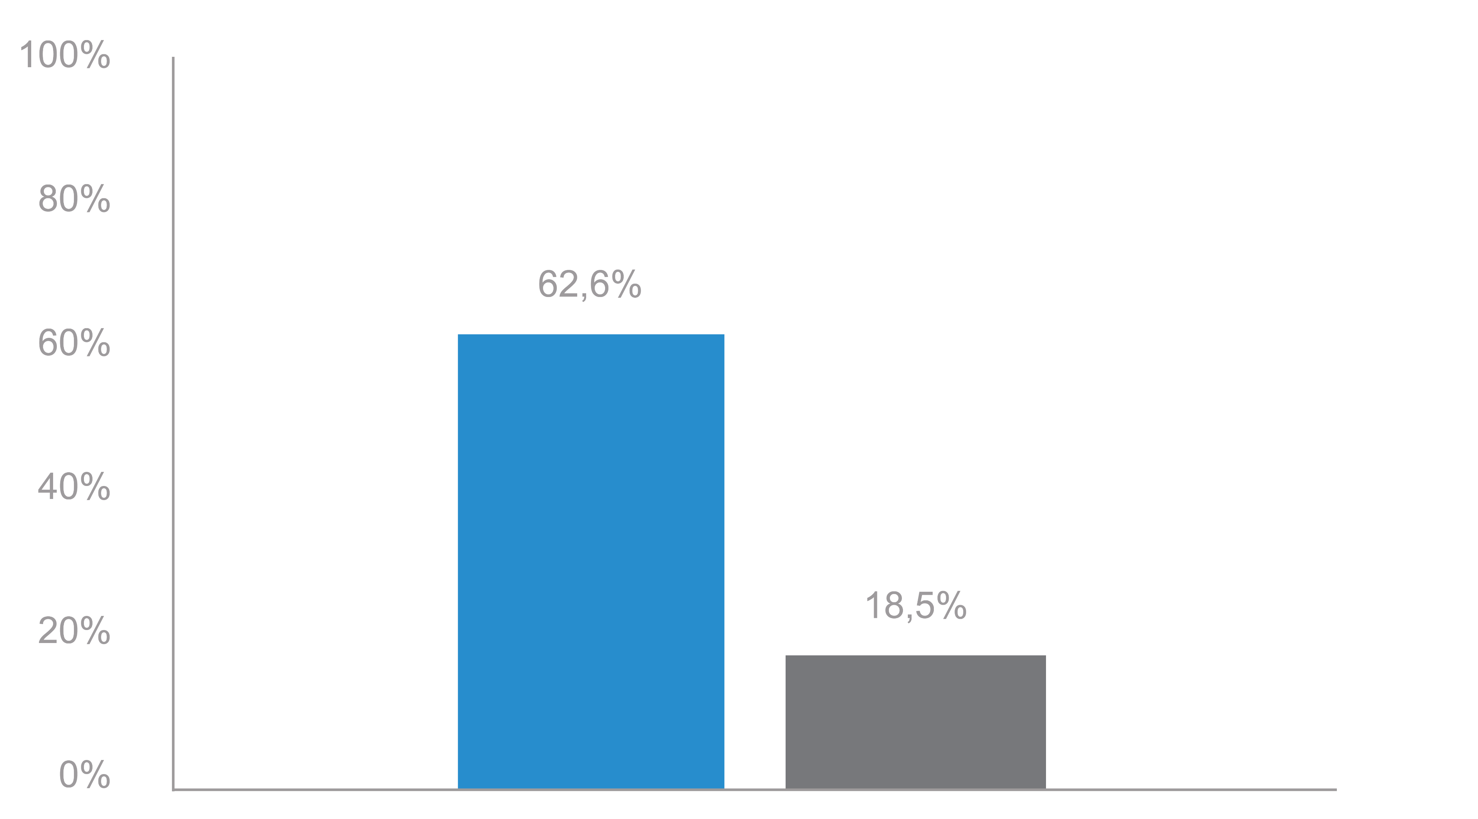
ARANOTE: PSA Response
Secondary endpoints
PSA <0.2 ng/ml at any time during treatment
Time until PSA progress
Darolutamide + ADT
Median NR (95% CI: NR–NR)
62.6 %
Patients
Event-free probability
18.5%
Placebo + ADT
Median 16.8 months (95% CI: 13.9–20.1)
HR: 0.31 (95% CI: 0.23–0.41)
Overall population
Time from randomization, months
Number of patients at risk
Darolutamide + ADT
Placebo + ADT
Darolutamide
Placebo
446
223
408
195
357
158
330
130
301
102
280
81
256
67
220
54
158
36
95
20
48
9
12
2
2
0
0
0

Slide 24
ARANOTE: Subsequent Life-prolonging Anticancer Therapies ª
Number of patients^{b} (%) 2:1 randomization | Darolutamide + ADT (N = 446)​ | Placebo + ADT (N = 223)​
Study therapy discontinuation, n (%) | 203 (45.5) | 160 (71.7)
Received life-prolonging antitumor follow-up therapy ^{c} n/n (%) | 66/203 (32.5)​ | 68/160 (42.5)​
Docetaxel | 46/203 (22.7)​ | 46/160 (28.8)​
Abiraterone acetate | 26/203 (12.8)​ | 21/160 (13.1)​
Enzalutamide | 6/203 (3.0)​ | 12/160 (7.5)​
Apalutamide | 3/203 (1.5)​ | 0​
Cabazitaxel | 2/203 (1.0)​ | 1/160 (0.6)​
Radium-223 | 2 /203 (1.0)​ | 0​
Olaparib | 1 /203 (0.5)​ | 0​

Slide 25
ARANOTE: Rates of TEAEs and TEAEs Leading to Permanent Discontinuation
Safety analysis
TEAEs leading to permanent discontinuation of therapy
Treatment-emergent adverse events, number of patients (%) | Darolutamide + ADT (N = 445ª)​ | Placebo + ADT (N = 221ª)​
All AE | 405 (91,0)​ | 199 (90,0)​
Serious AE | 105 (23,6)​ | 52 (23,5)​
Grade 3 or 4 AE | 137 (30.8) | 67 (30.3)
Grade 5 AE | 21 (4,7)​ | 12 (5,4)​
Darolutamide (N = 445 ª )
Placebo (N = 221 ª )
Darolutamide + ADT showed lower treatment discontinuation rates due to TEAEs vs. Placebo¹
This is the only comprehensive ARPI study on Prostate cancer, showing a difference in the discontinuation rate in favor of ARPI ¹⁻¹⁴

Slide 26
Therapy-related discontinuation rates from mHSPC approval studies¹⁻⁴ in advanced prostate cancer
TEAEs that led to discontinuation of treatment: Primary analysis (%)
ARANOTE¹ | ARCHES²
Daro + ADT
Placebo + ADT
Enza + ADT
Placebo + ADT
LATITUDE ³ | TITAN⁴
Abitur + ADT
Placebo + ADT
Apa + ADT
Placebo + ADT
Low discontinuation rates in dual therapy with darolutamide

Slide 27
ARANOTE: Most Common AEs that Occurred in ≥5% of Patients
Adverse events | Darolutamide + ADT (N=445ª) |  | Placebo + ADT (N=221ª)
 | n (%) | Grade 3/4 | n (%) | Grade 3/4
Anemia | 91 (20.4) | 14 (3.1) | 39 (17.6) | 8 (3.6)
Arthralgia | 55 (12.4) | 5 (1.1) | 25 (11.3) | 0
UTI | 52 (11.7) | 8 (1.8) | 17 (7.7) | 1 (0.5)
Back pain | 43 (9.7) | 5 (1.1) | 23 (10.4) | 2 (0.9)
Increased AST | 43 (9.7) | 10 (2.2) | 17 (7.7) | 1 (0.5)
Constipation | 42 (9.4) | 0 | 16 (7.2) | 0
Hot flush | 41 (9.2) | 0 | 16 (7.2) | 0
Increase ALT | 40 (9.0) | 9 (2.0) | 18 (8.1) | 1 (0.5)
Pain in extremity | 38 (8.5) | 1 (0.2) | 20 (9.0) | 4 (1.8)
Adverse events | Darolutamide + ADT (N=445ª) |  | Placebo + ADT (N=221ª)
 | n (%) | Grade 3/4 | n (%) | Grade 3/4
Hypertension | 38 (8.5) | 19 (4.3) | 19 (8.6) | 8 (3.6)
Bone pain | 33 (7.4) | 9 (2.0) | 27 (12.2) | 3 (1.4)
Increased weight | 33 (7.4) | 4 (0.9) | 17 (7.7) | 1 (0.5)
COVID-19 | 32 (7.2) | 1 (0.2) | 15 (6.8) | 2 (0.9)
Increased ALP | 30 (6.7) | 0 | 13 (5.9) | 3 (1.4)
Insomnia | 28 (6.3) | 0 | 6 (2.7) | 1 (0.5)
Hyperglycemia | 27 (6.1) | 1 (0.2) | 8 (3.6) | 0
Fatigue | 25 (5.6) | 0 | 18 (8.1) | 1 (0.5)
Increased creatinine | 21 (4.7) | 2 (0.4) | 15 (6.8) | 0
Headache | 18 (4.0) | 0 | 14 (6.3) | 2 (0.9)

Slide 28
ARANOTE: TEAEs commonly associated with ARPIs (%)
Safety analysis
a
a

Slide 29
ARANOTE: TEAE Exposure-Adjusted Incidence Rates
Safety analysis
Adverse events commonly associated with ARPIs 2:1 randomization | Darolutamide + ADT (N = 445ª) |  | Placebo + ADT (N = 221ª)
 | n (%) | EAIR^{b}/100 PY | n (%) | EAIR^{b}/100 PY
High blood pressure ^{c} | 42 (9.4) | 5.5 | 21 (9.5) | 6.7
Vasodilation and hot flashes | 41 (9.2) | 5.6 | 16 (7.2) | 5.0
Diabetes mellitus and hyperglycemia | 40 (9.0) | 5.3 | 21 (9.5) | 6.7
Cardiac arrhythmias ^{c} | 39 (8.8) | 5.1 | 15 (6.8) | 4.7
Fatigue | 25 (5.6) | 3.2 | 18 (8.1) | 5.7
rash ^{d} | 19 (4.3) | 2.4 | 8 (3.6) | 2.4
bone fracture ^{e} | 18 (4.0) | 2.3 | 5 (2.3) | 1.5
Coronary heart disease^{c} | 16 (3.6) | 2.0 | 3 (1.4) | 0.9
Weight loss | 14 (3.1) | 1.8 | 6 (2.7) | 1.8
Mental impairment ^{c} | 7 (1.6) | 0.9 | 1 (0.5) | 0.3
Falls, including accidents | 6 (1.3) | 0.8 | 2 (0.9) | 0.6
Heart failure ^{c} | 4 (0.9) | 0.5 | 2 (0.9) | 0.6
Depressed mood^{c} | 2 (0.4) | 0.2 | 2 (0.9) | 0.6
Cerebral ischemia | 1 (0.2) | 0.1 | 3 (1.4) | 0.9

Slide 30
ARANOTE: Summary
Darolutamide + ADT significantly prolonged rPFS in mHSPC patients vs. ADT
Darolutamide + ADT showed a clinical benefit in all secondary endpoints vs. ADT
Darolutamide showed a favorable safety profile

Slide 31
The ARANOTE phase 3 trial of darolutamide plus androgen-deprivation therapy in patients with metastatic hormone-sensitive prostate cancer: efficacy and safety by disease volume
Saad F, et al. Presented at American Society of Clinical Oncology - Genitourinary Cancers Symposium; February 26 –28; San Francisco, CA. Abstract 151

Slide 32
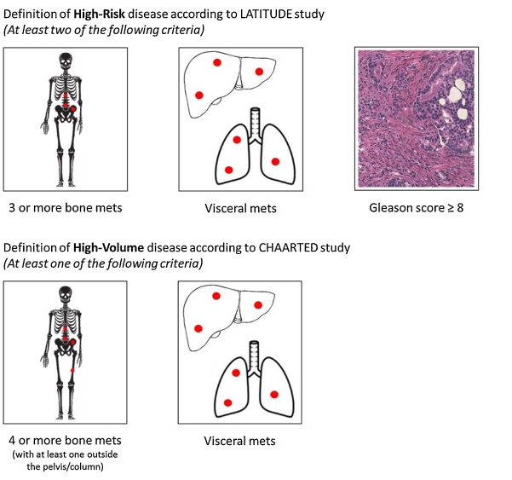
Extent of Disease Progression in mHSPC
“Volume” and “Risk” classifications differentiate M1 disease by number and location of metastases, as well direct tumor assessment via biopsy
In the post-hoc analysis, patients were evaluated by disease volume, which was defined according to CHAARTED criteria¹
71% (n=472) patients had high-volume disease and 29% (n= 197) had low-volume disease
High-Volume vs Low-Volume¹
High-Risk vs Low-Risk²
CHAARTED defines high-volume disease as: (at least one of the following criteria)¹
LATITUDE, STAMPEDE define high-risk disease as: (at least two of the following criteria)²
Notes:
mHSPC, metastatic hormone-sensitive prostate cancer; mets, metastases.
Bullet 1
NCCN v1.2021 p23 (hh,nn,uu footnotes)
EAU-EANM-ESTRO-ESUR-SIOG-Guidelines p87A, p88A
Bullet 1
Fizazi K 2017 NEJM p3A
Bullet 1
Hoyle AP 2019 Eur Urol p7,8A

Slide 33
ARANOTE: Baseline demographics and patient characteristics by disease volume
Post-hoc analysis
Characteristic at baseline | High volume |  | Low volume |  | All patients (N=669)
 | Darolutamide + ADT (N=315) | Placebo + ADT (N=157) | Darolutamide + ADT (N=315) | Placebo + ADT (N=157)
Age, median (range), years | 69.0 (43-93) | 69.0 (47-89) | 71.0 (50-87) | 70.0 (45-91) | 70.0 (43-93)
ECOG PS 0, n (%) | 149 (47.3) | 59 (37.6) | 86 (65.6) | 39 (59.1) | 333 (49.8)
Gleason score of ≥8 at initial diagnosis, n (%) | 236 (74.9) | 110 (70.1) | 75 (57.3) | 36 (54.5) | 457 (68.3)
Metastasis stage at initial diagnosis, n (%) De novo | 245 (77.8) | 121 (77.1) | 72 (55.0) | 47 (71.2) | 485 (72.5)
Serum PSA level, median (range), ng/mL | 28.9 | 27.0 | 10.9 | 15.6 | 21.3
Visceral metastases (centrally assessed), n (%) | 53 (16.8) | 27 (17.2) | 0 | 0 | 80 (12.0)
Received prior local therapy, n (%) | 52 (16.5) | 26 (16.6) | 28 (21.4) | 14 (21.2) | 120 (17.9)
ADT, androgen deprivation therapy; ECOG PS, Eastern Cooperative Oncology Group performance status; HV, high-volume; LN, lymph node; LV, low-volume; PSA, prostate-specific antigen.
Saad et al., ASCO GU 2025, Abstract 151.
Notes:
Baseline demographics and patient characteristics were generally balanced between the treatment arms in HV and LV subgroups (Table 1)
Patients with LV disease had some better prognostic parameters at baseline than patients with HV disease, including more patients with an Eastern Cooperative Oncology Group performance status of 0, Gleason score of <8, and who received prior local therapy, and lower median serum PSA levels

Slide 34
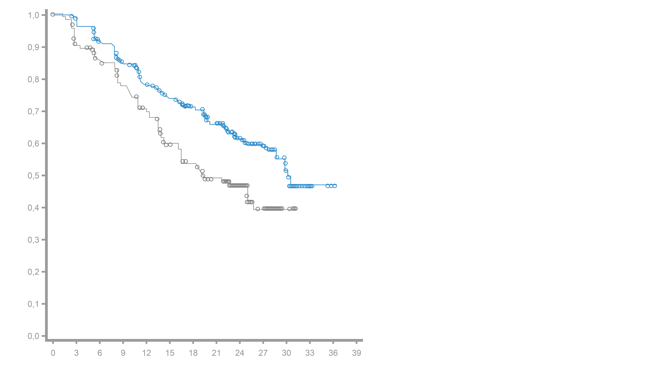
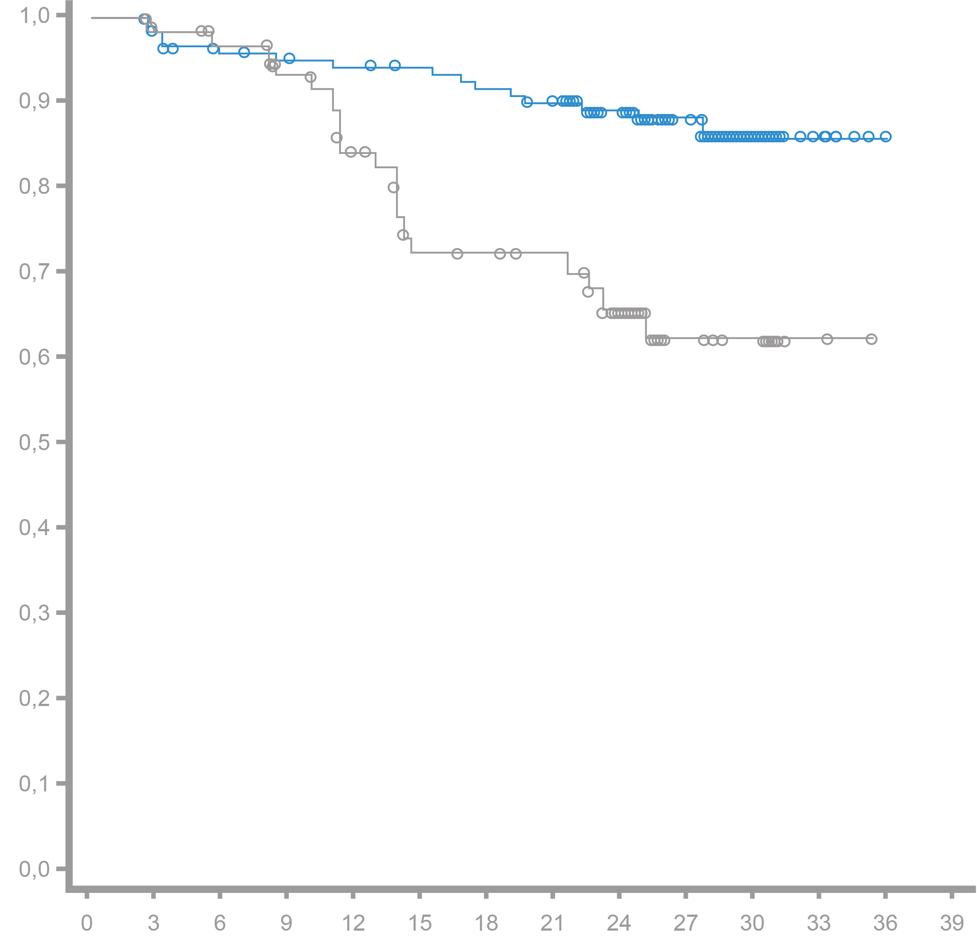
ARANOTE: rPFS in patients with High Volume (HV) and Low Volume (LV) disease
Darolutamide + ADT reduced the risk of radiological progression or death by 40% in the HV subgroup and 70% in the LV subgroup
Post-hoc analysis
rPFS in patients with HV
rPFS in patients with LV
Darolutamide + ADT
Median NR (NR–NR)
Darolutamide + ADT
Median: 30,2 months (28,8–NR)
Placebo + ADT
Median NR (25,0–NR)
Probability of rPFS
Probability of rPFS
Placebo + ADT
Median 19,2 months (16,1–26,0)
HR 0,60
(95% CI: 0,44–0,80)
HR 0,30
(95% CI: 0,15–0,60)
months
months
Number of patients at risk
Number of patients at risk
Darolutamide
Placebo
315
157
298
135
270
120
242
105
216
92
197
73
157
50
101
34
58
17
Darolutamide
Placebo
176
61
26
3
5
0
1
0
0
0
131
66
124
62
118
58
116
53
114
45
112
36
109
35
105
33
85
32
55
15
28
9
4
2
0
0
Notes:
The rPFS benefit with darolutamide + ADT was generally consistent across subgroups by baseline and stratification factors in the HV and LV subgroups

Slide 35
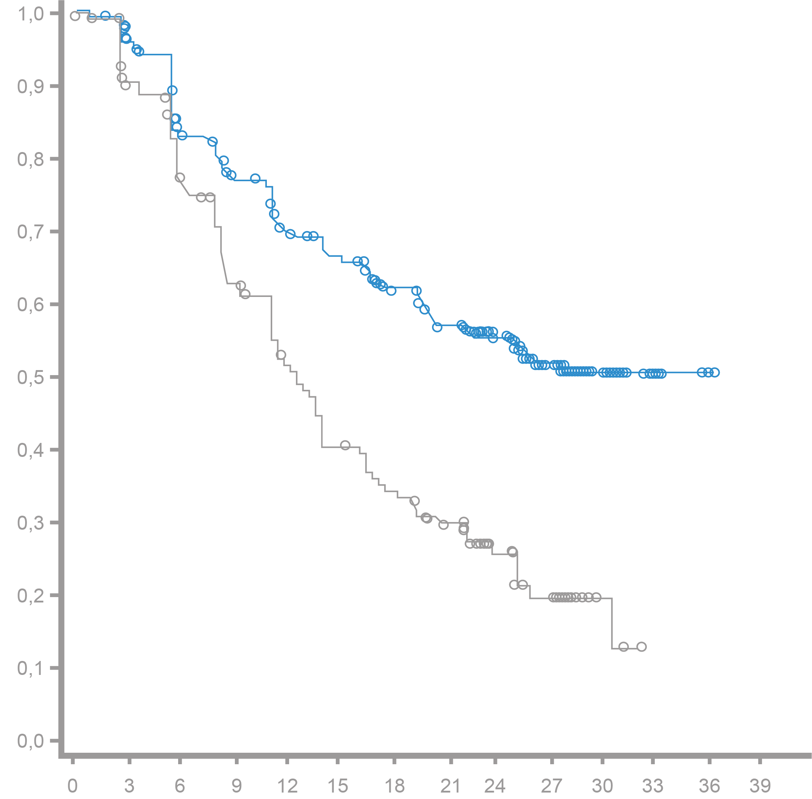
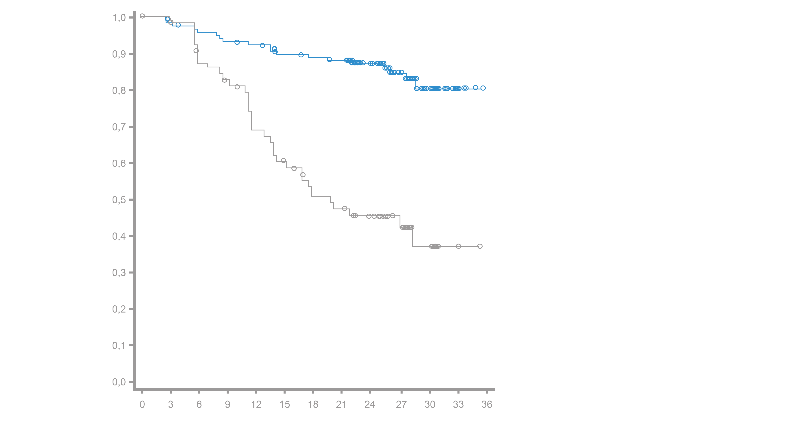
ARANOTE: Time to mCRPC in patients with HV and LV disease
Darolutamide + ADT delayed time to mCRPC vs placebo + ADT across the HV and LV subgroups, consistent with the overall population (HR 0.40 [95% CI: 0.32–0.51])
Post-hoc analysis
Time to mCRPC in patients with HV
Time to mCRPC in patients with LV
Darolutamide + ADT
Median NR (NR–NR)
Darolutamide + ADT
Median: NR (22,2–NR)
Placebo + ADT
Median 19,8 (13,8–NR)
Event-free probability
Event-free probability
Placebo + ADT
Median 12,4 Monate (11,1–13,9)
HR 0,46
(95% KI: 0,36–0,60)
HR 0,21
(95% CI: 0,12–0,37)
(95% CI
In the LV subgroup, a larger treatment effect was observed
Monate
Monate
Number of patients at risk
Number of patients at risk
Darolutamide
Placebo
315
157
293
135
245
113
223
90
198
70
185
55
162
46
141
36
94
22
54
11
Darolutamide
Placebo
25
3
7
0
2
0
0
0
131
66
124
62
119
54
116
49
114
40
108
33
106
27
104
25
83
20
56
14
26
7
7
2
0
0

Slide 36
ARANOTE: Other secondary efficacy endpoints overall and by volume of disease
Darolutamide + ADT improved other secondary efficacy endpoints versus placebo + ADT across volume subgroups with generally consistent effects between the HV subgroup and the overall population and a larger effect in the LV subgroup
Posthoc analysis
Secondary endpoint | Patient subgroups | Events/Patients |  | Median (95% CI), months |  |  | HR (95% CI) #
 |  | Darolutamide | Placebo | Darolutamide | Placebo
Time to start of systemic antitumor therapy | All patients † | 68/446 | 74/223 | NR (NR – NR) | NR (27.7–NR) |  | 0.40 (0.29–0.56)
 | High Volume | 60/315 | 55/157 | NR (NR – NR) | 29.6 (25.2–NR) |  | 0.47 (0.32–0.68)
 | Low Volume | 8/131 | 19/66 | NR (NR – NR) | NR (NR – NR) |  | 0.19 (0.08–0.43)
Time to PSA progression | All patients † | 93/446 | 108/223 | NR (NR – NR) | 16.8 (13.9–20.1) |  | 0.31 (0.23–0.41)
 | High Volume | 97/315 | 82/157 | NR (NR – NR) | 13.9 (12.0–17.3) |  | 0.34 (0.25–0.46)
 | Low Volume | 14/131 | 26/66 | NR (NR–NR) | 28.3 (16.8–NR) |  | 0.19 (0.10–0.37)
Time to pain progression | All patients † | 124/446 | 79/223 | NR (NR – NR) | 29.9 (29.7–NR) |  | 0.72 (0.54–0.96)
 | High Volume | 104/315 | 62/157 | NR (NR – NR) | 29.7 (18.9–NR) |  | 0.78 (0.57–1.06)
 | Low Volume | 20/131 | 17/66 | NR (NR – NR) | NR (NR – NR) |  | 0.53 (0.28–1.01)
0.00 0.50 1.00 1.50 2.00
Darolutamide preferred
Placebo preferred

Slide 37
ARANOTE: undetectable PSA (<0.2 ng/mL) in the HV and LV subgroups
A higher proportion of patients achieved undetectable PSA (<0.2 ng/mL) with darolutamide + ADT versus placebo + ADT in HV and LV subgroups that was consistent with the overall population (62.6%) in the HV subgroup and with higher rates in the LV subgroup
Post-hoc analysis
Patients with undetectable PSA (< 0,2 ng/ml) in the HV-group*
Patients with undetectable PSA (< 0,2 ng/ml) in the LV-group*
Patients who achieved a PSA level of <0,2 ng/ml, %
Patients who achieved a PSA level of <0,2 ng/ml, %
weeks
weeks
Darolutamide (n = 304)
Placebo (n = 148)
Darolutamide (n = 121)
Placebo (n = 63)

Slide 38
ARANOTE: TEAEs by disease volume subgroup
The incidence of TEAEs was similar between treatment arms across HV and LV subgroups
Consistent with the overall population, fewer patients receiving darolutamide + ADT discontinued study treatment due to TEAEs compared with those receiving placebo + ADT, in both HV and LV subgroups
Post-hoc analysis
TEAEs by disease volume subgroup
TEAEs, n (%) | High volume* |  | Low volume* |  | Overall ARANOTE population*
 | Darolutamide + ADT (N=314) | Placebo + ADT (N=156) | Darolutamide + ADT (N=131) | Placebo + ADT (N=65) | Darolutamide + ADT (N=445) | Placebo + ADT (N=221)
Any TEAE | 292 (93) | 143 (91.7) | 113 (86.3) | 56 (86.2) | 405 (91.0) | 199 (90.0)
Grade 3/4 | 98 (31.2) | 50 (32.1) | 39 (29.8) | 17 (26.2) | 137 (30.8) | 67 (30.3)
Serious | 89 (28.3) | 40 (25.6) | 16 (12.2) | 12 (18.5) | 105 (23.6) | 52 (23.5)
TEAE leading to discontinuation of the study drug | 23 (7.3) | 13 (8.3) | 4 (3.1) | 7 (10.8) | 27 (6.1) | 20 (9.0)

Slide 39
ARANOTE PSA Responses and Association with Outcomes: Undetectable and Ultra-Low PSA
Saad F, et al. Presented at European Association of Urology; March 21–24, 2025; Madrid, Spain.
Shore N, et al. Presented at American Association of Urology; April 26–29; Las Vegas, NV. Abstract IP26

Slide 40
ARANOTE: PSA Response (undetectable PSA <0.2 ng/mL) by Baseline PSA
A higher proportion of patients with low bPSA achieved undetectable PSA levels
Posthoc analysis
Baseline PSA < 4.1 ng/ml
(< First Quartile) #
Baseline PSA 4.1 - < 21.3 ng/ml
(First quartile to < median)
Baseline PSA ≥ 21.3 ng/ml
(≥ Median)
Patients who achieved an undetectable PSA level (< 0.2 ng/ml), %
Week
Week
Week
Darolutamide (n = 97)
Darolutamide (n = 108)
Darolutamide (n = 220)
Placebo (n = 46)
Placebo (n = 57)
Placebo (n = 108)

Slide 41
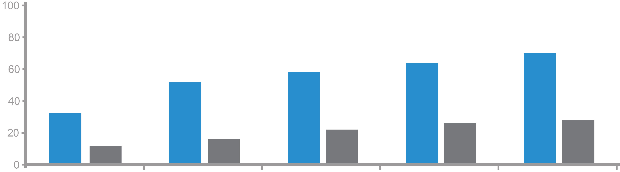
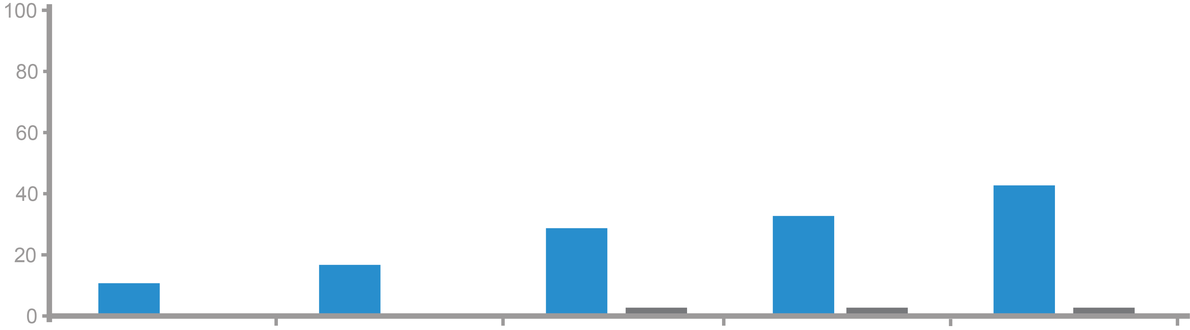
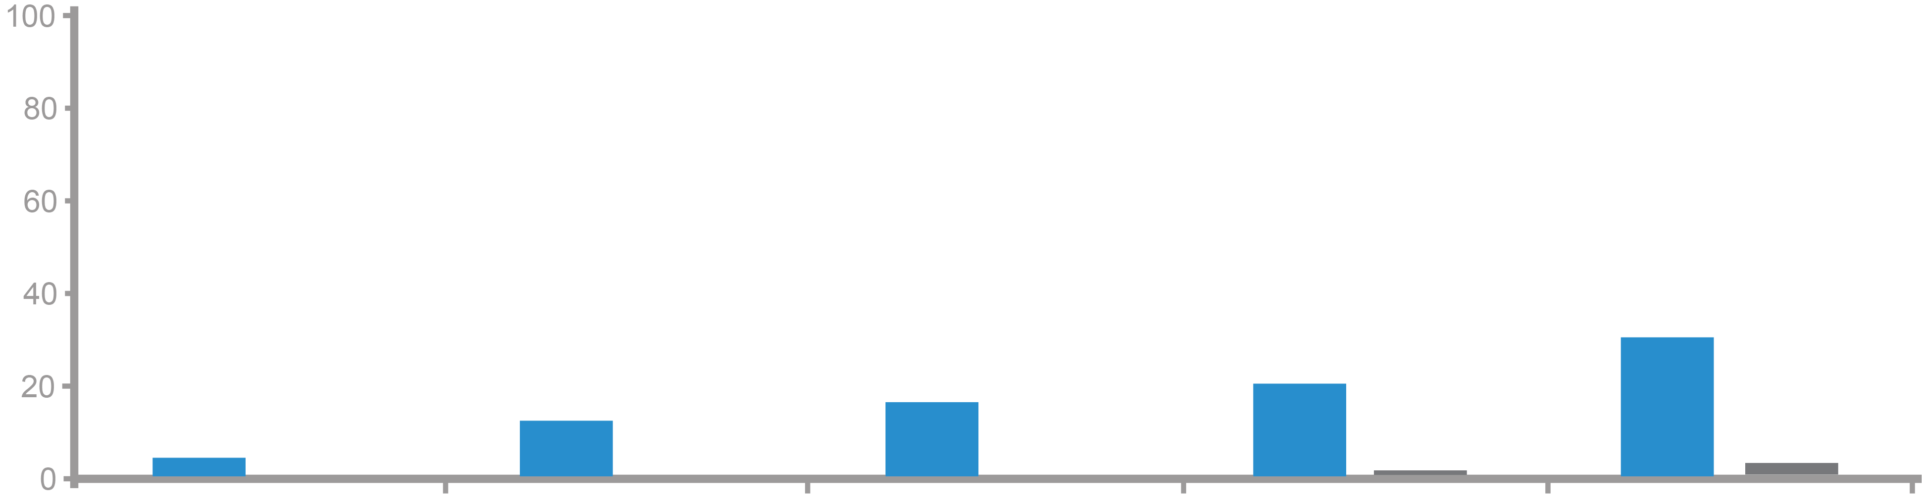
ARANOTE: PSA Response (ultra-low PSA <0.02 ng/mL) by Baseline PSA
Posthoc analysis
< 2% of patients with bPSA ≥ 4.1 ng/ml on ADT monotherapy achieved PSA < 0.02 ng/ml at any time
30.5% of patients with darolutamide + ADT and bPSA ≥ 21.3 ng/ml achieved PSA values < 0.02 ng/ml at any time
At each time point analyzed, darolutamide + ADT was associated with higher PSA response rates < 0.02 ng/ml vs. ADT
Ultra-low PSA rates < 0.02 ng/ml by Baseline PSA subgroups
Baseline PSA < 4.1 ng/ml (< Q1) #
62.3
68.9
Darolutamide
(n = 106)
Patients with PSA
< 0.2 ng/ml, %
50.9
56.5
32.1
24.5
26.4
Placebo
(n = 53)
11.3
15.1
20.8
Baseline PSA 4.1-<21.3 ng/ml (<Q1 to <median)
Darolutamide
(n = 108)
Patients with PSA
< 0.2 ng/ml, %
41.7
28.7
33.3
Placebo
(n = 57)
10.2
16.7
1.8
1.8
0
0
1.8
Baseline PSA ≥ 21.3 ng/ml ( ≥ median)
Darolutamide
(n = 220)
Patients with PSA
< 0.2 ng/ml, %
20.0
30.5
Placebo
(n = 108)
3.2
12.3
16.4
0
0
0
0.9
1.9
12 weeks 24 weeks 36 weeks 48 weeks at any time

Slide 42
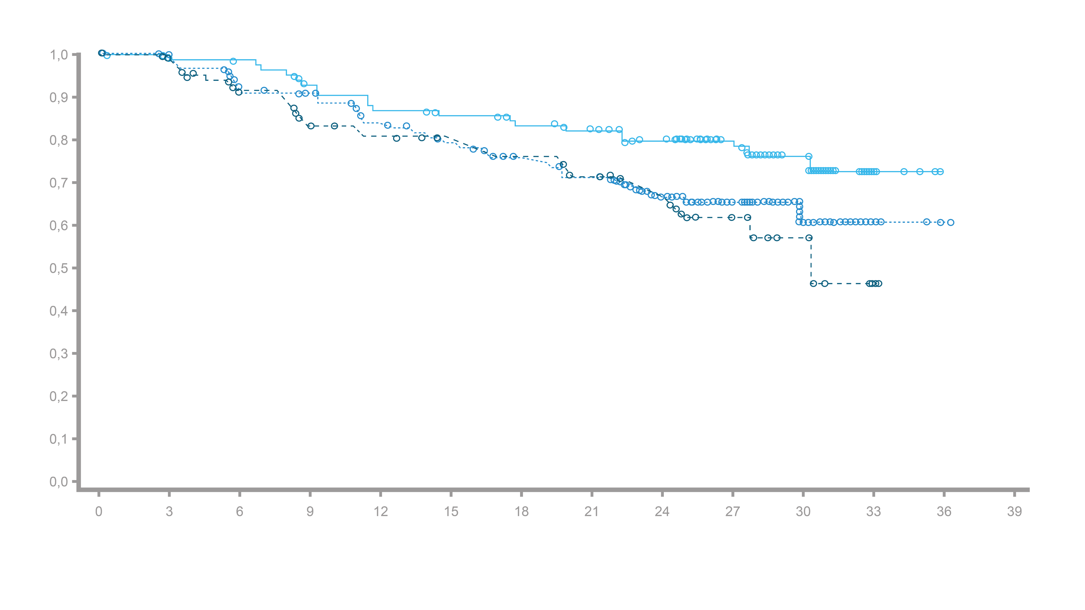
ARANOTE: Risk of Radiographic Progression or Death by Baseline PSA
Patients on darolutamide with low baseline PSA (<4.1 ng/mL) had a lower risk of radiographic progression or death than patients with high baseline PSA
Posthoc analysis
rPFS
Probability of rPFS
31 months (28–NR)
Baseline PSA < 4.1 ng/ml
Baseline PSA 4.1 – <21.3 ng/ml
Baseline PSA ≥ 21.3 ng/ml
<4.1 vs. ≥ 21.3: HR 0.63 (95% CI 0.39–1.02)
4.1 – < 21.3 vs. ≥ 21.3: HR 1.17 (95% CI 0.77–1.76)
Number of patients at risk
Months
Baseline PSA < 4.1 ng/m l
Baseline PSA 4.1 – <21.3 ng/ml
Baseline PSA ≥ 21.3 ng/ml
108
108
220
105
102
205
103
91
184
93
79
176
89
75
157
86
70
144
81
66
129
76
59
119
56
36
87
39
16
53
20
8
24
4
1
4
0
0
1
0
0
0

Slide 43
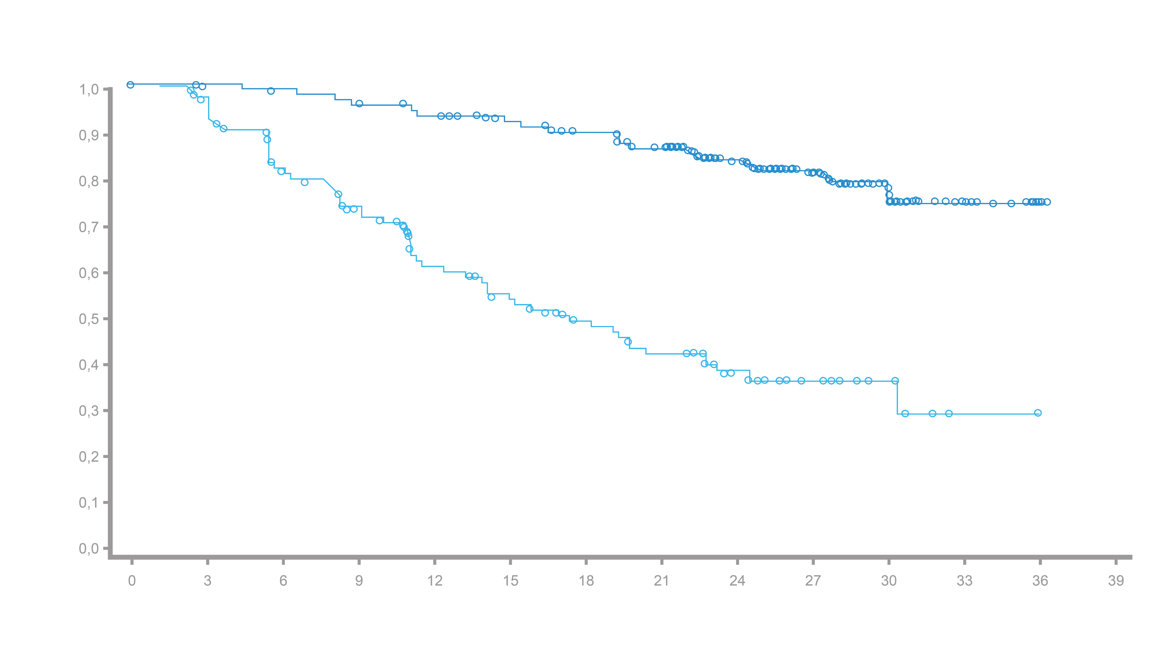
ARANOTE: Association of Undetectable PSA (<0.2 ng/mL) and Risk of Radiographic Progression or Death
Post-hoc analysis
Darolutamide achieved a deep PSA response: 3 times as many patients with undetectable PSA (< 0,2 ng/ml) at any time vs. ADT
Patients on darolutamide with undetectable PSA (< 0,2 ng/ml): lower risk of rPFS or death
rPFS
PSA < 0,2 ng/ml: NR (NR–NR)
Patients who achieved an undetectable PSA level (<0,2 ng/ml), %
Probability of rPFS
HR 0,19
(95% CI: 0,13–0,27)
PSA ≥ 0,2 ng/ml: 17 months (14–23)
weeks
months
Number of patients at risk
PSA
< 0,2 ng/ml
≥ 0,2 ng/ml
Darolutamide (n = 425#)
Placebo (n = 211#)
266
159
263
138
260
107
252
85
243
67
234
55
222
43
208
36
147
24
90
13
43
6
8
1
1
0
0
0
Notes:
Saad F 2024 Eur Urol p3/col2/sec3.3/para1/L1-5
Saad F 2024 Eur Urol p6/figure2A
Footnote a: Saad F 2024 Eur Urol p3/col1/para3/L4-7
Saad F 2024 Eur Urol
Bullet 1: p3/col2/sec3.3/para1/L1-5
Bullet 2: p3/col2/sec3.3/para1/L5-8, p4/col1/para1

Slide 44
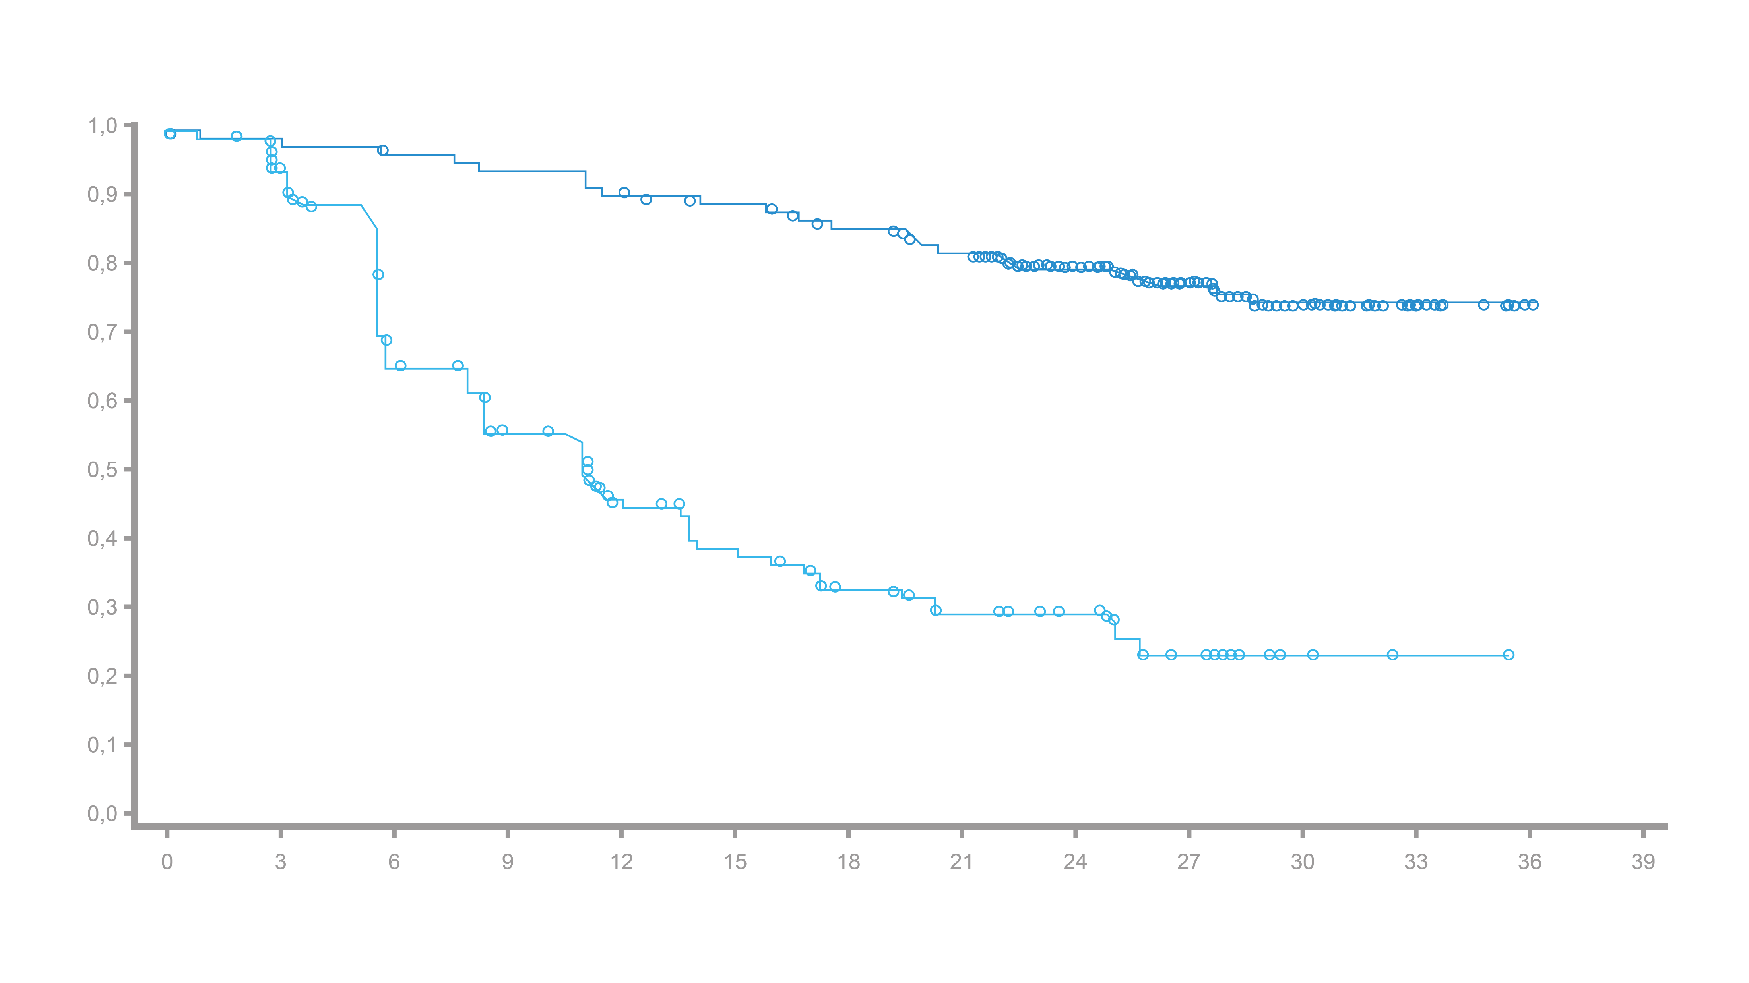
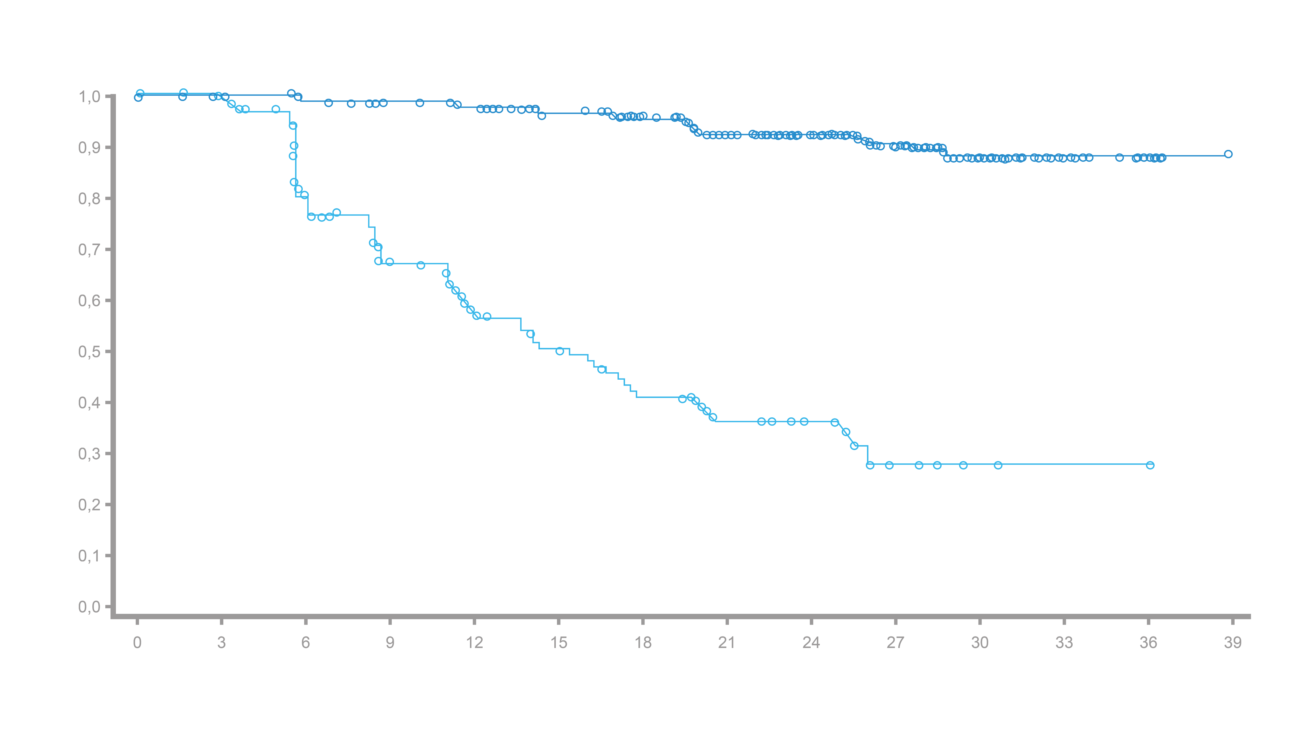
ARANOTE: Association of Undetectable PSA (<0.2 ng/mL) and Time to mCRPC Progression/ Time to PSA Progression
Posthoc analysis
Time to mCRPC
Time until PSA progress
PSA < 0.2 ng/ml: NR (NR–NR)
PSA < 0.2 ng/ml: NR (NR–NR)
Event-free probability
Event-free probability
HR 0.16
(95% KI: 0.12–0.23)
PSA ≥ 0.2 ng/ml: 11 months (8.5–14)
HR 0.08
(95% KI: 0.05–0.12)
PSA ≥ 0.2 ng/ml: 14 months (12–20)
Months
Months
Number of patients at risk
Number of patients at risk
PPE
< 0.2 ng/ml
≥ 0.2 ng/ml
PPE
< 0.2 ng/ml
≥ 0.2 ng/ml
266
159
260
137
255
89
247
72
239
54
230
44
216
33
202
26
144
19
92
9
44
3
13
1
2
0
0
0
266
159
261
136
256
90
250
69
241
49
231
39
215
31
188
23
134
17
86
6
45
2
11
1
2
0
0
0

Slide 45
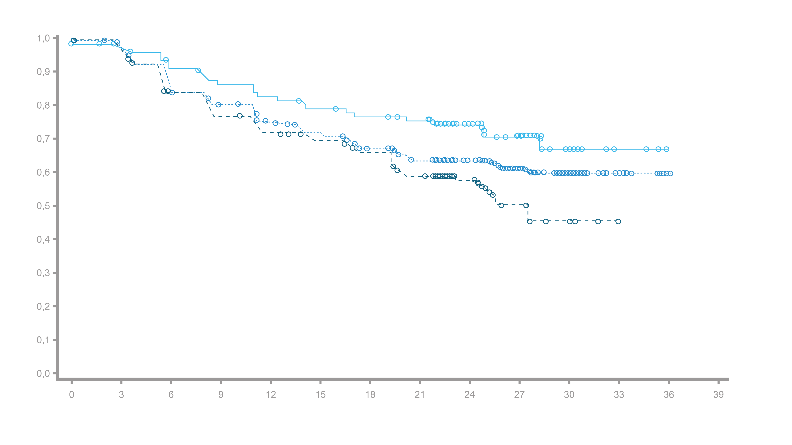
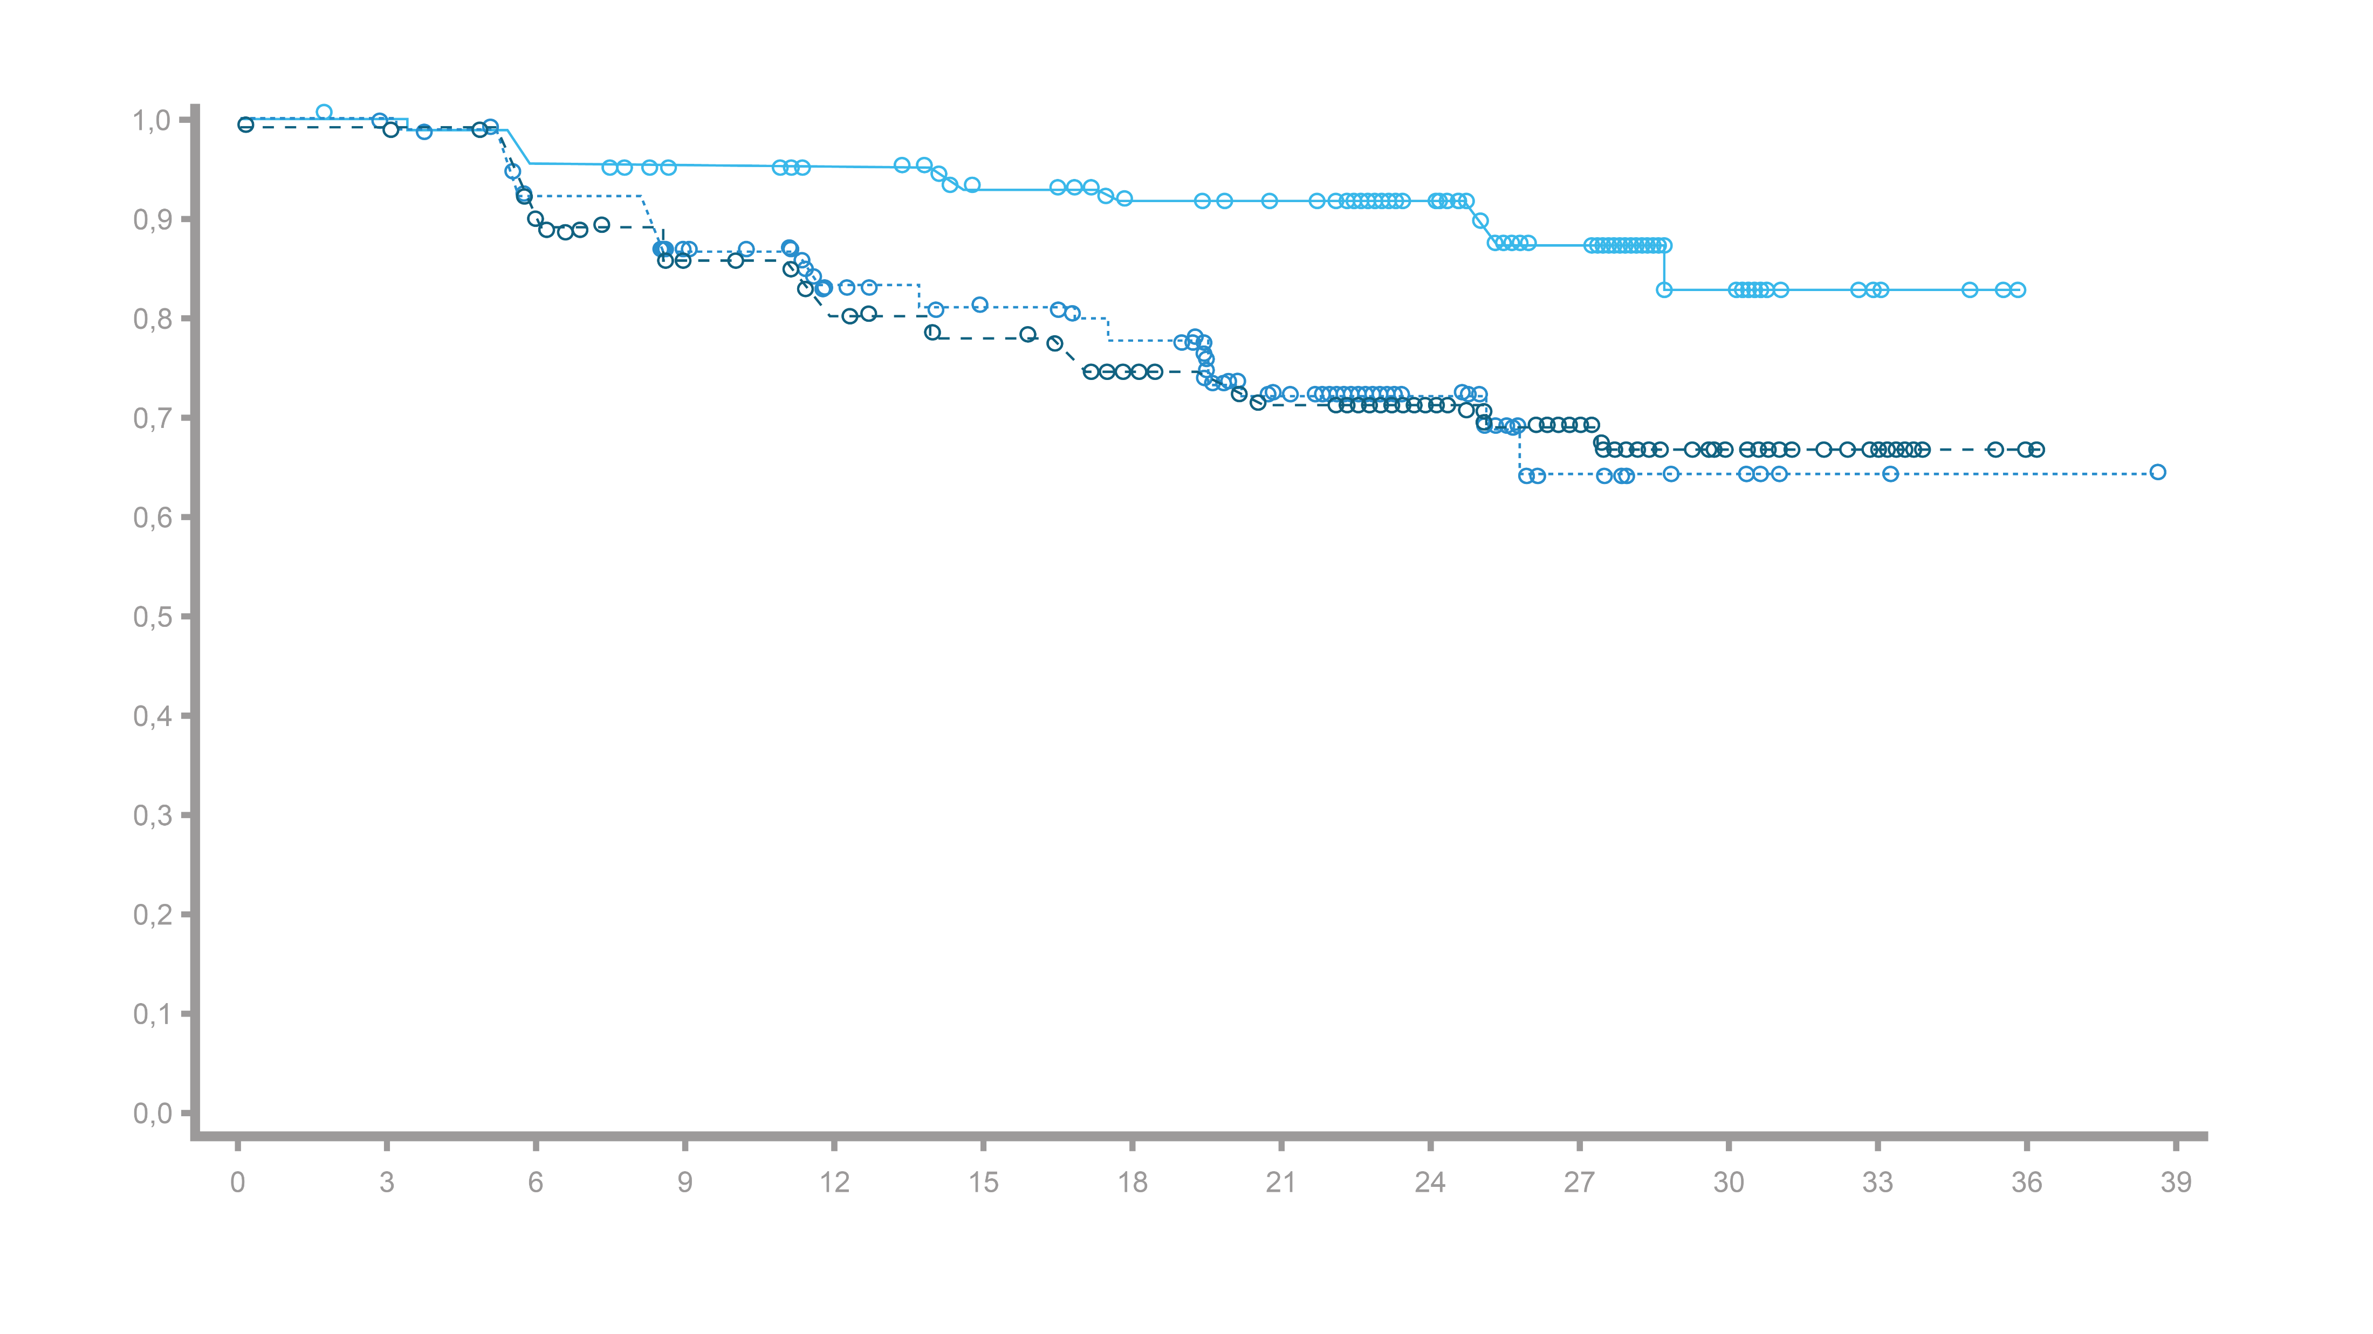
ARANOTE: Time to mCRPC Progression/ Time to PSA Progression by Baseline PSA
Posthoc analysis
Patients on darolutamide with low baseline PSA (<4.1 ng/mL) had a longer time to mCRPC and PSA progression than patients with high baseline PSA (≥ 21,3 ng/ml)
Baseline PSA < 4.1 ng/ml
Baseline PSA 4.1 – <21.3 ng/ml
Baseline PSA ≥ 21.3 ng/ml
Event-free probability
Event-free probability
26 months (20-NR)
< 4.1 vs. ≥ 21.3: HR 0.73 (95% CI 0.48–1.12)
4.1 –< 21.3 vs. ≥ 21.3: HR 1.33 (95% CI 0.92–1.93)
< 4.1 vs. ≥ 21.3: HR 0.34 (95% CI 0.18–0.64)
4.1– < 21.3 vs. ≥ 21.3: HR 0.96 (95% CI 0.60–1.53)
Months
Months
Number of patients at risk
Number of patients at risk
Baseline PSA
< 4.1 ng/ml
4.1 – < 21.3 ng/ml
≥ 21.3 ng/ml
108
108
220
105
102
205
103
91
184
93
79
176
89
75
157
86
70
144
81
66
129
76
59
119
56
36
87
39
16
53
20
8
24
4
1
4
0
0
1
0
0
0
Baseline PSA
< 4.1 ng/ml
4.1 – < 21.3 ng/ml
≥ 21.3 ng/ml
108
108
220
104
103
201
92
89
172
92
82
156
89
75
157
83
66
131
76
62
118
70
30
76
52
30
48
35
12
48
18
8
22
3
3
6
0
1
1
0
0
0

Slide 46
Median Baseline PSA in ARI Trials in mHSPC
Median baseline PSA
Active
Control
ARASENS¹
ARANOTE²
ARCHES³
TITAN⁴
Baseline PSA does not represent PSA prior to any treatment:
In ARASENS and ARANOTE:^{1,2}
Prior docetaxel was not permitted
Patients could have received ADT for up to 12 weeks prior to randomization
In ARCHES and TITAN:^{3,4}
Prior docetaxel was permitted
Patients could have received ADT for mHSPC prior to randomization for:
Up to 3 months, or up to 6 months if the patient had received prior docetaxel (ARCHES)
Up to 6 months (TITAN)
Notes:
Full DC
ARASENS
Smith MR 2022 NEJM (ARASENS), p2A (name of trial), 5A (baseline characteristics), 5B (baseline PSA)
ARCHES
Armstrong AJ 2019 J Clin Oncol (ARCHES), p2B (name of trial), 5C (baseline), 6B (baseline PSA)
TITAN
Chi KN 2019 NEJM (TITAN), p2A (name), 5C (baseline), 5D (PSA)
LATITUDE
Matsubara N 2020 Eur Urol, p2A (name), 4C (baseline PSA)
CHAARTED
Sweeney CJ 2015 NEJM (CHAARTED), p5B (baseline), 5C (PSA, second part of footer a), 1A (NCT number)
NCT00309985 (CHAARTED) Accessed 24-05-21, 1A (trial name and NCT number)
ARASENS: Saad F 2024 Eur Urol p4/table1 (median PSA in all patients = 28)
TITAN: Chi KN 2019 NEJM TITAN appendix p11A, p20/table/row6 (median PSA ~4-6)
Calculation: ~5 x5 = ~25 = ~28
ARCHES: Armstrong AJ 2019 J Clin Oncol (ARCHES) p6B (median PSA ~5)
Calculation: ~5 x5 = ~25 = ~28
ARASENS
Smith MR 2022 NEJM (ARASENS) p2B, 3A
ARCHES
Armstrong AJ 2019 J Clin Oncol (ARCHES) p2C
TITAN
Chi KN 2019 NEJM (TITAN) 3B
LATITUDE
Matsubara N 2020 Eur Urol 2B
CHAARTED
Sweeney CJ 2015 NEJM (CHAARTED) 2A, 3B
Note: The other trials allowed an induction period or previous adjuvant tx but none allowed pts to be receiving continuous ADT for mHSPC like CHAARTED
Footnote a:
ARASENS
Smith MR 2022 NEJM (ARASENS) p2B, 3A
ARCHES
Armstrong AJ 2019 J Clin Oncol (ARCHES) p2C
TITAN
Chi KN 2019 NEJM (TITAN) 3B
LATITUDE
Matsubara N 2020 Eur Urol 2B
CHAARTED
Sweeney CJ 2015 NEJM (CHAARTED) 2A, 3B
Note: The other trials allowed an induction period or previous adjuvant tx but none allowed pts to be receiving continuous ADT for mHSPC like CHAARTED

Slide 47
Conclusion
Patients achieve deep and durable PSA responses with darolutamide + ADT
Reaching PSA <0.2 ng/mL (undetectable) or <0.02 ng/mL (ultra-low) is important, as they both correlate with improved clinical outcomes
Lower baseline PSA is associated with higher rates of achieving PSA <0.2 ng/mL or <0.02 ng/mL and more rapid PSA responses
Many patients with higher baseline PSA do still achieve PSA <0.2 ng/mL or <0.02 ng/mL, but it may take longer. It’s important for clinical outcomes to achieve PSA <0.2 ng/mL or <0.02 ng/mL, not to get there quickly.
Notes:
Note: In ARANOTE, PSA was measured centrally and the assays used had increased sensitivity for measuring PSA to enable detection of deeper reductions in PSA to levels <0.02 ng/mL

Slide 48
Health-related quality of life (HRQoL) outcomes with darolutamide in the phase 3 ARANOTE trial.
Morgans A, et al. Presented at American Society of Clinical Oncology; May 29 – June 2; Chicago, IL. Abstract 5004

Slide 49
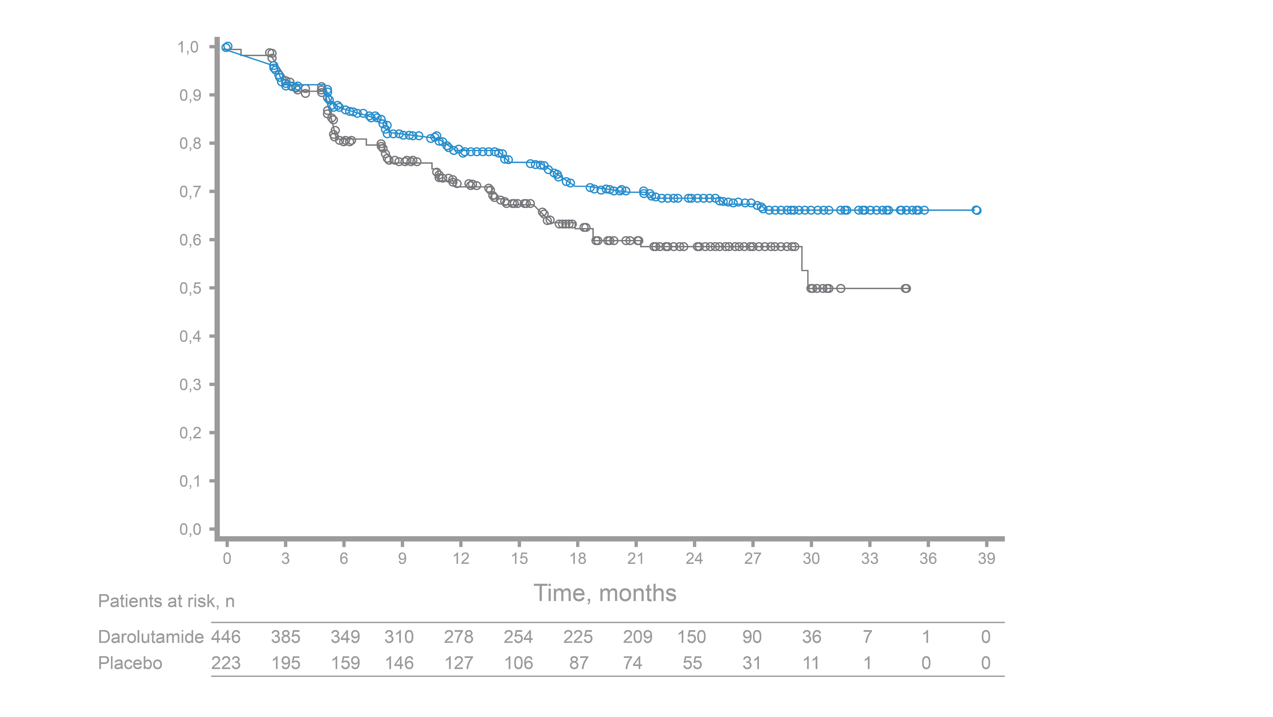
ARANOTE: Pain and Health-related quality of life (HRQoL)
Secondary endpoint
BPI-SF (Pain) ¹
=
Most severe pain in the last 24 hours
Time to pain progression
Darolutamide + ADT Median NE (95% KI: NE–NE)
FACT-P Total Score (Overall Well-being) ²
=
Physical well-being (energy, symptoms, side effects)
Social/family well-being (feeling close to family/supported by family/friends)
Emotional well-being (feeling sad, hopeless, nervous, worried)
Functional well-being (able to work/sleep, enjoyment of life)
Prostate cancer (bowel and urinary tract symptoms)
No pain progression, probability
Placebo + ADT
Median 29.9 (95% KI: 29.7–NE)
Stratified HR 0.72 (95% CI: 0.54-0.96)
Months
Number of patients at risk
Darolutamide
Placebo
446
223
385
195
349
159
310
146
278
127
254
106
225
106
209
74
150
55
90
31
36
11
7
1
1
0
0
0
Time from randomization to confirmed ≥ 2 point increase in peak pain score above nadir
ADT, androgen deprivation therapy; BPI-SF, Brief Pain Inventory–Short Form; CI, confidence interval; FACT-P, Functional Assessment of Cancer Therapy–Prostate; HR, hazard ratio; HRQoL, health-related quality of life; NE, not estimable
1. MD Anderson Cancer Center. https://www.mdanderson.org/research/departments-labs-institutes/departments-divisions/symptom-research/symptom-assessment-tools/brief-pain-inventory.html (accessed Apr 9, 2025); 2. FACIT.org. https://www.facit.org/measures/fact-p (accessed on 09.04.2025). 3. Morgans et al., ASCO 2025, Abstract 5004.

Slide 50
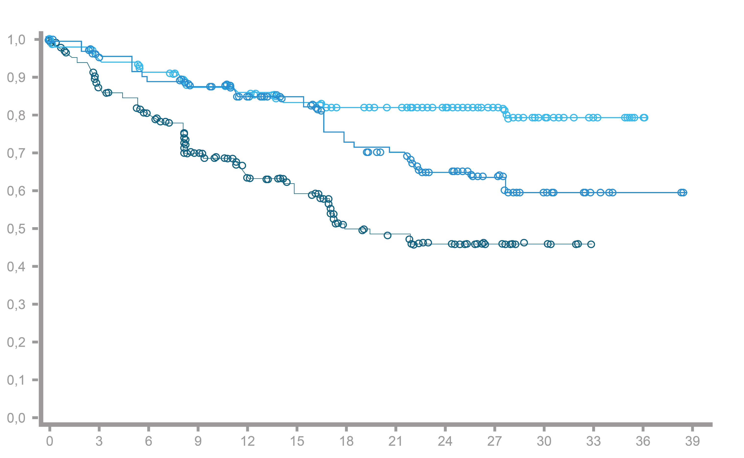
ARANOTE:Time to pain progression by PSA response in the Darolutamide Group
Patients who achieved PSA < 0,02 ng/ml or < 0,2 ng/ml* had a longer time** to pain progression
Post-hoc analysis
PSA response subgroup (PSA ng/ml)
< 0.02: Median NE
(95% CI NE–NE)
0.02 – < 0.2: Median NE
(95% CI 27.6–NE)
No pain progression,
Likelihood
≥ 0.2: Median 17.9 months
(95% CI 14.8–NE)
275/418 patients (66%) with bPSA ≥ 0.2 ng/ml achieved PSA < 0.2 ng/ml at any time; 185 (44%) of these achieved PSA < 0.02 ng/ml
 | PSA response subgroup (PSA ng/ml)
 | < 0.02 vs. ≥ 0.2 | 0.02 – < 0.2 vs. ≥ 0.2
Non-stratified HR (95% CI) | 0.26 (0.17–0.41) | 0.52 (0.33–0.81)
Number of patients at risk
Months
PSA < 0.02 ng/ml
PSA 0.02 – < 0.2 ng/ml
PSA ≥ 0.2 ng/ml
185
90
143
170
85
117
164
78
98
154
75
72
149
69
52
141
63
44
137
52
30
128
48
27
92
35
19
57
22
9
24
9
3
4
3
0
0
1
0
0
0
0
* at any time. ** vs. Patients with PSA ≥ 0.2 mg/ml.
CI, confidence interval; HR, hazard ratio; NE, not estimable; PSA, prostate-specific antigen.
Morgans et al., ASCO 2025, Abstract 5004.

Slide 51
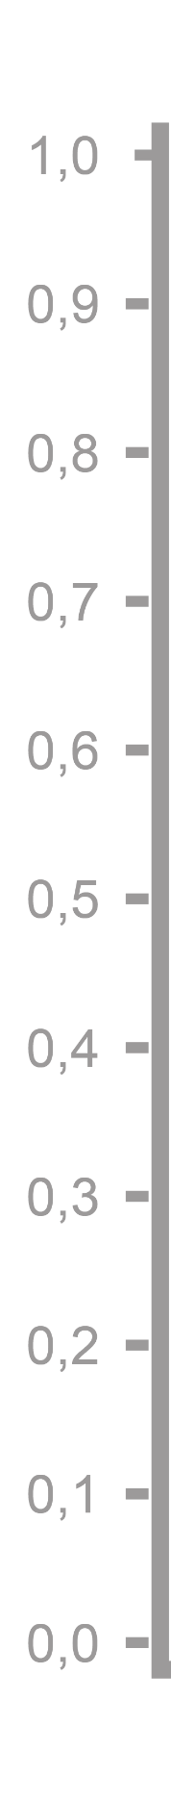
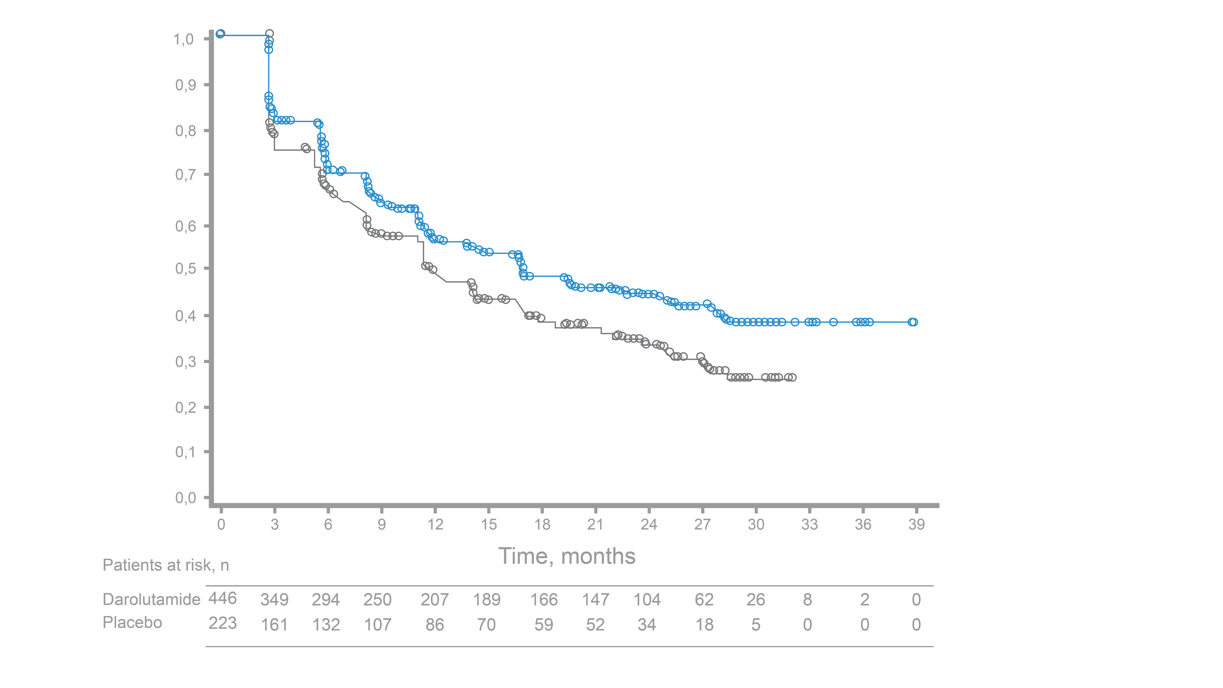
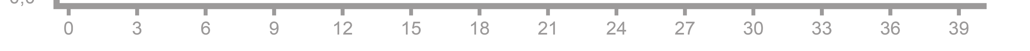
ARANOTE: Time to deterioration of the FACT-P total score*
Darolutamide prolonged the median time to worsening of the FACT-P total score by 5.1 months vs. ADT
Prespecified exploratory endpoint
no deterioration of the FACT-P total score, probability
Darolutamide + ADT Median 16,6 months (95% CI: 12,5–19,5)
Placebo + ADT
Median 11,5 months (95% CI: 8,7–14,0)
Stratified HR 0,76 (95% KI: 0,61–0,94)
Number of patients at risk
months
Darolutamide
Placebo
446
223
349
161
294
132
250
107
207
86
189
70
166
59
147
52
104
34
62
18
26
5
8
0
2
0
0
0
* Time from radomization to the first drop of ≥ 10 points in the total score.
ADT, androgen deprivation therapy; CI, Confidence interval; FACT-P, Functional Assessment of Cancer Therapy-Prostate; HR, Hazard Ratio; HRQoL, Health-related quality of life.
Morgans et al., ASCO 2025, Abstract 5004.

Slide 52
ARANOTE: Time to worsening of FACT-P subscores*
Post-hoc analysis
FACT-P Subscale | Darolutamide + ADT (n = 446) |  | Placebo + ADT (n = 223) |  |  | HR* (95% CI)
 | Patients with event, % | Median time to deterioration, months | Patients with event, % | Median time to deterioration, months
Total score | 52,9 | 16,6 | 61,0 | 11,5 |  | 0,76 (0,61-0,94)
Physical well-being | 57,6 | 16,1 | 58,7 | 13,9 |  | 0,90 (0,73-1,11)
Social/family well-being | 55,4 | 15,5 | 60,5 | 11,2 |  | 0,79 (0,64-0,98)
Emotional well-being | 49,3 | 19,3 | 52,5 | 15,7 |  | 0,88 (0,70-1,10)
Functional well-being | 55,4 | 14,5 | 61,4 | 11,3 |  | 0,78 (0,63-0,96)
Prostate cancer | 57,2 | 13,7 | 62,3 | 10,9 |  | 0,82 (0,66-1,01)
intestinal symptoms† | 50,2 | 20,1 | 47,5 | 16,6 |  | 0,96 (0,76-1,21)
Urinary tract symptoms † | 40,4 | NE | 46,2 | 18,5 |  | 0,78 (0,61-0,99)
Darolutamide preferred
Placebo preferred
0 0,5 1 1,5
* Time from randomization to first decline of ≥ 3 points in subscore values; † Progression is defined by a change ≥ 1 point in FACT-P6 (bowel symptoms) or ≥ 2 points in the sum of FACT-P7, FACT-P8, and FACT-BL2 (urinary tract symptoms).
ADT, androgen deprivation therapy; CI, Confidence interval; FACT-P, Functional Assessment of Cancer Therapy-Prostate; HR, Hazard Ratio.
Morgans et al., ASCO 2025, Abstract 5004.
HR* (95% CI)

Slide 53
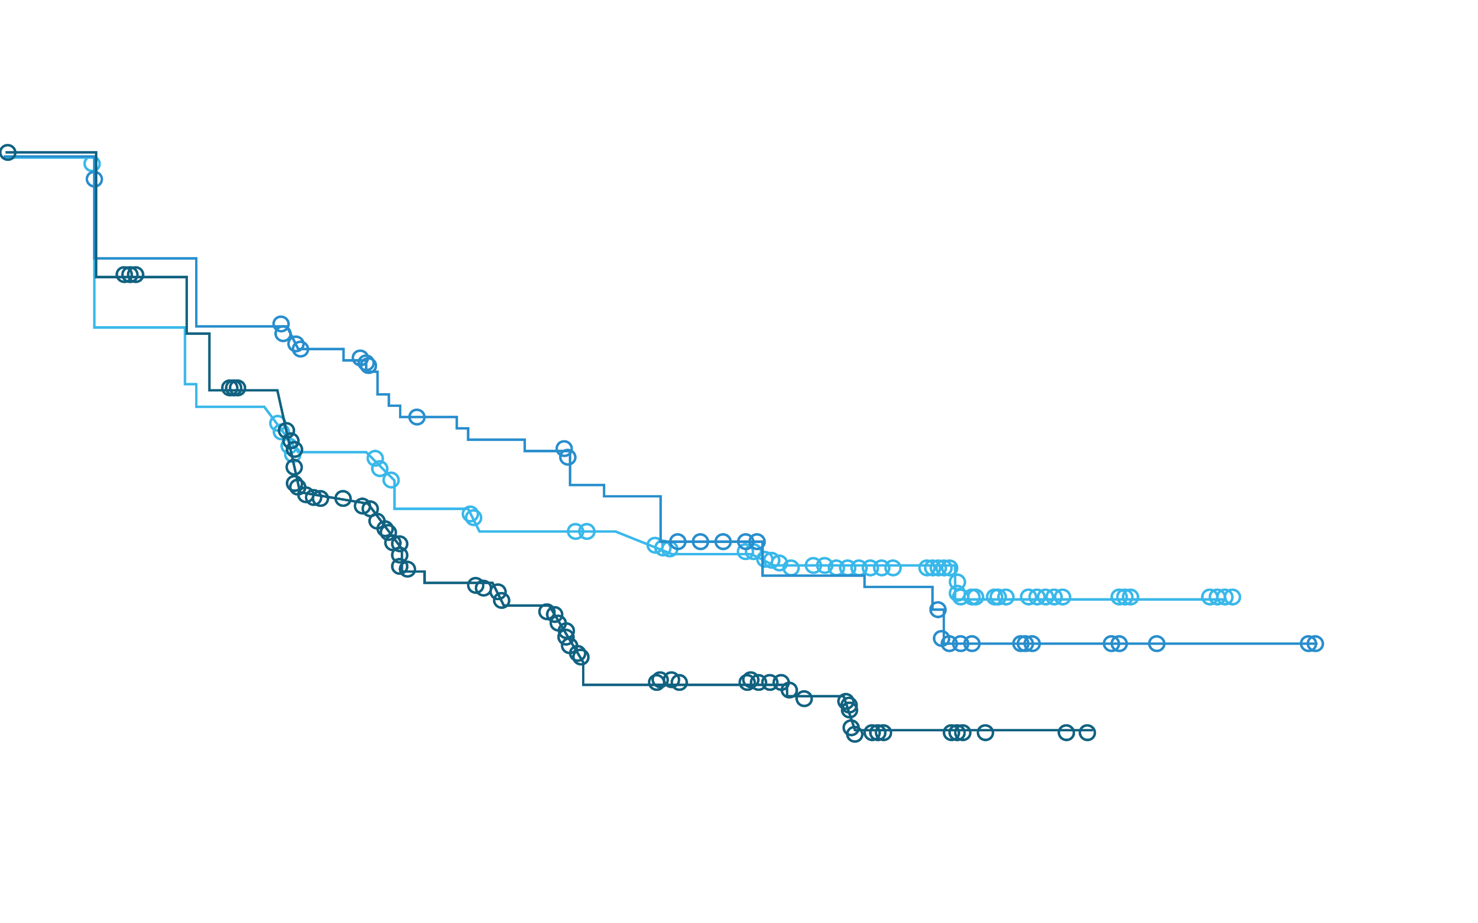
ARANOTE: Time to worsening of FACT-P subscores in the darolutamide group by PSA Response*
Patients who achieved PSA < 0.02 or < 0.2* had a longer time** to deterioration of HRQoL
Post-hoc analysis
PSA response subgroup
(PSA ng/ml)
< 0,02: Median 19,4 months
(95% CI 11,5–NE)
0,02 – < 0,2: Median 22,3 months
(95% CI 16,7–NE)
no deterioration of the FACT-P total score, probability
≥ 0,2: Median 11,3 months
(95% CI 8,7–16,0)
 | PSA response subgroup (PSA ng/ml)
 | < 0,02 vs. ≥ 0,2 | 0,02 – < 0,2 vs. ≥ 0,2
Non-stratified HR (95% KI) | 0,68 (0,50–0,91) | 0,65 (0,45–0,93)
Number of patients at risk
months
PSA < 0,02 ng/ml
PSA 0,02 – < 0,2 ng/ml
PSA ≥ 0,2 ng/ml
185
90
143
145
75
118
124
68
93
111
62
68
99
54
45
92
51
38
90
43
26
82
35
24
59
25
15
39
15
6
16
6
2
6
2
0
1
1
0
0
0
0

Slide 54
Conclusion
Authors’ summary:
Darolutamide has a positive impact on health-related quality of life
Darolutamide is the first and only androgen receptor inhibitor with clinically relevant effects on:
delaying pain progression
general well-being
Urinary tract symptoms
Functional well-being
Social and family well-being
an improvement in health-related quality of life was most evident in patients with ultra-low PSA response

Slide 55
Thank you for your attention!

Slide 56
Short product information NUBEQA®
The referenced data and publications are available upon request.
Short product information NUBEQA® :
AS.: Darolutamide. I.: NUBEQA is indicated in comb. with androgen deprivation therapy (ADT) for the treatm. of adult pat. with metastatic hormone-sensitive prostate cancer (mHSPC). NUBEQA is indicated in comb. with docetaxel and ADT for the treatm. of adult pat. with mHSPC, for whom docetaxel therapy is indicated. NUBEQA is indicated in comb. with ADT for the treatm. of adult pat. with non-metastatic, castration-resistant prostate cancer (nmCRPC), for those who are at high risk of develop. metastases (especially with a PSA-DT ≤ 10 m.). D/A: 600 mg (two 300 mg film-coated tablets) taken 2/day with a meal (total daily dose of 1200 mg). pat. receiving NUBEQA should also receive an LHRH agonist or antagonist concurrently or have had a bilat. orchiectomy. When used in comb. with docetaxel, the 1. of 6 docetaxel cycles should begin within 6 weeks of starting NUBEQA. CI.: Hypersensitivity to the active pharmaceut. ingredient or to one of the excipients. Women who are pregnant or of childbearing potential. Spec.W./Prec.: Renal/hepatic impairment: Closely monitor pat. with severe renal impair. or moderate/severe hepatic impair. for adverse reactions. Hepatotox.: In case of liver funct. test abnormalities suggestive of idiosyncr. DILI, NUBEQA must be permanently discont. ADT can prolong the QT interval: In case of risk factors or concomitant medication that prolong the QT interval, ECG monitoring should be consid.. Contraception: Sexually active pat. must use a highly effective form of contracept.. Bone density: may be affected during treatm. with NUBEQA due to long-term testosterone suppr. Recent cardiovasc. disease: The safety of NUBEQA in pat. with a clinic. relevant cardiovasc. disease in the last 6 months has not been proven, follow current guidelines. The prescr. dose is practically “sodium free”. Do not take if you have hereditary galactose intolerance, total lactase deficiency, or glucose-galactose malabsorption. AEs.: NUBEQA: Very common: Neutrophil count decr., AST and ALT incr., bilirubin incr., fatigue. Common: Ischaemic heart disease, cardiac failure, rash, pain in extremities, fractures. NUBEQA in comb. with docetaxel: Very common: Hypertension including occasional hypertensive emergency, AST incr., ALT incr., bilirubin incr., rash. Interactions: BCRP inhibitor, OATP 1B1 and 1B3, in the case of concurrent use with corresp. substrates, follow the recommendations in the resp. prescrib. information. Weak CYP3A4 inducer. Substrate of CYP3A4, P-gp, and BCRP. Use of strong CYP3A4 inducers and P-gp inducers during treatm. with NUBEQA should be avoided. UE: Very common: Neutrophil count decreased, AST and ALT increased, Bilirubin increased, Fatigue. Common: Ischaemic heart disease, Cardiac failure, Rash, Pain in extremities, Fractures. NUBEQA in combination with Docetaxel: Very common: Hypertension including hypertensive emergency, AST increased, ALT increased, Bilirubin increased, Rash. List: B. Bayer (Schweiz) AG, 8045 Zurich. Further inform.: www.swissmedicinfo.ch.
RP-M_DAR-CH-0108-3 07/2025

