Slide 1








USE OF
RIVAROXABAN
IN ADULTS
AND CHILDREN
Questions and answers on the use of rivaroxaban (Xarelto® and Xarelto® junior) in practice (RivaPrax)
A consensus document of the
RivaMoS Working party and the Haemostasis Working Party (WPH, Working Party Haemostasis) of the Swiss Society of Haematology
Reference:
Version August 2021
MA-M_RIV-CH-0195-2_03.2024

Slide 2








Table of contents
General Questions
Interactions
Precautionary Measures
Rivaroxaban for
Specific Indications
Further Questions
Patient Management
Determining Plasma Levels
Perioperative Management

Slide 3
Introduction
ABOUT
RIVAPRAX
Consensus document of the RivaMos Working Party and the Working Party Haemostasis of the Swiss Society of Haematology
Pragmatic and clinically relevant answers to questions for practitioners
Support with the regular clinical monitoring in the practice

Slide 4





Introduction
Since 2009
Prophylaxis of venous thromboembolic events (VTE) after major surgical interventions involving the lower extremities like hip and knee prostheses
Since april 2012
Treatment of deep vein thrombosis (DVT) as well as prophylaxis of recurrent DVT and pulmonary embolism (PE)
Prophylaxis of stroke and prophylaxis of systemic embolism for non-valvular atrial fibrillation (nvAF)
Since september 2013
Treatment of pulmonary embolism (PE)
Since June 2021
Treatment of VTE in paediatric patients
APPROVAL STATUS IN SWITZERLAND
Xarelto
®

Slide 5

General Questions

Slide 6
1.1 Which products with the active ingredient Rivaroxaban are available in Switzerland?
There are three products in Switzerland with the active ingredient rivaroxaban: Xarelto®, Xarelto® Junior and Xarelto® vascular.
They differ in the fields of application and dosages.
Please note that this document focuses on the discussion of issues concerning Xarelto® in adult patients and, in section 4.3, Xarelto® junior; For answers to questions regarding Xarelto® vascular, please refer to the "Swiss Expert Statement" on the use of rivaroxaban in chronic CAD and / or PAD.

Slide 7
1.2 Doses of rivaroxaban based on indication and eGFR (1/2)
 | eGFR |  | Remarks
 | ≥ 50 ml/min | #15 – 49 ml/min
Rivaroxaban (Xarelto®)
Thrombosis prophylaxis Following major orthopaedic procedures | 1x 10 mg | 1x 10 mg | 10 mg taken with or without food
 |  |  | No pre-operative administration, first dose 6–10 hours after wound closure, provided haemostasis is ensured.
Stroke prophylaxis In patients with nonvalvular atrial fibrillation | 1x 20 mg | 1x 15 mg | 15 mg and 20 mg taken with food 10 mg taken with or without food
In patients with atrial fibrillation undergoing PCI with placement of stents co-administered with a P2Y₁₂-inhibitor | 1x 15 mg | 1x 10 mg
DVT and PE therapy Acute phase from days 1 – 21 | 2x 15 mg | 2x 15 mg | 15 mg and 20 mg taken with food 10 mg taken with or without food
Extended prevention of recurrent VTE from day 22 | 1x 20 mg | 1x 20 mg
Extended treatment from month 7 | 1x 20 mg OR 1x 10 mg | 1x 20 mg OR 1x 10 mg
VTE treatment in children / adolescents 30 to < 50 kg | 1 x 15 mg | No data | Following initial parenteral anticoagulation; 15 and 20 mg taken with food
VTE treatment in children / adolescents ≥ 50 kg | 1 x 20 mg | No data
# According to the product information, use with caution in patients with eGFR 15-29 ml/min. Expert opinion: Patients with eGFR < 30 ml/min should not be started on rivaroxaban as this was an exclusion criterion during clinical trials. If the eGFR for patients on rivaroxaban deteriorates to < 30 ml/min, therapy may be continued under close monitoring.

Slide 8
1.2 Doses of rivaroxaban based on indication and eGFR (2/2)
 | eGFR |  | Remarks
 | ≥ 50 ml/min | #15 – 49 ml/min
Rivaroxaban (Xarelto junior)
VTE treatment in paediatric patients (neonates, infants, children < 30 kg) Treatment of VTE after initial parenteral anticoagulation for the prevention of recurrent VTE | Dose is dependent on bodyweight | No data | In children aged < 1 year renal function should only be assessed on the basis of serum creatinine. The use of Xarelto junior is not recommended in the case of serum creatinine levels > 97.5 percentile according to serum creatinine [reference values in Table 2 of SmPC].
Rivaroxaban (Xarelto® vascular)
Prevention of major atherothrombotic events (stroke, myocardial infarction, cardiovascular death)
In patients with coronary artery disease or manifest peripheral artery disease with a high risk of ischemic events, in combination with ASS | 2x 2.5 mg | 2x 2.5 mg | Taken with or without food
# According to the product information, use with caution in patients with eGFR 15-29 ml/min. Expert opinion: Patients with eGFR < 30 ml/min should not be started on rivaroxaban as this was an exclusion criterion during clinical trials. If the eGFR for patients on rivaroxaban deteriorates to < 30 ml/min, therapy may be continued under close monitoring.

Slide 9

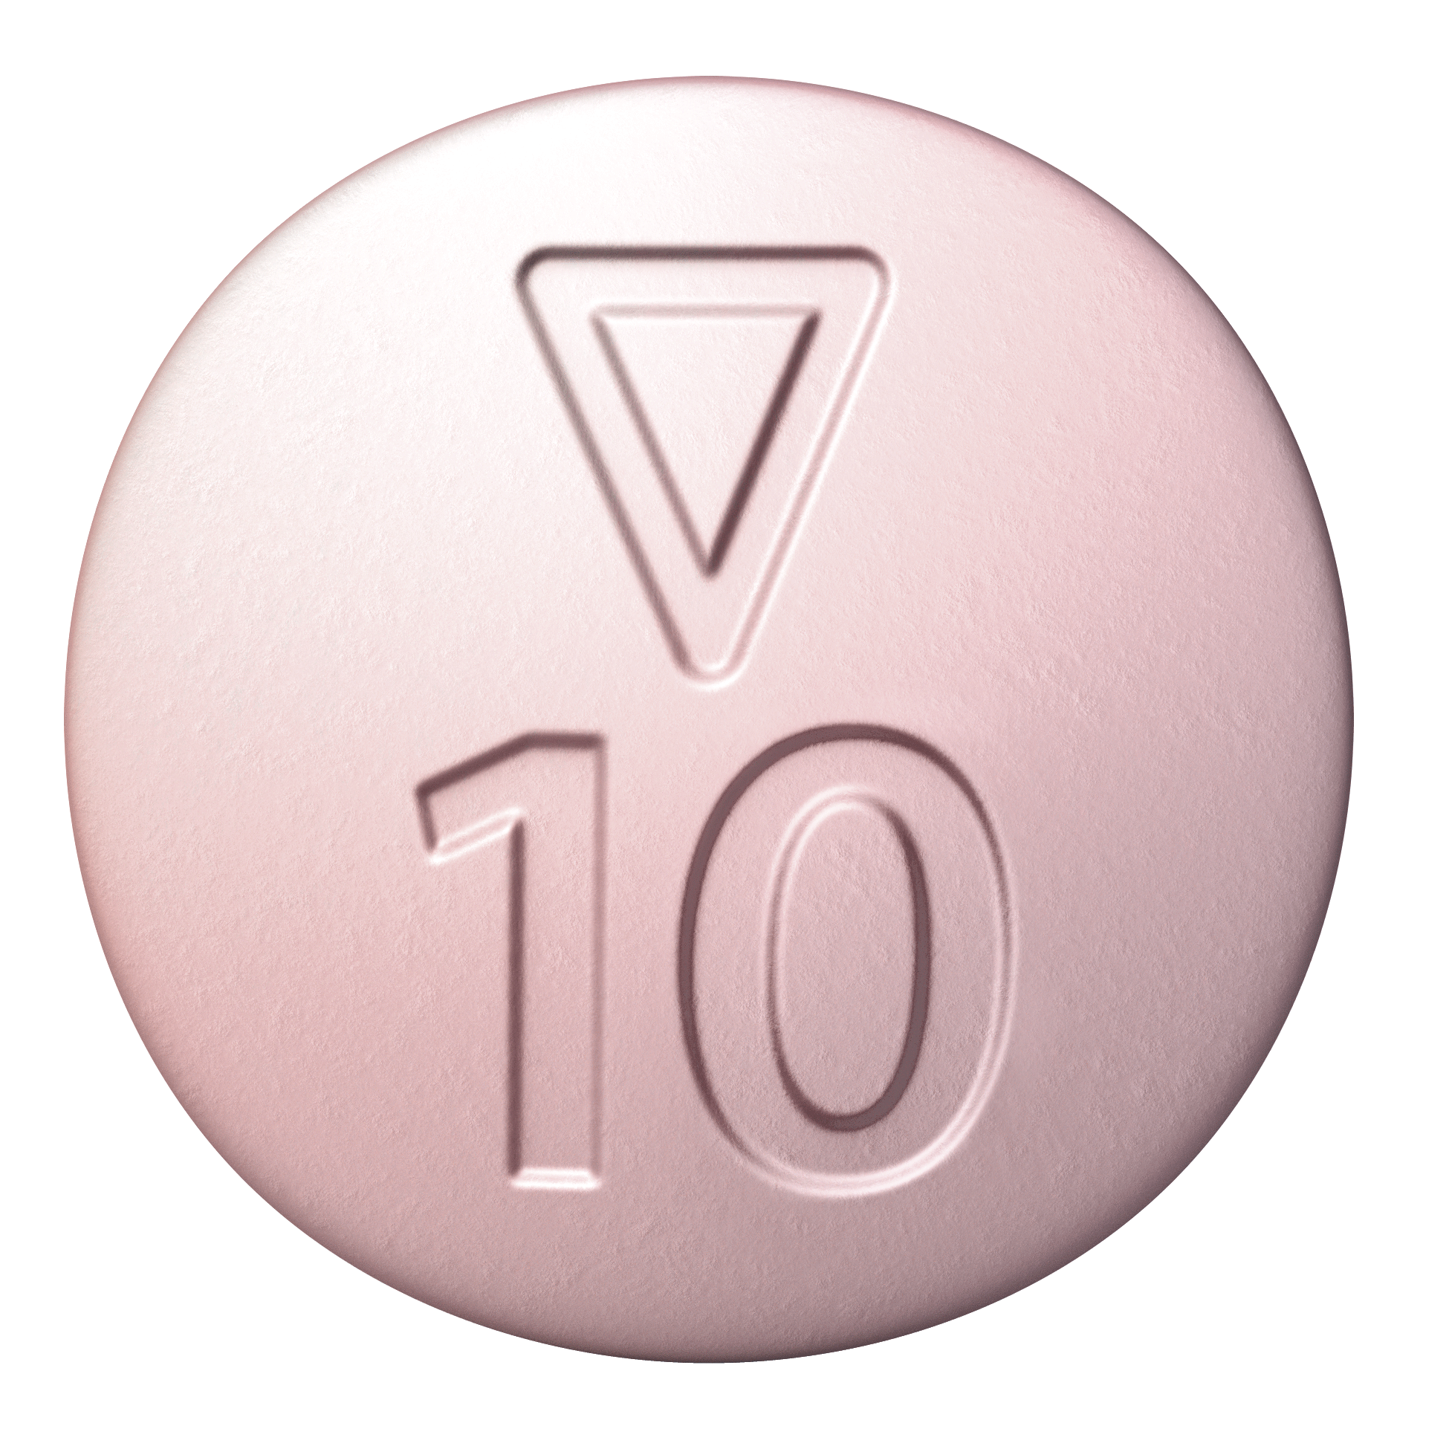
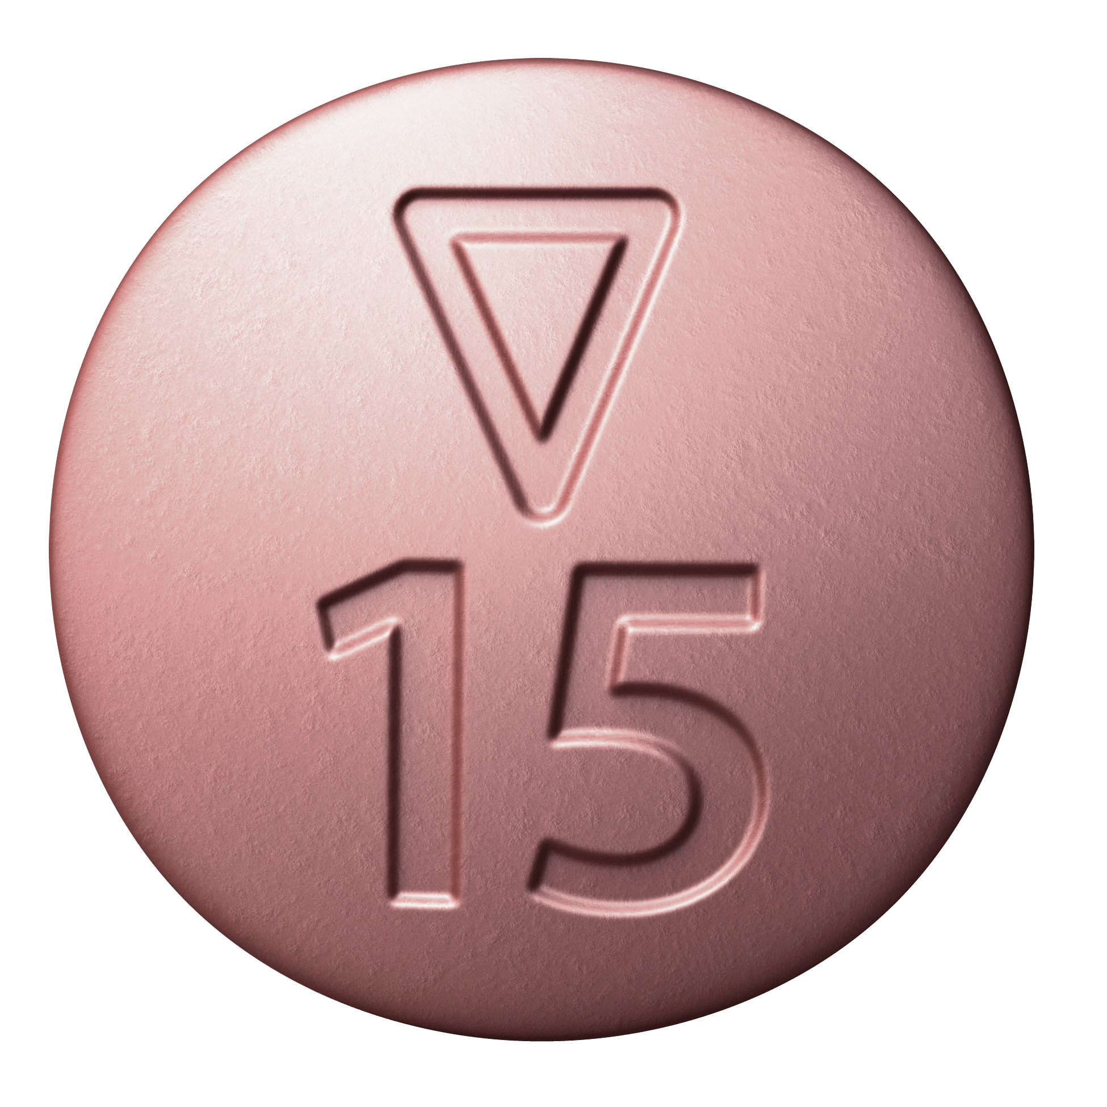
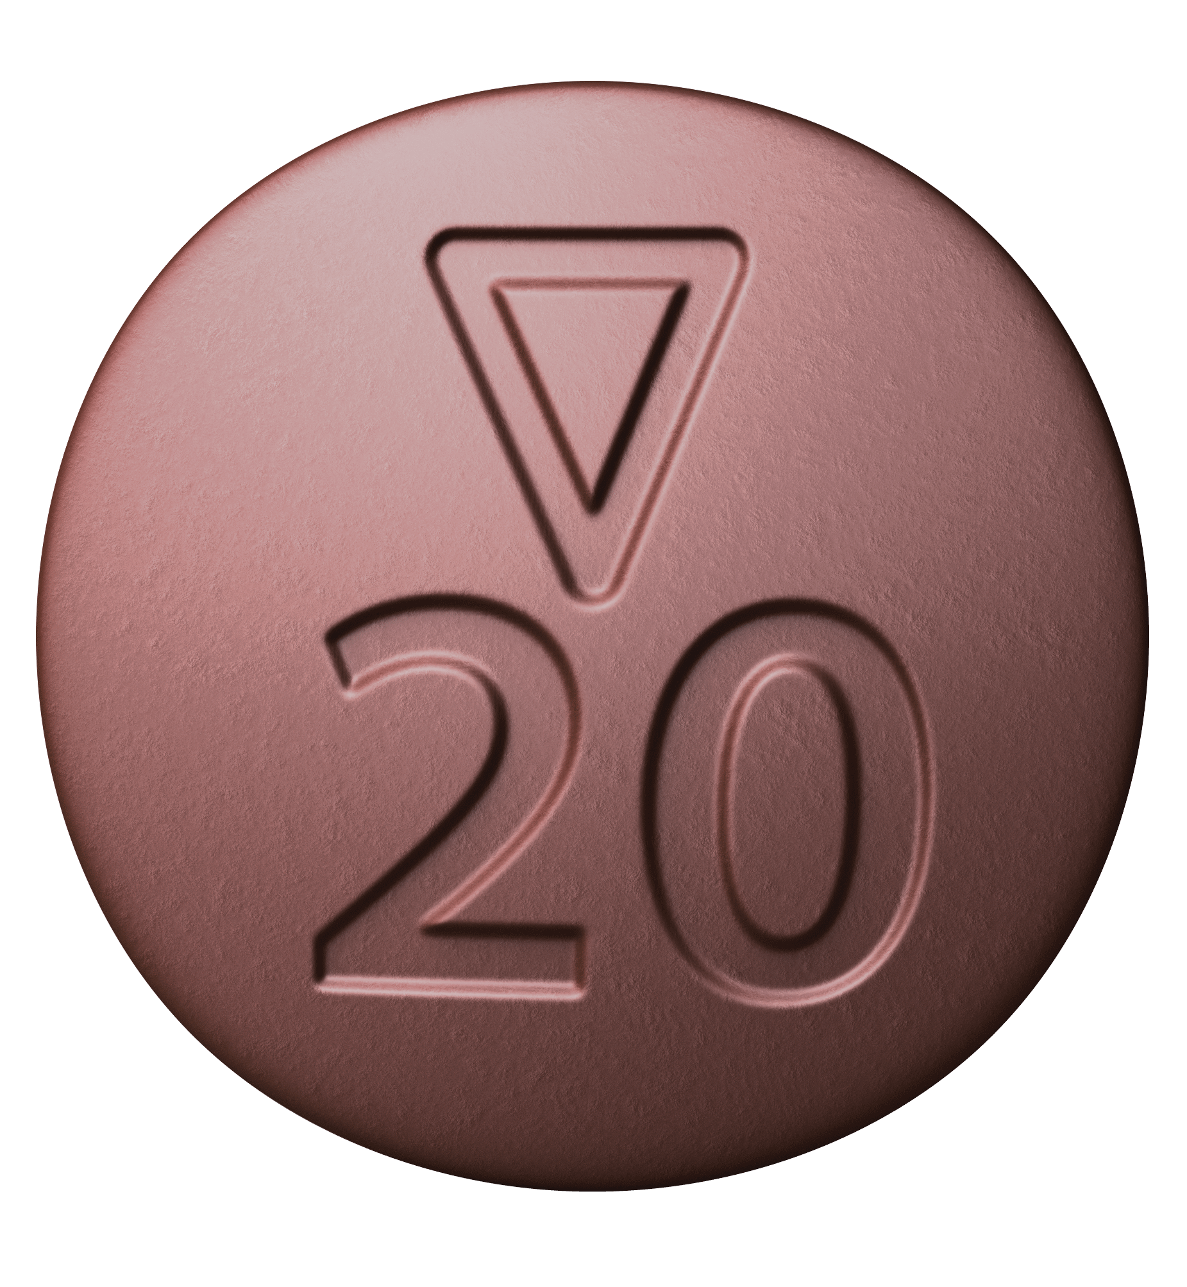
1.3 What is the best way to proceed if a tablet is missed?
General Questions
If taken once a day:
Take the missed dose immediately as soon as the oversight is noted.
The next day, return to the usual 1x 10 mg administration.
The daily dose must not be exceeded.
If taken twice a day:
During acute therapy of DVT/PE* with Xarelto®:
Missed dose should be taken immediately, ensure the daily dose of 30 mg. If necessary, 2x 15 mg tablets can be taken at once.
The next day, tablets should again be taken at the usual time.
*acute therapy of DVT/PE (day 1-21): 15 mg 2x/day, followed (from day 22) by 20 mg 1x/day
If the rivaroxaban tablet is regurgitated within 30 minutes of being taken, the dose should be taken again. If it is regurgitated more than 30 minutes after being taken, the dose should not be taken again and administration should continue as usual at the next scheduled time.

Slide 10
1.4 Can rivaroxaban be packed into weekly pill boxes?
Rivaroxaban can easily be removed from its blister packaging and stored in pill boxes for a period of one week.

Slide 11

1.5 Can rivaroxaban be ground with a pestle?
General Questions
It is generally recommended to use intact tablets in all cases.
If a patient finds it impossible to swallow a tablet, it can be ground with a pestle and, for example, mixed with a yoghurt.
According to the information for healthcare professionals, rivaroxaban can be administered via a gastric tube (providing it is placed in the proximal part of the stomach).
Rivaroxaban can be administered via a gastric tube: rivaroxaban is practically insoluble in water.
Xarelto® tablets should not be broken up
(absence of a score and small size)

Slide 12
1.6 How can rivaroxaban be compatible with sport?
Patients receiving anticoagulants must always be instructed not to play any sports with a high potential for injury or explicit body contact.
Patients being treated with rivaroxaban should observe the same safety and precautionary measures as when using other OACs.
If need be, the time that rivaroxaban is taken can be adjusted to suit a specific sporting activity (to avoid peak values at the time of the sporting activity in question).

Slide 13
1.7 How can compliance be improved for rivaroxaban?
Emphasise and explain the risk to the patient, e.g. by pointing out:
«One in ten patients with a CHA₂DS₂-VASc-Score of 6 or higher will suffer a stroke within a year unless they take an anticoagulant.»
Rituals that will help the patient not to forget their medicine.
To improve compliance information brochures and other helpful materials are provided by Bayer.
Even if rivaroxaban is taken on an irregular basis, the patient will quickly enjoy protection again soon after taking the medicine.

Slide 14
1.8 What is the best way to proceed for rivaroxaban patients who need an intramuscular (im) injection? (1/2)
General Questions
Prior to invasive procedures or surgical interventions, rivaroxaban should be discontinued at least 24 hours before the procedure, while this period may be extended depending on age and renal function
Careful assessment whether there are possible alternatives, prior to an im injection.
If i.m. injections are unavoidable, experts recommend the following procedure:
Use a long, thin needle (23G or 25G)
Preferably inject into the forearm (deltoid muscle).
Good compression for 5–10 minutes, without rubbing.
Do not aspirate (aspirating would cause more local adverse reactions in the presence of a bleeding tendency).
The person receiving anticoagulation or the parents/legal representative should be informed about the possibility of a haematoma following the injection and about further action.
After administration the person should be kept under observation for a minimum of 15 minutes at the location where the injection took place.
Haematomas following injection can additionally be treated by immobilisation, cooling and, if necessary, anti-inflammatory/analgesic treatment
(Caution: no platelet inhibiting medication)

Slide 15



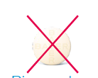



1.8 What is the best way to proceed for rivaroxaban patients who need an intramuscular (im) injection? (2/2)
Allgemeine Fragen
Management of rivaroxaban treatment:
The day before the injection:
The day of the injection:
The day after the injection
Morning
dose
Evening
dose
Morning
dose
Evening
dose
Morning
dose
Evening
dose
≥ 6 h after im injection!
1 x day
1 x day
1 x day
Rivaroxaban
Rivaroxaban
Rivaroxaban
2 x day
2 x day
2 x day
Rivaroxaban
Rivaroxaban
Rivaroxaban
The day before the injection: Rivaroxaban administration in the morning: the day before the injection the patient takes rivaroxaban in the morning as usual.
Rivaroxaban administration in the evening or twice daily: the patient omits the evening dose the day before the injection.
The day of the injection: The patient omits the dose in the morning before the injection and takes the rivaroxaban tablet no earlier than six hours after the intramuscular injection.
The day after the injection the patient takes rivaroxaban again according to the usual schedule.

Slide 16

Interactions

Slide 17
2.1 Does rivaroxaban change the plasma level of other medicines?
No, rivaroxaban neither induces nor inhibits CYP enzymes in the liver.
Rivaroxaban is a substrate of the CYP450 enzymes CYP3A4 and CYP2J2.

Slide 18
2.2 Is the plasma level of rivaroxaban changed by other medicines?
The simultaneous combination with potent inducers/inhibitors of CYP3A4 plus potent inducers/inhibitors of P-gp can result in a clinically relevant change of the plasma level.
Co-medication with moderate CYP3A4- and P-gp-inhibitors, together with other factors (e.g. renal insufficiency, additional platelet inhibition, or other medicines which have a similar influence on CYP3A4 and P-gp), may lead to a clinically significant increase in the plasma level of rivaroxaban and a corresponding increase in the risk of bleeding.

Slide 19
2.3 What medicines can the patient take at the same time as rivaroxaban?
Medicines | Combination with rivaroxaban | Plasma level of rivaroxaban | Comment
Acetaminophen, cyclosporin, nifedipine, felodipine, midazolam, triazolam, quinidine, dexamethasone | ✓ | ➔
Simvastatin, atorvastatin | ✓ | ➔
Verapamil, digoxin | ✓ | ➔
Antacids, omeprazole, H2-receptor antagonists, ranitidine | ✓ | ➔
ASA (≤ 100 mg), clopidogrel (75 mg) | ✓ | ➔ | Increased risk of bleeding, as with VKAs or LMWH
Naproxen, NSAIDs | ✓ | ➔ | Increased risk of bleeding, as with VKAs or LMWH
✓
= combination with rivaroxaban not a problem

Slide 20
2.3 What medicines should the patient not take at the same time as rivaroxaban?
Medicines | Combination with rivaroxaban | Plasma level of rivaroxaban | Comment
Amiodarone | ≈ |  | Higher plasma levels to be expected
Clarithromycin, telithromycin, erythromycin | ≈ |  | Caution for patients with impaired renal function
Rifampicin, phenobarbital and related substances, phenytoin, carbamazepine and St John’s wort | ✗ | ⬇ | Plasma level of rivaroxaban significantly reduced
VKAs | ✗ | ➔ | Increased risk of bleeding, additive effect (supra-additive on the INR)
Heparin, LMWH | ✗ | ➔ | Increased risk of bleeding, additive effect
Azole antifungals (CYP3A4 inhibitors): ketoconazole, itraconazole, miconazole, voriconazole, posaconazole, fluconazole | ✗ | ⬆ | AUC is increased about 2.6-fold
HIV-protease-inhibitors (CYP3A4 inhibitors: ritonavir, indinavir, atazanavir, etc. | ✗ | ⬆ | AUC is increased about 2.5-fold
Dual platelet inhibitors (ASA & clopidogrel, ASA & prasugrel, ASA & ticagrelor) | ✗ | ➔ | Rivaroxaban > 5 mg: significantly increased risk of bleeding (as with VKAs or LMWH)
≈ = caution, particularly for patients with impaired renal function ✗ = recommended not to take this at the same time as rivaroxaban

Slide 21
2.4 May patients on rivaroxaban be given platelet aggretgation inhibitors (PAIs)?
Yes, in principle rivaroxaban may be administered at the same time as PAIs such as NSAIDs, ASA (100 mg) or clopidogrel (75 mg).
The increased risk of bleeding is similar to that which occurs when a PAI is combined with a LMWH or VKA.
Simultaneous administration of more than one PAI should be avoided.
The combination of rivaroxaban with prasugrel or ticagrelor is currently insufficiently investigated and should therefore be avoided.
Administration of rivaroxaban + PAIs in the context of a PCI with stent implantation for nvAF patients was investigated in the PIONEER AF-PCI study. The combination of rivaroxaban 15 mg 1x/day (10 mg 1x/day with eGFR 30-49 ml/min) + clopidogrel triggered significantly less cases of clinically relevant bleeding than a triple therapy based on a VKA. The expert group recommends consulting an expert in case of questions regarding this dose reduction option, as listed in the product information.

Slide 22

Precautionary Measures

Slide 23
3.1 What needs to be considered with patients with renal insufficiency?
Check renal function at the start of therapy (if renal insufficiency is suspected or confirmed).
With patients with confirmed renal insufficiency, renal function should be checked at least every «eGFR divided by 10» months.
Patients requiring dialysis (eGFR < 15 ml/min): rivaroxaban must not be used (contraindication!).
eGFR [ml/min] | Prevention of VTE after major orthopaedic interventions* | Stroke prophylaxis in nvAF* | Stroke prophylaxis in nvAF after PCI and stent implan-tation + P2Y₁₂ inhibitor* | Treatment of DVT & PE*
≥ 50 | dose adjustment not needed | dose adjustment not needed | dose reduction to 15 mg 1x/day# | dose adjustment not needed
30 – 49 | dose adjustment not needed | dose reduction to 15 mg 1x/day | dose reduction to 10 mg 1x/day# | dose adjustment not needed
15 – 29 | no contraindication, but rivaroxaban not recommended | No contraindication, but increased caution; rivaroxaban not recommended where the indication for anticoagulation is recent | No contraindication, but increased caution; rivaroxaban not recommended where the indication for anticoagulation is recent | no contraindication, but rivaroxaban not recommended
* detailed indication under www.swissmedicinfo.ch #after consultation of an expert

Slide 24
3.2 What does the following reference mean in the information for healthcare professionals: «use with caution»?
Carefully weight the risk and benefit of anticoagulation is essential.
Before using rivaroxaban:
Medical examination (complications associated with bleeding, monitoring of wounds, etc.)
Measurement of haemoglobin (aenemia) and bleeding parameters
Estimation of renal function
Liver function tests
Before beginning with rivaroxaban therapy: Monitor patients for signs of bleeding complications or anaemia:
Regular medical examinations
If a patient‘s haemoglobin levels or blood pressure fall when on rivaroxaban therapy, the cause must be established.

Slide 25
3.3 What needs to be considered with patients with impaired hepatic function?
Rivaroxaban may be administered to people with hepatic insufficiency if their coagulation values are normal and they are not prone to bleeding.
No need to adjust the dose, but:
Patient should be monitored closely
Rivaroxaban plasma level may be increased (due to impaired metabolic performance in the liver)
Contraindication for:
Hepatic insufficiency or with patients whose laboratory tests show they are prone to bleeding.

Slide 26

3.4 What needs to be considered with elderly patients?
No dose adjustement necessary
Elderly patients (> 75 years) have increased rivaroxaban plasma levels by up to 50%
The half-life in elderly patients is 11–13 hours
With elderly patients with renal insufficiency or on co-medication the half-life may be significantly longer.
An analysis of the subgroup of elderly patients in Phase III studies has found the efficacy and safety of rivaroxaban to be comparable with the data for younger patients.

Slide 27
3.5 Are there patients who must not be given rivaroxaban?
Contraindications for rivaroxaban:
Clinically significant bleeding
Acute gastrointestinal ulcer or gastrointestinal ulcerative diseases
Severe liver disease and severe hepatic insufficiency with an increased risk of bleeding, as well as mild and moderate hepatic insufficiency in combination with pathological coagulation values
Renal insufficiency requiring dialysis
Pregnancy and breastfeeding
Acute bacterial endocarditis
Hypersensitivity to the active substance or one of the excipients

Slide 28
Rivaroxaban for Specific Indications

Slide 29

4.1 Prophylaxis for stroke and systemc embolisms associated with nonvalvular atrial fibrillation (nvAF)

Slide 30
4.1.1 Rivaroxaban is approved for patients with non-valvular AF. What is meant by valvular AF?
The use of rivaroxaban in patients with atrial fibrillation and a bioprosthetic heart valve or with transcatheter aortic valve implantation (TAVI) has been studied in randomised trials and is considered possible by experts based on these data
Rivaroxaban is not registered and
must therefore not be used
for patients with
valvular atrial fibrillation,
i.e. for patients with haemodynamically significant mitral stenosis and/or a mechanical heart valve.

Slide 31
4.1.2 Which patients with newly diagnosed nvAF may be treated with rivaroxaban to good effect?
All nvAF patients without any contraindication to rivaroxaban.
Patients following a stroke/TIA or with a previous history of stroke/TIA.
Patients who do not want or cannot take VKAs.
New nvAF patients who have not previously taken OACs.
Patients for whom therapy with VKAs is difficult or impossible (e.g. partial factor VII deficiency, factor IX propeptide mutation).

Slide 32
4.1.3 With which patients with nvAF does it make sense to switch from VKAs to rivaroxaban?
When a switch may make sense:
With frequent interactions with the VKA due to switching or irregular use of additional medicines
When experiencing problems on VKAs due to interactions with certain foods
Following an elective intervention
When INR is unstable (TTR < 60%) but with good compliance
When regular INR-monitoring is impossible (geographical or logistical reasons, or frequent travel)
When expressing an explicit preference for a switch
Important:
A patient for whom control with a VKA is proving problematic will not necessarily be a good candidate for rivaroxaban!

Slide 33

4.1.4 How do we deal with patients who need an OAC due to nvAF but cannot be given a VKA for safety reasons (risk of bleeding)?
Careful re-evaluation of the benefit and risiks of treatment with rivaroxaban.
Further discussions with the patient and/or their relatives with the focus on clarifying the possible benefits for the patient and any ongoing risks.

Slide 34
4.1.5 Can nvAF patients who have suffered a systemic embolism on rivaroxaban continue to be given rivaroxaban?
In principle, yes. Rivaroxaban significantly reduces the risk of thromboembolism.
Risik is never fully eliminated→ events remain a possibility over the long term.
In case of compliance issues:
Switching away from rivaroxaban may not be necessary.
Increase the information and support, to ensure the right dose is taken consistently over the long term.

Slide 35
4.1.6 How do we handle nvAF patients after PCI and stent implantation?
Anticoagulation is indicated for these patients due to atrial fibrillation and (double) platelet inhibition due to the PCI with stent implantation. This combination significantly increases the risk of bleeding.
For the duration of additional treatment with a P2Y₁₂ inhibitor (usually 12 months with clopidogrel) the dose of rivaroxaban may be reduced to 15 mg once daily (10 mg once daily with eGFR 30–49 ml/min) to reduce the risk of bleeding.
After stopping the P2Y₁₂ inhibitor rivaroxaban should be returned to the standard dose for patients with nvAF (20 mg once daily, or 15 mg once daily with eGFR 30–49 ml/min).
The expert group recommends consulting an expert in case of questions about this dosage option.

Slide 36

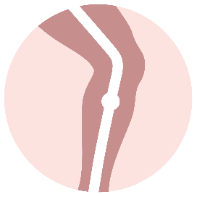
4.2 Therapy for acute DVT/PE as well as preventing recurrence of DVT/PE in adult patients

Slide 37
4.2.1 / 4.2.2 What is the best way to proceed if a patient has been given LMWH first?
If LMWH has been given first for a maximum of 5 days, the recommended dose of 15 mg 2x/day can be given for a further 21 days.
If LMWH has been given first for longer than 5 days, the recommended dose of 15 mg 2x/day can be given until day 21 after starting anticoagulation with LMWH.
Preliminary treatment with LWMH is not necessary. According to the information for healthcare professionals, it is possible to start with rivaroxaban directly.
However, the administration of LWMH beforehand is possible. During clinical trials som 70% of patients were given one or a maximum of two injections of LMWH before being started on two 15 mg daily doses of rivaroxaban for 21 days.

Slide 38
4.2.3 Why does treatment with rivaroxaban need to be at a higher dose for the first 21 days?
Dose-finding studies relating to VTE therapy showed: The results of the ODIXa study, in terms of reducing the thrombotic burden, tended to be better for twice daily administration for the first 21 days of therapy than for a single daily dose.
Comparative studies involving other anticoagulants (idraparinux, ximegalatran), for which no higher dose was used in the acute therapy stage, identified unacceptably high rates of recurrence during the initial phase of therapy.

Slide 39
4.2.4 Is there any current data on long-term secondary prophylaxis for VTE patients?
If long-term secondary prophylaxis with rivaroxaban is considered after anticoagulation treatment for at least 6 months, rivaroxaban 20 mg 1x/day should be continued in VTE patients at high risk of recurrence.
The EINSTEIN CHOICE study included VTE patients after 6 to 12 months of anticoagulation and no clear indication for continuation of therapy.
The EINSTEIN CHOICE study shows episodes of recurrent VTE occurred significantly less often on 10 mg 1x/day of rivaroxaban compared with 100 mg 1x/day of aspirin, while the rate of severe bleeding was comparable. There were no significant differences as regards the primary efficacy and safety endpoints compared with long-term prophylaxis based on 20 mg 1x/day of rivaroxaban.
For any issues regarding risk classification in the context of long-term secondary prophylaxis, consulting a specialist is recommendable.

Slide 40
4.2.5 Can rivaroxaban be used for thrombophilia patients for the indications „treatment or secondary prophylaxis for DVT/PE“?
EINSTEIN study programme: some 6% of patients were known to have thrombophilia.
The primary efficacy and safety end point across the pre-specified subgroup with thrombophilic coagulation problems was consistent in the EINSTEIN DVT and EINSTEIN PE studies with that of the broader population.
The expert group believes that rivaroxaban can be used for patients whose laboratory results indicate they have thrombophilia.
Exception: antiphospholipid antibody syndrome (APS) → essential to contact a haemostaseologist/haematologist and not to give DOAC in patients with high-risk APS.

Slide 41
4.2.6 Can rivaroxaban be used for cancer patients for the indications „treatment or secondary prophylaxis for DVT/PE“?
The 2021 American Society of Hematology (ASH) guidelines for management of VTE in patients with an active tumour recommend using LMWH or DOAC (apixaban or rivaroxaban) for initial treatment (first week) of DVT/PE in cancer patients, and DOAC (apixaban, edoxaban or rivaroxaban) in preference to LMWH or VKA for subsequent further treatment for 3–6 months.
The approved indication does not exclude oncology patients.
Based on the SELECT-D study and in accordance with the 2021 ASH Guidelines on the treatment of VTE in patients with an active tumour, the experts consider treatment with rivaroxaban in VTE patients with active tumour, a low risk of bleeding and no drug interactions with the systemic therapy as possible.
Rivaroxaban can therefore be used for patients to whom LMWH cannot be given for individual reasons.
Patients with colorectal, genitourinary and gastro-esophageal tumours should be treated with LMWH during the first 3–6 months.
After 3–6 months – on an individual basis and assuming there is a relevant indication – consider whether to continue anticoagulation with rivaroxaban.
Special caution is advised for patients at high risk of bleeding (e.g. chemotherapy, thrombocytopenia) and potential interactions of rivaroxaban with various chemotherapeutic agents (consult an oncologist).

Slide 42

4.3 VTE TREATMENT IN PAEDIATRIC PATIENTS

Slide 43
4.3.1 For which indication and in which dosage is rivaroxaban used in children?
Rivaroxaban is approved for the treatment of venous thromboembolisms (VTE) after initial parenteral anticoagulation (in the authorisation study for a minimum of 5 days) for the prevention of recurrent VTE in children aged 0-17 years.
Neonates, infants and children weighing under 30 kg receive rivaroxaban in the form of an oral suspension (Xarelto junior), children and adolescents weighing 30 kg or more in the form of the film-coated tablet (Xarelto) which has already been authorised for a long time for adults (see Table on slide 7).
The dose in paediatric patients is dependent on bodyweight
Pharmaceutical form | Bodyweight (kg) |  | Dosage (1 mg Rivaroxaban equals 1 ml Suspension) |  |  | Daily dose
 | Min | Max | 1 x per day | 2 x per day | 3 per day
Oral suspension | 2.6 | < 3 |  |  | 0.8 mg | 2.4 mg
 | 3 | < 4 |  |  | 0.9mg | 2.7 mg
 | 4 | < 5 |  |  | 1.4 mg | 4.2 mg
 | 5 | < 7 |  |  | 1.6 mg | 4.8 mg
 | 7 | < 8 |  |  | 1.8 mg | 5.4 mg
 | 8 | < 9 |  |  | 2.4 mg | 7.2 mg
 | 9 | < 10 |  |  | 2.8 mg | 8.4 mg
 | 10 | < 12 |  |  | 3 mg | 9 mg
 | 12 | < 30 |  | 5 mg |  | 10 mg
Film-coated tablet | 30 | < 50 | 15 mg |  |  | 15 mg
 | ≥50 |  | 20 mg |  |  | 20 mg

Slide 44
4.3.2 What is the procedure for switching paediatric patients from parenteral anticoagulation to rivaroxaban?
When a paediatric patient is switched from parenteral anticoagulation to rivaroxaban, the first administration of rivaroxaban should be performed as shown opposite
Unfractionated heparins: 4 hours after discontinuation of i.v. infusion
LMWH 2x daily: 12 hours after the last injection of LMW
LMWH 1x daily: 24 hours after the last injection of LMWH
Heparin/fondaparinux and rivaroxaban should not be administered concomitantly.

Slide 45
4.3.3 What should be done if a dose is forgotten spat out or regurgitated shortly after taking it?
1x daily administration (15 mg and 20 mg tablet): take the daily dose immediately after noticing and continue as usual the next day. Never take more than one tablet per day.
2x daily administration (Xarelto junior as a suspension): take immediately when you notice a dose has been missed; it can also be taken together with the evening dose. You should only make up for a missed evening dose on the same day.
3x daily administration (Xarelto junior as a suspension): do not take any more and continue with the regular dose as recommended at the next scheduled administration time, without compensating for the missed dose.
All dosage forms: continue with the regular dose as usual the next day.
If the patient spits out/regurgitates the tablet (Xarelto) or suspension (Xarelto junior) within 30 minutes after it has been taken: take the dose again.
If it is regurgitated more than 30 minutes after being taken, the dose should not be taken again and administration should continue as usual at the next scheduled time.

Slide 46

Further Questions

Slide 47
5.1 Can I also use rivaroxaban as VTE prophylaxis for medical patients?
Rivaroxaban cannot currently be recommended for use with medical patients.

Slide 48

5.2 Can I also use rivaroxaban as prophylaxis in the context of general surgery?
No. There is currently no clinical data and no approval on this issue. This kind of use can therefore not be recommended unless another registered indication for rivaroxaban applies.

Slide 49
5.3 Can I also use rivaroxaban as primary prophylaxis for travel-related thrombosis?
Where there is a relevant indication, i.e. for patients with specific risk factors, a prophylactic dose of a LMWH is usually prescribed as prophylaxis for travel-related thrombosis.
There are no approvals or studies for the use of rivaroxaban in this situation.
It is therefore up to the doctor treating the patient to decide what medicine to prescribe in this off-label situation.
Important: Information and consent of the patient.
Insurance providers are not obliged to cover the costs of the medicine. Unless the patient is duly informed and their consent obtained, preferably in writing, the prescribing doctor will be liable for any reimbursement.

Slide 50

Patient Management

Slide 51
6.1 What must patients be investigated for before rivaroxaban may be used?
Recommended procedure before starting therapy/prophylaxis with rivaroxaban:
Review of contraindications
Recording of patient’s history
Known problem with bleeding (procedure dependant on individual cases/consult a haemostasis specialist)
Gastrointestinal bleeding (if remedy not possible: potentially use VKA instead)
Myocardial infarction (rivaroxaban is suitable for these patients)
Coronary stents (close monitoring for any bleeding)
Stroke (time of starting treatment must be discussed with the neurologist)
Clinical Examination → Co-morbidities → What co-medication?/Interactions?
Laboratory tests
Quick’s test (normal initial values, otherwise clarification needed)
Haemoglobin, platelets, pathological values require clarification
Renal and hepatic function

Slide 52
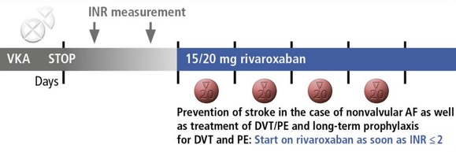
6.2 What is the procedure for switching from vitamin K antagonists to rivaroxaban?
Immediately stop the intake of Marcoumar® or Sintrom®.
Make sure the patient does not continue taking a VKA.
Caution: If the patient is at increased risk of bleeding (even temporarily), it is essential to wait until the INR value has fallen below 2.0 before rivaroxaban can be taken. This recommendation is at odds with the information for healthcare professionals for Xarelto®, which says switching to rivaroxaban is possible once the INR falls below 2.5.

Slide 53
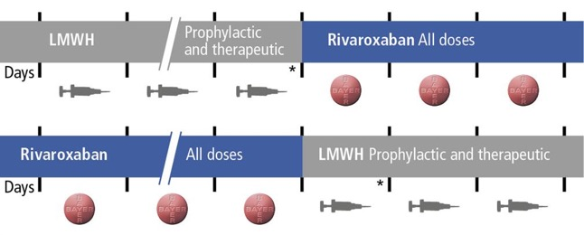
6.3 What are possible procedures for switching from LMWH to rivaroxaban and vice versa?
When switching from LMWH to rivaroxaban (or vice versa), rivaroxaban is given instead of the next LMWH dose.
* LMWHs may have an extended half-life in patients with renal insufficiency.

Slide 54
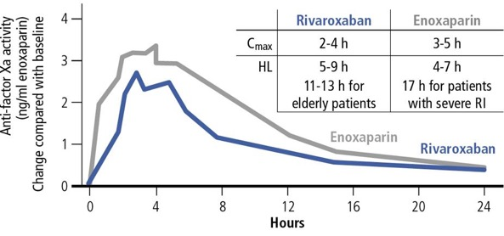
6.3 Pharmacokinetics of Rivaroxaban compared to LMWH
Rivaroxaban and LMWH have very similar pharmacokinetics.

Slide 55

6.4 What is the procedure for switching the time tablets are taken from morning to evening or vice versa?
Observe a 36 h window
Switching from morning to evening:
Switching from evening to morning:
x
x
x
x

Slide 56
6.5 Do patients taking rivaroxaban require regular monitoring visits?
No need for regular monitoring visits, as there is no need to check doses by monitoring the INR and no need for regular Quick’s tests.
Patients on long-term therapy with rivaroxaban:
At regular intervals (e.g. every 3 – 4 months) have renal function monitored and blood tests (anaemia) taken.
Only about a quarter of the questions are regarding issues related to INR monitoring; three-quarters of the questions concern general issues relating to anticoagulation, benefits, risks, etc.

Slide 57
6.6 What information should patients be given about rivaroxaban?
Patients should read the patient information brochure carefully and contact their doctor if they have any questions.
The tablets should be taken as prescribed.
15 and 20 mg tablets should always be taken at mealtimes (does not apply to 10 mg).
It is better to take tablets in the morning to improve compliance.
Tablets should be taken in the evening if the person will be playing any sport during the day with a potential risk of bleeding.
Patients should always carry their patient card with them.
The general practitioner should generally be consulted if another doctor intends to prescribe additional medicines such as analgesics or antirheumatic agents.
If a medical intervention is planned, patients should inform their doctor and dentist in good time that they are being treated with Xarelto.

Slide 58

Determining Plasma Levels

Slide 59
7.1 How can the plasma level of rivaroxaban be measured reliably?
Chromogenic testing of anti-FXa activity (in ng/ml or μg/l), duly calibrated with rivaroxaban-specific calibrators or with a universal LMWH-calibrated anti-Xa assay.
This test is commercially available from several manufacturers. Laboratories which determine heparin levels can usually determine the rivaroxaban level too.
Citrated blood must be taken to determine the level via chromogenic testing of anti-FXa, with the sample then being centrifuged and the plasma stored at -20°C.
Quick’s test is also influenced by rivaroxaban. This test is not recommended for the purpose of determining rivaroxaban levels (low sensitivity and lack of standardisation) and is not suitable for estimating the anticoagulation potency or the risk of bleeding.
Peak level: after 2 – 4h / trough level: after 24h
The time the blood sample is obtained is important, as the effect of rivaroxaban is directly dependent on the plasma concentration!

Slide 60
7.2 Can use of rivaroxaban be monitored via laboratory tests?
Based on the half-life of rivaroxaban, drug levels can be detected up to 36 h after the last intake by using sensitive tests.
All that can be determined, however, is the plasma level at the time the sample was taken (as opposed to levels over a longer period). This is therefore not suitable for monitoring compliance.

Slide 61
7.3 When do rivaroxaban levels need to be determined?
It is appropriate or may be helpful to determine the plasma level of rivaroxaban…
In the event of acute bleeding (particularly for patients with renal insufficiency).
If emergency interventions or operations are required.
For monitoring purposes before elective interventions.
In case of suspicion of intoxication.
If there is a suspicion of accumulation due to renal insufficiency/co-medication
the experts recommend a determination of the trough level.

Slide 62
7.4 What significance does the „rivaroxaban trough level“ have when deciding whether an intervention may be justified?
No clinical investigations have been conducted into rivaroxaban levels and the risk of bleeding or efficacy.
In some cases, the results obtained when the trough level is determined may show relevant differences; therefore we recommend contacting a haemostasis specialist or haematologist in good time.
As a rule, a threshold value of 50 ng/ml is acceptable for standard interventions, whereby the focus should be on the individual and surgical bleeding risk.

Slide 63
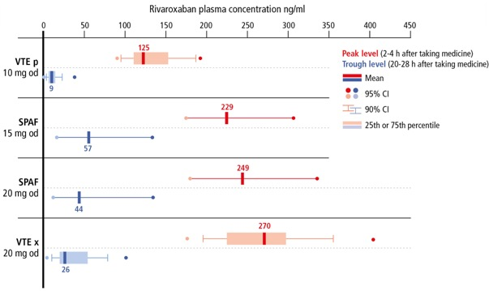
7.5 Rivaroxaban plasma levels (C_{max} and C_{min} in ng/ml or µg/l)

Slide 64
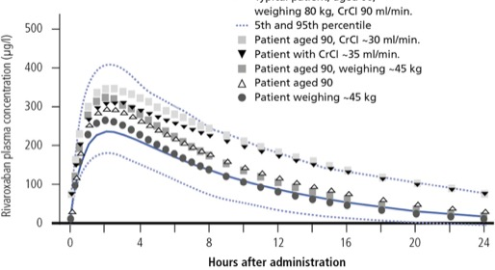
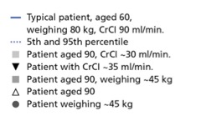
7.5 Simulations of rivaroxaban plasma concentration over time depending on age and renal function
Simulations of rivaroxaban plasma concentration for those taking 20 mg once daily

Slide 65

Perioperative Management

Slide 66
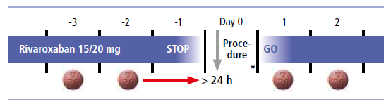
8.1 What is the procedure for any planned intervention?
The patient should be instructed not to take any rivaroxaban on the day before the intervention. Waiting period before intervention > 24 h, in most cases actually longer than 36 h.
A break of 48 h may be considered if the patient is aged over 75 and has impaired renal function.
The patient does not have to stop taking rivaroxaban with interventions where the risk of bleeding is very low (e.g.: dental hygiene, periodontal interventions, preservation interventions, crowns and bridges, etc.). The timing of such interventions should aim to leave a 12-24 h window between the time of last intake and the intervention.

Slide 67
8.2 What is the procedure when a patient is bleeding and known to be taking rivaroxaban?
Minor bleeding
Symptomatic treatment (e.g. mechanical compression, local use of tranexamic acid)
Moderate and severe bleeding
Rivaroxaban should be suspended until the situation is stable and there is no further risk of bleeding
Referral to hospital
Initiation of emergency measures
Clarification regarding the size of the rivaroxaban dose and when it was taken
In emergency situations coagulation analyses (Quick‘s test, aPTT, chromogenic anti-Xa test) should be performed and the rivaroxaban level determined
Surgical haemostasis where necessary and possible, fluid replacement (including administration of plamsa) and circulatory support
Consider tranexamic acid or desmopressin (DDAVP)
If these measures are insufficient to control bleeding, the use of Ondexxya® (andexanet alfa, see question 8.3) or prothrombin complex concentrates, FEIBA® or FVIIa (NovoSeven®) may be considered, especially if a relevant rivaroxaban plasma level has been detected (> 100 ng/ml).

Slide 68
8.3 Is there an antidote?
Ondexxya® (Andexanet alfa) is a recombinant modified factor Xa for antagonisation of direct factor Xa inhibitors. It has time-limited approval from Swissmedic in the following indication: For use in adult patients treated with a direct factor Xa (FXa) inhibitor (apixaban or rivaroxaban) if anticoagulation needs to be suspended because of life-threatening or uncontrollable bleeding.
The use of activated charcoal may be considered where tablets have been taken (overdose) within the previous 8 hours.
Given the short half-life of rivaroxaban, the effect diminishes quickly like with LMWH (after 16 – 24 h only a minor influence on haemostasis would still be expected).
Absorption of rivaroxaban is subject to saturation: the rivaroxaban concentration in plasma only increases negligibly at oral doses > 50 mg (ceiling effect).

Slide 69
8.4 What coagulation tests are changed/influenced when a patient is being treated with rivaroxaban?
How rivaroxaban may influence the results of coagulation tests
15/20 mg of rivaroxaban taken | Influence on test at rivaroxaban peak 2–8 h after taking medicine | Influence on test at trough level 16–18 h after taking medicine
Quick’s (%) |  | Little influence
INR (laboratory, plasma) | ⬆ | Little influence
INR (CoaguChek, capillary) | ⬆ | Little influence
aPTT |  | Little influence
Coagulation factors (II, V, VII, FVIII, IX, X, XI) |  | Little influence
Chromogenic anti-Xa test (for heparins, LMWH, and fondaparinux) | ⬆⬆ | 
ROTEM (intem/extem CT) |  | Little influence
ROTEM (MCF, intem CFT, Alpha) | Little influence | No influence
D-dimer#, fibrinogen, FXIII, TT | No influence | No influence
Value measured reduced by rivaroxaban (below normal range)
Value measured significantly increased by rivaroxaban (way above normal range)
Value measured increased by rivaroxaban (above normal range)
#Long-term anticoagulation lowers the patient’s D-dimer level.

Slide 70
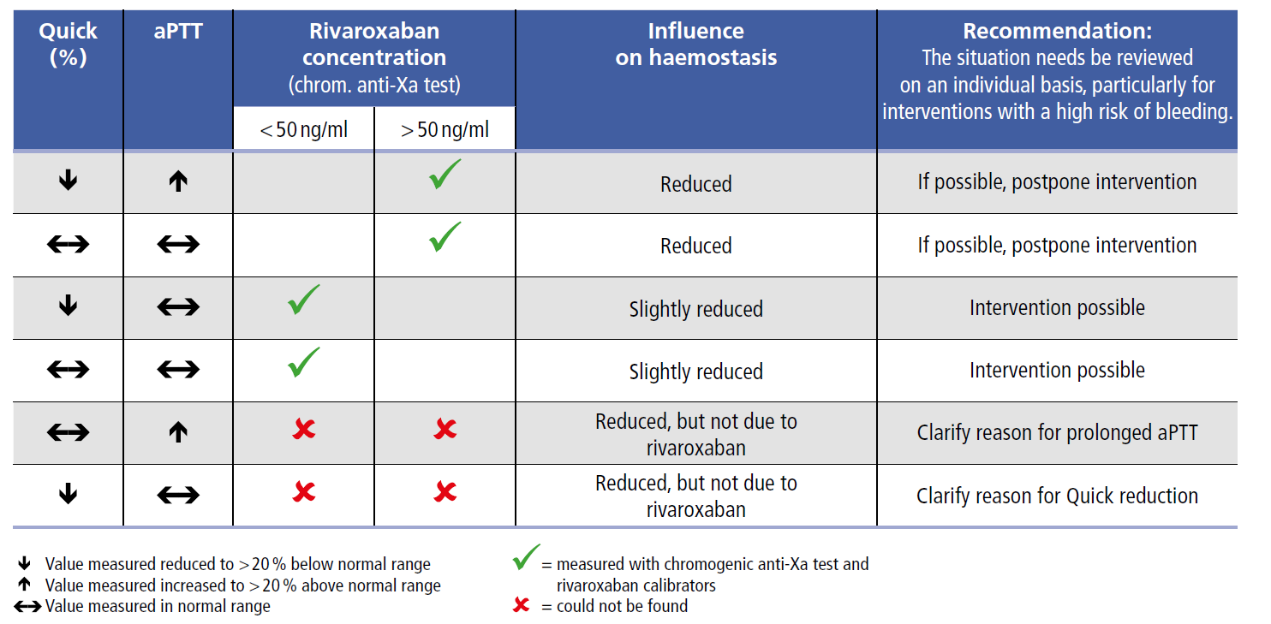
8.5 How must the results of coagulation tests be interpreted for a patient being given rivaroxaban?
Relationship between global coagulation tests and the plasma level of rivaroxaban

Slide 71
THANK YOU for your attention

Slide 72
Authors
Prof. Dr. Dr. W.A. Wuillemin, Chairman; Kantonsspital Luzern, Department of Haematology and Central Haematology Laboratory
Prof. Dr. A. Angelillo-Scherrer; Inselspital Bern, Bern University, University Clinic for Haematology and Central Haematology Laboratory
Prof. Dr. L. A. Alberio; CHUV Lausanne, Central Haematology Departement and Laboratory
Prof. Dr. M. Albisetti, University Children’s Hospital Zurich, Division of Haematology,
PD Dr. L.M. Asmis; Zentrum für perioperative Thrombose und Hämostase Zürich
Prof. Dr. W. Korte; Zentrum für Labormedizin St. Gallen, Centre for Haemostasis and Haemophilia
Dr. A. Mendez; Kantonsspital Aarau, Centre for Laboratory Medicine
PD Dr. H. Stricker; Ospedale La Carità, Locarno, Caposervizio Angiologia
Dr. J.D. Studt; Universitätsspital Zürich, Clinic for Haematology
Prof. Dr. D.A. Tsakiris; Universitätsspital Basel, Diagnostic Haematology
The RivaMoS studies are supported by Bayer (Schweiz) AG. The content of this statement reflects the opinions of the members of the working party.

Slide 73
Abbreviations
aPTT = activated partial thromboplastin time
ASA = acetylsalicylic acid
AUC = are under the curve
DOAC = direct oral anticoagulants
DVT = deep vein thrombosis
eGFR = estimated glomerular filtration rate
EMA = European Medicines Agency
FDA = US Food and Drug Administration
Hb = haemoglobin
HL = half-life
INR = international Normalized Ratio
LMWH = low-molecular-weight heparin
nvAF = non valvular atrial fibrillation
OAC = oral anticoagulation
PAI = platelet aggretgation inhibitors
PCC = Prothrombin complex concentrate (like e.g. Beriplex® or Prothromplex®)
PCI = percutaneous coronary intervention
PE = pulmonary embolism
P-gp = P-glycoprotein
PT = prothrombin time
TAVI = transcatheter aortic valve implantation
TIA = transient ischemic attack
TTR = time in therapeutic range
VKA = vitamin K-antagonist (Marcoumar®, Sintrom®)
VTE = veinous thromboembolic event

Slide 74
Abbreviated Summary of Product Characteristics Xarelto® (rivaroxaban)
Abbreviated Summary of Product Characteristics of Xarelto® (rivaroxaban): Direct factor Xa inhibitor C: Film-coated tablets with 10, 15 and 20 mg rivaroxaban. I: Adults: a) Thrombosis prophylaxis for major orthopaedic procedures on the lower extremities, such as hip or knee prostheses. b) Treatment of pulmonary embolism (PE) and deep vein thrombosis (DVT) as well as prophylaxis of recurring DVT and PE. c) Prophylaxis of stroke and systemic embolism in patients with nonvalvular atrial fibrillation; Pediatric population (body weight ≥ 30kg): Treatment of venous thromboembolism (VTE) after initial parenteral anticoagulation for the prophylaxis of recurrent VTE. D: Adults: a) 10mg 1x/day b) 15mg 2x/day for the first 21 days, followed by 20mg 1x/day; from month 7: 20mg 1x/day or 10mg 1x/day based on an individual benefit-risk evaluation c) 20mg 1x/day; for CrCl of 15-49ml/min: 15mg 1x/day. Take 15mg and 20mg with food. Pediatric population: For body weight ≥30kg to <50kg: 15mg 1x/day. For body weight ≥50kg: 20mg 1x/day. CI: hypersensitivity to any ingredients, acute bacterial endocarditis, clinically significant active bleeding, severe liver disease/hepatic impairment (HI) with a comparatively higher risk of bleeding; mild HI in combination with coagulopathy, renal impairment (RI) requiring dialysis, acute gastrointestinal (GI) ulcers or ulcerative GI disorders, pregnancy, lactation. W: concomitant medication (cf. "IA"); artificial heart valves; concomitant administration of drugs affecting haemostasis. PM: RI (CrCl 15-29ml/min) or RI in combination with drugs increasing the Xarelto® plasma level, increased risk of uncontrolled bleeding and haemorrhagic diathesis, recent haemorrhagic stroke, intracranial or intracerebral haemorrhage, recent GI ulcers/ulcerative disorders, severe uncontrolled hypertension, vascular retinopathy, intraspinal and intracerebral vascular anomalies, recent brain, spinal or eye surgery, medical history of bronchiectasis or pulmonary bleeding, spinal anaesthesia or puncture, discontinue at least 24 hours before invasive/surgical procedures, APS, individual cases of agranulocytosis and SJS were reported. Common ADRs: bleeding, anaemia, dizziness, headache, eye haemorrhage, haematoma, epistaxis, haemoptysis, nausea, obstipation, diarrhoea, elevated liver enzymes (ASAT, ALAT), pruritus, rash, pain in the extremities, fever, peripheral oedema, asthenia. IA: Strong CYP 3A4 + P-gp inhibitors (ritonavir, ketoconazole), strong CYP 3A4 + P-gp inducers (rifampicin, carbamazepine, phenobarbital, St. John's wort), drugs influencing haemostasis. Pack sizes: 10 & 30 x 10 mg film-coated tablets; 14, 28 & 98 x 15 mg or 20 mg film-coated tablets. (B), covered by health insurance companies (refer to Limitatio). Additional information available from www.swissmedicinfo.ch. Distribution: Bayer (Schweiz) AG, Uetlibergstr. 132, 8045 Zurich, Switzerland. MA-M_RIV-CH-0265-1_10.2022

Slide 75
Abbreviated Summary of Product Characteristics Xarelto® junior (rivaroxaban)
Abbreviated Summary of Product Characteristics of Xarelto® junior (rivaroxaban): Direct factor Xa inhibitor C: Granules for the preparation of a suspension with 1mg/ml rivaroxaban. I: Pediatric population (body weight < 30kg): Treatment of venous thromboembolism (VTE) after initial parenteral anticoagulation for the prophylaxis of recurrent VTE. D: depending on body weight, according table 1 in the profession information. CI: hypersensitivity to any ingredients, acute bacterial endocarditis, clinically significant active bleeding, severe liver disease/hepatic impairment (HI) with a comparatively higher risk of bleeding; mild HI in combination with coagulopathy, renal impairment (RI) requiring dialysis, acute gastrointestinal (GI) ulcers or ulcerative GI disorders, pregnancy, lactation. W: concomitant medication (cf. "IA"); artificial heart valves; concomitant administration of drugs affecting haemostasis. PM: birth before 37th week of pregnancy or body weight < 2.6kg or (breast) fed <10 days (no data), moderate or severe RI or RI in combination with drugs increasing the Xarelto® plasma level, increased risk of uncontrolled bleeding and haemorrhagic diathesis, recent haemorrhagic stroke, intracranial or intracerebral haemorrhage, recent GI ulcers/ulcerative disorders, severe uncontrolled hypertension, vascular retinopathy, intraspinal and intracerebral vascular anomalies, recent brain, spinal or eye surgery, medical history of bronchiectasis or pulmonary bleeding, spinal anaesthesia or puncture, discontinue at least 24 hours before invasive/surgical procedures, APS, individual cases of agranulocytosis and SJS were reported. Common ADRs: bleeding, anaemia, dizziness, headache, eye haemorrhage, haematoma, epistaxis, haemoptysis, nausea, obstipation, diarrhoea, elevated liver enzymes (ASAT, ALAT), pruritus, rash, pain in the extremities, fever, peripheral oedema, asthenia. IA: Strong CYP 3A4 + P-gp inhibitors (ritonavir, ketoconazole), strong CYP 3A4 + P-gp inducers (rifampicin, carbamazepine, phenobarbital, St. John's wort), drugs influencing haemostasis. Pack sizes: granules for the preparation of a suspension (50ml and 100ml), supply category B. Additional information available from www.swissmedicinfo.ch. Distribution: Bayer (Schweiz) AG, Uetlibergstr. 132, 8045 Zurich, Switzerland. MA-M_RIV-CH-0266-1_10.2022

Slide 76
Abbreviated Summary of Product Characteristics Xarelto® vascular (rivaroxaban)
Abbreviated Summary of Product Characteristics of Xarelto® vascular (rivaroxaban): Direct factor Xa inhibitor C: Film-coated tablets with 2.5 mg rivaroxaban I: In combination with acetylsalicylic acid (ASA) for the prevention of severe atherothrombotic events (stroke, myocardial infarction, cardiovascular death) in patients with coronary heart disease or manifest peripheral arterial vascular disease and a high risk of ischemic events. D: 2.5 mg 2x/day CI: hypersensitivity to any ingredients, acute bacterial endocarditis, clinically significant active bleeding, previous hemorrhagic / lacunar insult, ischemic stroke (<1 month), severe liver disease/hepatic impairment (HI) with a comparatively high risk of bleeding; mild HI in combination with coagulopathy, severe heart failure (NYHA III-IV, LVEF ≤30%), renal impairment (RI) requiring dialysis, acute gastrointestinal (GI) ulcers or ulcerative GI disorders, pregnancy, lactation. W: concomitant medication (cf. "IA"); <18 years; artificial heart valves; drugs affecting haemostasis. PM: RI (CrCl 15-29ml/min), increased risk of uncontrolled bleeding, congenital or haemorrhagic diathesis, intracranial or intracerebral haemorrhage, recent GI ulcers/ulcerative disorders, severe uncontrolled hypertension, vascular retinopathy, intraspinal and intracerebral vascular anomalies, recent brain, spinal or eye surgery, medical history of bronchiectasis or pulmonary bleeding, spinal anaesthesia or puncture, discontinue at least 24 hours before invasive/surgical procedures, concomitant administration of drugs influencing haemostasis, APS, individual cases of agranulocytosis and SJS were reported. Common ADRs: bleeding, anaemia, dizziness, headache, eye haemorrhage, haematoma, epistaxis, haemoptysis, nausea, obstipation, diarrhoea, elevated liver enzymes (ASAT, ALAT), pruritus, rash, pain in the extremities, fever, peripheral oedema,asthenia. IA: Strong CYP 3A4 + P-gp inhibitors (ritonavir, ketoconazole), strong CYP 3A4 + P-gp inducers (rifampicin, carbamazepine, phenobarbital, St. John's wort), drugs influencing haemostasis. Pack sizes: 28, 56 & 196 x 2.5 mg film-coated tablets. (B), covered by health insurance companies (refer to Limitatio). Additional information available from www.swissmedicinfo.ch. Distribution: Bayer (Schweiz) AG, Uetlibergstr. 132, 8045 Zurich, Switzerland. MA-M_RIV-CH-0090-1_02.2022

