Slide 1
Deep and Durable Prostate-specific Antigen Response to Darolutamide with Androgen Deprivation Therapy and Docetaxel, and Association with Clinical Outcomes for Patients with High- or Low-volume Metastatic Hormone-sensitive Prostate Cancer:
Analyses of the Randomized Phase 3 ARASENS Study
Bayer (Schweiz) AG Uetlibergstrasse 132 8045 Zürich www.bayer.com PP-NUB-CH-0282-1_06.2024

Slide 2
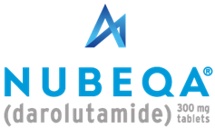
Disclaimer
The following has been developed in response to an unsolicited request for slides for a scientific presentation, is for scientific information purposes only and does not represent promotion of a non-licensed indication
Darolutamide is approved in Switzerland in combination with androgen deprivation therapy (ADT), for the treatment of adult patients with non metastatic castration resistant prostate cancer (NMCRPC) who are at high risk of developing metastases (especially PSADT ≤10 months).*
Darolutamide, in combination with docetaxel and androgen deprivation therapy (ADT), is indicated for the treatment of adult patients with metastatic hormone sensitive prostate cancer ( mHSPC ) for whom docetaxel therapy is indicated.*
This presentation may not be duplicated or distributed
Bayer (Schweiz) AG does not take any responsibility for any misuse of this information
* Respective professional information on www.swissmedicinfo.ch

Slide 3
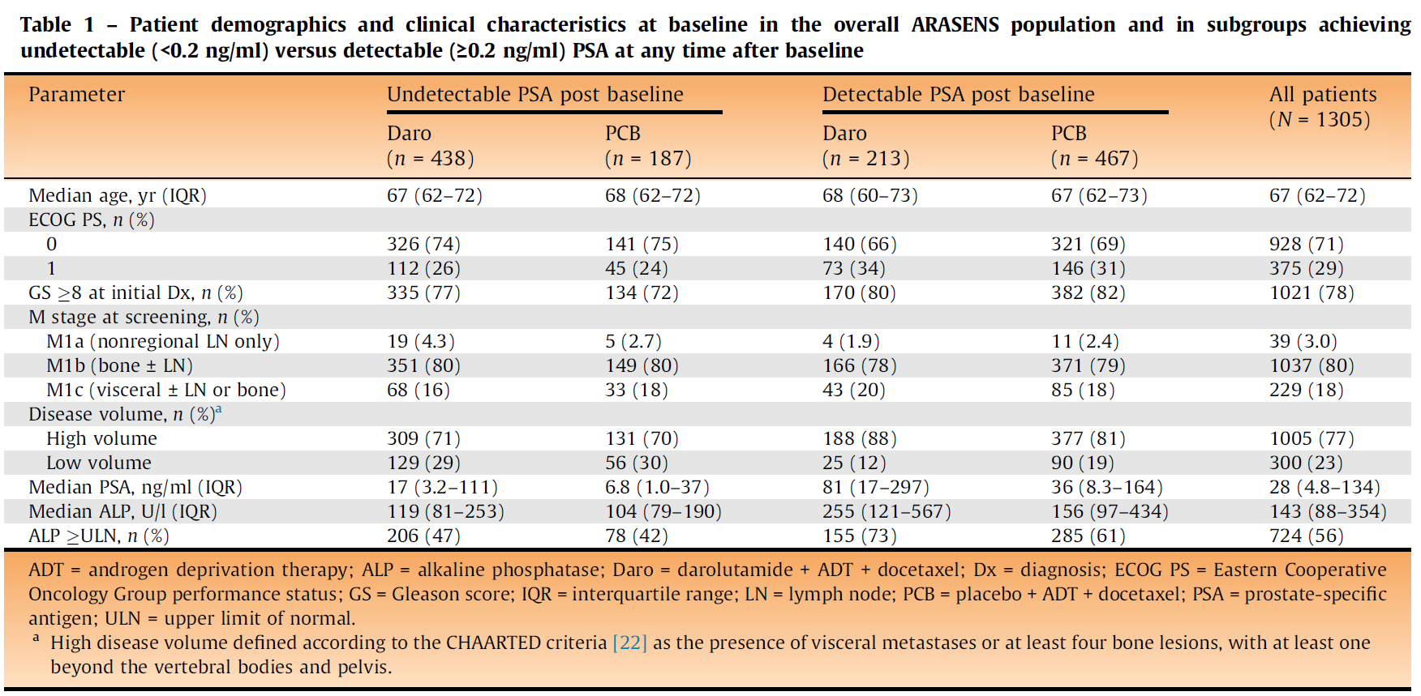
ARASENS: PSA Response and Association with Clinical Outcomes by Volume and Risk subgroups
3. Saad F, et. al Eur Urol. 2024 Apr 20:S0302-2838(24)02264-4. doi: 10.1016/j.eururo.2024.03.036. PMID: 38644146.

Slide 4
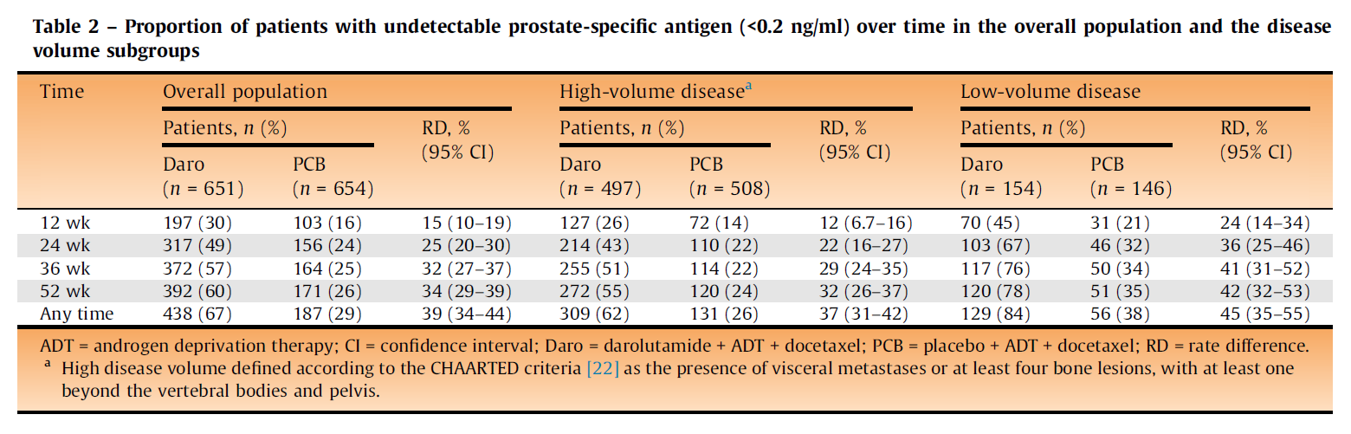
ARASENS: PSA Response and Association with Clinical Outcomes by Volume and Risk subgroups

Slide 5
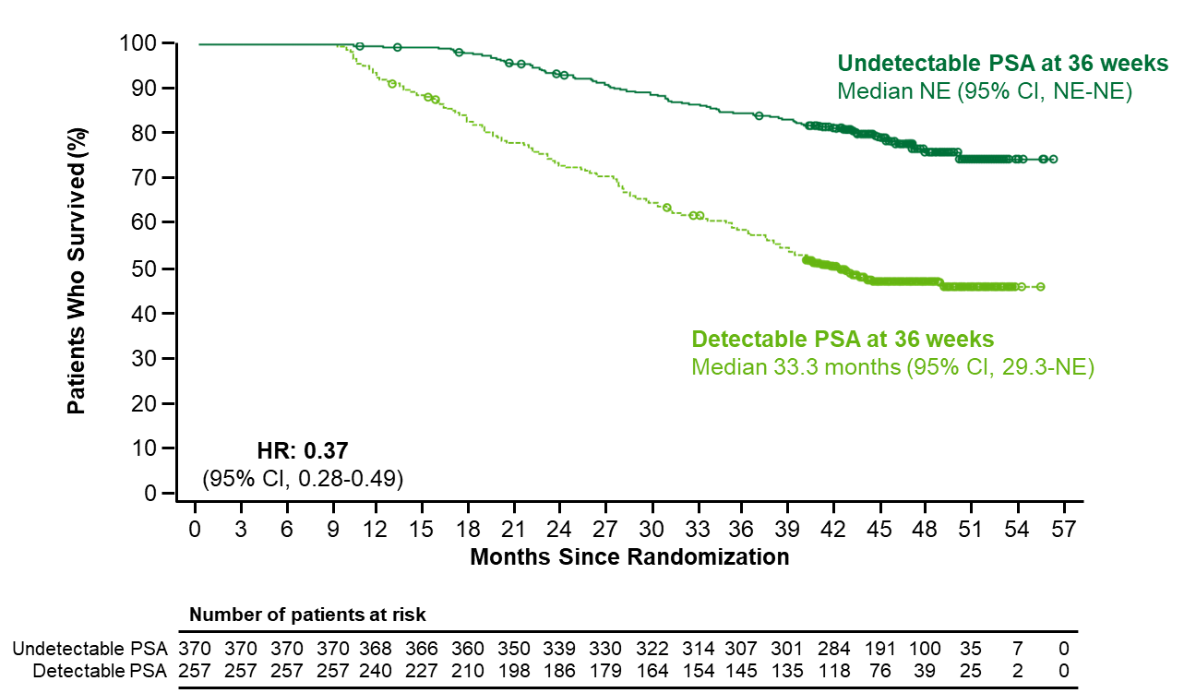
ARASENS: PSA Response in Patients With mHSPC – Overall Population
Overall Survival:
Undetectable vs Detectable PSA at 36 Weeks
(darolutamide + ADT with docetaxel group)
More than twice the number of patients in the darolutamide arm achieved undetectable PSA at any time after baseline compared to placebo
Undetectable PSA at 36 weeks was associated with improved overall for patients treated with darolutamide + ADT with docetaxel
ªPost hoc landmark analyses using Kaplan-Meier estimates. Undetectable PSA was defined as PSA <0.2 ng/mL.
ADT, androgen deprivation therapy; ALP, alkaline phosphatase; mHSPC, metastatic hormone-sensitive prostate cancer; PSA, prostate-specific antigen.
2. Saad F, et al. Presented at American Society of Clinical Oncology; June 3-7, 2022; Chicago, IL, USA. Abstract 5078. 3. Saad et. al. Eur Urol. 2024 Apr 20:S0302-2838(24)02264-4. doi: 10.1016/j.eururo.2024.03.036.

Slide 6
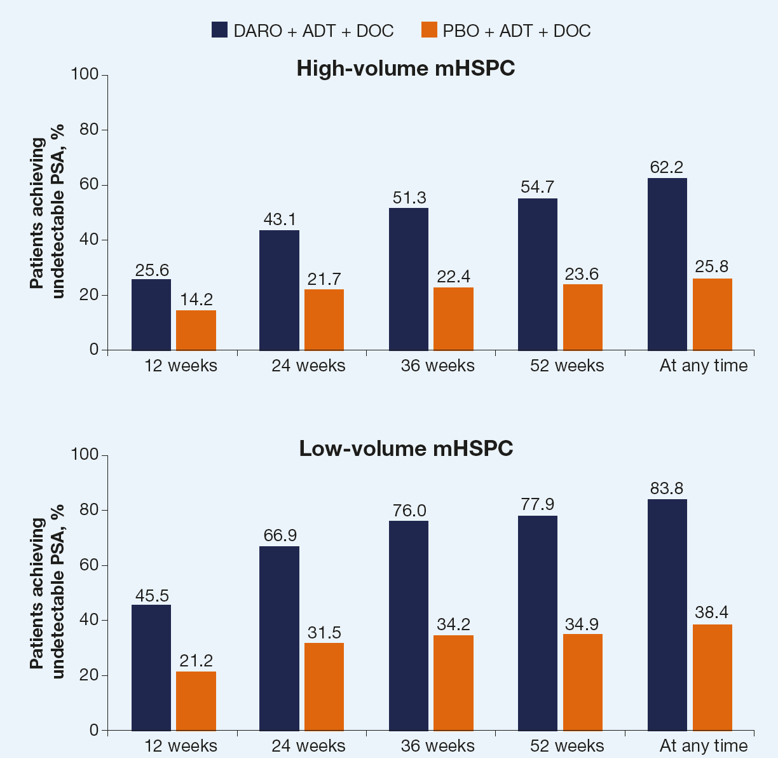




ARASENS: PSA Response and Association with Clinical Outcomes by Volume and Risk subgroups
Undetectable Rates:
83.4% of patients with low‑volume disease achieved undetectable PSA at any time with darolutamide + ADT + docetaxel
62.2% of patients with high‑volume disease achieved undetectable PSA at any time with darolutamide + ADT + docetaxel
Similarly, darolutamide achieved higher rates of undetectable PSA at any time vs. placebo in high-risk (63.1% vs 24.1%) and low‑risk (76.9% vs 39.2%) subgroups
PSA90 Response: Patients with high- and low- volume disease receiving darolutamide demonstrated rapid PSA90 response within 12 weeks, with >80% achieving PSA90 at 24 weeks and beyond
Undetectable PSA by disease volume subgroups

Slide 7
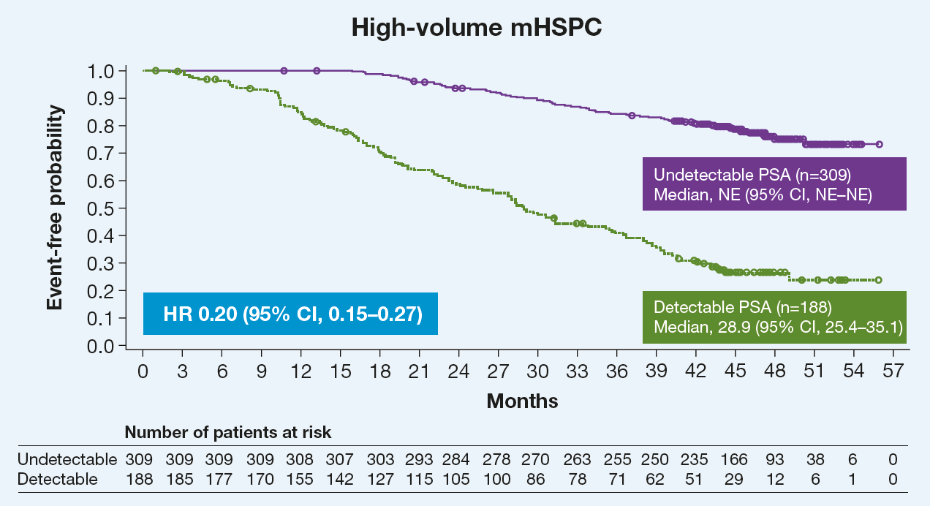
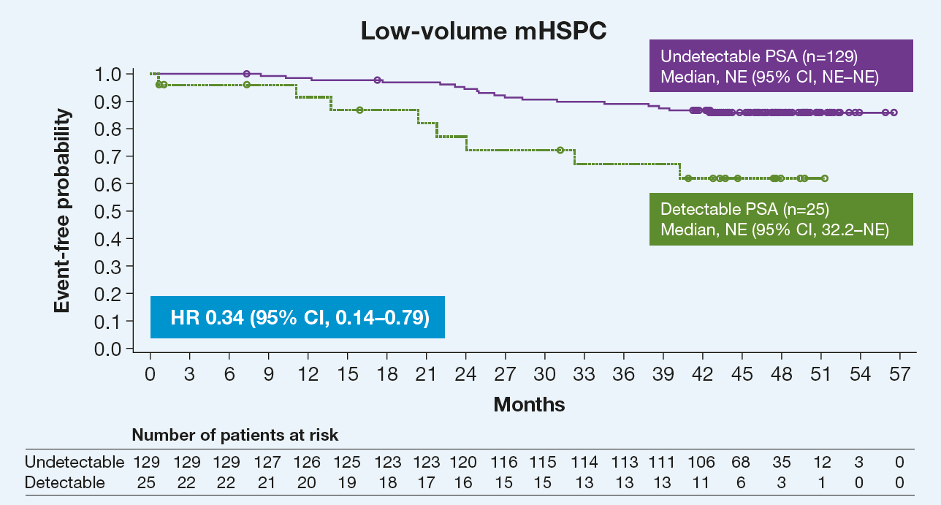
ARASENS: PSA Response and Association with Clinical Outcomes by Volume and Risk subgroups
Association between achievement of undetectable PSA at any time and OS in darolutamide-treated patients by disease volume subgroups
High-risk patients: median OS was not reached in patients with undetectable PSA (n=285) vs 28.0 months for those with detectable PSA (n=167) (HR 0.19; 95% CI, 0.14-0.26)
Low-risk patients: median OS was not reached in patients with undetectable PSA (n=153) vs 44.2 months for those with detectable PSA (n=46) (HR 0.30; 95% CI, 0.16-0.55)

Slide 8
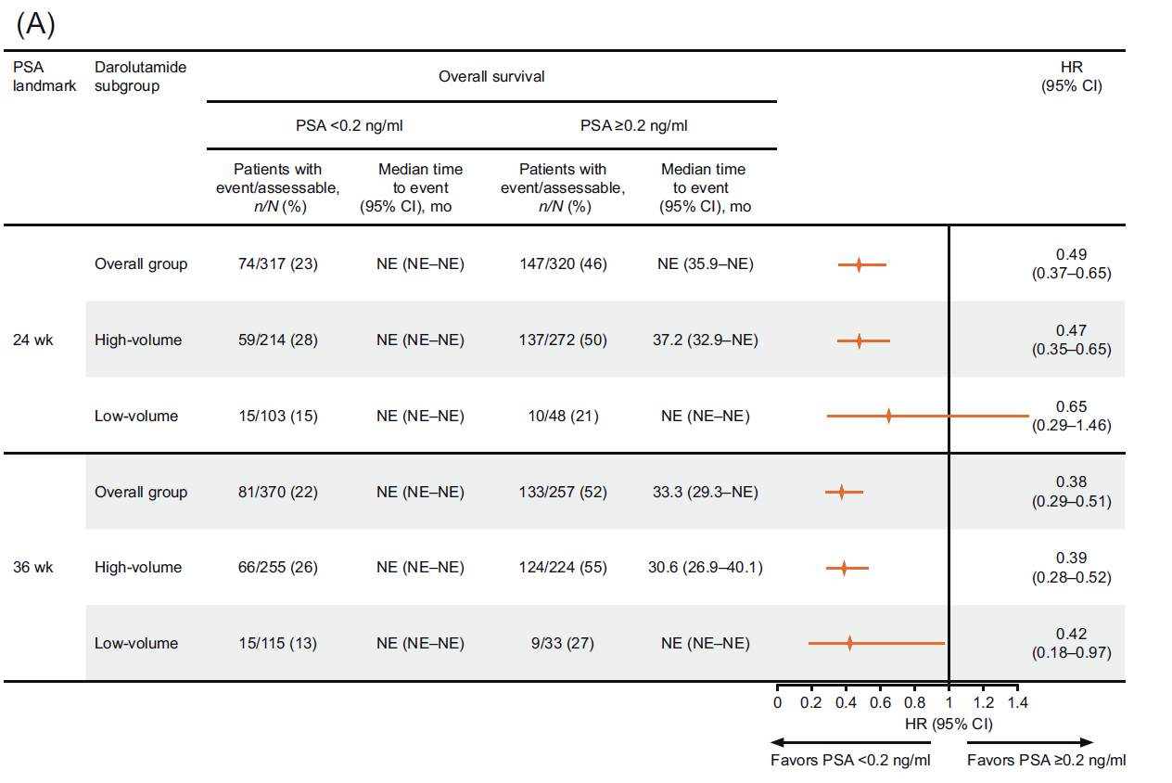
ARASENS: Association of PSA response and Overall survival
Fig. 2 – Association of undetectable PSA (<0.2 ng/ml) versus detectable PSA (≥0.2 ng/ml) with efficacy outcomes in the darolutamide group: (A) overall survival;
(B) time to CRPC; and (C) time to PSA progression. High-volume disease is defined according to the CHAARTED criteria as the presence of visceral
metastases or at least four bone lesions with at least one beyond the vertebral bodies and pelvis. CI = confidence interval; CRPC = castration-resistant prostate
cancer; HR = hazard ratio; NE = not estimable; PSA = prostate-specific antigen.
3. Saad et. al. Eur Urol. 2024 Apr 20:S0302-2838(24)02264-4. doi: 10.1016/j.eururo.2024.03.036

Slide 9
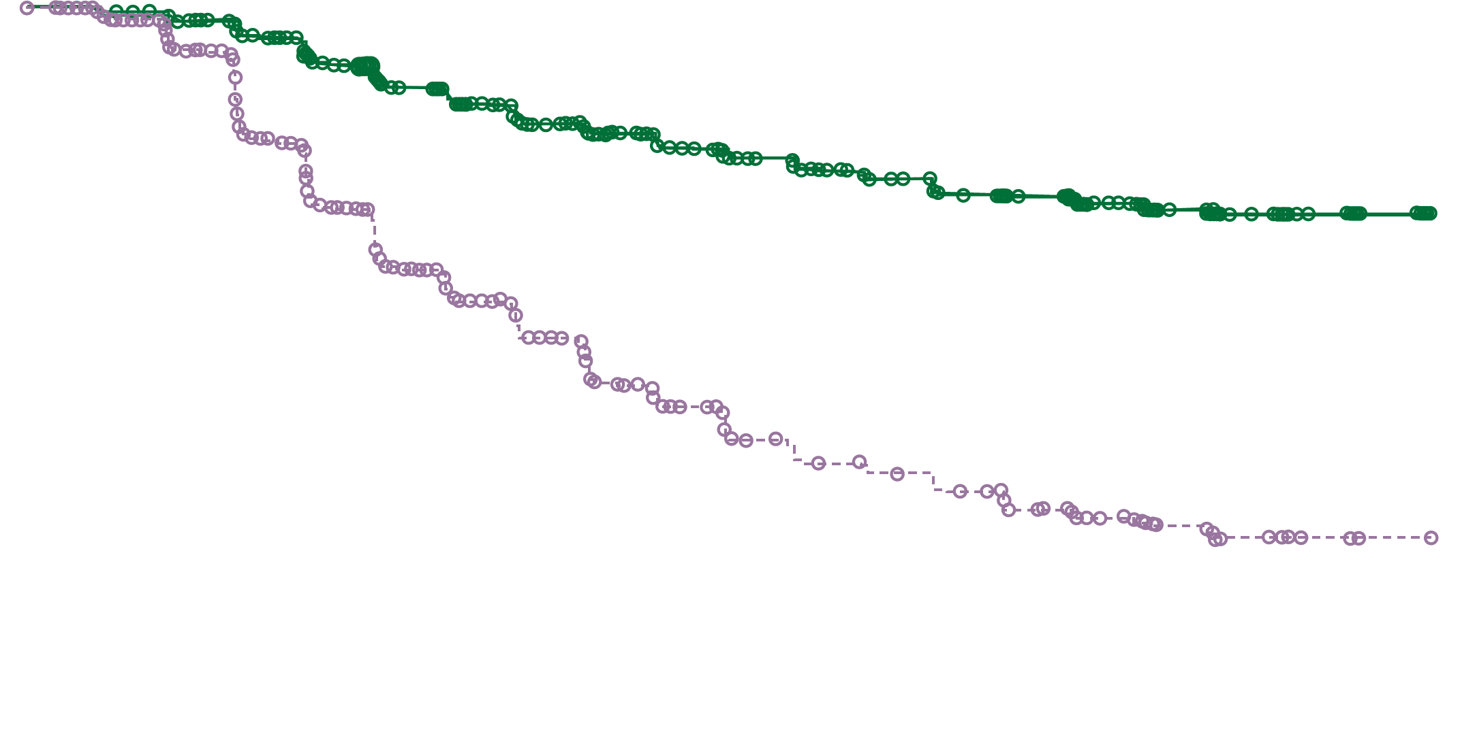
ARASENS: Time to PSA Progressionª - Overall Population
100
90
Darolutamide + ADT + Docetaxel
Median NE (95% CI, NE-NE)
80
70
60
Patients Who Did Not Have
PSA Progression, %
50
40
30
Placebo + ADT + Docetaxel
Median 22.4 months (95% CI, 22.1-27.6)
20
HR: 0.26
(95% CI, 0.21-0.31)
P<0.0001
10
0
0
3
6
9
12
15
18
21
24
27
30
33
36
39
42
45
48
51
54
57
Months Since Randomization
Number of patients at risk
Darolutamide
651
608
585
552
513
477
449
416
393
373
358
339
319
295
214
139
55
17
5
0
Placebo
654
605
542
432
354
293
253
220
186
167
144
132
114
104
77
38
14
4
1
0
ªExploratory analyses included time to PSA progression (≥25% increase from PSA nadir [lowest at or after baseline] and PSA increase ≥2 ng/mL 12 or more weeks from nadir [both confirmed by a second value ≥ 3 weeks later]) and undetectable PSA (<0.2 ng/mL for 2 samples ≥3 weeks apart) at 24, 36, and 52 weeks and any time during treatment.
ADT, androgen deprivation therapy; CI, confidence interval; mHSPC, metastatic hormone-sensitive prostate cancer; NE, not estimable; PSA, prostate-specific antigen.
2. Saad F, et al. Presented at American Society of Clinical Oncology; June 3-7, 2022; Chicago, IL, USA. Abstract 5078. 3. Saad et. al. Eur Urol. 2024 Apr 20:S0302-2838(24)02264-4. doi: 10.1016/j.eururo.2024.03.036

Slide 10
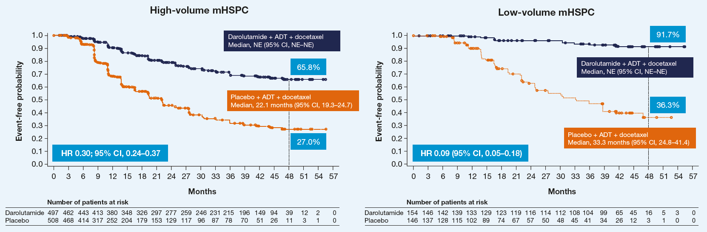
ARASENS: Time to PSA Progression in High- and Low‑Volume Patients
Time to PSA progression by disease volume subgroups
Patients who received darolutamide and achieved undetectable PSA had improved time to PSA progression vs those who did not achieve undetectable PSA independent of the disease volume
PSA progression-free rates at 4 years were higher with darolutamide vs placebo for high-volume (65.8% vs 27.0%) and low-volume (91.7% vs 36.3%) disease

Slide 11
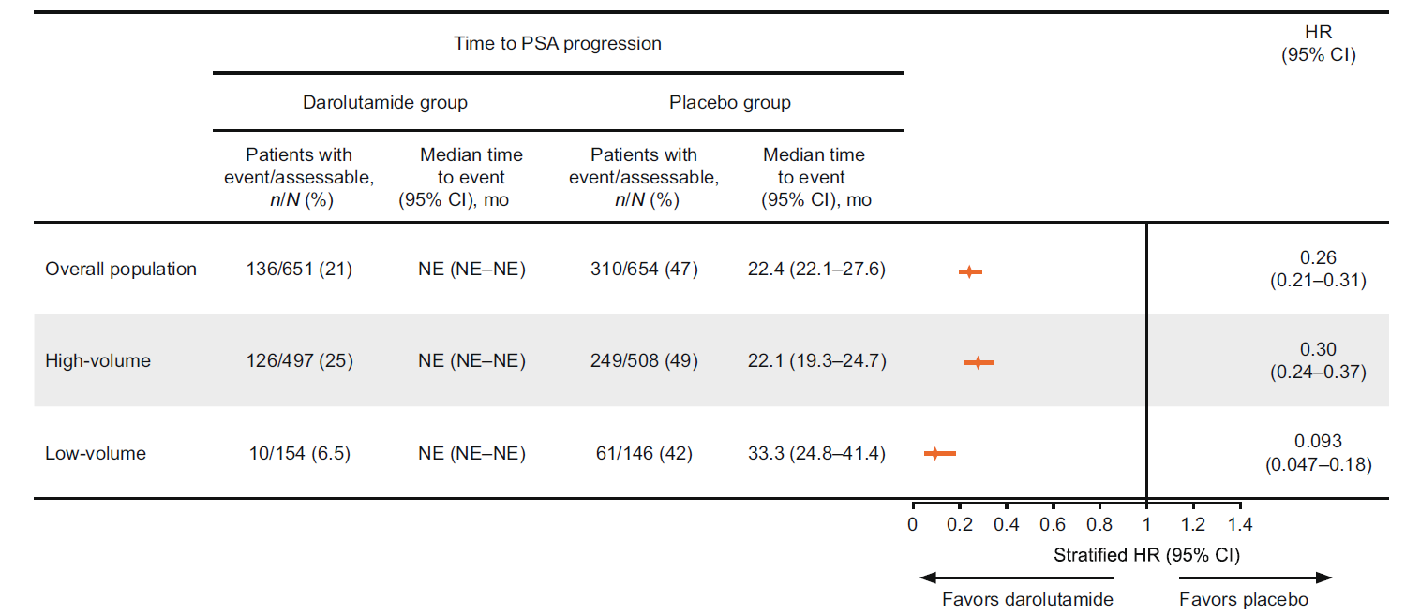
ARASENS: Time to PSA Progression
Fig. 1 – Time to PSA progression in the disease volume subgroups. Data cutoff October 25, 2021. High-volume disease is defined according to the CHAARTED criteria as the presence of visceral metastases or at least four bone lesions, with at least one beyond the vertebral bodies and pelvis.
ADT = androgen deprivation therapy; CI = confidence interval; HR = hazard ratio; NE = not estimable; PSA = prostate-specific antigen.
(adapted from Saad et al. Eur Urol 2024)
3. Saad et. al. Eur Urol. 2024 Apr 20:S0302-2838(24)02264-4. doi: 10.1016/j.eururo.2024.03.036

Slide 12
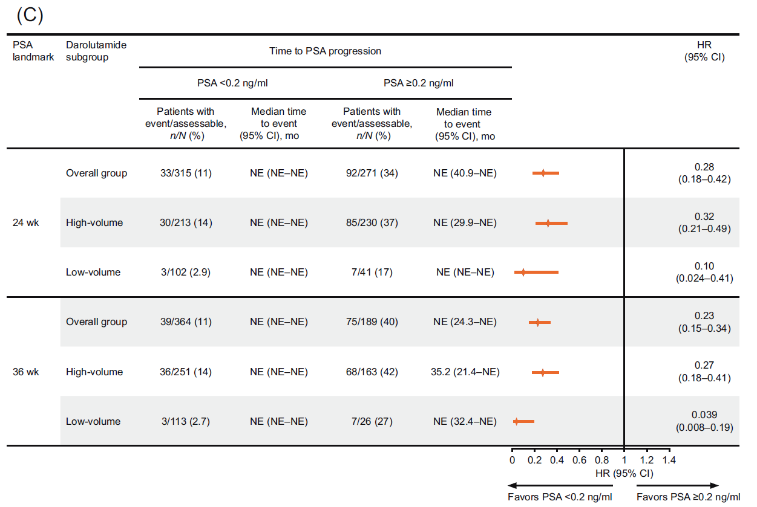
ARASENS: Association of PSA response and Time to PSA progression
Fig. 2 – Association of undetectable PSA (<0.2 ng/ml) versus detectable PSA (≥0.2 ng/ml) with efficacy outcomes in the darolutamide group: (A) overall survival;
(B) time to CRPC; and (C) time to PSA progression. High-volume disease is defined according to the CHAARTED criteria as the presence of visceral
metastases or at least four bone lesions with at least one beyond the vertebral bodies and pelvis. CI = confidence interval; CRPC = castration-resistant prostate
cancer; HR = hazard ratio; NE = not estimable; PSA = prostate-specific antigen.
3. Saad et. al. Eur Urol. 2024 Apr 20:S0302-2838(24)02264-4. doi: 10.1016/j.eururo.2024.03.036

Slide 13
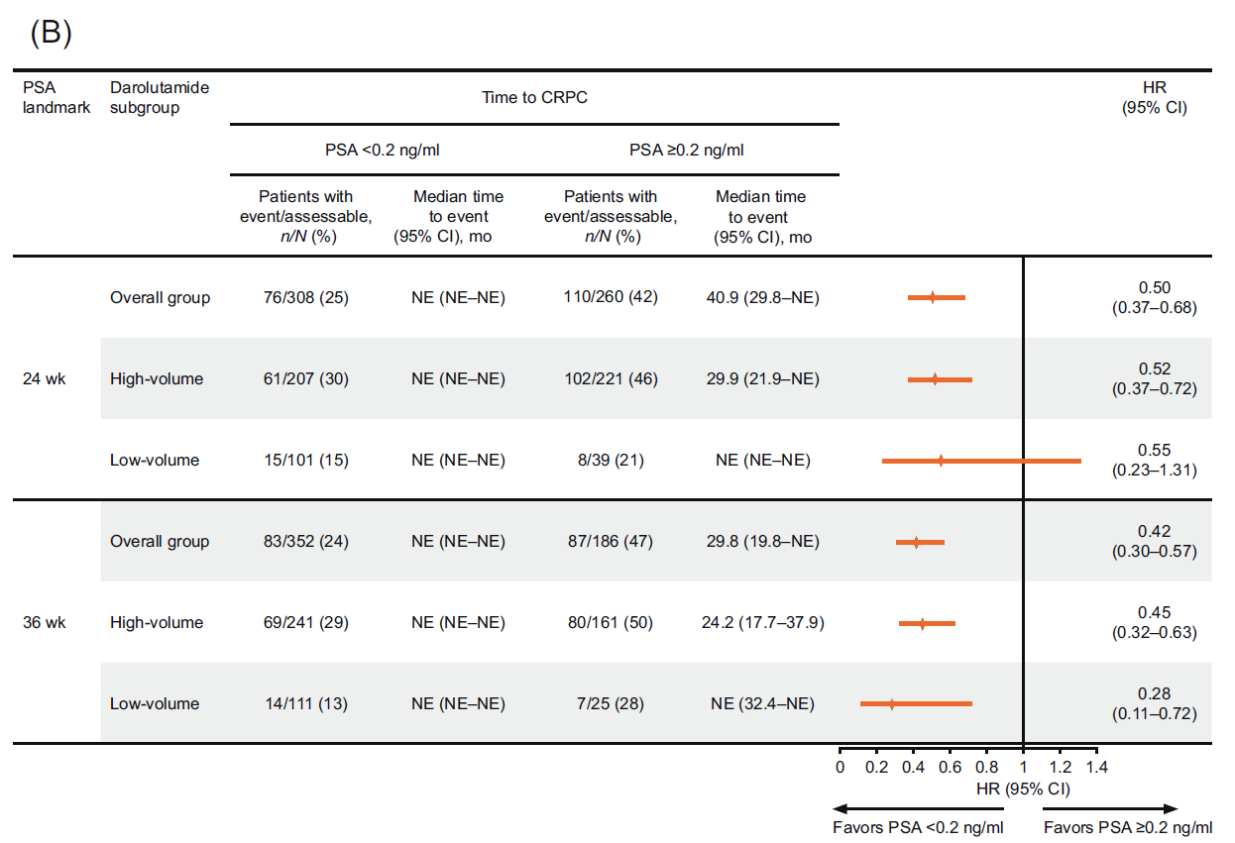
ARASENS: Association of PSA response and Time to CRPC
Fig. 2 – Association of undetectable PSA (<0.2 ng/ml) versus detectable PSA (≥0.2 ng/ml) with efficacy outcomes in the darolutamide group: (A) overall survival;
(B) time to CRPC; and (C) time to PSA progression. High-volume disease is defined according to the CHAARTED criteria as the presence of visceral
metastases or at least four bone lesions with at least one beyond the vertebral bodies and pelvis. CI = confidence interval; CRPC = castration-resistant prostate
cancer; HR = hazard ratio; NE = not estimable; PSA = prostate-specific antigen.
3. Saad et. al. Eur Urol. 2024 Apr 20:S0302-2838(24)02264-4. doi: 10.1016/j.eururo.2024.03.036

Slide 14
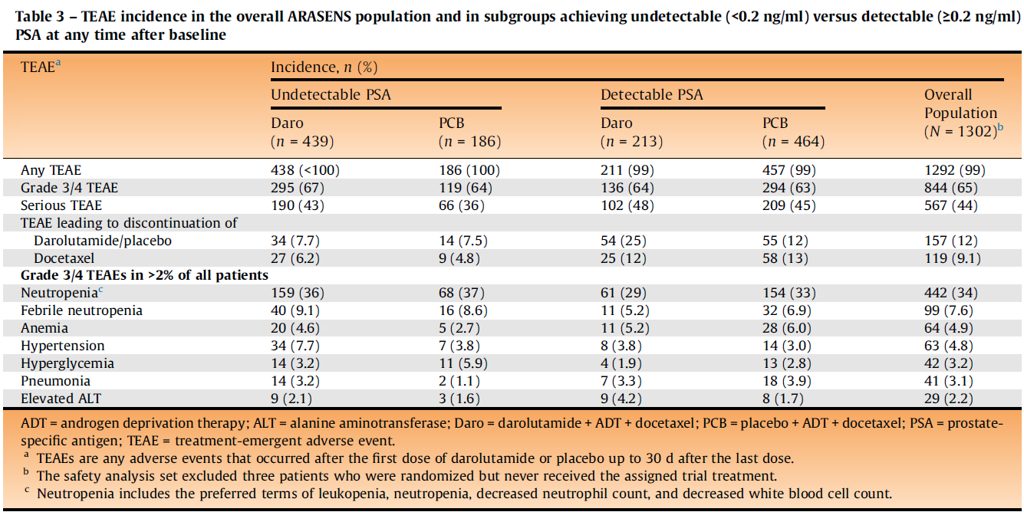
ARASENS: PSA response and Safety
3. Saad et. al. Eur Urol. 2024 Apr 20:S0302-2838(24)02264-4. doi: 10.1016/j.eururo.2024.03.036

Slide 15
ARASENS: PSA Response - Overall Population
PSA decrease from baseline | Darolutamide with ADT + Docetaxel² | ADT + Docetaxel⁵
<0.2 ng/mL (percent of patients)
Darolutamide + ADT + Docetaxel
Docetaxel + ADT
Placebo + ADT + Docetaxel
Placebo + ADT
*These studies show different clinical scenarios, include different patient populations, and are not intended to compare therapies.

Slide 16
PSA Responses of ARI Agents in Patients with mHSPC
PSA decrease from baseline | Darolutamide^{2,3} | Enzalutamide⁶ | Apalutamide^{7,8}
<0.2 ng/mL (percent of patients)
Darolutamide + ADT + Docetaxel
Enzalutamide + ADT
Apalutamide + ADT
Placebo + ADT + Docetaxel
Placebo + ADT
Placebo + ADT
*These studies show different clinical scenarios, include different patient populations, and are not intended to compare therapies.
2. Saad F, et al. Presented at American Society of Clinical Oncology; June 3-7, 2022; Chicago, IL, USA. Abstract 5078 3.Saad et. al. Eur Urol. 2024 Apr 20:S0302-2838(24)02264-4. doi: 10.1016/j.eururo.2024.03.036 3. 6. Armstrong AJ, et al. J Clin Oncol 2019;37:2974-2986. 7. Chi KN et al. N Engl J Med. 2019; 381(1):13-24. 8. Chowdury S, et al; Ann Oncol. 2023 May;34(5):477-485.

Slide 17
Summary Author Conclusions
Patients with mHSPC treated with darolutamide plus ADT and docetaxel in ARASENS achieved deep and durable PSA responses in comparison with to placebo plus ADT and docetaxel
Achievement of undetectable PSA was correlated with increased better OS, a longer time to CRPC, and a longer time to PSA progression.
Deep PSA response (undetectable PSA) was correlated with prolonged time to PSA progression and improved survival in darolutamide-treated patients with high- and low-volume and high- and low-risk mHSPC
These findings add to the evidence supporting PSA response as an important prognostic indicator for patients with mHSPC and extend the findings to include patients regardless of disease volume or risk
3. Saad et. al. Eur Urol. 2024 Apr 20:S0302-2838(24)02264-4. doi: 10.1016/j.eururo.2024.03.036

Slide 18
References
Saad et al. Prostate-Specific Antigen (PSA) Outcomes With Darolutamide (DARO), Androgen-Deprivation Therapy (ADT) and Docetaxel (DOC) in Patients (Pts) With High- and Low-Volume Metastatic Hormone-Sensitive Prostate Cancer (mHSPC) in ARASENS ESMO 2023, Abstract 1784P.
Saad F, et al. Association of prostate-specific antigen (PSA) response and overall survival (OS) in patients with metastatic hormone-sensitive prostate cancer (mHSPC) from the phase 3 ARASENS trial. Presented at American Society of Clinical Oncology; June 3-7, 2022; Chicago, IL, USA. Abstract 5078
Saad F., et al. Deep and Durable Prostate-specific Antigen Response to Darolutamide with Androgen Deprivation Therapy and Docetaxel, and Association with Clinical Outcomes for Patients with High- or Low-volume Metastatic Hormone-sensitive Prostate Cancer:Analyses of the Randomized Phase 3 ARASENS Study. Eur Urol. 2024 Apr 20:S0302-2838(24)02264-4.
Fachinformation Schweiz Nubeqa (Darolutamid): www.swissmedicinfo.ch
Kyriakopoulos CE, et al. Chemohormonal Therapy in Metastatic Hormone-Sensitive Prostate Cancer: Long-Term Survival Analysis of the Randomized Phase III E3805 CHAARTED Trial. J Clin Oncol. 2018;36(11):1080-1087.
Armstrong AJ, et al. ARCHES: A Randomized, Phase III Study of Androgen Deprivation Therapy With Enzalutamide or Placebo in Men With Metastatic Hormone-Sensitive Prostate Cancer.J Clin Oncol 2019;37:2974-2986.
Chi KN et al. Apalutamide for Metastatic, Castration-Sensitive Prostate Cancer.N Engl J Med. 2019; 381(1):13-24.
Chowdury S, et al. Deep, rapid, and durable prostate-specific antigen decline with apalutamide plus androgen deprivation therapy is associated with longer survival and improved clinical outcomes in TITAN patients with metastatic castration-sensitive prostate cancer. Ann Oncol. 2023 May;34(5):477-485.
The referenced data, or publications, are available upon request.

Slide 19
Short product information NUBEQA®
▼ This medicinal product is subject to additional monitoring. For further information, see Summary of Product Characteristics/Patient Information Leaflet for NUBEQA® at www.swissmedicinfo.ch.
Short product information NUBEQA®
Active substance: Darolutamide. Indication: NUBEQA, in combination with docetaxel and androgen deprivation therapy (ADT), is indicated for the treatment of adult patients with metastatic hormone-sensitive prostate cancer (mHSPC), for whom docetaxel therapy is indicated. NUBEQA, in combination with ADT, is indicated for the treatment of adult patients with non-metastatic, castration-resistant prostate cancer (nmCRPC), for those who are at high risk of developing metastases (especially with a PSADT ≤ 10 months). Dosage/Administration: 600 mg (two 300-mg film-coated tablets) taken twice daily with a meal (total daily dose of 1200 mg). Patients receiving NUBEQA should also receive an LHRH analogue concurrently or have had a bilateral orchiectomy. Patients with mHSPC should start treatment with NUBEQA in combination with six cycles of docetaxel. Contraindications: Hypersensitivity to the active pharmaceutical ingredient or to one of the excipients. Women who are pregnant or of childbearing potential. Special warnings/precautions for use: Renal/hepatic impairment: Closely monitor patients with severe renal impairment or moderate/severe hepatic impairment for adverse reactions. Hepatotoxicity: In case of liver function test abnormalities suggestive of idiosyncratic DILI, NUBEQA must be permanently discontinued. ADT can prolong the QT interval: In case of risk factors or concomitant medication that prolong the QT interval, ECG monitoring should be considered. Contraception: Sexually active patients must use a highly effective form of contraception. Bone density: may be affected during treatment with NUBEQA due to long-term testosterone suppression. Recent cariovascular disease: The safety of NUBEQA in patients with a clinically relevant cardiovascular disease in the last six months has not been proven, follow current guidelines. The prescribed dose is practically “sodium free”. Do not take if you have hereditary galactose intolerance, total lactase deficiency, or glucose-galactose malabsorption. Adverse effects: NUBEQA: Very common: Neutrophil count decreased, AST increased, bilirubin increased, fatigue. Common: Ischaemic heart disease, cardiac failure, rash, pain in extremities, musculoskeletal pain, fractures. NUBEQA in combination with docetaxel: Very common: Hypertension including occasional hypertensive emergency, AST increased, ALT increased, bilirubin increased, rash. Interactions: BCRP inhibitor, OATP 1B1 and 1B3, in the case of concurrent use with corresponding substrates, follow the recommendations in the respective prescribing information. Weak CYP3A4 inducer. Substrate of CYP3A4, P-gp, and BCRP. Use of strong CYP3A4 inducers and P-gp inducers during treatment with NUBEQA should be avoided. Dispensing category: B. Authorization holder: Bayer (Schweiz) AG, Uetlibergstrasse 132, 8045 Zurich. For detailed information, please refer to the published medicinal product information at www.swissmedicinfo.ch. MA-M_DAR-CH-0198-3 12/23

