Slide 1


Anticoagulation in nvAF – Which NOAC do you trust?
PP-XAR-CH-0739-02.2024
Notes:
Source: Confidential folder

Slide 2
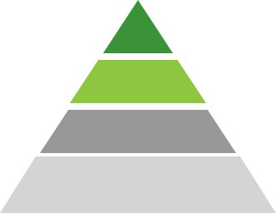


What evidence do you trust for your treatment decisions?
What randomised, controlled phase III trials can do
Gold Standard for the evaluation of efficacy and safety (Guidelines)
Proof of therapeutic effect
Product comparisons are possible
Randomised, controlled Phase III trials
x
Prospective, non-interventional clinical trials
Declining level of evidence
What real-world evidence can do
Confirmation of event rates of randomised controlled phase III-trials in a broader patient population Information on adherence and persistence
Prospective patient registries
What real-world evidence cannot do
x No direct product comparisons
x No causality
x No reverse conclusion to randomised, controlled phase III trials
Retrospective database analysis and patient registries
Only randomised trials with a high degree of evidence can show causality¹
Retrospective analyses of databases should not be used for the comparison of therapies due to methodological biases¹
Adapted from Fanaroff et al.¹
References: 1. Fanaroff et al. Eur Heart J 2018; Aug 21;39(32):2932-2941

Slide 3
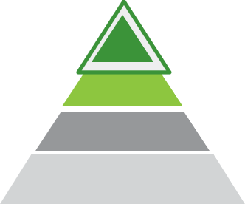
Consistent efficacy and safety of NOACs in phase III trials¹⁻⁴
According to the study population, lower risk was associated with lower event rates, and higher risk was associated with higher event rates.
Correlation of CHADS₂ score and stroke/SE rates
Stroke/SE (% per year)
Correlation of HAS-BLED score and major bleeding rates
Major bleeding (% per year)
3.6
2.8
2.1
1.7
1.3
1.2
Apixaban
ARISTOTLE¹
Phase III
Edoxaban
ENGAGE AF²
Phase III
Rivaroxaban
ROCKET AF³
Phase III
Apixaban ARISTOTLE¹
Phase III
Edoxaban
ENGAGE AF²
Phase III
Rivaroxaban
ROCKET AF³
Phase III
Mean CHADS₂ score
3.5
Mean HAS-BLED score
2.8
2.5
2.8
2.1
2.0
No head-to-head comparison
Abbreviations: CHADS₂ score, score for assessing stroke risk in patients with nvAF; HAS-BLED score, score for assessing bleeding risk in prophylactically anticoagulated nvAF patients; NOACs, Non-vitamin K antagonist oral anticoagulants; SE, systemic embolism.
References: 1. Granger et al. N Engl J Med 2011;365:981‑992. 2. Giugliano RP, et al. N Engl J Med 2013;369:2093‑2104. 3. Patel et al. N Engl J Med. 2011; 37(14):1154-7 4. Pokorney SD, et al. EHJ 2016;37(14):1154-57.
Notes:
Source: Confidential folder

Slide 4
Consistent rates of major GI bleeding with NOACs in phase III trials ¹⁻⁴
According to the study population, lower risk was associated with lower event rates, and higher risk was associated with higher event rates.
Correlation of HAS-BLED score and GI bleeding rates
Major GI bleeding (% per year)
2.0
1.5
0.8
Apixaban
ARISTOTLE¹
Phase III
Edoxaban
ENGAGE AF²
Phase III
Rivaroxaban
ROCKET AF³
Phase III
Mean HAS-BLED score
2.5
2.8
2.0
No head-to-head comparison
Abbreviations: GI, Gastrointestinal; HAS-BLED score, score for assessing bleeding risk in prophylactically anticoagulated nvAF patients; NOACs, Non-vitamin K antagonist oral anticoagulants.
References: 1. Granger et al. N Engl J Med 2011;365:981‑992. 2. Giugliano RP, et al. N Engl J Med 2013;369:2093‑2104. 3. Patel et al. N Engl J Med. 2011; 37(14):1154-7 4. Pokorney SD, et al. EHJ 2016;37(14):1154-57.
Notes:
Source: Confidential folder

Slide 5
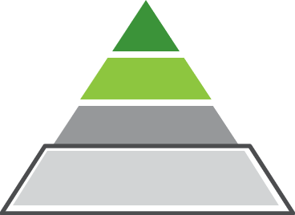
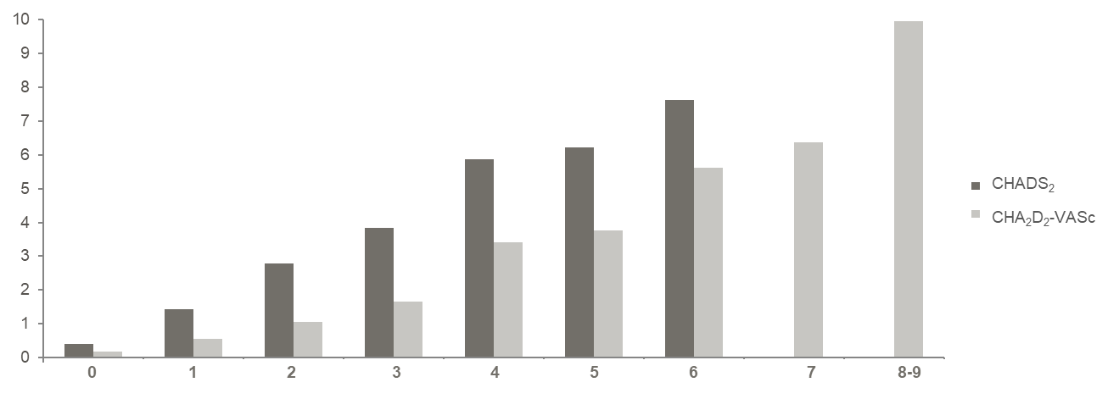
Correlation of CHADS₂ (CHA₂DS₂-VASc) score and rates of major bleeding
Retrospective analysis of US commercial insurance database (OptumLabs DataWarehouse)
39,539 patients with nvAF and treated with NOAC (43% rivaroxaban, 20% apixaban, 38% dabigatran, 0.04% edoxaban)
Major bleeding (% per year)
0 1 2 3 4 5 6 7 8-9
Adapted from Yao et al.¹
Abbreviations: nvAF, non-valvular atrial fibrillation; CHADS₂ score, score for assessing stroke risk in patients with nvAF, CHA₂DS₂-VASc score, adaption of CHA₂DS₂ score; NOAC, Non-vitamin K antagonist oral anticoagulant.
References: 1. Yao et al. Am J Cardiol. 2017 Nov 1;120(9):1549-1556.
Notes:
New slide

Slide 6
A closer look at the evidence from nvAF phase III trials: absolute event rates versus ratios
Absolute event rates of major bleeding in nvAF patients with renal impairment (% per year)^{1-4*}
Forest plot for major bleeding events in nvAF patients with renal impairment¹⁻⁴
6.4
5.3
ROCKET AF³
4.5
4.7
4.0
3.2
ENGAGE AF²
ARISTOTLE¹
ENGAGE AF²
ROCKET AF³
ARISTOTLE¹
Mean CHADS2 score¹⁻³
0
0.5
Advantage NOAC
1
1.5
Advantage VKA
2
3.7
2.6
3.1
Rivaroxaban Edoxaban Apixaban
VKA
Adapted from Turpie et al.
No head-to-head comparison
Adapted from Turpie et al.
No head-to-head comparison
Absolute event rates of NOACs correlate with the risk score: the higher the score, the higher the event rate.^{1-3,5-7}
Despite lower CHADS₂ scores, significantly higher bleeding rates were observed in the VKA arm of ARISTOTLE.^{1,4}
«It is not known whether the […] benefit with apixaban is related to the molecule, to chance, other confounders, or possibly to a higher-than-expected bleeding rate with warfarin […].»⁴
Abbreviations: CHADS₂ score, score for assessing stroke risk in patients with nvAF; CrCl, creatinine clearance; eGFR, estimated glomerular filtration rate; nvAF, non-valvular atrial fibrillation; NOAC, non-vitamin K antagonist oral anticoagulant; VKA, vitamin K antagonist *ROCKET AF: CrCl 30 – 49 ml/min; ENGAGE AF: CrCl ≤50 ml/min; ARISTOTLE: eGFR ≤50 ml/min. References: 1: Hohnloser et al Eur Heart J. 2012;33(22):2821‑30. 2. Bohula EA, et al. Trial. Circulation 2016;134(1):24-36. 3. Fox Eur Heart J 2011;32(19):2387-94. 4. Turpie AGG, et al. Ther Adv Cardiovasc Dis 2017;11(9):243-256. 5. Friberg et al. Eur Heart J 2012; 33:1500–1510. 6. Olesen JB et al. BMJ 2011;342:d124 7. Yao et al. Am J Cardiol 2017 Nov 1;120(9):1549-1556.
Notes:
Source: VKA enclosure
It is not known whether the […] benefit with apixaban is related to the molecule, to chance, other confounders, or possibly to a higher-than-expected bleeding rate with warfarin […]

Slide 7
Do NOACs differ in major bleeding events associated with nvAF?
“A randomised trial to adequately assess the safety of one anticoagulant versus another would have to enrol at least 85,000 patients for at least 5 years to detect a 10% difference in major bleeding events.” ¹
References: 1. Ferro et al. JAMA. 2021 Dec 21;326(23):2372-2374
Notes:
Neues Slide

Slide 8
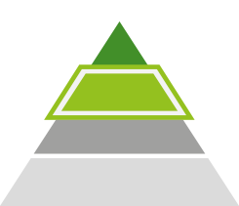
XANTUS pooled complements evidence on rivaroxaban: prospective global study conducted in 47 countries¹
XANTUS pooled¹
Rivaroxaban post-marketing surveillance study (PMSS) programme
Prospective global study in 47 countries
11,121 patients
Follow-up: 1 year
CHADS₂ score: 2.0
HAS-BLED score: 2.0
Events per 100 patient-years¹
Rivaroxaban 20 mg Rivaroxaban 15 mg
2.3
1.3
1.5
0.8
Stroke/SE
Major bleeding
2.3
2.3
1.8
1.8
Mean HAS-BLED score*
Mean HAS-BLED score*
Adapted from Kirchhof et al. 2018: 72(2):141-53.
“PMSS studies are necessary to confirm the real-life applicability of results obtained in phase III trials.”²
Abbreviations: CHADS₂ score, score for assessing stroke risk in patients with nvAF; HAS-BLED score, score for assessing bleeding risk in prophylactically anticoagulated nvAF patients; PMSS, post-marketing surveillance study. References: 1. Kirchhof et al. J Am Coll Cardiol. 2018 Jul 10;72(2):141-153. 2. Cemin et al. International Journal of Cardiology 2023;131618. .
*HAS-BLED score according to dosage from internal data
Notes:
Source: Confidential folder

Slide 9


ETNA-AF and XANTUS PMSS confirmed in real-world conditions the results obtained in the pivotal studies ENGAGE AF and ROCKET-AF¹
Rivaroxaban | XANTUS²
Edoxaban | ETNA-AF³
Apixaban
PMSS evidence
Global programme
Global programme
No global evidence available from PMSS*
*Only PMSS data collected in Japan were published⁴
Abbreviations: PMSS, post-marketing surveillance study. References: 1. Cemin et al. Int J Cardiol 2023;131618 2. Kirchhof et al. J Am Coll Cardiol 2018; 10;72(2):141-153 3. De Caterina et al. J Clin 2021;10(4):573 4. Sairaku et al. Eur J Clin Pharmacol 2023;79(5):579–88
Notes:
Source: Confidential folder

Slide 10


What can retrospective data add to the evidence on NOACs?
Influence of statistical method?
Clinical relevance?
Notes:
New slide

Slide 11
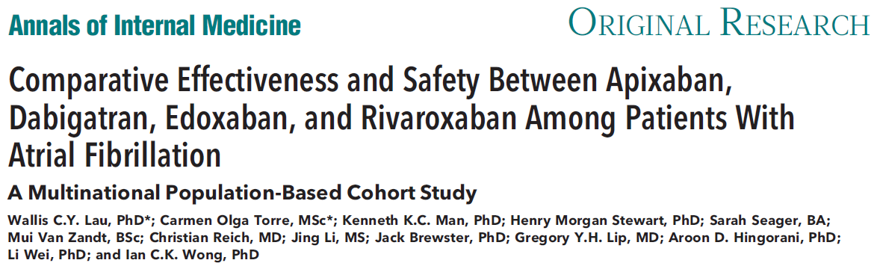
Database analysis by Lau et al. (Annals Int Med 2022)¹
Retrospective database analysis
Five electronic health care databases (France, Germany, UK, US), >200 million patients
Patients with a recent diagnosis of nvAF and a new NOAC prescription
Propensity score matching to compare NOAC populations
Abbreviations: nvAF, non-valvular atrial fibrillation; NOAC, non-vitamin K antagonist oral anticoagulant.
References: 1 Lau WCY, et al. Ann Intern Med 2022 Nov;175(11):1515-1524
Notes:
New slide

Slide 12
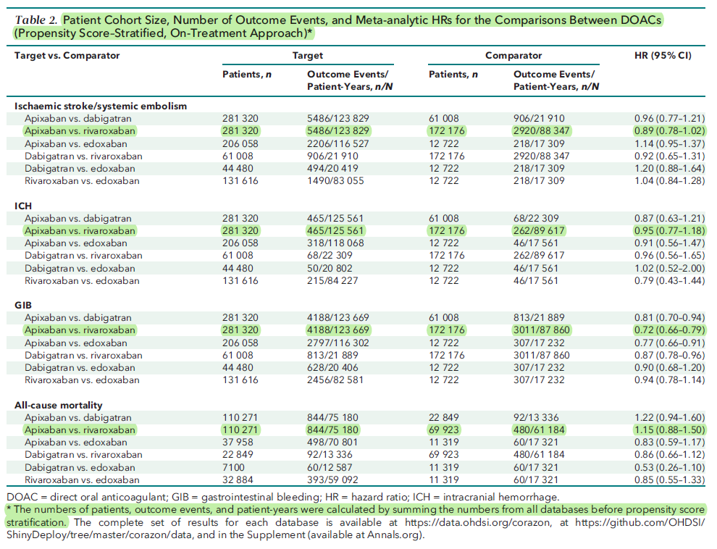
Database analysis by Lau et al. (Annals Int Med 2022)
The table shows raw data for patient numbers and event rates, combined with hazard ratios after propensity score matching
Excerpt from the publication: “Most baseline characteristics of NOAC patients were similar before propensity score matching, with a standardized difference of less than 0.10, and remained well balanced after stratification.”
How did matching affect the results?
Abbreviations: GIB, gastrointestinal bleeding; HR, hazard ratio; ICH, intracerebral haemorrhage; NOAC, non-vitamin K antagonist oral anticoagulant.
References: 1. Lau WCY et al. Ann Intern Med 2022 Nov;175(11):1515-1524

Slide 13
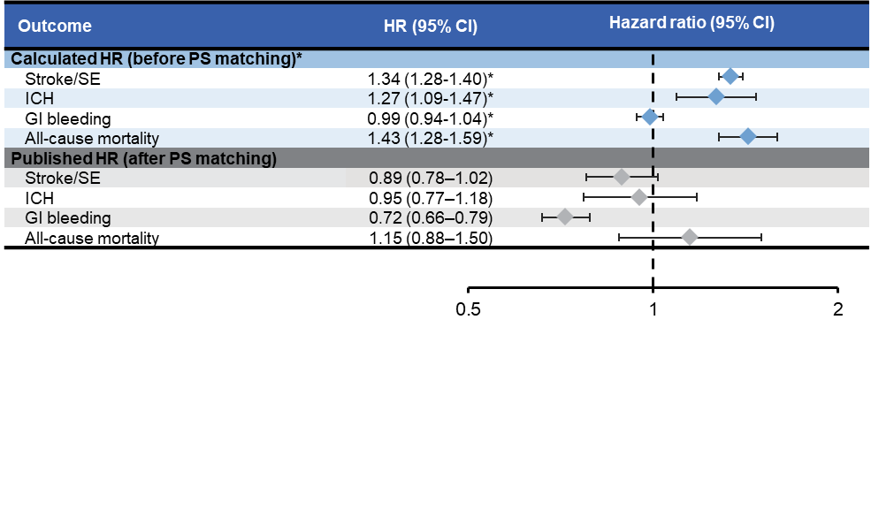
Database analysis by Lau et al. (Annals Int Med 2022)
Discrepant results before and after PS Matching
Are we observing the clinical effects of the drugs or rather effects of the statistical method?
„Most baseline characteristics of NOAC users were similar before propensity score stratification, with standardized differences less than 0.10, and remained well balanced after stratification“¹
“…in populations already similar before Propensity Score Matching (PSM), PSM increases the imbalance in comparison to the original data."²
„We show that applying alternative study designs can yield discrepant results, in terms of direction and significance of association." ³
*Calculated from table 2 in reference1, HR and CI were calculated based on total number of events per patient-year total using an online calculator (Hazard Ratio Calculator - Calculate Hazard Ratio, HR Confidence Intervals & p-value (gigacalculator.com) Abbreviations: GI, gastrointestinal; HR, hazard ratio; CI, confidence interval; ICH, intracerebral haemorrhage, PS, propensity score; SE, systemic embolism. References: 1. . Lau WCY et al. Ann Intern Med 2022 Nov;175(11):1515-1524. 2. King G. et al. Polit Analysis 2019;27(4):435-454. 3. Fanaroff et al. Eur Heart J 2018;39(32):2932-2941
Notes:
New slide
GIB, gastrointestinal bleeding; HR, hazard ratio; ICH, intracerebral haemorrhage; NOAC, Non-vitamin K antagonist oral anticoagulants
Calculated from Table 2 in Ref 1, HR and CI were calculated based on total number of events per patient-year total using an online calculator (Hazard Ratio Calculator - Calculate Hazard Ratio, HR Confidence Intervals & p-value (gigacalculator.com).
Calculated from Table 2 in Ref 1

Slide 14
Statistical methods can show significance without clinical relevance^{1,2}
US Claims Register¹
ISR Clalit Health Services²
Events per 100 patient-years
Rivaroxaban
Apixaban
Events per 100 patient-years
0.8
Ischaemic
5.6
HR: 0.92
(95% CI 0.86–0.99)
Ischaemic
HR: 1.12
stroke
stroke
0.7
(95% CI 1.05–1.21)
4.9
0.4
HR: 1.09
1.2
HR: 0.86
(95% CI 0.98–1.22)
ICH
0.9
(0.74–1.00)
ICH
0.3
4.4
HR: 1.06
(95% CI 1.02–1.09)
1.8
HR: 0.88
(95% CI 0.78–0.99)
4.1
Mortality
1.6
Mortality
Median follow-up: 0.5 years
NNT Ischaemic stroke: 909
pro Apixaban
Median Follow-up: 2.1 years
NNT Ischaemic stroke: 154
pro Rivaroxaban
Abbreviations: HR, hazard ratio; ICH, intracerebral haemorrhage; NNT, Number Needed to Treat.
References: 1. Ray WA, et al. JAMA 2022 Apr 5;327(13):1294. 2. Talmor-Barkan Y, et al. Eur Heart J Cardiovasc Pharmacother 2022; 15;9(1):26-37
Notes:
New slide

Slide 15

Solid and consistent evidence for Rivaroxaban with the compliance benefit of OD dosing
Practical considerations are relevant when choosing a NOAC. OD dosing is easier for patients and is associated with better compliance, which in turn is important for stroke prevention.¹⁻⁴
Effective stroke prevention^{5,6}
Good safety profile^{5,7}
OD Dosing⁶
# Benefits for patients⁶
Abbreviations: NOAC, non-vitamin K antagonist oral anticoagulant.
References: 1. McHorney et al. Curr Med Res Opin 2019;35(4):653‑660 2. Coleman et al. Curr Med Res Opin. 2017;33(6):1033-1043. 3. Alberts al. Int J Cardiol. 2016;215:11‑3 4. Deshpande et al. Curr Med Res Opin. 2018 Jul;34(7):1285-1292. 5. Patel et al. N Engl J Med. 2011 Sep 8;365(10):883-91. 6. Product Characteristics Xarelto® Switzerland, www.swissmedicinfo.ch.
7. Kirchof et al. J Am Coll Cardiol. 2018 Jul 10;72(2):141-153.
Notes:
Source: Confidential folder

Slide 16
NOAC once or twice daily? Not plasma levels, but clinical evidence is decisive
Rivaroxaban phase II: Trend for better net benefit with OD dosing¹
Edoxaban phase II: Trend for less bleeding with OD dosing^{2,3}
30
25
20
15
10
5
0
Major bleeding
VTE + All-cause mortality n=2,825*
30
25
20
15
10
5
0
Major and non-major bleeding
n=1,146**
Event rate (%)
Enoxaparin
Event rate (%)
VKA
5 mg† 2.5 mg† OD BID
10 mg 5 mg†
OD BID
Dose of Rivaroxaban
20 mg OD
10 mg BID
60 mg 30 mg
OD BID
Dose of Edoxaban
* After hip or knee replacement surgery
† Study on dose finding/dose frequency. Dose not authorised for VTE/nvAF in Switzerland. Adapted from Trujillo et al. 2014¹
**nvAF
Adapted from Salazar et al. 2012³
Phase II data for rivaroxaban and edoxaban favour OD treatment¹⁻³
Patients prefer the convenience of OD dosing to BID dosing⁴
OD dosing is expected to improve compliance which is associated with better treatment outcomes for patients.⁴
Abbreviations: BID, twice daily; NOAC; non-vitamin K antagonist oral anticoagulant; nvAF, non-valvular atrial fibrillation; OD, once daily; VKA, vitamin K antagonist; VTE, venous thromboembolism. References: 1. Trujillo T et al. Drugs. 2014 Sep;74(14):1587-603. 2. Weitz JI et al. Thromb Haemost. 2010 Sep;104(3):633-41. 3. Salazar DE et al. Thromb Haemost. 2012 May;107(5):925-36. 4. Kreutz R. J Thromb Thrombolysis 2014;38(2):137–49.
Notes:
Source: Enclosure OD/BID

Slide 17
NOAC once or twice daily? Not plasma levels, but clinical evidence is decisive
Apixaban phase II: Trend toward lower event rates for efficacy endpoints with comparable bleeding rates in BID dosing^{1,2}
30
VTE + All-cause mortality n=1,238*
VKA
30
Non-major bleeding Major bleeding
25
25
Event rate (%)
20
Event rate (%)
20
Enoxaparin
15
15
10
5
0
10
5
0
Enoxaparin
VKA
5 mg 2.5 mg 10 mg† 5 mg
OD BID OD BID
20 mg† 10 mg†
OD BID
5 mg 2.5 mg 10 mg† 5 mg
OD BID OD BID
20 mg† 10 mg†
OD BID
* After knee replacement surgery
† Study on dose finding/dose frequency. Dose not authorised for VTE/nvAF in Switzerland.
Adapted from Lassen et al. 2007²
Abbreviations: BID, twice daily; NOAC; non-vitamin K antagonist oral anticoagulant; nvAF, non-valvular atrial fibrillation; OD, once daily; VKA: vitamin K antagonist; VTE, venous thromboembolism. References: 1. Hanna MS et al. Ann N Y Acad Sci. 2014 Nov;1329(1):93-106 . 2. Lassen MR et al. J Thromb Haemost 2007;5(12):2368–75
Notes:
Source: Enclosure OD/BID

Slide 18



Clinical trials suggest that intracerebral haemorrhages occur independently of plasma levels
Rivaroxaban plasma concentration (ng/ml)
300
Intracerebral haemorrhages
Ischaemic strokes
250
200
183
150
137
100
20 mg (CrCl >50 ml/min)
50
0
Peak – very high (184 – > 343 ng/ml)
Intermediate (138–183 ng/ml)
Trough (≤137 ng/ml)
0
2
4
6
8
10 12 14
Time after ingestion (h)
16 18
20 22
24
Clinical Data– Distribution of intracerebral haemorrhages (n=51)¹
11 (22%) 6 (12%) 34 (67%)
«The [...] results suggest that ICH in patients taking rivaroxaban is not facilitated by high or peak levels of the active substance.» Seiffge et al. 2018¹
Adapted from Seiffge et al ¹. Schematic representation of events. Exact time of the events is unknown.
Abbreviations: CrCL, creatinine clearance; ICH, intracerebral haemorrhage.
References: 1. Seiffge DJ, et al. Ann Neurol. 2018 Mar;83(3):451-459.
Notes:
Source: Slidedeck NOAC in Perspective.

Slide 19
Clinical trials suggest that ischaemic strokes occur independently of plasma levels
Rivaroxaban plasma concentration (ng/ml)
300
Intracerebral haemorrhage
Ischaemic strokes
250
200
183
150
137
100
20 mg (CrCl >50 ml/min)
50
0
0
2
4
6
8
10 12 14
Time since ingestion (h)
16
18
20 22
24
Peak – very high (184 – > 343 ng/ml)
Intermediate (138–183 ng/ml)
Trough (≤137 ng/ml)
Clinical Data – Distribution of ischaemic strokes (n=190)¹
53 (28%) 11 (6%)
126 (66%)
Clinical data suggest that ischaemic strokes occur independently of plasma levels.
Adapted from Seiffge et al ¹. Schematic representation of events. Exact time of the events is unknown.
Abbreviations: CrCL, creatinine clearance.
References: 1. Seiffge DJ, et al. Ann Neurol. 2018 Mar;83(3):451-459.
Notes:
Source: Slidedeck NOAC in Perspective

Slide 20
Backup

Slide 21
XANTUS pooled complements evidence on rivaroxaban: prospective global study conducted in 47 countries¹
XANTUS pooled¹
Rivaroxaban post-marketing surveillance study (PMSS) programme
Prospective global study in 47 countries
11,121 patients
Follow-up: 1 year
CHADS₂ score: 2.0
HAS-BLED score: 2.0
Stroke/SE (% per year)
1.7
1.0
1.3
1.2
Rivaroxaban
XANTUS pooled¹
Phase IV (prospective)
Apixaban
ARISTOTLE²
Phase III
Edoxaban
ENGAGE AF³
Phase III
Rivaroxaban
ROCKET AF⁴
Phase III
Mean CHADS₂ score
3.5
2.8
2.0
2.1
“PMSS studies are necessary to confirm the real-life applicability of results obtained in phase III trials.”⁵
Abbreviations: CHADS₂ score, score for assessing stroke risk in patients with nvAF; HAS-BLED score, score for assessing bleeding risk in prophylactically anticoagulated nvAF patients; PMSS, post-marketing surveillance study. References: 1. Kirchhof et al. J Am Coll Cardiol 2018 Jul 10;72(2):141-153 . 2. Granger et al. N Engl J Med 2011;365:981‑992. 3. Giugliano RP, et al. N Engl J Med 2013;369:2093‑2104. 4. Patel et al. N Engl J Med. 2011; 37(14):1154-7 5. Cemin et al. Int J Cardiol 2023;131618
Notes:
Source: Confidential folder

Slide 22
XANTUS pooled complements evidence on rivaroxaban: prospective global study conducted in 47 countries¹
XANTUS pooled¹
Rivaroxaban post-marketing surveillance study (PMSS) programme
Prospective global study in 47 countries
11,121 patients
Follow-up: 1 year
CHADS₂ score: 2.0
HAS-BLED score: 2.0
Major bleeding (% per year)
3.6
2.8
2.1
1.7
Rivaroxaban
XANTUS pooled¹
Phase IV (prospective)
Apixaban
ARISTOTLE²
Phase III
Edoxaban
ENGAGE AF³
Phase III
Rivaroxaban
ROCKET AF⁴
Phase III
Mean CHADS₂ score
3.5
2.8
2.0
2.1
“PMSS studies are necessary to confirm the real-life applicability of results obtained in phase III trials.”⁵
Abbreviations: CHADS₂ score, score for assessing stroke risk in patients with nvAF; HAS-BLED score, score for assessing bleeding risk in prophylactically anticoagulated nvAF patients; PMSS, post-marketing surveillance study. References: 1. Kirchhof et al. J Am Coll Cardiol 2018 Jul 10;72(2):141-153 . 2. Granger et al. N Engl J Med 2011;365:981‑992. 3. Giugliano RP, et al. N Engl J Med 2013;369:2093‑2104. 4. Patel et al. N Engl J Med. 2011; 37(14):1154-7 5. Cemin et al. Int J Cardiol 2023;131618
Notes:
Source: Confidential folder

Slide 23

Fake or fact: What can retrospective data contribute to the NOAC evidence?
Retrospective database analysis by Lau et al.¹: 527,226 patients ≥ 18 years with nvAF from 5 databases with patients from 4 countries (D, F, UK, USA)
«Most baseline characteristics of NOAC patients were similar before and after propensity score matching[…]»¹
Outcome | HR (95% CI) | Hazard ratio (95% CI)
Before PSM*
Calculated HR based on publication*
Stroke/SE | 1.34 | (1.28-1.40)*
ICH | 1.27 | (1.09-1.47)*
GI bleeding | 0.99 | (0.94-1.04)*
All-cause mortality | 1.43 | (1.28-1.59)*
Before Propensity Score Matching (PSM)* Conclusion: Advantage for rivaroxaban
?
Published HR
After PSM
Stroke/SE 0.89 (0.78–1.02)
ICH 0.95 (0.77–1.18)
After Propensity Score Matching (PSM) Conclusion: Advantage for apixaban
GI bleeding 0.72 (0.66–0.79)
All-cause mortality 1.15 (0.88–1.50)
0.5
Apixaban
1
favours
2
Rivaroxaban
Adapted from Lau et al.¹
The results of retrospective database analyses are significantly influenced by the statistical method.
Therefore, product comparisons based on such data should be avoided. ²
Abbreviations: HR, hazard ratio; CI, confidence interval; ICH, intracerebral haemorrhage; nvAF, non-valvular atrial fibrillation; PSM, propensity score matching.
*Calculated by Bayer (Switzerland) AG using the numbers in table 2 in reference 1, HR and CI were calculated based on total number of events per patient-year total using an online calculator (Hazard Ratio Calculator - Calculate Hazard Ratio, HR Confidence Intervals & p-value (gigacalculator.com) based on the total number of events per patient year. Presentation of HR & CI was not peer reviewed and published.
References: 1. Lau et al. Ann Intern Med 2022 Nov;175(11):1515-1524. 2. Fanaroff et al. Eur Heart J 2018 Aug 21;39(32):2932-2941.
Notes:
Source: Enclosure Lau et al.

Slide 24
HR before and after PSM: What happened to the patient data?
Harvard Professor King et al: In populations already similar before Propensity Score Matching (PSM), PSM increases imbalance compared to baseline data.¹
A
A
A
X X
B
B
X X
B
Non-randomised group
Pair formation (PSM)
some patients are excluded
Matched groups
We cannot simply replace randomised trials with retrospective real-world data.²
„The pharmaceutical industry should avoid the inappropriate use of observational studies for commercial and marketing purposes”²
Abbreviations: HR, hazard ratio; PSM, propensity score matching.
References: 1. King et al. Polit Analysis 2019;27(4):435-454 2. Rosendaal et al. J Thromb Haemost 2016 Nov;14(11):2091
Notes:
Source: Enclosure Lau et al.

Slide 25
References (1)
Alberts MJ, et al. Association between once‑ and twice‑daily direct oral anticoagulant adherence in nonvalvular atrial fibrillation patients and rates of ischemic stroke. Int J Cardiol. 2016;215:11‑3.
Bohula EA, et al. Impact of renal function on outcomes with Edoxaban in the ENGAGE AF-TIMI 48 Trial. Circulation2016;134(1):24-36.
Cemin et al. Lessons derived from post authorisation safety studies (ETNA-AF and XANTUS) on once daily direct oral anticoagulants for atrial fibrillation. International Journal of Cardiology 2023;131618.
Coleman C, et al. Importance of balancing follow‑up time and impact of oral‑anticoagulant users’ selection when evaluating medication adherence in atrial fibrillation patients treated with rivaroxaban and Apixaban. Curr Med Res Opin 2017;33(6):1033-1043.
De Caterina et al. Safety and Effectiveness of Edoxaban in Atrial Fibrillation Patients in Routine Clinical Practice: One-Year Follow-Up from the Global Noninterventional ETNA-AF Program. JCM 2021;10(4):573.
Deshpande CG et al. Impact of medication adherence on risk of ischemic stroke, major bleeding and deep vein thrombosis in atrial fibrillation patients using novel oral anticoagulants. Curr Med Res Opin. 2018 Jul;34(7):1285-1292.
Fanaroff AC et al. Stroke prevention in atrial fibrillation: re-defining 'real-world data' within the broader data universe. Eur Heart J. 2018 Aug 21;39(32):2932-2941
Ferro EG et al. Informing the Choice of Direct Oral Anticoagulant Therapy in Patients With Atrial Fibrillation. JAMA. 2021 Dec 21;326(23):2372-2374.
Fox KAA et al. Prevention of stroke and systemic embolism with rivaroxaban compared with warfarin in patients with non‑valvular atrial fibrillation and moderate renal impairment. Eur Heart J 2011;32(19):2387-94.
Friberg L, et al. Evaluation of risk stratification schemes for ischaemic stroke and bleeding in 182 678 patients with atrial fibrillation: the Swedish Atrial Fibrillation cohort study. Eur Heart J 2012; 33:1500–1510.
Giugliano RP, et al. Edoxaban versus warfarin in patients with atrial fibrillation. N Engl J Med 2013;369:2093‑2104.
Granger CB, et al. Apixaban versus warfarin in patients with atrial fibrillation. N Engl J Med 2011;365:981‑992.
Hanna MS et al. Development of apixaban: a novel anticoagulant for prevention of stroke in patients with atrial fibrillation. Ann N Y Acad Sci. 2014 Nov;1329(1):93-106
Hohnloser SH, et al. Efficacy of apixaban when compared with warfarin in relation to renal function in patients with atrial fibrillation: insights from the ARISTOTLE trial. Eur Heart J. 2012;33(22):2821‑30.
King G et al. Why Propensity Scores Should Not Be Used for Matching. Political Analysis. 2019;27(4):435-454.
Kirchhof P et al. Global XANTUS program Investigators. Global Prospective Safety Analysis of Rivaroxaban. J Am Coll Cardiol. 2018 Jul 10;72(2):141-153.
Kreutz R. A clinical and pharmacologic assessment of once-daily versus twice-daily dosing for rivaroxaban. J Thromb Thrombolysis 2014;38(2):137–49.
Lassen MR et al. The efficacy and safety of apixaban, an oral, direct factor Xa inhibitor, as thromboprophylaxis in patients following total knee replacement. J Thromb Haemost 2007;5(12):2368–75.

Slide 26
References (2)
Lau WCY et al. Comparative Effectiveness and Safety Between Apixaban, Dabigatran, Edoxaban, and Rivaroxaban Among Patients With Atrial Fibrillation : A Multinational Population-Based Cohort Study. Ann Intern Med. 2022 Nov;175(11):1515-1524
Madigan et al. Does design matter? Systematic evaluation of the impact of analytical choices on effect estimates in observational studies. Ther Adv Drug Saf. 2013 Apr;4(2):53-62
McHorney CA, et al. Modeling the impact of real-world adherence to once-daily (QD) versus twice-daily (BID) nonvitamin K antagonist oral anticoagulants on stroke and major bleeding events among non‑valvular atrial fibrillation patients. Curr Med Res Opin. 2019;35(4):653‑660.
Olesen JB, et al. Validation of risk stratification schemes for predicting stroke and thromboembolism in patients with atrial fibrillation: nationwide cohort study. BMJ 2011;342:d124.
Patel MR et al. Rivaroxaban versus warfarin in nonvalvular atrial fibrillation. N Engl J Med. 2011 Sep 8;365(10):883-91.Pokorney SD, O'Brien EC, Granger CB. Assessing generalizability of trial results in general practice. Eur Heart J. 2016 Apr 7;37(14):1154-7.
Pokorney et al. Assessing generalizability of trial results in general practice. EHJ 2016;37(14):1154-57.
Product Characteristics Xarelto® Switzerland, www.swissmedicinfo.ch.
Ray WA et al. Association of Rivaroxaban vs Apixaban With Major Ischemic or Hemorrhagic Events in Patients With Atrial Fibrillation. JAMA. 2021 Dec 21;326(23):2395-2404. Erratum in: JAMA. 2022 Apr 5;327(13):1294.
Rosendaal FR, Reitsma PH. Brave real world. J Thromb Haemost. 2016 Nov;14(11):2091.
Salazar DE et al. Modelling and simulation of edoxaban exposure and response relationships in patients with atrial fibrillation. Thromb Haemost. 2012 May;107(5):925-36.
Seiffge DJ et al. Novel Oral Anticoagulants in Stroke Patients study group. Rivaroxaban plasma levels in acute ischemic stroke and intracerebral hemorrhage. Ann Neurol. 2018 Mar;83(3):451-459.
Sairaku et al. Increased major bleeding incidence in atrial fibrillation patients with apixaban: a review of Japanese post-marketing surveillance studies of direct oral anticoagulants. Eur J Clin Pharmacol 2023;79(5):579–88.
Talmor-Barkan Y et al. Head-to-head efficacy and safety of rivaroxaban, apixaban, and dabigatran in an observational nationwide targeted trial. Eur Heart J Cardiovasc Pharmacother. 2022 Dec 15;9(1):26-37.
Trujillo T et al. Clinical use of rivaroxaban: pharmacokinetic and pharmacodynamic rationale for dosing regimens in different indications. Drugs. 2014 Sep;74(14):1587-603.
Turpie AGG, et al. Nonvitamin K antagonist oral anticoagulant use in patients with renal impairment. Ther Adv Cardiovasc Dis 2017;11(9):243-256.
Weitz JI et al. Randomised, parallel‑group, multicentre, multinational phase 2 study comparing edoxaban, an oral factor Xa inhibitor, with warfarin for stroke prevention in patients with atrial fibrillation. Thromb Haemost. 2010 Sep;104(3):633-41.
Yao X et al. Comparison of the CHA2DS2-VASc, CHADS2, HAS-BLED, ORBIT, and ATRIA Risk Scores in Predicting Non-Vitamin K Antagonist Oral Anticoagulants-Associated Bleeding in Patients With Atrial Fibrillation. Am J Cardiol. 2017 Nov 1;120(9):1549-1556.
The referenced data and the respective publications will be provided on request.

Slide 27
Abbreviated Summary of Product Characteristics
Abbreviated Summary of Product Characteristics of Xarelto® (rivaroxaban): Direct factor Xa inhibitor C: Film-coated tablets with 10, 15 and 20 mg rivaroxaban. I: Adults: a) Thrombosis prophylaxis for major orthopaedic procedures on the lower extremities, such as hip or knee prostheses. b) Treatment of pulmonary embolism (PE) and deep vein thrombosis (DVT) as well as prophylaxis of recurring DVT and PE. c) Prophylaxis of stroke and systemic embolism in patients with nonvalvular atrial fibrillation; Pediatric population (body weight ≥ 30kg): Treatment of venous thromboembolism (VTE) after initial parenteral anticoagulation for the prophylaxis of recurrent VTE. D: Adults: a) 10mg 1x/day b) 15mg 2x/day for the first 21 days, followed by 20mg 1x/day; from month 7: 20mg 1x/day or 10mg 1x/day based on an individual benefit-risk evaluation c) 20mg 1x/day; for CrCl of 15-49ml/min: 15mg 1x/day. Take 15mg and 20mg with food. Pediatric population: For body weight ≥30kg to <50kg: 15mg 1x/day. For body weight ≥50kg: 20mg 1x/day. CI: hypersensitivity to any ingredients, acute bacterial endocarditis, clinically significant active bleeding, severe liver disease/hepatic impairment (HI) with a comparatively higher risk of bleeding; mild HI in combination with coagulopathy, renal impairment (RI) requiring dialysis, acute gastrointestinal (GI) ulcers or ulcerative GI disorders, pregnancy, lactation. W: concomitant medication (cf. "IA"); artificial heart valves; concomitant administration of drugs affecting haemostasis. PM: RI (CrCl 15-29ml/min) or RI in combination with drugs increasing the Xarelto® plasma level, increased risk of uncontrolled bleeding and haemorrhagic diathesis, recent haemorrhagic stroke, intracranial or intracerebral haemorrhage, recent GI ulcers/ulcerative disorders, severe uncontrolled hypertension, vascular retinopathy, intraspinal and intracerebral vascular anomalies, recent brain, spinal or eye surgery, medical history of bronchiectasis or pulmonary bleeding, spinal anaesthesia or puncture, discontinue at least 24 hours before invasive/surgical procedures, APS, individual cases of agranulocytosis and SJS were reported. Common ADRs: bleeding, anaemia, dizziness, headache, eye haemorrhage, haematoma, epistaxis, haemoptysis, nausea, obstipation, diarrhoea, elevated liver enzymes (ASAT, ALAT), pruritus, rash, pain in the extremities, fever, peripheral oedema, asthenia. IA: Strong CYP 3A4 + P-gp inhibitors (ritonavir, ketoconazole), strong CYP 3A4 + P-gp inducers (rifampicin, carbamazepine, phenobarbital, St. John's wort), drugs influencing haemostasis. Pack sizes: 10 & 30 x 10 mg film-coated tablets; 14, 28 & 98 x 15 mg or 20 mg film-coated tablets. (B), covered by health insurance companies (refer to Limitatio). Additional information available from www.swissmedicinfo.ch. Distribution: Bayer (Schweiz) AG, Uetlibergstr. 132, 8045 Zurich, Switzerland. MA-M_RIV-CH-0265-1_10.2022

