Slide 1
DAROLUTAMIDE in nmCRPC (NUBEQA®)
PP-NUB-CH-0245-2 / 2024.06.

Slide 2
Disclaimer
The following has been developed in response to an unsolicited request for slides for a scientific presentation, is for scientific information purposes only and does not represent promotion of a non-licensed indication
Darolutamide is approved in combination with androgen deprivation therapy (ADT), is indicated for the treatment of adult patients with non-metastatic, castration-resistant prostate cancer (NM-CRPC) who are at high risk of developing metastases (especially PSADT ≤ 10 months).¹
This presentation may not be duplicated or distributed
Bayer (Schweiz) AG does not take any responsibility for any misuse of this information

Slide 3
TABLE OF CONTENT
nmCRPC
What is Darolutamide?
ARAMIS: Phase 3 Study in nmCRPC

Slide 4
Non-metastatic castration-resistant prostate cancer (nmCRPC)

Slide 5




nmCRPC Definition²⁻⁴
Castrate serum testosterone < 50 ng/dL
Biochemical progression: Three consecutive rises in PSA at least one week apart resulting in two 50% increases over the nadir, and a PSA > 2 ng/mL
no detectable clinical metastases using bone scan and CT-scan*
Frequent PSA testing for men on treatment with ADT has resulted in earlier detection of biochemical progression
*A consensus statement by the Prostate Cancer Radiographic Assessments for Detection of Advanced Recurrence (RADAR) group suggested a bone scan and a CT scan when the PSA reached 2 ng/mL; and if this was negative, it should be repeated when the PSA reached 5 ng/mL, and again after every doubling of the PSA based on PSA testing every three months for asymptomatic men. ³

Slide 6

Patients With nmCRPC Can Have Rising PSA Levels But Are Mostly Asymptomatic From Their Cancer⁵⁻¹⁶
No radiologic evidence of metastatic disease with conventional imaging methods
Asymptomatic from their cancer outside of adverse events associated with prior or ongoing treatments for prostate cancer
Chemotherapy
Treatment Initiation
Radiological Progression
PSA level rising despite ADT; additional treatment needed to control disease progression
PSA Progression
PSA level
PSA Nadir
Visceral metastases
20 MONTHS
5-8 MONTHS
7-10 MONTHS
40 MONTHS
Local disease/ biochemical relapse
Nonmetastatic CRPC
Metastatic CRPC
Asymptomatic
Symptomatic

Slide 7
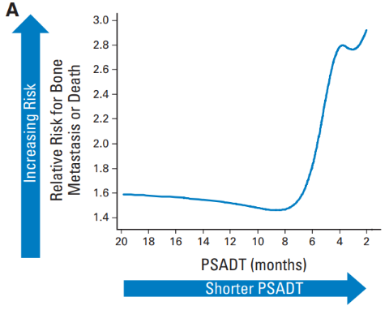


Patients With Shorter PSADT Are at a Greater Risk of Distant Metastasis and Therefore Have a High Urgency for Treatment
1/3 of nmCRPC progresses to mCRPC within 2 years on ADT alone¹⁷
In men with CRPC, PSADT is a strong predictor for the speed of disease progression in terms of development of metastases and overall survival
Patients with shorter PSADT are at a greater risk of distant metastasis
In men with prostate cancer, 5-year survival is reduced after the development of metastases¹⁹
Relative risk for bone metastasis–free survival (BMFS)²³
56% without bone metastases
3% with bone metastases
Bone metastases significantly lower QOL and increase healthcare costs¹⁸⁻²²
$

Slide 8
Systemic therapy for M0 CRPC according to Guidelines
NCCN Guidelines Prostate Cancer (Version 4.2024)¹⁶
For patients with CRPC, imaging studies negative for distant metastases and PSADT ≤ 10 months, secondary hormone therapy (with apalutamide, darolutamide or enzalutamide) is the preferred regimen [category 1 evidence]
EAU Guideline (update 2024)²
Offer apalutamide, darolutamide or enzalutamide to patients with M0 CRPC and a high risk of developing metastasis (PSA-DT < 10 months) to prolong time to metastases and overall survival [strong rating]
ESMO Guideline Prostate Cancer (update 2020/2023)^{24,41}
Apalutamide, darolutamide or enzalutamide should be considered as options for men with M0 (on bone scan and CT) CRPC and a high risk of disease progression [Evidence rating: I, B].

Slide 9
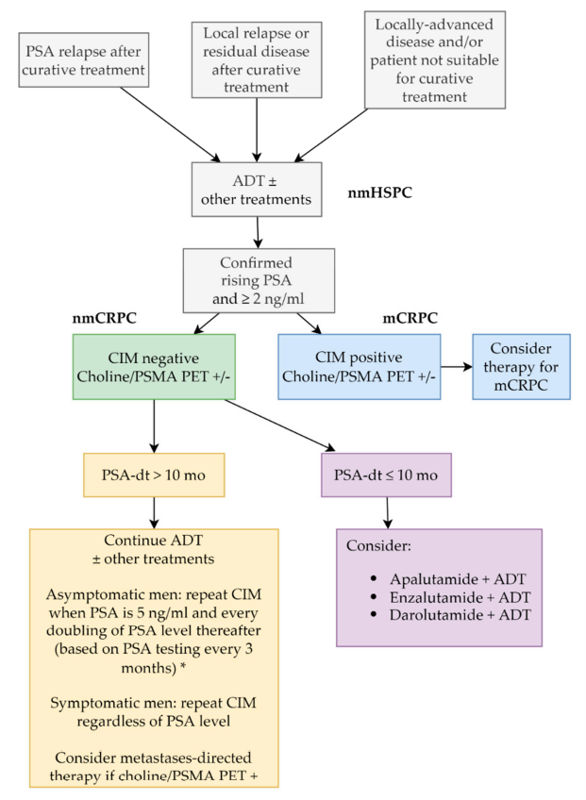
Possible algorithm of treatment in patients with nmCRPC^{3,25}
* Consensus statement by the RADAR group².
ADT: androgendeprivation therapy; CIM: conventional imaging; mCRPC: metastatic castration-resistant prostate cancer; nmCRPC: nonmetastatic castration-resistant prostate cancer; nmHSPC: nonmetastatic hormone-sensitive prostate cancer; PET: positron emission tomography; PSA: prostate-specific antigen; PSA-dt: PSA doubling time; PSMA: prostate-specific membrane antigen.

Slide 10
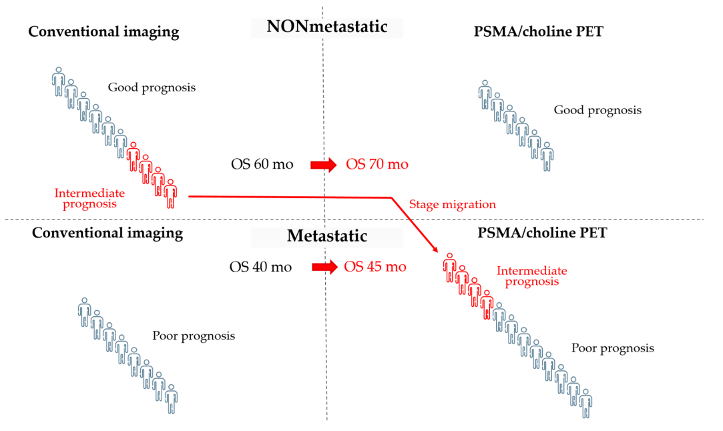
The use of PSMA-PET in nmCRPC can cause stage migration and the Will Rogers phenomenon²⁵
use of PSMA-PET results in a migration of nmCRPC to metastatic stage
the prognosis of migrated patients would be worse than that of those who remained in the nonmetastatic stage
OS= overall survival.

Slide 11
What is Darolutamide?

Slide 12
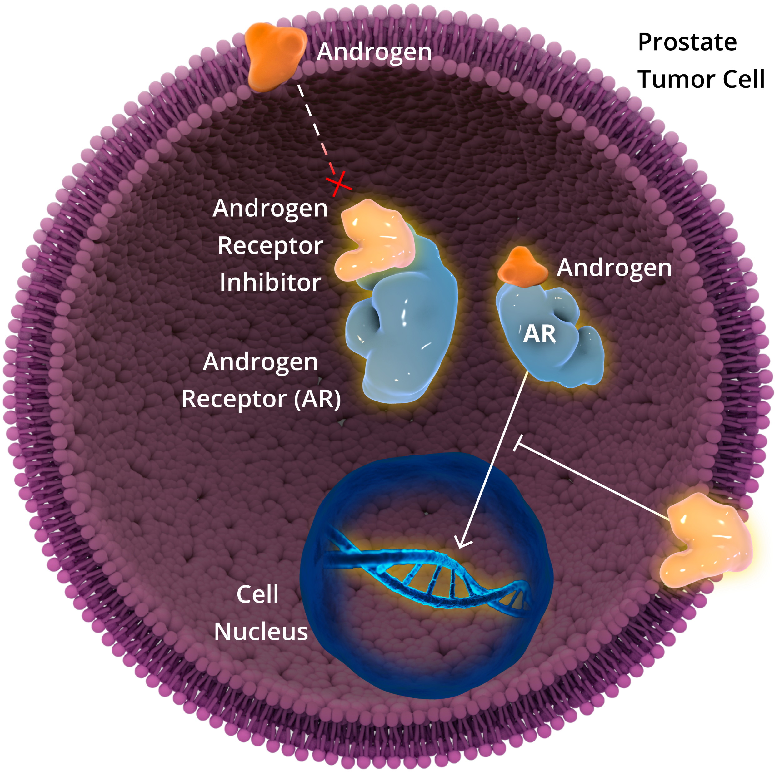
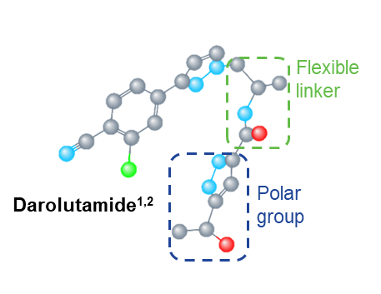
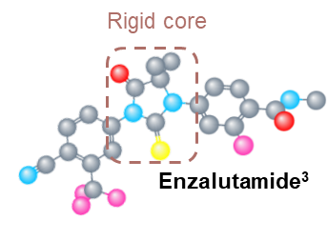
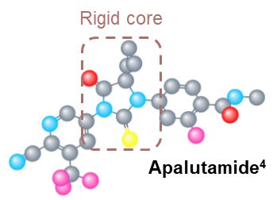
Darolutamide Is a Potent Androgen Receptor Inhibitor
Darolutamide Mechanism of Action
Darolutamide Is a Potent Androgen Receptor Inhibitor With²⁶:
Darolutamide is a potent androgen receptor inhibitor²⁵
AR inhibition blocks nuclear translocation of the AR, preventing growth and promoting apoptosis of prostate cancer cells²⁵⁻²⁸
Preclinical models have demonstrated targeting the AR can enhance taxane-induced cellular apoptosis²⁹
Darolutamide is structurally distinct from apalutamide and enzalutamide ^{25,32-34}:
Darolutamide is a more polar molecule with a flexible structure*,³²⁻³⁴
A High Binding Affinity and Selectively for the AR ²⁵
Limited Penetration of the Blood-brain Barrier in Preclinical Studies ³⁰
Limited potential for DDIs with medications commonly taken by patients with prostate cancer ^{1,30,31}
Inhibits PSA
Expression

Slide 13
ARAMIS: Phase 3 Study in nmCRPC

Slide 14
ARAMIS Trial Design^{8,35,36}
Global randomized double-blind, placebo-controlled Phase III trial investigating the safety and efficacy of darolutamide in men with nmCRPC (NCT02200614)
ADT + darolutamide
600 mg bid
Final analysis:
OS
Time to pain progression
Time to first cytotoxic chemotherapy
Time to first symptomatic skeletal event
Safety
Patients (N=1509)
Men with nmCRPC
PSADT of ≤10 months
Stratification
PSADT (≤6 vs >6 months)
Use of osteoclast-targeted therapy (yes vs no)
Primary analysis:
MFS
2:1 randomization
ADT + placebo
At the time of study unblinding (November 30, 2018), 170 patients from the placebo group crossed over to receive open-label darolutamide
Significance testing does not apply to exploratory endpoints.
ADT, androgen deprivation therapy; bid, twice a day; nmCRPC, non-metastatic castration-resistant prostate cancer; OS, overall survival; PSADT, prostate-specific antigen doubling time.

Slide 15
ARAMIS: Patient Criteria* and Treatment^{8,35}
Patients and physicians were blinded to patients’ treatment assignment but not to PSA levels
Inclusion Criteria
CRPC
High-risk nonmetastatic (M0)
PSADT of ≤10 months
PSA ≥2 ng/mL
presence of pelvic lymph nodes less than 2 cm in diameter in the short axis below the aortic bifurcation was allowed
ECOG PS 0–1
At screening:
Hb ≥ 9.0 g/dl
abs. neutrophil count ≥ 1500/µl
platelet count ≥ 100,000/µl
Exclusion Criteria
Metastases
Prior treatment with second-generation ARIs or CYP17i
Prior chemotherapy or immunotherapy for prostate cancer
Use of systemic corticosteroid
Radiation ≤12 weeks prior to randomization
Osteoclast-targeted therapy† use to prevent skeletal-related events ≤12 weeks prior to randomization
*Patients with a history of seizure were not excluded from the study.
†BHA defined as bisphosphonate or denosumab.²
ARI, androgen receptor axis inhibitor; BHA, bone health agent; bid, twice a day; CRPC, castration-resistant prostate cancer; CT, computed tomography; ECOG PS, Eastern Cooperative Oncology Group Performance Status; PSA, prostate-specific antigen; PSADT, prostate-specific antigen doubling time; Tx, treatment.

Slide 16
ARAMIS: Patient Demographics and Baseline Characteristics⁸
 | Darolutamide + ADT (N=955) | Placebo + ADT (N=554)
Median age, years (range) | 74 (48-95) | 74 (50-92)
Geographical region, n (%)
North America | 108 (11) | 76 (14)
Asia Pacific | 119 (13) | 67 (12)
Rest of world* | 728 (76) | 411 (74)
Median time from initial diagnosis (range), months | 86.2 (2.6-337.5) | 84.2 (0.5-344.7)
Baseline presence of regional pathological lymph nodes by central imaging review, n (%)
Yes | 100 (10.5) | 66 (11.9)
No | 855 (89.5) | 488 (88.1)
PSA doubling time
Median (range), months | 4.4 (0.7-11.0) | 4.7 (0.7-13.2)
≤6 months, n (%) | 667 (70) | 371 (67)
>6 months, n (%) | 288 (30) | 183 (33)
Median serum testosterone (range), nmol/L† | 0.6 (0.2-25.9) | 0.6 (0.2-7.3)
ECOG performance status, n (%)
0 | 650 (68) | 391 (71)
1 | 305 (32) | 163 (29)
Use of bone-sparing agent, n (%)
Yes | 31 (3) | 32 (6)
No | 924 (97) | 522 (94)
Prior hormonal therapy‡, n (%)
1 | 177 (19) | 103 (19)
≥2 | 727 (76) | 420 (76)
Not applicable¶ | 51 (5) | 31 (5)
*This category predominantly includes European countries (15% of these patients came from non-European countries). †Testosterone values from screening or Day 1 could be used for eligibility and all patients met the inclusion criterion of having a testosterone value lower than 1.7 nmol/L. ‡Common prior hormonal therapies for prostate cancer (received by ≥10% of all patients) included leuprorelin (52%), goserelin (32%), triptorelin (29%), bicalutamide (66%), flutamide (13%), and cyproterone (11%). ¶Patients who underwent surgical castration are not required to have been/being treated with hormonal drug therapy.

Slide 17
ARAMIS: Metastasis-free Survival (MFS) ⁸
Primary endpoint
1.0
HR 0.41 (95% CI 0.34–0.50)
P<0.001
59% risk reduction
0.9
0.8
0.7
0.6
Darolutamide + ADT: 40.4 months (median)
0.5
Survival Probability
0.4
0.3
Placebo + ADT: 18.4 months (median)
0.2
0.1
Darolutamide
Placebo
0.0
0
4
8
12
16
20
24
28
32
36
40
44
48
Number of patients at risk
Months
Darolutamide
Placebo
955
554
817
368
675
275
506
180
377
117
262
75
189
50
116
29
68
12
37
4
18
0
2
0
0
0
ADT, androgen deprivation therapy; CI, confidence interval; HR, hazard ratio; mets, metastases; MFS, metastasis-free survival.

Slide 18
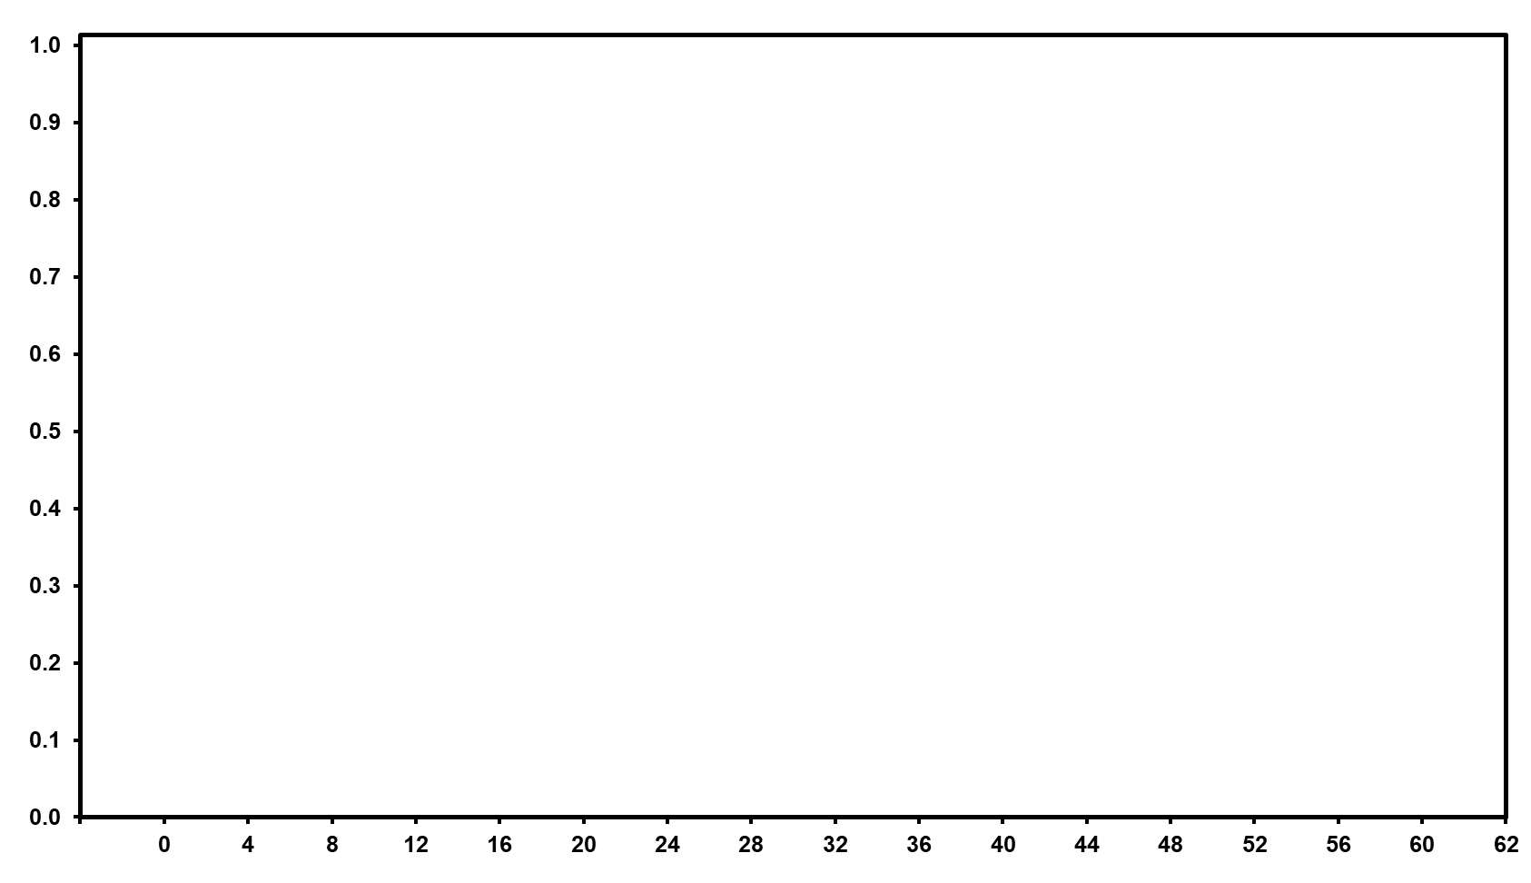

ARAMIS: Overall Survival ³⁶
Secondary endpoint -
Final Analysis
1.0
0.9
0.8
0.7
0.6
Survival Probability
0.5
0.4
Received subsequent life-prolonging therapy:
Darolutamide | Placebo
141 (15%) | 309 (56%)
170 patents from the placebo cross-over group received darolutamide
0.3
HR 0.69 (95% CI 0.53-0.88) P=0.003
31% risk reduction for death
0.2
0.1
Darolutamide + ADT
Placebo +ADT
0.0
0
4
8
12
16
20
24
28
32
36
40
44
48
52
56
60
Number of patients at risk
Months
Darolutamide
Placebo
955
554
932 530
906 497
863 460
816 432
771 394
680 333
549 261
425 182
293 130
214 93
129 54
69 28
37 16
12 4
0
0
ADT, androgen deprivation therapy; CI, confidence interval; HR, hazard ratio; NE, not estimable; OS, overall survival.

Slide 19
ARAMIS: Subsequent Life-Prolonging Therapies in Patients Who Discontinued Study Treatment ³⁶
Final Analysis
 | ARAMIS
Patients who discontinued study treatment, n (%) | DARO + ADT | PBO + ADT
Received life-prolonging therapy | 141 (15) | 309 (56)
Received systemic therapy for PC | – | –
Subsequent antineoplastic therapy | – | –
Life-prolonging therapy for CRPC received:
Darolutamide | – | 170 (31)
Docetaxel | 82 (9) | 75 (14)
Abiraterone, abiraterone acetate | 29 (3) | 33 (6)
Enzalutamide | 28 (3) | 29 (5)
Sipuleucel-T | 1 (0.1) | 2 (0.4)
Cabazitaxel | 1 (0.1) | 0 (0)

Slide 20
ARAMIS: Secondary Endpoints ³⁶
Secondary endpoints -
Final Analysis
Time to Pain Progression†
Time to First Cytotoxic Chemotherapy
Time to First Symptomatic Skeletal Event
1.0
HR 0.65 (95% CI 0.53-0.79)
P<0.001
1.0
1.0
0.9
0.9
0.9
0.8
Darolutamide + ADT: 40.3 months (median)
0.8
0.8
0.7
0.7
HR 0.58 (95% CI 0.44-0.76)
P<0.001
0.7
HR 0.48 (95% CI 0.29-0.82)
P=0.005
0.6
0.6
0.6
0.5
Time to pain progression probability
Time to initiation of cytotoxic chemotherapy probability
Time to first symptomatic skeletal event probability
0.4
Placebo + ADT: 25.4 months (median)
0.5
0.5
0.3
0.4
0.4
0.2
Darolutamide
Placebo
0.3
0.3
0.1
0.2
Darolutamide
Placebo
0.2
Darolutamide
Placebo
0.0
0.1
0.1
0
4
8
12
16
20
24
28
32
36
40
44
48
0.0
0.0
Number of patients at risk
Months
0
4
8
12
16
20
24
28
32
36
40
44
48
52
56
60
Number of patients at risk
0
4
8
12
16
20
24
28
32
36
40
44
48
52
56
60
Number of patients at risk
Months
Months
Darolutamide
Placebo
955
554
749
387
585
285
444
198
337
125
238
83
170
54
99
30
59
14
29
6
14
1
1
0
0
0
955
554
916 511
863 459
805 403
738 364
678 312
578 254
453 183
339 119
232 78
164 58
93 26
45 13
19 7
3 0
0
0
955
554
916 511
876 473
823 424
763 388
704 339
601 282
477 210
363 139
253 93
182 70
100 38
46 20
21 11
4 2
0
0
All analyses for the placebo group include the 170 patients who crossed over to darolutamide treatment during the open-label study period. CI, confidence interval; HR, hazard ratio; SSE, symptomatic skeletal event.

Slide 21
ARAMIS: Quality of Life (QOL) ^{37,38}
As men with nmCRPC generally are asymptomatic from their cancer and have good QOL, it is important to maintain their lifestyles
Darolutamide maintained QOL for patients with nmCRPC and significantly delayed deterioration of FACT-P PCS scores when compared to placebo
Darolutamide delays worsening of pain and disease-related symptoms (P<0.01 for bowel and urinary symptoms) compared with placebo
ARAMIS: Deterioration of FACT-P PCS Scores Was Significantly Delayed by Darolutamide When Compared to Placebo
FACT-P PCS | Median time to deterioration (95% CI), months
FACT-P PCS | Darolutamide (n=955) | Placebo (n=554) | Hazard ratio | HR (95% CI) | Log-rank test P value
 | 11.07 (11.04-11.14) | 7.88 (7.46-11.07) |  | 0.80 (0.70-0.91) | 0.0005
Treatment group | Events | Censored | Total
Darolutamide Placebo | 590 354 | 365 200 | 955 554
*Higher scores indicate better QOL.
CI, confidence interval; FACT-P, Functional Assessment of Cancer Therapy-Prostate; HR, hazard ratio; NE, not estimable; nmCRPC, nonmetastatic castration-resistant prostate cancer; PCS, prostate cancer subscale, QOL, quality of life.

Slide 22
ARAMIS: Summary of TEAEs ^{8,36}
Safety
 | PRIMARY ANALYSIS |  | FINAL ANALYSIS
Any AE
Grade 3 or 4
Grade 5
Serious AEs
Leading to permanent discontinuation of study drug
Darolutamide (N=954)
Placebo (N=554)
Darolutamide (N=954)
Placebo (N=544)
AE, adverse event; TEAE, treatment-emergent adverse event.

Slide 23



ARAMIS: Incidence of TEAEs^{8,36}
Safety- Final Analysis
 |  | Any Grade | Grade 3-4
Rash | Rash (primary analysis)
 | Rash (final analysis)
GI | Diarrhea
 | Nausea
Skeletal | Fractures (primary analysis)
 | Fractures (final analysis)
 | Back Pain
 | Arthralgia
 | Pain in Extremities
Hormonal | Hypothyroidismª
 | Weight Decrease
 | Hot Flush
Cardiac | Hypertension
 | Coronary Artery Disorders
 | Heart Failure
Darolutamide (N=954)
Placebo (N=554)
Darolutamide (N=954)
Placebo (N=554)
At baseline, use of concomitant bone- sparing agents^{b} was 3% in DARO arm vs 6% in PBO arm
GI, gastrointestinal; TEAE, treatment-emergent adverse event.; a Data from the primary analysis of ARAMIS⁹; b Bone-sparing agents are defined as osteoclast–targeted therapy (bisphosphonate and denosumab) used for prevention of bone loss;.

Slide 24
ARAMIS Drug-Drug Interactions Between Commonly Prescribed Drugs and AR Inhibitors
Substance class | Example | Way of interaction^{1,40,41} | Interactions
 |  |  | Apalutamid⁴⁰ | Enzalutamid³⁹ | Darolutamid¹
Antithrombotics | Warfarin | CYP2C9-Substrate | x | x
 | Clopidogrel | Inhibitor of CYP2C8, CYP2B6 and OATP1B1 |  | x
 | Dabigatran | P-gp-Substrate | x | x
 | Rivaroxaban | CYP3A4-Substrate | x | x
Calcium channel blockers | Nifedipin, Felodipin | CYP3A4-Substrate | x | x
 | Verapamil | Inhibitor of CYP3A (moderat) and P-gp; P-gp-Substrate | x | x
 | Diltiazem | CYP3A4-Inhibitor | x
 | Amlodipin | CYP3A4-Substrate | x | x
Cardiac therapies (eg glycosides) | Digoxin | P-gp-Substrate | x | x
Proton-pump inhibitors | Omeprazol | CYP2C19-Substrate; CYP2C19-Inhibitor | x | x
Analgesics | Fentanyl | CYP3A4-Substrate | x | x
Hypnotics | Diazepam | CYP2C19-Substrate | x | x
 | Midazolam | CYP3A4-Substrate | x | x
Antipsychotics | Haloperidol | Substrate von CYP3A4 and CYP2D6; CYP2D6-Inhibitor | x | x
Antibiotics | Clarithromycin | Inhibitor of CYP3A4, P-Gp, OATP1B1 and OATP1B3 | x | x | x
 | Rifampin | Induktor of CYP1A2, 2B6, 2C8, 2C9, 2C19, 3A4 and P-gp; Inhibitor of OATP1B1 and OATP1B3 | x | x | x
Anticonvulsants | Carbamazepin | Induktor of CYP2B6, CYP2C9, CYP3A4 and P-gp |  | x | x
Statines | Simvastatin | Substrate of BCRP, OATP1B1 and OATP1B3 | x | x | #
This slide was adapted from the professional information of the respective products. It is not meant to be a comparison between AR inhibitors. Before concurrent administration of two drugs consult the respective professional information of the two products.

Slide 25
ARAMIS: Concomitant Medications
Comedications (by indication) | Patients using comedication, n (%)
 | Darolutamide + ADT (N=955) | Placebo + ADT (N=554)
Any comedication | 943 (98.7) | 543 (98.0)
Cardiovascular disease Agents acting on the renin-angiotensin system Antithrombotics Lipid-modifying agents β-blocking agents Calcium channel blockers Cardiac therapies (eg, glycosides, antiarrhythmics, antianginals) Diuretics Vasoprotectives | 522 (54.7) 409 (42.8) 329 (34.5) 283 (29.6) 217 (22.7) 212(22.2) 217 (22.7) 183 (19.2) | 276 (49.8) 220 (39.7) 218 (39.4) 153 (27.6) 126 (22.7) 115 (20.8) 102 (18.4) 113 (20.4)
Pain and inflammation Analgesics Anti-inflammatories/DMARDs Corticosteroids (systemic)ª | 514 (53.8) 249 (26.1) 122 (12.8) | 279 (50.4) 124 (22.4) 81 (14.6)
Urological disorders Urologicals (eg, ED agents, BPH treatments, OAB treatments) | 299 (31.3) | 176 (31.8)
GI and metabolic disorders Acid-related disorders Antidiabetics Antidiarrheals^{b} Constipation medications | 281 (29.4) 176 (18.4) 145 (15.2) 156 (16.3) | 170 (30.7) 119 (21.5) 95 (17.1) 70 (12.6)
Infection Antibiotics (systemic) | 257 (26.9) | 138 (24.9)
Nervous system disorders Psycholeptics Psychoanaleptics | 188 (19.7) 108 (11.3) | 109 (19.7) 52 (9.4)
In ARAMIS, 98.7% of patients in the darolutamide arm and 98.0% of patients in the placebo arm received at least one concomitant medication³¹
The most common concomitant medications were antihypertensives and analgesics³¹
Concomitant use of statins and antithrombotics was common, and similar between darolutamide and placebo arms³¹
The incidence of AEs was comparable between patients treated with darolutamide and those treated with placebo, and did not appear to be increased significantly by drug-drug interactions^{8,31}
The overall incidence of drug-related TEAEs was comparable between patients receiving concomitant statins in both treatment arms³¹
The percentage of patients with dose modifications or who permanently discontinued the study drug due to AEs was also comparable between the study arms^{8,31}

Slide 26
ARAMIS Conclusions
Efficacy
Darolutamide + ADT improved MFS by a median of 22 months (40.4 months vs 18.4 months with placebo + ADT; HR 0.41; P<0.001)⁸
Darolutamide significantly reduced the risk of death by 31% in men with nmCRPC (HR 0.69; 95% CI 0.53-0.88; P=0.003)³⁶
Darolutamide significantly improved clinically meaningful endpoints including: delaying pain progression by ~15 months, significant delay in time to initiation of cytotoxic chemotherapy (HR 0.58) and in time to first SSE (HR 0.48)
Safety
In the final analysis of ARAMIS, darolutamide continued to only show ≤2% differences between the darolutamide and placebo arms for most AEs of interest³⁶
Fatigue was the only AE with more than 10% incidence in the darolutamide arm (13.2% vs 8.3% in the placebo arm)³⁶
Discontinuation rates due to AEs in the ARAMIS final analysis remained unchanged and were similar to placebo, highlighting the favorable tolerability profile for darolutamide
Quality of Life
HRQOL was maintained in patients treated with darolutamide + ADT^{37,38}
Darolutamide + ADT demonstrated clinically significant delays in time to deterioration of local symptoms compared with placebo + ADT^{37,38}

Slide 27
References
Professional Information NUBEQA; www.swissmedicinfo.ch, Stand June 2022
EAU – EANM – ESTRO – ESUR – SIOG Guidelines on Prostate Cancer 2024. Available at: https://uroweb.org/guideline/prostate-cancer/. Accessed June 2024
Crawford, E.D., et al. Challenges and recommendations for early identification of metastatic disease in prostate cancer. Urology, 2014. 83: 664
Luo J, Beer TM, Graff JN. Treatment of Nonmetastatic Castration-Resistant Prostate Cancer. Oncology (Williston Park). 2016;30(4):336-344.
Selli C et al. Burden of Illness in Prostate Cancer Patients with a Low-to-Moderate Risk of Progression: A One-Year, Pan-European Observational Study. Prostate Cancer. 2014;2014:472949.
Ryan CJ et al. The IMAAGEN Study: Effect of Abiraterone Acetate and Prednisone on Prostate Specific Antigen and Radiographic Disease Progression in Patients with Nonmetastatic Castration Resistant Prostate Cancer. J Urol. 2018;200:344-352.
Parker C, et al. Alpha emitter radium-223 and survival in metastatic prostate cancer. N Engl J Med. 2013;369(3):213-223.
Fizazi K et al. Darolutamide in Nonmetastatic, Castration-Resistant Prostate Cancer. N Engl J Med. 2019;380:1235-1246.
Smith MR et al. Apalutamide Treatment and Metastasis-free Survival in Prostate Cancer. N Engl J Med. 2018;378:1408-1418.
Hussain M et al. Enzalutamide in Men with Nonmetastatic, Castration-Resistant Prostate Cancer. N Engl J Med. 2018;378:2465-2474.
Beer TM et al. Enzalutamide in Men with Chemotherapy-naïve Metastatic Castration-resistant Prostate Cancer: Extended Analysis of the Phase 3 PREVAIL Study. Eur Urol 2017;71:151-154.
Beer TM et al. Enzalutamide in metastatic prostate cancer before chemotherapy. N Engl J Med. 2014;371:424-433.
Ryan CJ et al. Abiraterone in metastatic prostate cancer without previous chemotherapy. N Engl J Med. 2013;368:138-148.
Pezaro CJ, et al. Visceral disease in castration-resistant prostate cancer. Eur Urol. 2014;65(2):270-273.
Ryan CJ, et al. Abiraterone acetate plus prednisone versus placebo plus prednisone in chemotherapy-naive men with metastatic castration-resistant prostate cancer (COU-AA-302): final overall survival analysis of a randomised, double-blind, placebo-controlled phase 3 study. Lancet Oncol. 2015;16(2):152-160.
NCCN Guidelines® Prostate Cancer. Version 4.2024. Available at: https://www.nccn.org . Accessed June 2024.
Kirby M, et al. Characterising the castration-resistant prostate cancer population: a systematic review. Int J Clin Pract. 2011;65(11):1180-1192.
Nørgaard M, et al. Skeletal related events, bone metastasis and survival of prostate cancer: a population based cohort study in Denmark (1999 to 2007). J Urol. 2010;184(1):162-167.
Hagiwara M, et al. Healthcare utilization and costs associated with skeletal-related events in prostate cancer patients with bone metastases. Prostate Cancer Prostatic Dis. 2013;16(1):23-27.
Jayasekera J, et al. The economic burden of skeletal-related events among elderly men with metastatic prostate cancer. Pharmacoeconomics. 2014;32(2):173-191.
McDougall JA, et al. The Clinical and Economic Impacts of Skeletal-Related Events Among Medicare Enrollees With Prostate Cancer Metastatic to Bone. Oncologist. 2016;21(3):320-326.
Lage MJ, et al. The cost of treating skeletal-related events in patients with prostate cancer. Am J Manag Care. 2008;14(5):317-322.
Smith MR, et al. Denosumab and bone metastasis-free survival in men with nonmetastatic castration-resistant prostate cancer: exploratory analyses by baseline prostate-specific antigen doubling time. J Clin Oncol. 2013;31(30):3800-3806.
Parker C. et al, Prostate Cancer: ESMO Clinical Practice Guidelines for diagnosis, treatment and follow-up, Annals of Oncology 2020,Volume 31, Issue 9, 1119-1133
Moilanen A, et al. Discovery of ODM-201, a new-generation androgen receptor inhibitor targeting resistance mechanisms to androgen signaling-directed prostate cancer therapies. Sci Rep. 2015;5:12007.
Sasaki T, Sugimura Y. The Importance of Time to Prostate-Specific Antigen (PSA) Nadir after Primary Androgen Deprivation Therapy in Hormone-Naïve Prostate Cancer Patients. J Clin Med. 2018;7(12):565-574.
Balk SP, et al. AR, the cell cycle, and prostate cancer. Nucl Recept Signal. 2008;6:e001.
Wen S, et al. Androgen receptor (AR) positive vs negative roles in prostate cancer cell deaths including apoptosis, anoikis, entosis, necrosis and autophagic cell death. Cancer Treat Rev. 2014;40(1):31-40.
Mout L, et al. Continued androgen signalling inhibition improves cabazitaxel efficacy in prostate cancer. EBioMedicine. 2021;3:103681.
Palmieri VE, et al. Darolutamide in hormone-sensitive and castration-resistant prostate cancer. Expert Rev Clin Pharmacol. 2021 May;14(5):535-544.
Shore N, et al. Evaluation of Clinically Relevant Drug-Drug Interactions and Population Pharmacokinetics of Darolutamide in Patients with Nonmetastatic Castration-Resistant Prostate Cancer: Results of Pre-Specified and Post Hoc Analyses of the Phase III ARAMIS Trial. Target Oncol. 2019;14:527-539.
PubChem. Compound ID: 67171867. Accessed: August 2022.
Pubchem. Compound ID: 15951529. Accessed: August 2022.
DrugCentral 2021. Drug ID: 5278. https://drugcentral.org/drugcard/5278?q=apalutamide. Accessed: August 2022.
ClinicalTrials.gov identifier: NCT02200614.
Fizazi K, et al. Nonmetastatic, Castration-Resistant Prostate Cancer and Survival with Darolutamide. N Engl J Med. 2020;383:1040-1049.
Smith MR, et al. Darolutamide and health-related quality of life in patients with non-metastatic castration-resistant prostate cancer: An analysis of the phase III ARAMIS trial. Eur J Cancer. 2021; 154:138-146.
Shore N, et al. Impact of darolutamide on local symptoms in patients with nonmetastatic castration-resistant prostate cancer. Presented at the American Urological Association 2021 Annual Meeting. September 10-13, 2021; Abstract PD34-10.
Professional Information Xtandi; www.swissmedicinfo.ch, Stand March 2022
Professional Information Erleada; www.swissmedicinfo.ch, Stand April 2022
Fizazi K, Gillessen S. Updated treatment recommendations for prostate cancer from the ESMO Clinical Practice Guideline considering treatment intensification and use of novel systemic agents. Ann Oncol. 2023 Jun;34(6):557-563.

Slide 28
Short Professional Information
▼ This medicinal product is subject to additional monitoring. For further information, see Summary of Product Characteristics/Patient Information Leaflet for NUBEQA® at www.swissmedicinfo.ch.
Short product information NUBEQA®
Active substance: Darolutamide. Indication: NUBEQA, in combination with docetaxel and androgen deprivation therapy (ADT), is indicated for the treatment of adult patients with metastatic hormone-sensitive prostate cancer (mHSPC), for whom docetaxel therapy is indicated. NUBEQA, in combination with ADT, is indicated for the treatment of adult patients with non-metastatic, castration-resistant prostate cancer (nmCRPC), for those who are at high risk of developing metastases (especially with a PSADT ≤ 10 months). Dosage/Administration: 600 mg (two 300-mg film-coated tablets) taken twice daily with a meal (total daily dose of 1200 mg). Patients receiving NUBEQA should also receive an LHRH analogue concurrently or have had a bilateral orchiectomy. Patients with mHSPC should start treatment with NUBEQA in combination with six cycles of docetaxel. Contraindications: Hypersensitivity to the active pharmaceutical ingredient or to one of the excipients. Women who are pregnant or of childbearing potential. Special warnings/precautions for use: Renal/hepatic impairment: Closely monitor patients with severe renal impairment or moderate/severe hepatic impairment for adverse reactions. Hepatotoxicity: In case of liver function test abnormalities suggestive of idiosyncratic DILI, NUBEQA must be permanently discontinued. ADT can prolong the QT interval: In case of risk factors or concomitant medication that prolong the QT interval, ECG monitoring should be considered. Contraception: Sexually active patients must use a highly effective form of contraception. Bone density: may be affected during treatment with NUBEQA due to long-term testosterone suppression. Recent cariovascular disease: The safety of NUBEQA in patients with a clinically relevant cardiovascular disease in the last six months has not been proven, follow current guidelines. The prescribed dose is practically “sodium free”. Do not take if you have hereditary galactose intolerance, total lactase deficiency, or glucose-galactose malabsorption. Adverse effects: NUBEQA: Very common: Neutrophil count decreased, AST increased, bilirubin increased, fatigue. Common: Ischaemic heart disease, cardiac failure, rash, pain in extremities, musculoskeletal pain, fractures. NUBEQA in combination with docetaxel: Very common: Hypertension including occasional hypertensive emergency, AST increased, ALT increased, bilirubin increased, rash. Interactions: BCRP inhibitor, OATP 1B1 and 1B3, in the case of concurrent use with corresponding substrates, follow the recommendations in the respective prescribing information. Weak CYP3A4 inducer. Substrate of CYP3A4, P-gp, and BCRP. Use of strong CYP3A4 inducers and P-gp inducers during treatment with NUBEQA should be avoided. Dispensing category: B. Authorization holder: Bayer (Schweiz) AG, Uetlibergstrasse 132, 8045 Zurich. For detailed information, please refer to the published medicinal product information at www.swissmedicinfo.ch.
MA-M_DAR-CH-0198-3 12/23

