Slide 1
Clinical presentation of patients with nvAF
Management of nvAF Patients with Diabetes

Slide 2

Why do nvAF patients with diabetes need
your extra attention?
Diabetes frequency in nvAF up to¹
Higher cardiovascular risk for
nvAF patients with diabetes
Stroke and systemic embolism^{2,3}
49%
Major adverse cardiovascular events (MACE)²
Major adverse limb events (MALE)²
PP-XAR-CH-0470-2_06.2021
      …and facing 18% higher risk of CV death.⁴
CV: cardiovascular; nvAF: non valvular atrial fibrillation

Slide 3
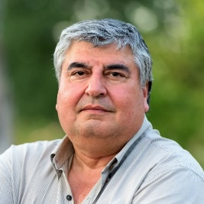




Patient with nvAF: Holistic view of protection
The Atrial Fibrillation Better Care (ABC) approach is embedded
in ESC 2020 guidelines⁵
A
Anticoagulation /
Avoid stroke
B
C
Comorbidities /
Cardiovascular risk
factor management
Better symptom
control
Identify low-risk patients who
do not need OAC
Consider stroke prevention if CHA₂DS₂-VASc ≥1(m), 2(f)
Assess bleeding risk, address modifiable bleeding risk factors
Choose OAC
(NOAC in preference to VKA*)
Assess symptoms,
QoL and patient’s preferences
Optimise rate control
Consider a rhythm control strategy (CV, AADs, ablation)
Comorbidities and cardiovascular
risk factors
Lifestyle changes (obesity reduction, regular exercise, reduction of alcohol use etc.)
PP-XAR-CH-0470-2_06.2021
* Except for patients with mechanical heart valves or moderate-to-severe mitral stenosis.
nvAF: non valvular atrial fibrillation; CV: cardiovascular; VKA: vitamin K antagonist; OAC: oral anticoagulant; AAD: antiarrhythmic drug; QoL: quality of life; NOAC: non vitamin K antagonist oral anticoagulant; ESC: european society of cardiology; f: female; m: male

Slide 4





How do you protect Mr. Marty?
Up to 2 in 5 patients with nvAF have diabetes and are at
greater risk of stroke^{3,6,7}
Mr. Marty
64 years old
Non-valvular atrial fibrillation
Diabetes
Hypertension
Overweight
Diabetes is associated
with an 11% ↑ risk
of major CV events^{*8}
and 18% ↑ risk of CV death^{†4}
Limb events remain a major problem for patients with nvAF and diabetes⁹
Taking my dog to the park is
a big part of my social life,
and I want to keep doing that
for years to come.
A B C pathway⁵
PP-XAR-CH-0470-2_06.2021
* In patients with nvAF and either CAD, CVD, PAD or ≥3 risk factors for atherosclerotic disease; †In patients with diabetes.
nvAF: non valvular atrial fibrillation; CV: cardiovascular

Slide 5
Protecting nvAF patients requires consideration
of cardiovascular death as well as stroke¹⁰
Prespecified diabetes subanalysis (n=5695)
HR 0.82
(95% CI 0.63–1.08)
HR 0.80
(95% CI 0.64–0.99)
HR 1.0
(95% CI 0.81–1.24)
VKA
Rivaroxaban
RRR
20%
HR 0.62
(95% CI 0.36–1.05)
PP-XAR-CH-0470-2_06.2021
In the total population of the ROCKET AF study, there was no significant difference with regards to the endpoint “cardiovascular death” or the primary safety endpoint “severe and non-severe bleeding” vs. VKA.
CI: confidence interval; HR: hazard ratio; RRR: relative risk reduction; SE: systemic embolism; VKA: vitamin k antagonist

Slide 6
Consistent efficacy & safety of factor Xa inhibitors vs VKA in nvAF patients with diabetes
Proportion of diabetic patients: |  |  | 40% |  | 25% |  | 36%
 |  |  | ROCKET-AF¹⁰ |  | ARISTOTLE¹¹ |  | ENGAGE¹²
Outcome | Rivaroxaban events/100 PY (total events) n=2878 | VKA events/100 PY (total events) n=2817 | HR (95% Cl) | HR (95% Cl) | HR (95% Cl) | HR (95% Cl) | HR (95% Cl) | HR (95% Cl)
Primary efficacy outcome: Stroke or SE | 1.74 (95) | 2.14 (114) |  | 0.82 (0.63–1.08) |  | 0.75 (0.53–1.05) |  | 0.98 (0.72–1.35)
Vascular death* | 2.83 (152) | 3.65 (192) |  | 0.80 (0.64–0.99) |  | 0.89 (0.66–1.20) |  | 1.03 (0.82–1.30)
Major bleeding | 3.79 (165) | 3.90 (169) |  | 1.00 (0.81–1.24) |  | 0.96 (0.74–1.25) |  | 0.87 (0.70–1.09)
PP-XAR-CH-0470-2_06.2021
No head-to-head comparison
0.1
1
2
0
1
2
0
1
2
Favours
Rivaroxaban
Favours
VKA
Favours
Apixaban
Favours
VKA
Favours
Edoxaban
Favours
VKA
* Results for vascular death are from post hoc analysis.
CI: confidence interval; HR: hazard ratio; NOAC: non-vitamin K antagonist oral anticoagulant; nvAF: non valvular atrial fibrillation; SE: systemic embolism; PY: patient year; VKA: vitamin k antagonist

Slide 7
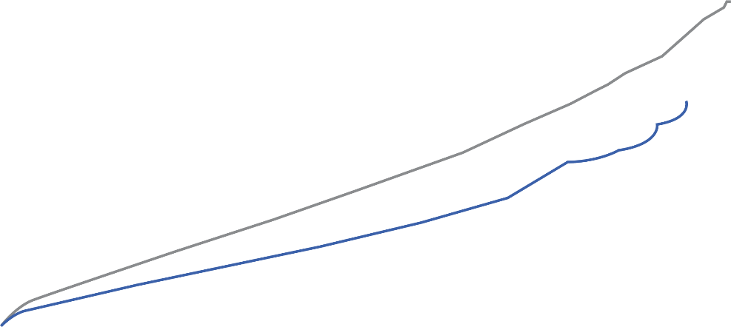
Consistent protection for nvAF patients could be
observed in real-life¹
Stroke, systemic embolism, or vascular death
VKA (n=83’971)
Rivaroxaban (n=32’078)
nvAF patients with diabetes treated with Rivaroxaban could benefit from a 10% RRR of vascular death vs VKA.¹
One minus cumulative survival
Time (days)
PP-XAR-CH-0470-2_06.2021
Optum EHR data set claims data in patients with atrial fibrillation and diabetes from 11/2010 to 12/2019; 31% of patients in the Rivaroxaban arm were on a reduced dose of 15 mg OD. The median follow-up was 2.9 years.
nvAF: non valvular atrial fibrillation; RRR: relative risk reduction; VKA: vitamin k antagonist

Slide 8

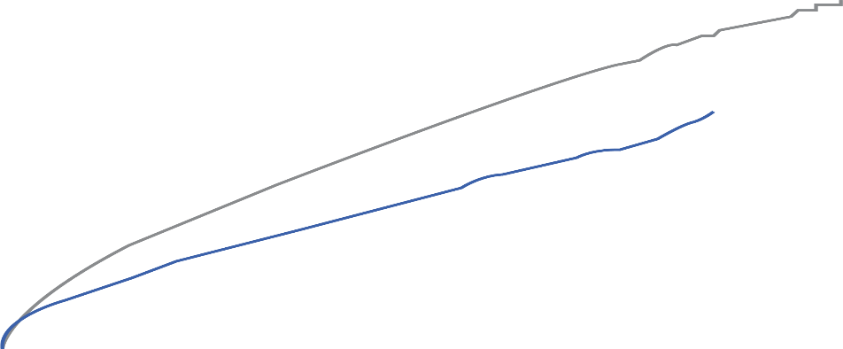

In real-life, Rivaroxaban was associated with fewer bleeding-related hospitalizations vs VKA¹
Hospitalization for major or clinically relevant nonmajor bleed
Critical organ
bleedings
significantly
reduced
VKA (n=83’971)
RRR
37%
Rivaroxaban (n=32’078)
Intracranial hemorrhage significantly
reduced
One minus cumulative survival
RRR
28%
Time (days)
PP-XAR-CH-0470-2_06.2021
Optum EHR data set claims data in patients with atrial fibrillation and diabetes from 11/2010 to 12/2019; 31% of patients in the Rivaroxaban arm were on a reduced dose of 15 mg OD.
The median follow-up was 2.9 years.
nvAF: non valvular atrial fibrillation; RRR: relative risk reduction; VKA: vitamin k antagonist

Slide 9
nvAF patients with diabetes like Mr. Marty
fear amputation almost as much as blindness or death⁹
Major adverse limb events in nvAF patients with diabetes²
HR 0.37
(95% CI 0.21–0.65)
Consistent rates of major bleeding in this real-life
analysis and the phase III study ROCKET-AF.^{2,10}
RRR
63%
PP-XAR-CH-0470-2_06.2021
MarketScan claims data in patients with atrial fibrillation and diabetes; 24% of patients in the Rivaroxaban arm were on a reduced dose of 15 mg OD.
CI: confidence interval; HR: hazard ratio; nvAF: non valvular atrial fibrillation; PY: patient year; RRR: relative risk reduction; VKA: vitamin k antagonist

Slide 10
Imagine that nvAF patients like Mr. Marty’s kidney function is deteriorating additionally
Incidence of kidney disease frequency in Type 2 diabetes¹³
Faster deterioration in kidney function
in diabetes patients compared to non-diabetes patients¹⁴
40%
×2
PP-XAR-CH-0470-2_06.2021
      >70% of patients with T2DM die from cardiovascular causes.¹⁵
T2D: type 2 diabetes

Slide 11

How do you keep him protected?
Kidney disease occurs in
around 1 in 3 patients with
type 2 diabetes¹⁶
Mr. Marty
64 years old
Non-valvular atrial fibrillation
Diabetes
Hypertension
Overweight
Moderate renal impairment
Diabetes is a major
cause of kidney failure
requiring dialysis¹⁷
nvAF patients with chronic kidney disease and diabetes are more likely to die from CV causes
than those without diabetes¹⁸
My friend ended up on dialysis
and I’m really scared that
could happen to me too.
A B C pathway⁵
PP-XAR-CH-0470-2_06.2021
Rivaroxaban is not recommended in patients with CrCl <15 ml/min.¹⁹
CV: cardiovascular

Slide 12
In nvAF patients, NOAC use was associated
with lower decline of renal function vs. VKA
ORBIT-AF registry (n=6682)
VKA
NOAC
p<0.0001
p<0.0001
Patients with nvAF
face renal decline over time.²⁰
p<0.0001
PP-XAR-CH-0470-2_06.2021
Study period was 2 years
Cr: creatinine; CrCl: creatinine clearance; NOAC: non-vitamin K antagonist oral anticoagulant; nvAF: non valvular atrial fibrillation ; VKA: vitamin k antagonist .

Slide 13
There is a chance to preserve Mr. Marty’s kidneys instead of having to replace them²¹
Patients with nvAF and diabetes (n=21’682)
HR 0.83
(95% CI 0.74–0.92)
HR 0.82
(95% CI 0.70–0.96)
VKA
Rivaroxaban
PP-XAR-CH-0470-2_06.2021
MarketScan claims data; 22.6% on a reduced dose of 15 mg OD; patients with baseline stage 5 chronic kidney disease or undergoing haemodialysis excluded; hazard ratios estimated using Cox regression.
CKD: chronic kidney disease; CI: confidence interval; nvAF: non valvular atrial fibrillation ; PY: patient year; VKA: vitamin k antagonist .

Slide 14



Mr. Marty may have a lower risk of renal decline
on Rivaroxaban than on VKA
nvAF patients with diabetes²²
Events/100 PY
HR (95% CI)
AF patients¹
Events (n)
HR (95% CI)
Rivaroxaban
VKA
≥30% decline in eGFR | 17.25 | 25.46 | 0.68 (0.53–0.86)
Doubling of serum creatinine | 2.11 | 4.26 | 0.50 (0.26–0.97)
Acute kidney injury* | 11.07 | 14.70 | 0.75 (0.58–0.97)
Kidney failure† | 1.30 | 1.95 | 0.67 (0.32–1.41)
Cited in 2019 guideline update²³
Favours
Rivaroxaban
Favours
VKA
PP-XAR-CH-0470-2_06.2021
Data from subgroup analysis of diabetic patients.
* Defined as a hospitalisation or emergency department visit with a diagnosis code of AKI at the primary or secondary position; †Defined as eGFR <15 mL/min/1.73 m², having kidney transplant, or undergoing long-term dialysis.
CI: confidence interval; HR: hazard ratio; eGFR, estimated glomerular filtration rate; nvAF: non valvular atrial fibrillation; PY: patient year; VKA: vitamin k antagonist

Slide 15


Ensure your nvAF patients with diabetes like Mr. Marty remain protected beyond stroke
PP-XAR-CH-0470-2_06.2021

Slide 16
References
1. Coleman CI, et al. Thromboembolism, bleeding and vascular death in nonvalvular atrial fibrillation patients with type 2 diabetes receiving Rivaroxaban or warfarin. Cardiovasc Diabetol 2021;20(1):52.
2. Baker WL, et al. Effectiveness and safety of Rivaroxaban and warfarin for prevention of major adverse cardiovascular or limb events in patients with non-valvular atrial fibrillation and type 2 diabetes. Diabetes Obes Metab2019;21(9):2107–2114.
3. Patel MR, et al. Rivaroxaban versus warfarin in nonvalvular atrial fibrillation. N Engl J Med 2011;365(10):883–891.
4. Raghavan S. et al. Diabetes Mellitus–Related All-Cause and Cardiovascular Mortality in a National Cohort of Adults. J Am Heart Assoc 2019;8(4):e011295.
5. Hindricks G, et al. 2020 ESC Guidelines for the diagnosis and management of atrial fibrillation developed in collaboration with the European Association for Cardio-Thoracic Surgery (EACTS). Eur Heart J 2020;42(5):373–498.
6. Giugliano RP, et al. Edoxaban versus Warfarin in Patients with Atrial Fibrillation. N Engl J Med 2013;369(22):2093–2104.
7. Granger CB, et al. Apixaban versus Warfarin in Patients with Atrial Fibrillation. N Engl J Med 2011;365(11):981–992.
8. Miao B, et al. Four-year incidence of major adverse cardiovascular events in patients with atherosclerosis and atrial fibrillation.Clin Cardiol 2020;43(5):524–531
9. Wukich DK, Raspovic KM and Suder NC. Patients With Diabetic Foot Disease Fear Major Lower-Extremity Amputation More Than Death. Foot Ankle Spec 2018;11(1):17–21.
10. Bansilal S, et al. Efficacy and safety of Rivaroxaban in patients with diabetes and nonvalvular atrial fibrillation: the Rivaroxaban Once-daily, Oral, Direct Factor Xa Inhibition Compared with Vitamin K Antagonism for Prevention of Stroke and Embolism Trial in Atrial Fibrillation (ROCKET AF Trial).Am Heart J 2015;170(4):675–682.e8.
11. Ezekowitz JA, et al. Clinical outcomes of patients with diabetes and atrial fibrillation treated with Apixaban: results from the ARISTOTLE trial. Eur Heart J Cardiovasc Pharmacother 2015;1(2):86–94.
12. Plitt A, et al. Efficacy and safety of edoxaban in patients with diabetes mellitus in the ENGAGE AF-TIMI 48 trial. Supplemental Appendix. Int J Cardiol. 2020;304:185–191.
13. Cosentino F, et. al. 2019 ESC Guidelines on diabetes, pre-diabetes, and cardiovascular diseases developed in collaboration with the EASD: The Task Force for diabetes, pre-diabetes, and cardiovascular diseases of the European Society of Cardiology (ESC) and the European Association for the Study of Diabetes (EASD).Eur Heart J 2019;41(2),255–323.
14. Hemmelgarn BR, et al. Progression of kidney dysfunction in the community-dwelling elderly. Kidney Int 2006;69(12):2155-2161.
15. Laakso M. Cardiovascular disease in type 2 diabetes from population to man to mechanisms: the Kelly West Award Lecture 2008. Diabetes Care 2010 Feb;33(2):442–449.
16. Pecoits-Filho P, et al. Interactions between kidney disease and diabetes: dangerous liaisons. Diabetol Metab Syndr 2016;8:50
17. Kramer A, et al. ERA-EDTA Registry: Renal replacement therapy in Europe: a summary of the 2013 ERA-EDTA Registry Annual Report with a focus on diabetes mellitus. Clin Kidney J 2016;9(3):
457–469.
18. Fox CS, et al. Associations of kidney disease measures with mortality and end-stage renal disease in individuals with and without diabetes: a meta-analysis. Lancet 2012;380(9854):1662–1673.
19. Information professionnelle Xarelto®: www.swissmedicinfo.ch
20. Inohara T, et al. Decline in renal function and oral anticoagulation dose reduction among patients with atrial fibrillation. Heart 2020;106(5):358–364.
21. Hernandez AV, et al. Rivaroxaban vs. warfarin and renal outcomes in non-valvular atrial fibrillation patients with diabetes. Eur Heart J Qual Care Clin Outcomes 2020;6(4):301–307.
22. Yao X, et al. Renal Outcomes in Anticoagulated Patients With Atrial Fibrillation.J Am Coll Cardiol 2017;70(21):2621–2632.
23. January CT et al. 2019 AHA/ACC/HRS Focused Update of the 2014 AHA/ACC/HRS Guideline for the Management of Patients With Atrial Fibrillation: A Report of the American College of Cardiology/American Heart Association Task Force on Clinical Practice Guidelines and the Heart Rhythm Society. J Am Coll Cardiol. 2019;74(1):104–132.
PP-XAR-CH-0470-2_06.2021

Slide 17
Xarelto®
Abbreviated Summary of Product Characteristics
Abbreviated Summary of Product Characteristics of Xarelto® (rivaroxaban):
Direct factor Xa inhibitor C: Film-coated tablets with 10, 15 and 20 mg rivaroxaban; granules for the preparation of a suspension with 1 mg/ml rivaroxaban. I: Adults: a) Thrombosis prophylaxis for major orthopaedic procedures on the lower extremities, such as hip or knee prostheses. b) Treatment of pulmonary embolism (PE) and deep vein thrombosis (DVT) as well as prophylaxis of recurring DVT and PE. c) Prophylaxis of stroke and systemic embolism in patients with nonvalvular atrial fibrillation; Pediatric population: Treatment of venous thromboembolism (VTE) after initial parenteral anticoagulation for the prophylaxis of recurrent VTE. D: a) 10 mg 1×/day b) 15 mg 2×/day for the first 21 days, followed by 20 mg 1×/day; from month 7: 20 mg 1×/day or 10 mg 1×/day based on an individual benefit-risk evaluation c) 20 mg 1×/day; for CrCl of 15–49 ml/min: 15 mg 1×/day Take 15 mg and 20 mg with food. Pediatric population: depending on body weight, after at least 5 days of initial treatment with common parenteral anticoagulants. CI: hypersensitivity to any ingredients, acute bacterial endocarditis, clinically significant active bleeding, severe liver disease/hepatic impairment (HI) with a comparatively higher risk of bleeding; mild HI in combination with coagulopathy, renal impairment (RI) requiring dialysis, acute gastrointestinal (GI) ulcers or ulcerative GI disorders, pregnancy, lactation. W: concomitant medication (cf. “IA”); artificial heart valves; drugs affecting haemostasis. PM: RI (CrCl 15–29 ml/min) or RI in combination with drugs increasing the Xarelto® plasma level, increased risk of uncontrolled bleeding and haemorrhagic diathesis, recent haemorrhagic stroke, intracranial or intracerebral haemorrhage, recent GI ulcers/ulcerative disorders, severe uncontrolled hypertension, vascular retinopathy, intraspinal and intracerebral vascular anomalies, recent brain, spinal or eye surgery, medical history of bronchiectasis or pulmonary bleeding, spinal anaesthesia or puncture, discontinue at least 24 hours before invasive/surgical procedures, concomitant administration of drugs influencing haemostasis, APS, individual cases of agranulocytosis and SJS were reported. Common ADRs: bleeding, anaemia, dizziness, headache, eye haemorrhage, haematoma, epistaxis, haemoptysis, nausea, obstipation, diarrhoea, elevated liver enzymes (ASAT, ALAT), pruritus, rash, pain in the extremities, fever, peripheral oedema, asthenia. IA: Strong CYP 3A4 + P-gp inhibitors (ritonavir, ketoconazole), strong CYP 3A4 + P-gp inducers (rifampicin, carbamazepine, phenobarbital, St.John’s wort), drugs influencing haemostasis. Pack sizes: 10 & 30×10 mg film-coated tablets; 14, 28 & 98×15 mg or 20 mg film-coated tablets; hospital packs of 10×1 film-coated tablets. (B), covered by health insurance companies (refer to Limitatio); granules for the preparation of a suspension (50 ml and 100 ml). Additional information available from www.swissmedicinfo.ch. Distribution: Bayer (Schweiz) AG, Uetlibergstrasse 132, 8045 Zurich.
MA-M_RIV-CH-0185-1_06.2021
PP-XAR-CH-0470-2_06.2021

