Slide 1
What does protection mean for patients with VTE?
Management of patients with venous thromboembolism

Slide 2
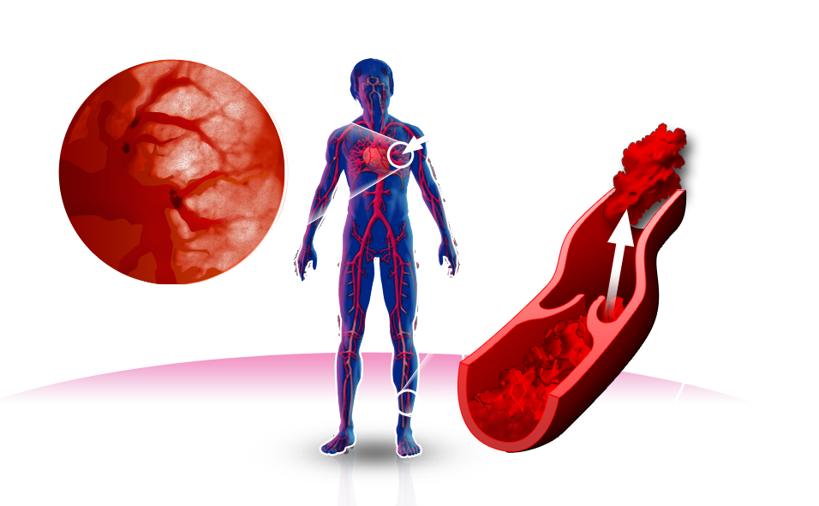
Deep vein thrombosis (DVT) and pulmonary embolism (PE)
Pulmonary embolism
PE occurs when parts of the clot detach and travel in the blood (embolus) to block vessels in the lungs
Migration
Embolus
As the venous clot grows (thrombus), it extends along the vein
Thrombus
Deep vein thrombosis
DVT: deep vein thrombosis; PE: pulmonary embolism

Slide 3
VTE is a major cause of death in Europe^{1,2}
Deaths resulting from common cancers
Deaths resulting from VTE
Prostate
Breast
Number of deaths
Lung
VTE: venous thromboembolism

Slide 4

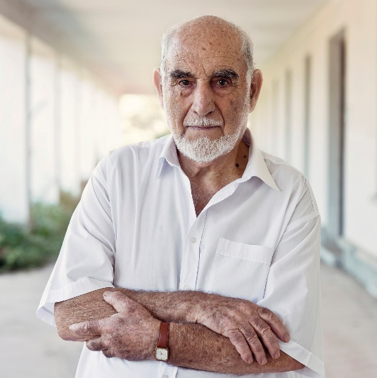

How would you protect patients with VTE like Mr. Bucher?
20% of patients with VTE have renal impairment³
Mr. Bucher
70 years old
Pulmonary embolism with no identified provoking factor
CrCl 47 ml/min
Renal impairment is associated with a 2–5× risk of fatal PE⁴
…and a 3× risk of major bleeding vs. VTE patients without renal impairment³
I had a blood clot and my doctor says my kidneys aren't working so well. I really hope that doesn’t cause more problems.
VTE: venous thromboembolism; CrCL: creatinine clearance; PE: pulmonary embolism

Slide 5

Mr. Bucher needs effective protection during the high-risk acute phase of VTE
Meta-analysis of 15 trials in VTE* (n=27’237): Risk of VTE recurrence over time⁵
Initial high-risk period
Rates of recurrent VTE (per PT/YR)
Time after index event (weeks)
* A literature search of MEDLINE, EMBASE and CENTRAL during April 2013 identified randomised control trials of acute pharmacological treatment and prevention of recurrent VTE, enrolling >200 subjects/treatment arm, requiring anticoagulation for =3 months and reporting time to objectively confirmed recurrent VTE (N=27’237).⁵
PT: patient; VTE: venous thromboembolism; YR: year

Slide 6
Protect your patients during the high-risk
acute phase of VTE
EINSTEIN PE subanalysis (n=347): Clot resolution after 21 days of anticoagulation with rivaroxaban 15 mg BID* for PE⁶
87%
…of patients treated with rivaroxaban experienced complete or partial resolution (n=180).#
* Pre-defined safety analysis of the EINSTEIN PE study involving 347 patients with scan-confirmed PE who received a follow-up CT or Q-scan after 21 days of anticoagulant therapy.⁶ # Overall rates of clot resolution were comparable between rivaroxaban and enoxaparin/VKA.⁶
BID: twice daily; CT: computerised tomography; PE: pulmonary embolism; VKA: vitamin K antagonist; VTE: venous thromboembolism

Slide 7
Take care of your patients with acute VTE
from the start
EINSTEIN DVT and PE: Similar efficacy with lower risk of major bleeding under rivaroxaban vs. enoxaparin/VKA⁷
Recurrent VTE*
Major bleeding#
3.0
HR 0.89
95% CI 0.66–1.19
p<0.001
3.0
HR 0.54
95% CI 0.37–0.79
p=0.002
2.5
2.5
2.0
2.0
46% RRR 0.8% ARR
Cumulative event rate (%)
Cumulative event rate (%)
1.5
1.5
1.0
1.0
0.5
0.5
0.0
0.0
0
30
60
90
120
150
180
210
240
270
300
330
360
0
30
60
90
120
150
180
210
240
270
300
330
360
Time to event (days)
Time to event (days)
Rivaroxaban (n=4150)
Rivaroxaban (n=4130)
Enoxaparin/VKA (n=4131)
Enoxaparin/VKA (n=4116)
Clinically relevant bleeding, the primary safety outcome, was similar between groups (9.4% in the rivaroxaban group vs 10.0% in enoxaparin/VKA group [HR=0.93; 95% CI 0.81–1.06]).
* recurrent VTE measured in the ITT population; Intention to treat (n=8281); # major bleeding measured from the safety population as a secondary outcome measure; safety analysis (n=8246)
VTE: venous thromboembolism; DVT: deep vein thrombosis; PE: pulmonary embolism; VKA: vitamin K antagonist

Slide 8

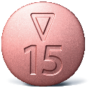

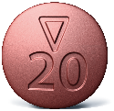
Clear single drug approach from the start on
Rivaroxaban dosing regimen for the treatment of DVT/PE⁸
Initial treatment (21 days)
Continued treatment (day 22 onwards)
15 mg BID
20 mg OD
Rivaroxaban 15 mg and 20 mg tablets are to be taken with food; no dose adjustment needed based on CrCl
VTE: venous thromboembolism; DVT: deep vein thrombosis; PE: pulmonary embolism; CrCl: creatinine clearance

Slide 9
ESC PE Guidelines 2019: Possibility of early discharge and home treatment of PE
Recommendations for early discharge and home treatment⁹ | Class* | Level**
Carefully selected patients with low-risk PE should be considered for early discharge and continuation of treatment at home, if proper outpatient care and anticoagulant treatment can be provided. | IIa | A
* Class of recommendations; ** Level of evidence
PE: pulmonary embolism

Slide 10


Extending Mr. Peters’ treatment is supported by ESC PE Guidelines 2019⁹
The 2019 ESC guidelines for acute PE recommend extended therapy in patients with: No identifiable risk factors
Persistent and minor transient/reversible risk factors
Mr. Peters
65 years old
PE after recent flight
eGFR 70 ml/min
Recommendation for rivaroxaban:
Consider reduced dose (10 mg OD) for extended anticoagulation after the first 6 months of treatment (20 mg OD)
I don’t want to live in fear of having another PE and ending up in hospital again.
OD: once daily; ESC: European Society of Cardiology; PE: pulmonary embolism; eGFR: estimated glomerular filtration rate

Slide 11

High risk of recurrence for patients with VTE after discontinuing anticoagulation
Cumulative rate of VTE recurrence in patients who had discontinued anticoagulant treatment¹⁰
Meta-analysis of 18 Studies (n=7515)
VTE: venous thromboembolism

Slide 12
Impact of clinical risk factors in recurrence for patients with VTE
Cumulative proportions of recurrent thrombosis after cessation of anticoagulant therapy* (n=558)¹¹
0.20
Unprovoked
0.15
Cumulative proportion of recurrent events
Provoked by non-surgical risk factors
0.10
0.05
0
Provoked by surgery
0
4
8
12
16
20
24
Time since event (months)
* Patients with malignant disease and antiphospholipid syndrome were excluded from the study
VTE: venous thromboembolism .

Slide 13
Provoked VTE Risk Factor Classification
Classification of risk factors according to index venous thromboembolic event¹²
 | PERSISTENT | TRANSIENT
Minor | Body mass index >30 kg/m² Family history of VTE Calculated CrCl <50 ml/min Congestive heart failure Inflammatory bowel disease Lower extremity paralysis or paresis or known thrombophilia (including deficiency of antithrombin, protein C, or protein S, Factor V Leiden or prothrombin gene mutation, and antiphospholipid syndrome) | Use of oestrogen Immobilisation Lower limb trauma with transient impairment of mobility Travel >8 hours Pregnancy* Puerperium*
Major | Active cancer excluding basal cell or squamous cell skin cancer | Major surgery/trauma Caesarean section*
* Attention, observe contraindications according to the summary of product characteristics (www.swissmedicinfo.ch).
CrCl: creatinine clearance

Slide 14
Mr. Peters needs protection for as long as his risk remains
EINSTEIN EXTENSION/CHOICE: No statistically significant difference between recurrence rates of unprovoked and provoked VTE after 1 year¹²
Placebo (n=590)
ASA (n=1131)
Rivaroxaban (n=2832)
HR=0.68 vs. unprovoked (95% CI 0.32–1.30)
HR=0.81 vs. unprovoked (95% CI 0.56–1.16)
Cumulative incidence of recurrent VTE at 1 year (%)
Provoked VTE not related to major risk factors (active cancer, surgery, trauma)
p<0.001 versus ASA 100 mg
ASA: acetylsalicylic acid; VTE: venous thromboembolism; DVT: deep vein thrombosis; PE: pulmonary embolism

Slide 15
Categorization of risk factors for patients with VTE based on the risk of recurrence over the long term¹³
High risk of relapse
Long-term anticoagulation,
if no contra-indication
Active tumor
Provoked event with a persistent risk factor
Severe thrombophilia*
Moderate risk of relapse
Prolonged
secondary prophylaxis
VTE relapse
Unprovoked event
Provoked event with mild, uncertain and transient risk, e.g. travel
Low risk of relapse
Cessation after 3–6 months
Cessation after 3 months
Provoked event with a clear, hard risk factor (e.g. operation, leg injury with reduced mobility, bed confinement)
The pill or hormone therapy (now ceased)
DVT in the lower leg
* Antiphospholipid syndrome (please note the warning notice in the respective specialist information), protein C-deficiency, protein S deficiency, antithrombin deficiency VTE: venous thromboembolism; DVT: Deep vein thrombosis

Slide 16
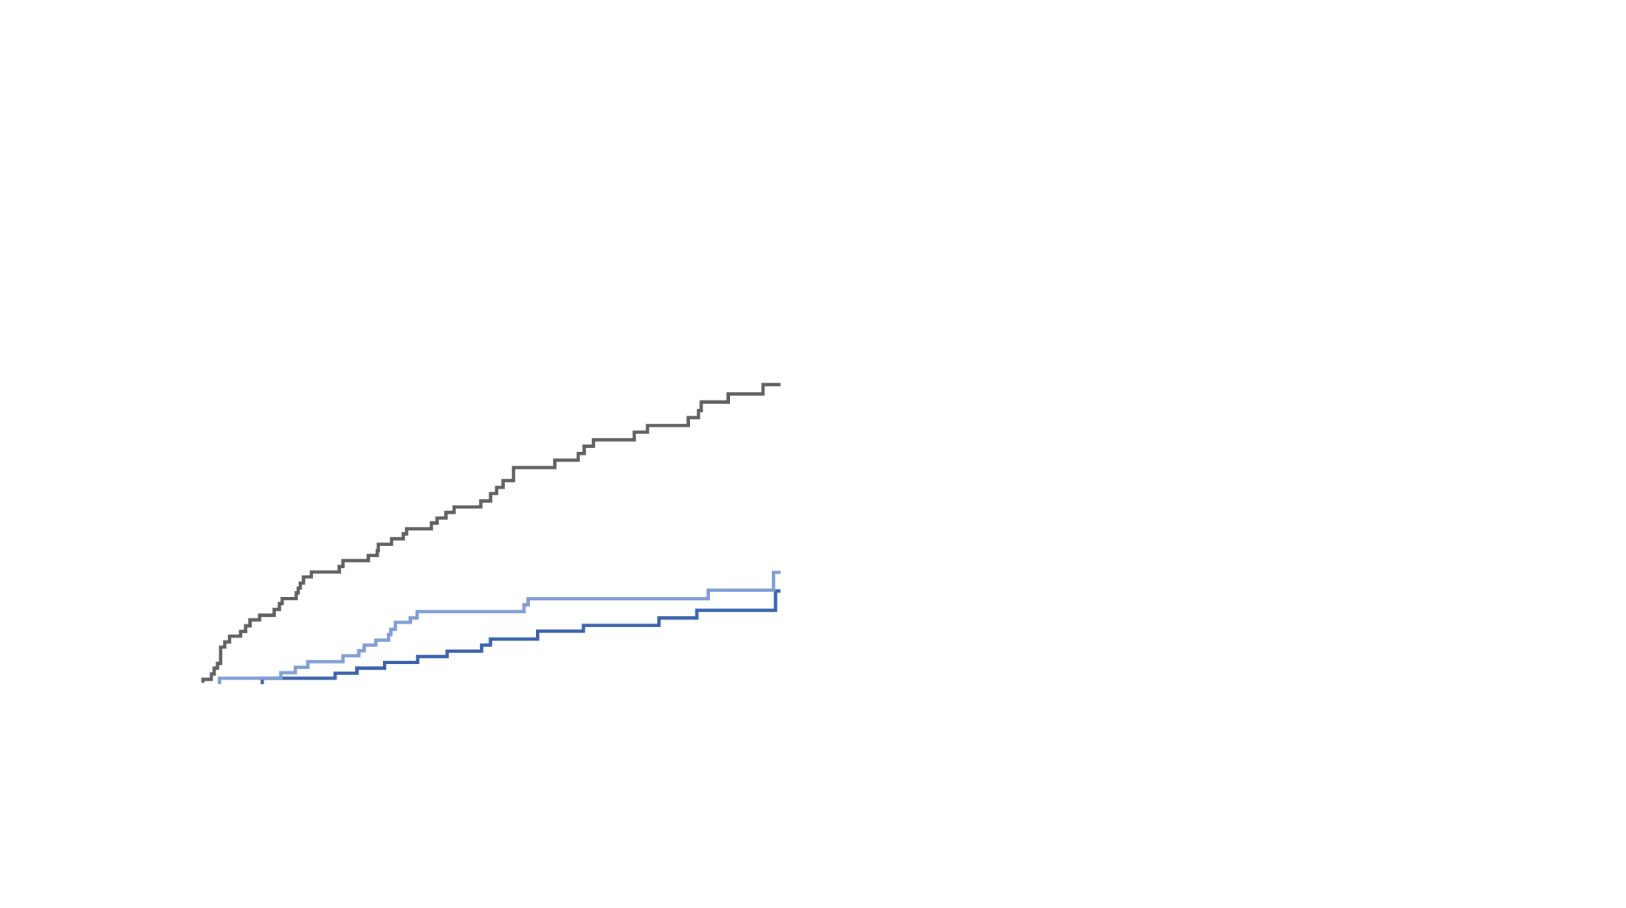
Extend your VTE patients’ protection for as long as their risk for recurrence persists¹⁴
EINSTEIN CHOICE: Both rivaroxaban doses showed superior efficacy vs. ASA at reducing recurrent VTE, with a similar risk of bleeding¹⁴
Efficacy*
Safety analysis
5
4
ASA, 100 mg 1x daily (n=1131)
3
66% RRR
74% RRR
<1%
Cumulative incidence (%)
2
Rivaroxaban, 20 mg 1x daily (n=1107)
Experienced major bleeding in 1 year^{14,}**
1
Rivaroxaban, 10 mg 1x daily (n=1126)
0
0
30
60
90
120
150
180
210
240
270
300
330
367
Time to event (days)
Rivaroxaban 10 mg 1x daily vs. ASA 100 mg 1x daily, p<0.001, RRR: 74%, ARR 3.2% Rivaroxaban 20 mg 1x daily vs. ASA 100 mg 1x daily, p<0.001, RRR: 66%, ARR 2.9%
* intention-to-treat analysis; ** Rivaroxaban® 10 mg (0.4%) und 20 mg (0.5%) vs. ASA (0.3%), p=ns
ASA: acetylsalicylic acid; VTE: venous thromboembolism.

Slide 17





Your patients need protection that can be tailored to their individual risk
Rivaroxaban dosing regimen for the treatment of DVT/PE⁸
Initial treatment (21 days)
Continued treatment
(day 22 onwards)
Extended treatment* (month 7 onwards)
15 mg BID
20 mg OD
20 mg OD
10 mg OD
If extended oral anticoagulation is decided after PE in a patient without cancer, a reduced dose of rivaroxaban (10 mg OD) should be considered after 6 months of therapeutic anticoagulation.⁹
Rivaroxaban 15 mg and 20 mg tablets are to be taken with food; no dose adjustment needed based on CrCl
* A daily, 20 mg dose of Xarelto® should be prescribed for patients who are continuing to receive treatment for DVT or PE after a period of at least six months and in whom the risk of recurrent DVT or PE is considered to be high. A daily 10 mg or 20 mg dose of Xarelto® can be prescribed for patients with a low risk of recurrent DVT or PE based on a careful consideration of the individual risk of recurrent DVT or PE against the risk of bleeding.⁸
ESC: European Society of Cardiology; VTE: venous thromboembolism; DVT: deep vein thrombosis; PE: pulmonary embolism; CrCl: creatinine clearance

Slide 18






Reduce your VTE patient’s treatment burden with a simple, injection-free dosing regimen
Rivaroxaban⁸
15 mg BID (21 days)
20 mg OD (day 22 onwards)
10 mg OD (month 7 onwards)
or 20 mg OD*
Single oral drug
Apixaban¹⁵
2x 5 mg BID (7 days)
5 mg BID (day 8 to month 6)
2.5 mg BID (month 7 onwards)
Parenteral anticoagulant + Edoxaban¹⁶
Parenteral anticoagulant ($>$5 days)
Edoxaban 60 mg OD (following parenteral anticoagulant disontinuation)
Parenteral + oral treatment
Parenteral anticoagulant + Dabigaran¹⁷
Parenteral anticoagulant ($>$5 days)
Dabigatran 150 mg BID (following parenteral anticoagulant disontinuation)
* A daily, 20 mg dose of Xarelto® should be prescribed for patients who are continuing to receive treatment for DVT or PE after a period of at least six months and in whom the risk of recurrent DVT or PE is considered to be high. A daily 10 mg or 20 mg dose of Xarelto® can be prescribed for patients with a low risk of recurrent DVT or PE based on a careful consideration of the individual risk of recurrent DVT or PE against the risk of bleeding.⁸
BID: twice daily; DVT: deep vein thrombosis; OD: once daily; PE: pulmonary embolism; VTE: venous thromboembolism

Slide 19
ESC PE Guidlines 2019: Long-term secondary prevention of VTE in patients without cancer
Patients in whom extension beyond 3 months is recommended⁹ | Class* | Level**
Oral anticoagulant treatment of indefinite duration is recommended for patients presenting with recurrent VTE (that is, with at least one previous episode of PE or DVT) not related to a major transient or reversible risk factor. | I | B
If extended oral anticoagulation is decided after PE in a patient without cancer, a reduced dose of the NOACs apixaban (2.5 mg bid) or rivaroxaban (10 mg od) should be considered after 6 months of therapeutic anticoagulation. | IIa | A
* Class of recommendations; ** Level of evidence
VTE: venous thromboembolism; DVT: deep vein thrombosis; PE: pulmonary embolism; NOACs: novel oral anticoagulants

Slide 20





What safety means for your patients with VTE
Efficacy
Effective protection from early recurrence in the first 21 days^{6,18}
Safety
Low rate of major bleedings¹⁴
Simplicity
Tailored dosing for
extended treatment without routine coagulation monitoring
Compliance
Simple to start and easy to maintain supporting adherence
Patient benefit⁸

Slide 21
References
1. Cohen AT, et al, Venous thromboembolism (VTE) in Europe. The number of VTE events and associated morbidity and mortality, Thromb Haemost 2007;98(4):756–764.
2. GLOBOSCAN http://globocan.iarc.fr/Pages/fact_sheets_cancer.aspx [accessed 22 April 2021]
3. Moustafa F, et al., Clinical outcomes during anticoagulant therapy in fragile patients with venous thromboembolism, Res Pract Thromb Haemost 2017;1(2):172–179.
4. Monreal M, et al., Venous thromboembolism in patients with renal insufficiency: findings from the RIETE Registry, Am J Med 2006;119(12):1073–1079.
5. Limone BL, Hernandez A, Michalak D et al. Timing of recurrent venous thromboembolism early after the index event: a meta-analysis of randomized controlled trials. Thromb Res 2013;132(4):420–426.
6. van Es J, et al., Clot resolution after 3 weeks of anticoagulant treatment for pulmonary embolism: comparison of computed tomography and perfusion scintigraphy, J Thromb Haemost 2013;11(4): 679–685.
7. Prins MH, et al., Oral Rivaroxaban versus standard therapy for the treatment of symptomatic venous thromboembolism: a pooled analysis of the EINSTEIN-DVT and PE randomized studies, Thromb J 2013;11(1):21.
8. Fachinformation Xarelto® Schweiz, www.swissmedicinfo.ch.
9. Konstantinides SV, Meyer G, Becattini C et al. 2019 ESC Guidelines for the diagnosis and management of acute pulmonary embolism developed in collaboration with the European Respiratory Society (ERS). Eur Heart J 2020;41(4):543–603.
10. Prandoni P, et al., The risk of recurrent venous thromboembolism after discontinuing anticoagulation in patients with acute proximal deep vein thrombosis or pulmonary embolism. A prospective cohort study in 1,626 patients, Haematologica 2007;92(2):199–205.
11. Baglin T, et al., Incidence of recurrent venous thromboembolism in relation to clinical and thrombophilic risk factors: prospective cohort study, Lancet 2003;362(9383):523–526.
12. Prins MH, et al. Risk of recurrent venous thromboembolism according to baseline risk factor profiles, Blood Adv 2018;2(7):788–796.
13. Schimmelpfennig J and Bauersachs R. Die verlängerte Sekundärprophylaxe nach venöser Thrombose. Georg Thieme Verlag KG Stuttgart, New York. Phlebologie 2018; 47(06):303–308.
14. Weitz JI, et al, Rivaroxaban or Aspirin for Extended Treatment of Venous Thromboembolism, N Engl J Med 2017;376:1211-1222.
15. Fachinformation Eliquis® Schweiz, www.swissmedicinfo.ch.
16. Fachinformation Lixiana® Schweiz, www.swissmedicinfo.ch.
17. Fachinformation Pradaxa® Schweiz,www.swissmedicinfo.ch.
18. Agnelli G, et al., Treatment of Proximal Deep-Vein Thrombosis With the Oral Direct Factor Xa Inhibitor Rivaroxaban (BAY 59-7939). Circulation 2007;116(2):180–187.

Slide 22
Xarelto® Abbreviated Summary of Product Characteristics
Abbreviated Summary of Product Characteristics of Xarelto® (rivaroxaban): Direct factor Xa inhibitor C: Film-coated tablets with 10, 15 and 20 mg rivaroxaban. I: Adults: a) Thrombosis prophylaxis for major orthopaedic procedures on the lower extremities, such as hip or knee prostheses. b) Treatment of pulmonary embolism (PE) and deep vein thrombosis (DVT) as well as prophylaxis of recurring DVT and PE. c) Prophylaxis of stroke and systemic embolism in patients with nonvalvular atrial fibrillation; Pediatric population (body weight ≥ 30kg): Treatment of venous thromboembolism (VTE) after initial parenteral anticoagulation for the prophylaxis of recurrent VTE. D: Adults: a) 10mg 1x/day b) 15mg 2x/day for the first 21 days, followed by 20mg 1x/day; from month 7: 20mg 1x/day or 10mg 1x/day based on an individual benefit-risk evaluation c) 20mg 1x/day; for CrCl of 15-49ml/min: 15mg 1x/day. Take 15mg and 20mg with food. Pediatric population: For body weight ≥30kg to <50kg: 15mg 1x/day. For body weight ≥50kg: 20mg 1x/day. CI: hypersensitivity to any ingredients, acute bacterial endocarditis, clinically significant active bleeding, severe liver disease/hepatic impairment (HI) with a comparatively higher risk of bleeding; mild HI in combination with coagulopathy, renal impairment (RI) requiring dialysis, acute gastrointestinal (GI) ulcers or ulcerative GI disorders, pregnancy, lactation. W: concomitant medication (cf. "IA"); artificial heart valves; concomitant administration of drugs affecting haemostasis. PM: RI (CrCl 15-29ml/min) or RI in combination with drugs increasing the Xarelto® plasma level, increased risk of uncontrolled bleeding and haemorrhagic diathesis, recent haemorrhagic stroke, intracranial or intracerebral haemorrhage, recent GI ulcers/ulcerative disorders, severe uncontrolled hypertension, vascular retinopathy, intraspinal and intracerebral vascular anomalies, recent brain, spinal or eye surgery, medical history of bronchiectasis or pulmonary bleeding, spinal anaesthesia or puncture, discontinue at least 24 hours before invasive/surgical procedures, APS, individual cases of agranulocytosis and SJS were reported. Common ADRs: bleeding, anaemia, dizziness, headache, eye haemorrhage, haematoma, epistaxis, haemoptysis, nausea, obstipation, diarrhoea, elevated liver enzymes (ASAT, ALAT), pruritus, rash, pain in the extremities, fever, peripheral oedema, asthenia. IA: Strong CYP 3A4 + P-gp inhibitors (ritonavir, ketoconazole), strong CYP 3A4 + P-gp inducers (rifampicin, carbamazepine, phenobarbital, St. John's wort), drugs influencing haemostasis. Pack sizes: 10 & 30 x 10 mg film-coated tablets; 14, 28 & 98 x 15 mg or 20 mg film-coated tablets. (B), covered by health insurance companies (refer to Limitatio). Additional information available from www.swissmedicinfo.ch. Distribution: Bayer (Schweiz) AG, Uetlibergstr. 132, 8045 Zurich, Switzerland. MA-M_RIV-CH-0265-1_10.2022

