Slide 1
Clinical presentation of PAD patients and their unmet needs from revascularization to chronic PAD
Management of PAD patients

Slide 2



PAD patients need enhanced vascular protection
after peripheral revascularization¹
Risk factor management
Symptom control
Intervention*
Today
Death?
Minor or major amputation?
CV and limb risk
Revascularization
PP-XAR-CH-0500-2_06.2021
Asymptomatic PAD
Intermittent claudication
Critical limb
ischaemia
Chronic
PAD
Time
CV: cardiovascular; PAD: Perippheral arterial diisease
* Considered for patients with claudication (Fontaine stage II) in the presence of appropriate vascular morphology and poor quality of life.

Slide 3
Your PAD patients remain at risk of life-threatening and disabling events, whether or not they have been revascularized²
Reach Registry: Outcomes in (US) PAD patients
Asymptomatic (n=134)
Claudication (n=539)
Prior revascularisation (n=692)
Prior amputation (n=312)
PP-XAR-CH-0500-2_06.2021
CV: cardiovascular; MI: myocardial infarction; PAD: Perippheral arterial diisease

Slide 4
High risk for vascular events in PAD patients after peripheral revascularisation³
Premier Healthcare Database (n=393’017)
Major amputation/
Limb revascularization
“Acute”
postrevascularisation
phase
“Chronic” phase
MI/Stroke
Patients face a rapid increase
in limb ischaemic risk in the first
year following revascularization.
Cumulative Incidence Rate
Male
Along with a steady increase
in cardiovascular ischaemic risk over
time.
Mace
Time from Index Encounter Discharge (Years)
PP-XAR-CH-0500-2_06.2021
Median follow-up: 2.7 years
MACE: Major adverse cardiac events; MALE: Major adverse limb events; MI: Myocardial infarction

Slide 5
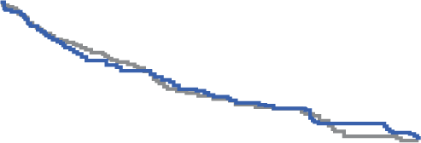
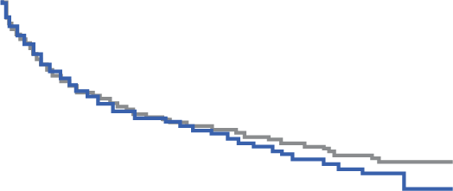
No antithrombotic strategy has demonstrated efficacy for reducing MACE and MALE after peripheral revascularization yet
DAPT with clopidogrel after surgical revascularisation (CASPAR)⁴
Anticoagulation with VKA* after surgical revascularisation (Dutch BOA)⁵
Graftocclusion/revascularisation/replacement, amputation above ankle, death:
Overall graph occlusion
100
100
90
HR 0.98 (95% CI 0.78–1.23)
HR 0.95 (95% CI 0.82–1.11)
80
90
70
80
60
Proportion of patients
event free (%)
Proportion of patients
occlusion free (%)
50
70
40
30
GUSTO moderate or severe bleeding:
HR 2.84 (95% CI 1.32–6.08)
60
Haemorrhagic stroke: HR 3.48 (95% CI 1.14–10.60)
20
Clopidogrel
50
Oral anticoagulants
10
0
Placebo
Aspirin
PP-XAR-CH-0500-2_06.2021
40
0
50
100
150
200
250
300
350
400
450
500
550
0
200
400
600
800
1000
1200
1400
Time (days)
Time (days)
* phenprocoumon or acenocoumarol
CI: confidence interval; DAPT: dual antiplatelet therapy; HR: hazard ratio; MACE: major adverse cardiovascular events; MALE: major adverse limb events; VKA: vitamin K antagonist

Slide 6

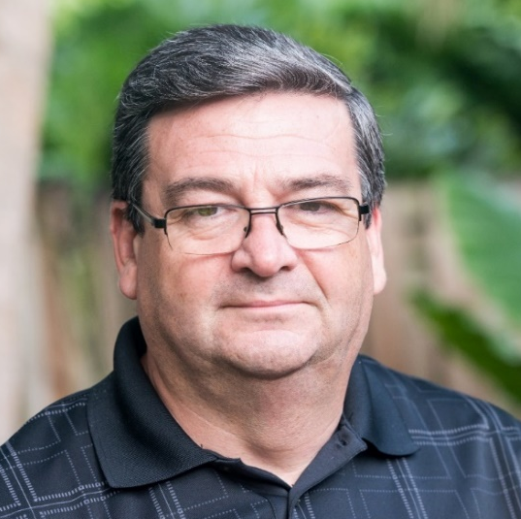



How would you protect Mr. Keller after lower-extremity revascularisation?
Up to 2 in 5 patients with
PAD patients undergo revascularisation²
Mr. Keller
64 years old
Chronic limb
ischaemia
(Fontaine III)
Undergoing revascularisation
Hypertension
Smoker
Obese
(BMI 30 kg/m²)
After the intervention
they are at increased
risk of vascular events^{2,3}
…and despite standard
therapy they face a
poor prognosis³
I never thought I’d ending up
having a procedure, and I only hope for the best possible outcome.
PP-XAR-CH-0500-2_06.2021
BMI, body mass index; CV, cardiovascular; PAD, peripheral artery disease

Slide 7

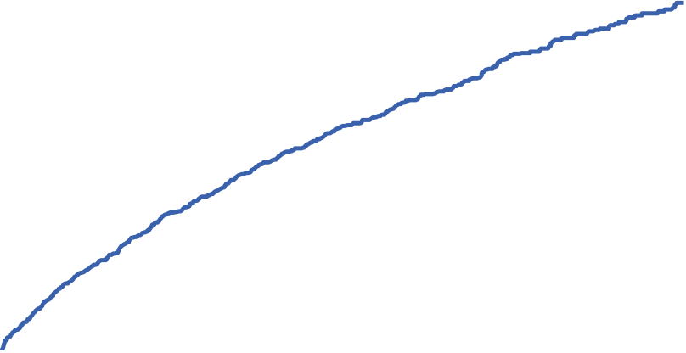
You can enhance Mr. Keller’s vascular protection
after revascularization⁶
Cumulative incidence of ALI, major amputation of vascular aetiology,
MI, ischaemic stroke or CV death in VOYAGER PAD
20
19.9%
Aspirin
17.3%
Rivaroxaban 2.5 mg BID
plus Aspirin
16
12
HR 0.85 (95% CI 0.76–0.96)
p=0.009
NNT over 3 years: 39
Cumulative incidence (%)
8
RRR
15%
4
0
0
182
366
547
731
912
1096
Days from randomisation
Number at risk
Rivaroxaban plus Aspirin | 3286 | 3082 | 2938 | 2834 | 2219 | 1415 | 684
Aspirin | 3278 | 3030 | 2881 | 2773 | 2151 | 1351 | 642
PP-XAR-CH-0500-2_06.2021
ALI: Acute limb ischaemia; CV: Cardiovascular; MI: Myocardial infarction; NNT: Number needed to treat; PAD: Peripheral arterial disease; RRR_ relative risk reduction

Slide 8
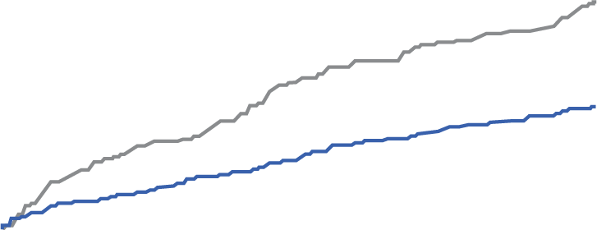
Mr. Keller could benefit from an early risk reduction which continued over time⁷
Cumulative incidence of ALI in VOYAGER PAD
Rivaroxaban 2.5 mg BID plus Aspirin (n=3286)
Aspirin (n=3278)
6 months
ARR 1.5%
3.2%
3 months
ARR 1.1%
Cumulative incidence of ALI (%)
1 month
ARR 0.52%
1.7%
Months from randomisation
PP-XAR-CH-0500-2_06.2021
ALI,: acute limb ischaemia; BID: twice daily; PAD: Peripheral arterial disease

Slide 9
PAD patients after revascularization could have enhanced protection without an increase in the most serious bleeds⁷
Safety outcomes in VOYAGER PAD
HR 1.43
(95% CI 0.97–2.10)
p=0.07
Aspirin
Rivaroxaban 2.5 mg BID
plus Aspirin
ARI: 0.78%
NNH: 129
HR 0.78
(95% CI 0.38–1.61)
HR 1.02
(95% CI 0.33–3.15)
HR 0.91
(95% CI 0.47–1.76)
PP-XAR-CH-0500-2_06.2021
* primary safety outcome
ARI: Absolute risk increase; ICH: Intracranial hemorrhage; NNH: Number needed to harm; PAD: Peripheral arterial disease; TIMI: Thrombolysis in Myocardial Infarction

Slide 10
Unplanned hospital management due to post-procedural bleeding risk was not increased with additional low dose anticoagulation⁷
Post-procedural bleeding in VOYAGER PAD
Aspirin
Rivaroxaban 2.5 mg BID
plus Aspirin
Number per 100 patients/year (%)
PP-XAR-CH-0500-2_06.2021
ALI: acute limb ischaemia; BID: twice daily; CI: confidence interval; CV: cardiovascular; HR: hazard ratio; MI: myocardial infarction; NNT: number needed to treat; OD: once daily; RRR: relative risk reduction

Slide 11
Unplanned revascularization or hospitalization could be prevented for your PAD patients – benefits of interventions can be maintained⁶
Secondary outcomes | Rivaroxaban 2.5 mg BID + Aspirin (n=3286) |  | Aspirin (n=3278) |  | HR (95% CI) |  | p-value
 | Event n (%) | K-M estimate at 3 yrs | Event n (%) | K-M estimate at 3 yrs
ALI, major amputation of avascular aetiology, MI, ischaemic stroke, CV death | 433 (13.2) | 14.7 | 528 (16.1) | 18.2 |  | 0.80 (0.71–0.91) | <0.001
Unplanned index limb revascularisation for recurrent limb ischaemia | 584 (17.8) | 20.0 | 655 (20.0) | 22.5 |  | 0.88 (0.79–0.99) | 0.03
Hospitalisation for coronary or peripheral event of a thrombotic nature | 262 (8.0) | 8.7 | 356 (10.9) | 12.1 |  | 0.72 (0.62–0.85) | <0.001
PP-XAR-CH-0500-2_06.2021
Favours Rivaroxaban
2.5 mg BID plus Aspirin
Favours
Aspirin
ALI: Acute limb ischaemia; CV: Cardiovascular; MI: Myocardial infarction; PAD: Peripheral arterial disease

Slide 12
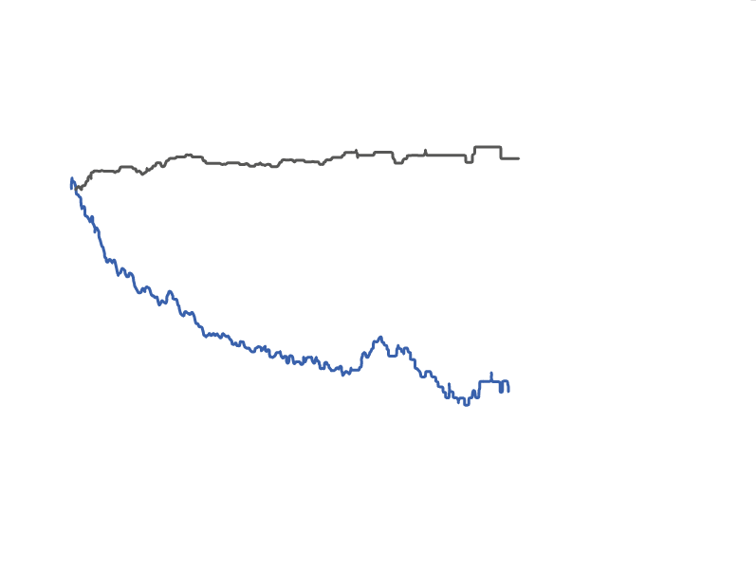
The protection against vascular events increased over time,
without corresponding increase in TIMI major bleeding⁷
The rivaroxaban 2.5 mg BID risk-benefit profile over time
200
The risk of bleeding remains stable.
The risk of bleeding remains stable.
100
0
Baseline denotes treatment with Aspirin
–100
–200
While the risk of limb ischaemia and
major CV events decreases over time.
Events prevented or caused
vs Aspirin (n)
–300
–400
–500
TIMI major bleeding*
–600
0
6
12
18
24
30
36
Primary composite efficacy
outcome of ALI, major
amputation of vascular
aetiology, MI, ischaemic
stroke or CV death
Months
PP-XAR-CH-0500-2_06.2021
* primary safety outcome
ALI: Acute limb ischaemia, CV: Cardiovascular, MI: Myocardial infarction, PAD: Peripheral arterial disease

Slide 13
Your PAD patients can be protected following lower-extremity revascularization, regardless of clopidogrel use^{#8}
VOYAGER PAD subanalysis: Outcomes
HR (95% CI)
p-interaction
ALI, major vascular amputation, MI, ischaemic stroke or CV death*
With clopidogrel | 0.85 (0.71–1.01) |  | 0.92
No clopidogrel | 0.86 (0.73–1.01)
TIMI major bleeding†
With clopidogrel | 1.33 (0.78–2.26) |  | 0.71
No clopidogrel | 1.55 (0.88–2.72)
PP-XAR-CH-0500-2_06.2021
Favours Rivaroxaban
2.5 mg BID plus Aspirin
Favours
Aspirin
* primary efficacy outcome; † primary safety outcome; # clopidogrel use (>30d) was associated with higher bleeding risk without additional benefit on the efficacy side
ALI: Acute limb ischaemia; CV: Cardiovascular; MI: Myocardial infarction; PAD: Peripheral arterial disease; TIMI, Thrombolysis In Myocardial Infarction

Slide 14
Offering vascular protection for your PAD patients like Mr. Keller after both endovascular and surgical interventions⁶
Endovascular revascularization procedures
Surgical revascularization procedures
PP-XAR-CH-0500-2_06.2021
PAD: Peripheral arterial disease

Slide 15
You can provide protection for your patients
undergoing endovascular revascularization^{6,8,9}
Patients with CLI or claudication requiring LE revascularisation
Y
Is the patient already on DPI?
Stop rivaroxaban 12–24 h before
the procedure
N
Endovascular revascularisation
Does the patient have any contraindications to DPI?
Consider alternatives
e.g. DAPT or SAPT
Y
N
Initiate DPI therapy on the day after angioplasty
(after ensuring no puncture site haematoma, AV fistula or pseudoaneurysm)
Is the patient at high risk of
post-interventional failure?
Y
For certain endovascular patients,
consider adding clopidogrel
Where possible, limit use to 30 days to minimise bleeding risk
N
DPI only
PP-XAR-CH-0500-2_06.2021
Chronic PAD
Continue DPI for long-term management
Illustrative care pathway based on expert insights.
CLI: critical limb ischaemia; DAPT: dual antiplatelet therapy; DPI: dual pathway inhibition;; LE: lower extremity; N: no; PAD: peripheral artery disease; SAPT: single antiplatelet therapy; Y: yes

Slide 16
You can provide protection for your patients
undergoing surgical revascularization^{6,8,9}
Patients with CLI or claudication requiring LE revascularisation
Y
Is the patient already on DPI?
Stop rivaroxaban 12–24 h before
the procedure
N
Surgical revascularisation
Does the patient have any
contraindications to DPI?
Consider alternatives
e.g. DAPT or SAPT
Y
N
Initiate DPI therapy as soon as haemostasis is achieved
(usually 2–4 days after surgery)
Is the patient at high risk of
post-interventional failure?
Y
For certain endovascular patients,
consider adding clopidogrel
Where possible, limit use to 30 days to minimise bleeding risk
N
DPI only
PP-XAR-CH-0500-2_06.2021
Chronic PAD
Continue DPI for long-term management
Illustrative care pathway based on expert insights.
CLI: critical limb ischaemia; DAPT: dual antiplatelet therapy; DPI: dual pathway inhibition;; LE: lower extremity; N: no; PAD: peripheral artery disease; SAPT: single antiplatelet therapy; Y: yes

Slide 17
VOYAGER PAD enrolled patients with symptomatic PAD
undergoing lower-extremity revascularisation⁶
Key inclusion criteria
Key exclusion criteria
Age ≥50 years
Confirmed moderate-to-severe lower extremity occlusive PAD*
Technically successful peripheral
infrainguinal revascularisation for symptomatic PAD within the last
10 days prior to randomisation
Prior revascularisation on index leg within
10 days of the qualifying revascularisation
ALI within 2 weeks prior to the qualifying revascularisation
Planned post-procedural co-administration of additional antiplatelet agent other than clopidogrel† and Aspirin
Confirmed ACS within last 30 days
Medically documented history of ICH, stroke or TIA
PP-XAR-CH-0500-2_06.2021
* based on clinical, anatomical and haemodynamic evidence; #Clopidogrel allowed for up to 6 months after the qualifying revascularisation.
ACS: acute coronary syndrome; ALI: acute limb ischaemia; ICH: intracranial haemorrhage; PAD: peripheral artery disease; TIA: transient ischaemic attack

Slide 18








How can you help ensure that PAD patients recover well from revascularization and are protected against future events?
Key incluson criteria
Rivaroxaban 2.5 mg BID plus Aspirin can be started as soon as haemostasis has been achieved*⁶
Post-revascularisation¹
Chronic phase^{†6,9}
~6 months⁶
Rivaroxaban 2.5 mg BID plus Aspirin
supported in guidelines from:
¹⁰
¹¹
¹
¹²
PP-XAR-CH-0500-2_06.2021
* within 10 days from lower-extremity revascularisation procedure⁶; † Rivaroxaban 2.5 mg BID plus Aspirin can be started at any point for patients with chronic symptomatic PAD^{9,13}
BID: twice daily; EASD: European Association for the Study of Diabetes; ESC: European Society of Cardiology; ESVM: European Society for Vascular Medicine; GVG: Global Vascular Guidelines; PAD: peripheral artery disease

Slide 19

PAD patients can benefit from enhanced vascular protection in
line with 2019 European guidelines
Recommendation | Class | Level
2019 ESVM guidelines on the management of PAD¹ The combined therapy of Aspirin 100 mg OD and rivaroxaban 2.5 mg BID should be considered in PAD patients without a high risk of bleeding, or other contraindications. | IIa | B
2019 ESC–EASD guidelines on diabetes, pre-diabetes and CVD¹⁰ In patients with diabetes and chronic symptomatic lower-extremity artery disease without high bleeding risk, a combination of rivaroxaban vascular dose (2.5 mg BID) and Aspirin (100 mg OD) should be considered. | IIa | B
PP-XAR-CH-0500-2_06.2021
BID: twice daily; CVD: cardiovascular disease; EASD: European Association for the Study of Diabetes; ESC: European Society of Cardiology; ESVM: European Society for Vascular Medicine; OD: once daily; PAD: peripheral artery disease

Slide 20
You can keep your PAD patients protected, even when their condition is chronic⁹
Efficacy endpoints for PAD subgroup in COMPASS (n=4996)
HR 0.72
p=0.0047
HR 0.91
p=NR
Aspirin
Rivaroxaban 2.5 mg BID
plus Aspirin
ARR: 1.8%
HR 0.54
p=0.0054
HR 0.30
p=0.011
ARR: 1.0%
ARR: 0.5%
      27% of PAD patients in COMPASS had previous revascularisation (n=1342)†
PP-XAR-CH-0500-2_06.2021
including CV death, MI and stroke; † the number includes patients assigned to the rivaroxaban 2.5 mg BID plus Aspirin and the Aspirin arms in COMPASS
ALI: Acute limb ischaemia; ARR: absolute risk reduction; BID: twice daily; CLI: Critical limb ischaemia; HR: Hazars ration; MACE: Major adverse cardiac events; MALE: Major adverse limb events; NR: not reported;; PAD: Peripheral arterial disease

Slide 21
Offering an acceptable bleeding risk for the most serious bleedings is an important part of vascular protection for PAD patients⁹
Safety outcomes for PAD subgroup in COMPASS (n=4996)
HR 1.61
(95% CI 1.12–2.31)
HR
not reported
HR
not reported
HR 1.55
(95% CI 0.64–3.74)
ARI: 1.2%
Aspirin
Rivaroxaban 2.5 mg BID
plus Aspirin
†
PP-XAR-CH-0500-2_06.2021
* non-fatal symptomatic; † non-fatal and non-ICH
ARI: absolute risk increase; BID: twice daily; CI: confidence intervals; HR: hazard ratio; ICH: Intracranial hemorrhage; PAD: peripheral arterial disease .

Slide 22
Optimize the therapy of PAD patients with the first antithrombotic regimen to significantly reduce both MACE and MALE vs Aspirin
CAPRIE
(subgroup analysis)¹⁴
CHARISMA
(subgroup analysis)¹⁵
EUCLID⁸
COMPASS
(subgroup analysis)⁹
Clopidogrel versus Aspirin in patients
with symptomatic PAD
Clopidogrel plus aspirin versus Aspirin in patients with PAD
Ticagrelor versus
clopidogrel
in patients with symptomatic PAD
Rivaroxaban 2.5 mg bid plus Aspirin versus Aspirin in patients with PAD
MACE
↓24%
MACE
↓28%
No reduction
in risk of MACE
No decrease
in MALE*
MALE#
↓46%
MALE
not reported
MALE
not reported
MALE
not reported
Bleeding events
not reported
No increase in severe bleeding
No increase in severe bleeding
Major bleeding
1.6×
PP-XAR-CH-0500-2_06.2021
* hospitalization for ALI or lower limb revascularization (individual endpoints); # composite of acute or chronic limb ischaemia leading to an intervention
ALI: acute limb ischaemia; MACE: major adverse cardiac events; MALE: Major adverse limb events; PAD: Peripheral arterial disease

Slide 23

Ensure your PAD patients like Mr. Keller remain protected
from revascularization to the chronic phase
Rivaroxaban 2.5 mg BID plus Aspirin^{9,13}
⁶
⁹
PP-XAR-CH-0500-2_06.2021
BID: twice daily; PAD: Peripheral arterial disease.

Slide 24
References
1. Frank U, et al. Conservative treatment for PAD: Risk factor management. European Society for Vascular Medicine (ESVM). Guideline on peripheral arterial disease. Vasa 2019;48(Supplement 102):1–79.
2. Mahoney EM et al. Vascular hospitalization rates and costs in patients with peripheral artery disease in the United States. Circ Cardiovasc Qual Outcomes 2010;3(6):642–651.
3. Hess CN, et al. Long-Term Outcomes and Associations with Major Adverse Limb Events After Peripheral Artery Revascularization. J Am Coll Cardiol 2020;75(5):498–508.
4. Belch JJF, et al. Results of the randomized, placebo-controlled clopidogrel and acetylsalicylic acid in bypass surgery for peripheral arterial disease (CASPAR) trial. J Vasc Surg 2010;52(4):825–833, 833.e1-2.
5. Dutch Bypass Oral anticoagulants or Aspirin (BOA) Study Group. Efficacy of oral anticoagulants compared with aspirin after infrainguinal bypass surgery (The Dutch Bypass Oral anticoagulants or Aspirin study): a randomised trial. Lancet 2000; 355(9201):346–351.
6. Bonaca MP, et al. Rivaroxaban in Peripheral Artery Disease after Revascularization. N Engl J Med 2020;382(21):1994–200.
7. Bonaca MP et al. ACC. Chicago, USA, 28–30 March 2020, Abstract 402-10. Available at https://cpcclinicalresearch.org/wp-content/uploads/2020/03/CPC-VOYAGER-PAD-Primary-Results-Slide-Presentation-by-Marc-P.-Bonaca.pdf [accessed 07 Mai 2021]
8. Hiatt WR, et al. Rivaroxaban and Aspirin in Peripheral Artery Disease Lower Extremity Revascularization - Impact of Concomitant Clopidogrel on Efficacy and Safety. Circulation. 2020;142(23):2219–2230.
9. Anand SS et al. Rivaroxaban with or without aspirin in patients with stable peripheral or carotid artery disease: an international, randomised, double-blind, placebo-controlled trial. Lancet 2018;391(10117):219–229.
10. Consentino F, et al. 2019 ESC Guidelines on diabetes, pre-diabetes, and cardiovascular diseases developed in collaboration with the EASD. Eur Heart J 2020;41(2):255–323.
11. Conte MS, et al. Global vascular guidelines on the management of chronic limb-threatening ischemia. J Vasc Surg 2019;69(6S):3S–125S.
12. Knuuti J, et al. 2019 ESC Guidelines for the diagnosis and management of chronic coronary syndromes.Eur Heart J 2019;41(3):407–477.
13. Fachinformation Xarelto® vascular Schweiz: www.swissmedicinfo.ch.
14. Caprie Steering Committee, A randomised, blinded, trial of clopidogrel versus aspirin in patients at risk of ischaemic events (CAPRIE).Lancet 1996;348(9038):1329–1339.
15. Cacoub PP, et al, Patients with peripheral arterial disease in the CHARISMA trial.Eur Heart J 2009;30(2):192–201.
16. Bonaca MP, et al, Vorapaxar in Patients With Peripheral Artery Disease.Circulation 2013;127(14):1522–1529.
17. Hiatt WR, et al, Ticagrelor versus Clopidogrel in Symptomatic Peripheral Artery Disease. N Engl J Med 2017;376(1):32–40.
PP-XAR-CH-0500-2_06.2021

Slide 25
Xarelto® vascular
Abbreviated Summary of Product Characteristics
Abbreviated Summary of Product Characteristics of Xarelto® vascular (rivaroxaban):
Direct factor Xa inhibitor C: Film-coated tablets with 2.5 mg rivaroxaban I: In combination with acetylsalicylic acid (ASA) for the prevention of severe atherothrombotic events (stroke, myocardial infarction, cardiovascular death) in patients with coronary heart disease or manifest peripheral arterial vascular disease and a high risk of ischemic events. D: 2.5 mg 2x/day CI: hypersensitivity to any ingredients, acute bacterial endocarditis, clinically significant active bleeding, previous hemorrhagic / lacunar insult, ischemic stroke (<1 month), severe liver disease/hepatic impairment (HI) with a comparatively high risk of bleeding; mild HI in combination with coagulopathy, severe heart failure (NYHA III-IV, LVEF ≤30%), renal impairment (RI) requiring dialysis, acute gastrointestinal (GI) ulcers or ulcerative GI disorders, pregnancy, lactation. W: concomitant medication (cf. "IA"); <18 years; artificial heart valves; drugs affecting haemostasis. PM: RI (CrCl 15-29ml/min), increased risk of uncontrolled bleeding, congenital or haemorrhagic diathesis, intracranial or intracerebral haemorrhage, recent GI ulcers/ulcerative disorders, severe uncontrolled hypertension, vascular retinopathy, intraspinal and intracerebral vascular anomalies, recent brain, spinal or eye surgery, medical history of bronchiectasis or pulmonary bleeding, spinal anaesthesia or puncture, discontinue at least 24 hours before invasive/surgical procedures, concomitant administration of drugs influencing haemostasis, APS, individual cases of agranulocytosis and SJS were reported. Common ADRs: bleeding, anaemia, dizziness, headache, eye haemorrhage, haematoma, epistaxis, haemoptysis, nausea, obstipation, diarrhoea, elevated liver enzymes (ASAT, ALAT), pruritus, rash, pain in the extremities, fever, peripheral oedema,asthenia. IA: Strong CYP 3A4 + P-gp inhibitors (ritonavir, ketoconazole), strong CYP 3A4 + P-gp inducers (rifampicin, carbamazepine, phenobarbital, St. John's wort), drugs influencing haemostasis. Pack sizes: 28, 56 & 196 x 2.5 mg film-coated tablets. (B), covered by health insurance companies (refer to Limitatio).
Additional information available from www.swissmedicinfo.ch. Distribution: Bayer (Schweiz) AG, Uetlibergstr. 132, 8045 Zurich, Switzerland.
MA-M_RIV-CH-0089-1_03.2020
PP-XAR-CH-0500-2_06.2021

