Slide 1
Finerenone in CKD and T2D
Scientific Slide Deck
Date of preparation: March 2024

Slide 2
Background

Slide 3


CV death risk in patients with CKD in relation to eGFR and/or albuminuria
CKD = eGFR <60 ml/min/1.73 m² for >3 months¹
and OR
CKD = albuminuria UACR >30 mg/g for >3 months¹
Risk of CV death by eGFR*^{#,2}
Risk of CV death by UACR*²
4.0
4.0
3.0
3.0
2.0
2.0
Adjusted HR
Adjusted HR
1.5
Reference
1.5
Reference
1.0
1.0
0.8
0.8
0
0
0
0
15
30
45
60
75
90
105
2.5
5
10
30
300
1000
eGFR (ml/min/1.73 m²)
UACR (mg/g)
Notes:
CV mortality risk in patients with CKD increases with lower eGFR and higher UACR

Slide 4
Risk of adverse outcomes in patients with CKD and T2D
CKD = eGFR <60 ml/min/1.73 m² for >3 months¹
and OR
CKD = albuminuria UACR >30 mg/g for >3 months¹
Albuminuria categories (UACR, mg/g)
A1 Normal to mildly increased | A2 Moderately increased | A3 Severely increased
<30 | 30–300 | >300
CKD prognosis by eGFR and UACR
GFR categories (ml/min/1.73 m²) | G1 | ≥90
 | G2 | 60–89
 | G3a | 45–59
 | G3b | 30–44
 | G4 | 15–29
Low risk*
Moderately increased risk
120
High risk
Very high risk
Notes:
Risk of adverse outcomes in patients with CKD and T2D increases with lower eGFR and higher UACR

Slide 5



Drivers of CKD progression in T2D
Drivers of CKD progression in T2D^{1–3}
Tubulointerstitial damage and inflammation^{1–3}
Haemodynamic^{1,2} (Elevated BP and/or intraglomerular pressure)
Glomerulosclerosis^{1–3}
RAAS, TGF-β,
endothelins
Inflammation
and fibrosis^{1–3}
CKD PROGRESSION
Kidney fibrosis
Mesangial expansion^{1,2}
TGF-α, SAA, TGF-β, VEGF-A, collagen, CTGF
Metabolic^{1,2}
(poor glycaemic control)
Glomerular hypertrophy^{1,3}
AGE, NADPH, ROS, TGF-β
Mineralocorticoid Receptor over-activation
1. Alicic RZ, et al. Clin J Am Soc Nephrol 2017;12:2032–2045; 2. Mora-Fernández C, et al. J Physiol 2014;18:3997; 3. Bauersachs J, et al. Hypertension 2015;65:257–263
Notes:
CKD progression in T2D is driven by the combined effects of metabolic, haemodynamic, inflammatory and fibrotic factors

Slide 6
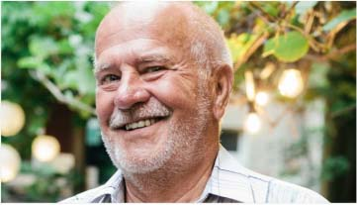

The CKD progresses silently despite good blood glucose and blood pressure control^{1,2}
Patient
62 years
T2D for 15 years
BMI: 28 kg/m²
Laboratory
eGFR: 42 ml/min/1.73 m²
eGFR value -5 vs last year’s control
Serumpotassium: 4.4 mmol/l
UACR: 780 mg/g (78 mg/mmol)
Diabetes controlled
Blood pressure controlled
But the CKD progresses silently

Slide 7
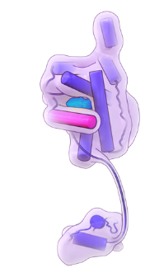
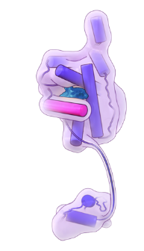
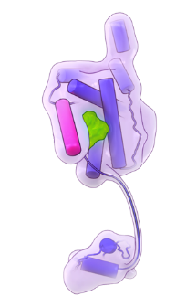

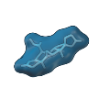

Finerenone is a novel, bulky, nonsteroidal and selective MR antagonist that is different from available steroidal drugs
Aldosterone antagonists
Finerenone
Spironolactone
Eplerenone
Finerenone
Structural properties | Flat (steroidal)¹ | Flat (steroidal)¹ |  | Bulky (nonsteroidal)^{1,4}
Potency to MR | High^{2,3} | Moderate^{2,3} |  | High^{1,2}
Selectivity to MR | Low^{2,3} | Moderate^{2,3} |  | High^{1,2}
Half life | Approx. 1.5h Active metabolites present for several days^{2,5} | 4-6h^{2,6} |  | Approx. 2h^{2,7}
Sexual side effects | Yes (gynecomastia)^{2,5} | Less than spironolactone^{2,6} |  | No signal in phase III studies^{8,9}
Protective effect on renal inflammation and fibrosis | No data | Less pronounced compared to finerenone (pre-clinical)^{2,10} |  | More pronounced compared to eplerenone (pre-clinical)^{2,10}
Based on preclinical data and
Phase III programme

Slide 8
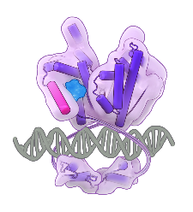
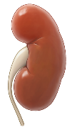

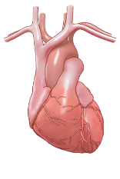

Finerenone is a selective nonsteroidal MRA that interacts with the MR in a different way to steroidal MRAs
Finerenone blocks MR overactivation, which contributes to inflammation and fibrosis, leading to kidney and CV damage^{1,2}
Finerenone has a unique binding mechanism and distribution vs steroidal MRAs, which results in high potency, selectivity and a differential effect on MR cofactor binding^{1,2}
In FIDELIO-DKD and FIGARO-DKD, finerenone was shown to slow CKD progression and improve CV outcomes in patients with CKD and T2D^{3,4}
The incidence of hyperkalaemia leading to permanent discontinuation was low
Inhibition of inflammation and fibrosis
Finerenone
MR
DNA
Modest effects on blood pressure

Slide 9
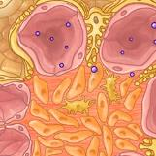
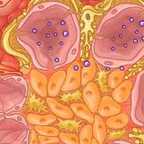
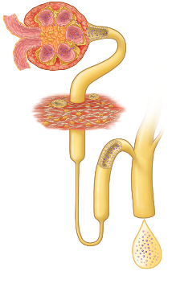
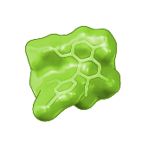
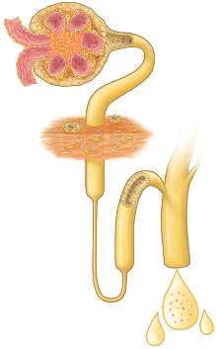
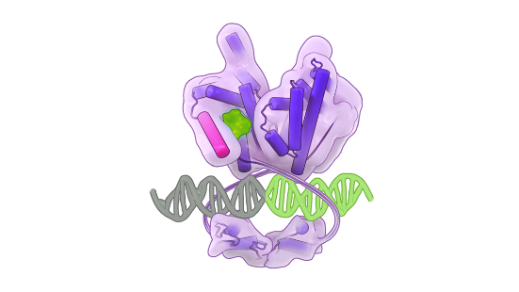
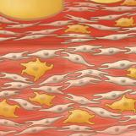
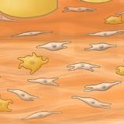
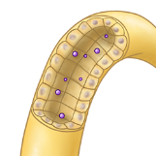

Proposed mode of action of finerenone in the kidneys
Finerenone
Mineralocorticoid receptor
Finerenone blocks the transcription of pro-inflammatory, pro-fibrotic genes in various cell types.^{3–5}
Nephron
Podocyte
Mesangial cell
Macrophage
Anti-inflammatory and anti-fibrotic action^{6–8}
Macrophage
Fibroblast
DNA
Homeostatic action
Finerenone induces a conformational change in the mineralocorticoid receptor that is different from the change observed with steroid hormones or steroidal MRAs. This blocks cell-specific recruitment of cofactors.^{1–5}
K⁺
Urine with reduced albumin and normalised Na⁺ concentration
Epithelial cell
Na⁺
Notes:
MR overactivation results in the upregulation of proinflammatory and profibrotic gene expression and inflammation and fibrosis in the kidneys.^{1–3} Finerenone is a potent and selective non-steroidal MRA^{4,5} that, by binding to and antagonising the MR, affects the expression of MR-target genes.^{5,6} In the setting of MR overactivation, finerenone inhibits the expression of pro-inflammatory and pro-fibrotic mediators,⁶ including those associated with CKD progression.^{7–9}

Slide 10
Study design

Slide 11






FIGARO-DKD and FIDELIO-DKD study designs
Finerenone 10 mg od or 20 mg od*
FIGARO-DKD¹
FIDELIO-DKD:
Completed
FIGARO-DKD:
Estimated
completion
Feb 2021
Run-in period
Screening period
7437
R
Initial dosing of study drug based on eGFR at screening; during the study, dosing was guided by serum [K⁺] levels and eGFR changes
Patients randomised
4–16 weeks Maximum tolerated dose of ACEi/ARB
FIDELIO-DKD²
Placebo
5734
FIGARO-DKD¹
FIDELIO-DKD²
FIDELITY³
Pooled analysis
Primary endpoint
Key outcomes
Composite endpoint: Time to CV death, non-fatal MI, non-fatal stroke, or hospitalisation for HF
Composite endpoint: Time to kidney failure,# sustained ≥40% eGFR decline, or renal death
CV composite: Time to CV death, non-fatal MI, non-fatal stroke, or hospitalisation for HF
Key secondary endpoint
Same as primary endpoint in FIDELIO-DKD
Same as primary endpoint in FIGARO-DKD
57% kidney composite: Time to kidney failure, # sustained ≥57% eGFR decline, or renal death
*Patients received an initial dose of finerenone of 10 mg od or 20 od based on an eGFR at the screening visit of 25–<60 or ≥60 ml/min/1.73 m², respectively.^{1,2} Up-titration to finerenone 20 mg od was permitted at any time after visit 2 (month 1) based on K⁺-levels; down-titration to finerenone 10 mg od was permitted at any time after start of treatment in response to changes in potassium. ACEi, angiotensin-converting ezyme inhibitor; ARB, angiotensin receptor blocker; CKD, chronic kidney disease; CV, cardiovascular; eGFR, estimated glomerular filtration rate; HF, heart failure; [K+], potassium concentration; MI, myocardial infarction; od, once daily; T2D, type 2 diabetes.
1. Pitt B, et al. N Engl J Med 2021;385:2252-63; 2. Bakris GB, et al. N Engl J Med 2020;383:2219–2229; 3. Agarwal R, et al. Eur Heart J 2022; 43:474-484
Notes:
FIGARO-DKD and FIDELIO-DKD investigated the effects of finerenone on kidney and CV outcomes in over 13,000 patients with CKD and T2D

Slide 12



The finerenone phase III programme
Albuminuria categories (mg albumin/g creatinine)¹
A1 Normal to mildly increased | A2 Moderately increased | A3 Severely increased
0–29 | 30–299 | ≥300–4999
FIGARO-DKD (N=7437)² CKD eligibility criteria
UACR 30–<300 mg/g and eGFR 25–≤90 ml/min/1.73 m²
Or UACR ≥300–≤5000 mg/g and eGFR ≥60 ml/min/1.73 m²
GFR categories (ml/min/1.73 m²) | G1 | ≥90
 | G2 | 60–89
 | G3a | 45–59
 | G3b | 30–44
 | G4 | 15–29
 | G5 | <15
FIDELIO-DKD (N=5734)³ CKD eligibility criteria
UACR 30–<300 mg/g and eGFR ≥25–<60 ml/min/1.73 m² and a history of diabetic retinopathy
Or UACR ≥300–≤5000 mg/g and eGFR ≥25–<75 ml/min/1.73 m²
FIDELITY Pooled analysis
(N=13,171)⁴
Notes:
The finerenone phase III programme included patients across a broad spectrum of CKD severity

Slide 13





FIDELITY Study: Design
13,171 patients randomised
3 years’ median follow-up
48 countries
R
Finerenone 10 or 20 mg od*
Placebo
Key eligibility criteria
Key outcomes
UACR (mg/g)
0–29 | 30–299 | ≥300–≤5000
T2D
CV composite
CKD
Time to CV death, non-fatal MI, non-fatal stroke, or HHF
GFR (ml/min/1.73 m²) | >90
 | 60–89
 | 45–59
 | 30–44
 | 15–29
On single RASi
57% eGFR kidney composite
Serum [K⁺] ≤4.8 mmol
Time to kidney failure,# sustained ≥57% decrease in eGFR from baseline, or renal death
Symptomatic HFrEF
Notes:
FIDELITY is a large individual patient data meta-analysis of FIDELIO-DKD and FIGARO-DKD

Slide 14
FIDELITY Study: Baseline characteristics
Characteristic | Total (N=13,026)
Age, years | 65
Male, % | 70
Duration of T2D, years | 15.4
HbA1c, % | 7.7
SBP/DBP, mmHg | 137/76
History of CV disease, n (%) | 5935 (46)
History of HF, % | 1007 (7.7)
Serum [K⁺], mmol/l | 4.4
Medications, n (%) | Total (N=13,026)
CV medications RASi Statins Beta-blockers Calcium antagonists Diuretics | 13,003 (100) 9399 (72) 6504 (50) 7358 (57) 6710 (52)
Glucose-lowering therapies Metformin Insulin GLP-1RAs SGLT-2is | 12,720 (98) 7557 (58) 7630 (59) 944 (7.2) 877 (6.7)
Notes:
At baseline, patients had well-controlled blood pressure and HbA1c, and CV medications were used by most patients

Slide 15

FIDELITY Study: Baseline eGFR and UACR
Baseline eGFR (ml/min/1.73 m²)
Baseline UACR (mg/g)*
<25: 1%
<30: 2%
25–<45: 33%
≥60:
40%
≥300– ≤5000:
67%
30–<300:
31%
45–<60: 26%
Notes:
FIDELITY included patients across a broad spectrum of eGFR stages and severity of albuminuria.
40% of patients had albuminuric CKD with preserved kidney function (eGFR ≥60 ml/min/1.73 m²)

Slide 16
Kidney outcomes

Slide 17
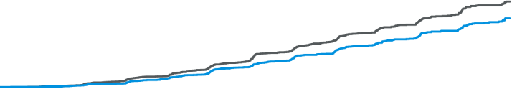
FIDELITY Study: Kidney composite outcome
Time to kidney failure,* sustained ≥57% decrease in eGFR from baseline, or renal death#
25
HR=0.77; 95% CI 0.67–0.88
p=0.0002
20
NNT after 3 years = 60 (95% CI 38–142)
15
Placebo: 465/6507 (7.1%)‡
Cumulative incidence (%)
10
5
Finerenone: 360/6519 (5.5%)‡
0
0
6
12
18
24
30
36
42
48
No. at risk
Time to first event (months)
Finerenone
6519
6291
6107
5848
5027
3973
2815
2024
959
Placebo
6507
6292
6071
5815
4949
3932
2798
1988
962
Notes:
Finerenone significantly reduced the risk of the ≥57% eGFR kidney composite outcome by 23% vs placebo

Slide 18
FIDELITY Study: Incidences of all components of the composite kidney outcome
Outcome | Finerenone (n=6519) | Placebo (n=6507) | HR (95% CI) |  | p-value
 | n (%) | n (%)
eGFR 57% composite kidney outcome | 360 (5.5) | 465 (7.1) |  | 0.77 (0.67–0.88) | 0.0002
Kidney failure | 254 (3.9) | 297 (4.6) |  | 0.84 (0.71–0.99) | 0.039
ESKD# | 151 (2.3) | 188 (2.9) |  | 0.80 (0.64–0.99) | 0.040‡
eGFR <15 ml/min/1.73 m^{2¶} | 195 (3.0) | 237 (3.6) |  | 0.81 (0.67–0.98) | 0.026‡
≥57% decrease in eGFR from baseline¶ | 257 (3.9) | 361 (5.5) |  | 0.70 (0.60–0.83) | <0.0001
Renal death | 2 (<0.1) | 4 (<0.1) |  | 0.53 (0.10–2.91) | –
≥57% decrease in eGFR is equivalent to doubling of serum creatinine
Favours finerenone
Favours placebo
Notes:
Finerenone significantly reduced the risk of all non-fatal components of the ≥57% eGFR kidney composite outcome¹

Slide 19
FIDELITY Study: Reduction of UACR over time
A ~30% reduction of the mean UACR with finerenone vs placebo at 4 months was maintained throughout the study
Ratio of LS mean at 4 months: 0.68; 95% CI 0.66–0.70
Placebo
(-5%)
(+2%)
(-6%)
(-6%)
UACR LS mean ratio to baseline#
Finerenone
(-36%)
(-43%)
(-41%)
Geometric mean UACR at baseline:
Finerenone: 445.4 (gSD 3.5)
Placebo: 454.3 (gSD 3.5)
4
Months since randomisation
N
Finerenone
Placebo
6517
6504
6273
6239
5988
5973
4867
4829
2745
2706
899
872
Notes:
Finerenone reduced UACR by 32% between baseline and month 4 vs placebo

Slide 20
CV composite outcome
Time to CV death, non-fatal MI, non-fatal stroke or hospitalisation for HF

Slide 21
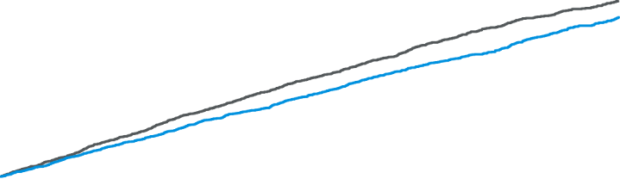
FIDELITY Study: CV composite outcome
Time to CV death, non-fatal MI, non-fatal stroke, or hospitalisation for HF
25
HR=0.86; 95% CI 0.78–0.95
p=0.0018
Placebo: 939/6507 (14.4%)#
20
NNT after 3 years = 46 (95% CI 29–109)
15
Cumulative incidence (%)*
10
Finerenone: 825/6519 (12.7)#
5
0
0
6
12
18
24
30
36
42
48
No. at risk
Time to first event (months)
Finerenone
6519
6360
6202
6009
5273
4207
3065
2187
1087
Placebo
6507
6330
6125
5938
5184
4147
2969
2135
1082
Notes:
On top of optimised RAS blockade, finerenone significantly reduced the risk of the composite CV outcome by 14% vs placebo

Slide 22
FIDELITY Study: Incidences of all components of the composite CV outcome
Outcome | Finerenone (n=6519) | Placebo (n=6507) | HR (95% CI) |  | p-value
 | n (%) | n (%)
Composite CV outcome | 825 (12.7) | 939 (14.4) |  | 0.86 (0.76–0.95) | 0.0018
HHF | 256 (3.9) | 325 (5.0) |  | 0.78 (0.66–0.92) | 0.0030
CV death | 322 (4.9) | 364 (5.6) |  | 0.88 (0.76–1.02) | 0.092
Non-fatal MI | 173 (2.7) | 189 (2.8) |  | 0.91 (0.74–1.12) | 0.36
Non-fatal stroke | 198 (3.0) | 198 (3.0) |  | 0.99 (0.82–1.21) | 0.95
Favours finerenone
Favours placebo
Notes:
The CV benefits of finerenone were primarily driven by reduction in HHF

Slide 23
Safety and vital signs

Slide 24

FIDELITY Study: Impact on systolic blood pressure
The difference in mean SBP between groups was –3.0 mmHg at month 12*
(0.5)
(0.5)
(0.0)
(–0.1)
(–1.1)
Mean SBP at baseline (mmHg):
Placebo: 136.7 ±14.3
Finerenone: 136.8 ±14.2
Mean SBP (mmHg)
(–3.2)
(–2.5)
(–2.4)
(–2.9)
(–1.8)
Patients (n):
Finerenone
Placebo
Months since randomisation
6509
6489
6324
6310
6070
6057
5001
4968
2842
2814
926
901
Numbers in parentheses show mean change from baseline; error bars show standard deviation
*Analysis of safety set
SBP, systolic blood pressure
Agarwal R, et al. Eur Heart J 2022; 43:474-484
Notes:
Finerenone had a modest impact on blood pressure

Slide 25
FIDELITY Study: Impact on serum potassium concentration
The maximum difference in mean serum [K⁺] between groups was 0.19 mmol/l at month 4
(0.21)
(0.20)
(0.18)
(0.17)
(0.13)
Mean baseline serum [K⁺] Finerenone: 4.35±0.44 Placebo: 4.35±0.44
Mean serum [K⁺] (mmol/l)
(0.02)
(0.02)
(0.02)
(0.03)
(0.03)
Patients (n):
Finerenone
Placebo
Months since randomisation
6510
6487
6234
6229
5990
5965
4916
4878
2781
2759
912
887
Numbers in parentheses show change from baseline; error bars show standard deviation [K⁺], potassium concentration
Agarwal R, et al. Eur Heart J 2022; 43:474-484
Notes:
In FIDELITY, finerenone had a predictable impact on serum potassium concentration

Slide 26
FIDELITY Study: Overall safety outcomes and kidney AEs
Investigator-reported AEs, n (%) | Finerenone (n=6510) | Placebo (n=6489)
Any AE | 5608 (86.1) | 5607 (86.4)
Leading to discontinuation | 414 (6.4) | 351 (5.4)
Any serious AE | 2060 (31.6) | 2186 (33.7)
Acute kidney injury | 220 (3.4) | 234 (3.6)
Leading to hospitalisation | 85 (1.3) | 86 (1.3)
Leading to discontinuation | 14 (0.2) | 10 (0.2)
Gynecomastia | 8 (0.1) | 11 (0.2)
Notes:
Overall safety outcomes and kidney AEs were similar between treatment arms

Slide 27

FIDELITY: Impact on Hyperkalemia by eGFR Category
eGFR < 60 ml/min/1,73 m²
eGFR ≥ 60 ml/min/1,73 m²
Finerenone (n = 3908)
Finerenone (n = 2602)
Placebo (n = 3900)
Placebo (n = 2588)
Patients (%)
Incidence of Hyperkalemia (serumpotassiom ≥ 5 mmol/l)
There were no hyperkalaemia-related deaths in over 13,000 patients over 3 years median follow-up

Slide 28
Summary and conclusions

Slide 29
FIDELITY summary and conclusions
In patients with CKD stage 1–4 with moderate to severe albuminuria (UACR ≥30 mg/g [≥3 mg/mmol]) and T2D and treated with a optimised RASi,
finerenone in addition to standard of care vs placebo
Reduced the risk of CKD progression
by 23% (NNT=60)*
Reduced albuminuria constantly by 30%
Reduced the risk of CV morbidity and mortality by 14% (NNT=46)*
Reduced hospitalisations for HF by 22%
The safety profile of finerenone was at the level of placebo
The increase in hyperkalemia with finerenone was manageable, and routine potassium monitoring remains mandatory
Mean effects on BP (- 3 mmHg) and serum potassium (+ 0.19 mmol/l) were moderate

Slide 30
Finerenone indication in Switzerland

Slide 31


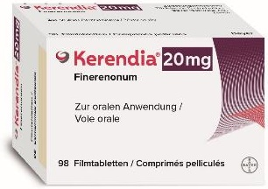

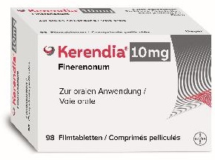
Finerenone (Kerendia®) - Indication
Kerendia is indicated to delay the progression of chronic kidney disease in adult patients with type 2 diabetes mellitus
For study outcomes regarding the effects on cardiovascular events see section «Clinical efficacy» in the professional information.

Slide 32
Finerenone (Kerendia®) - Limitatio
Kerendia® is reimbursed for the delay of the progression of chronic kidney disease in adult patients with T2D
Criteria for treatment initiation:
Serum potassium level ≤ 5 mmol/l
Prior treatment with a maximum tolerated approved dose of an ACE inhibitor or an ARB
Chronic kidney disease for at least 3 months
eGFR of 25-59 ml/min/1.73 m² and urinary ACR of > 30 mg/g (> 3 mg/mmol, A2 und A3)
or
eGFR of 25-75 ml/min/1.73 m² and urinary ACR of > 300 mg/g (> 30 mg/mmol, A3)
Reimbursed since June 1, 2023
Albuminuria
(ACR, albumin/creatinine)
 |  | A1 Normal to mildly increased | A2 Moderately increased | A3 Severely increased
 |  | < 30 mg/g < 3 mg/mmol | 30-300 mg/g 3-30 mg/mmol | > 300 mg/g > 30 mg/mmol
G1 | ≥ 90
G2 | 60-89
G3a | 45-60
G3b | 30-44
G4 | 15-29
CKD stage
(KDIGO 2012)
GFR categories
(ml/min/1.73 m²)
Scope of Kerendia® according to limitation
Kerendia can be used independently of SGLT2 inhibitors.
In combination with SGLT2 inhibitors only in patients with eGFR of 25-59 ml/min/1.73 m² and urinary ACR of > 300 mg/g (> 30 mg/mmol, A3, shaded area)
Shaded area: in combination with SGLT2 inhibitors. Adapted to KDIGO 2012
Spezialitätenliste, www.spezialitaetenliste.ch

Slide 33


Dosing
Therapy initiation and maintenance depend on eGFR and Serum-[K⁺]¹
Start
Check serum-[K⁺] after 4 weeks
≥60 ml/min/1.73 m²
20 mg OD**
20 mg OD*
≤4.8 mmol/l
Maintain dosage
(10 mg or 20 mg OD)
eGFR
>4.8–5.5 mmol/l
Withhold Kerendia®
Restart at 10 mg OD when serum-[K⁺] ≤ 5 mmol/l
10 mg OD*
>5.5 mmol/l
<60 ml/min/1.73 m²
Kerendia® in addition to standard therapy.¹
Therapy with Kerendia® is not recommended if serum-[K⁺] >5 mmol/l.¹
* Kerendia® initiation dosage in patients on therapy with a moderate CYP3A4 inhibitor (e.g. Verapamil): 10 mg OD.
** In patients on 10 mg OD starting dose. Only increase dose to 20 mg OD if eGFR decrease did not exceed 30% vs. last measurement.
eGFR: estimated glomerular filtration rate; [K⁺]: Potassium concentration

Slide 34
CKD screening in diabetes recommendations

Slide 35
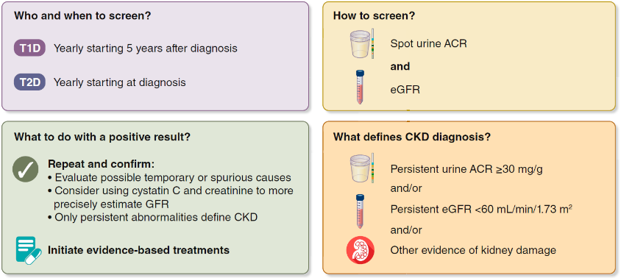
CKD screening and diagnosis for people living with diabetes
Diabetes Management in Chronic Kidney Disease: A Consensus Report by the American Diabetes Association (ADA) and Kidney Disease: Improving Global Outcomes (KDIGO)
Screening includes measurement of both urine albumin and eGFR. Abnormalities should be confirmed.
Persistent abnormalities in either urine ACR or eGFR (or both) diagnose CKD and should lead to immediate initiation of evidence-based treatments.
ACR, albumin-to-creatinine ratio; CKD, chronic kidney disease; eGFR, estimated glomerular filtration rate; T1D, type 1 diabetes; T2D, type 2 diabetes.

Slide 36
Reduction of albuminuria in CKD and T2D

Slide 37

Albuminuria is an early marker of CKD and increased CV risk ¹⁻³
Time since T2D diagnosis¹
eGFR <60 ml/min/1.73m²
1600
140
1400
120
1200
100
1000
800
Increased CV risk (UACR>10 mg/g)³
80
UACR (mg/g)
eGFR (ml/min/1.73 m²)
600
60
400
40
300
20
200
30
0
0
UACR 30–300 mg/g
UACR >300 mg/g
In the classical model of CKD in T2D disease progression, the onset of moderate-to-severely increased albuminuria precedes eGFR falling below 60 ml/min/1.73m² (i.e. stage 3 CKD)^{1,2}
However, in contemporary clinical practice, 33–67% of patients develop an eGFR <60 ml/min/1.73m² without/prior to developing albuminuria^{4–6}
Notes:
The clinical diagnosis of CKD in a patient with T2D is based on the presence of albuminuria (UACR ≥30 mg/g) and/or reduced kidney function (eGFR <60 ml/min/1.73 m²), sustained over at least 3 months, in the absence of signs or symptoms of other primary causes of kidney damage.^{1,2} The figure here depicts the classical model of CKD in type 2 diabetes progression, in which UACR rises from relatively early in the disease course; meanwhile eGFR remains relatively stable until severely increased levels of albuminuria precipitate its fall.^{3,4} However, in contemporary clinical practice a significant proportion of patients with an eGFR <60 ml/min/1.73m² do not develop albuminuria prior to CKD stage 3 diagnosis.^{5–7} Consequently, for early diagnosis of CKD in T2D and early identification of patients at increased CV risk, assessment of both albuminuria and eGFR is required.

Slide 38
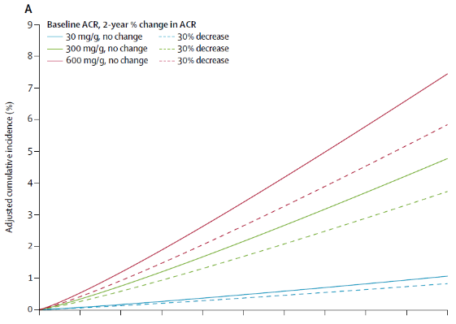
Change in albuminuria and subsequent risk of ESKD
Meta-analysis of observational studies
Cumulative incidence of ESKD* over time based on baseline albuminuria levels and a 30% decline in albuminuria vs no decline as measured by ACR
individual-level data from 28 eligible observational cohorts in the Chronic Kidney Disease Prognosis Consortium (CKD-PC)
N = 693’816
80% had diabetes
30% reduction in ACR over 2 years
reduction of ESKD by 17% (HR=0.83, CI 0.74 - 0.94)
*Adjusted for age, sex, race/ethnicity (black vs non-black), systolic blood pressure, total cholesterol, diabetes, history of CV disease, current smoking, first eGFR and albuminuria
ACR: albumin-to-creatinine ratio; CI: confidence interval; ESKD: end-stage kidney disease; HR: hazard ratio

Slide 39
Each 30% reduction in UACR leads to kidney benefit and a potential to reduce the risk of CKD progression
Albuminuria categories (mg albumin/g creatinine)¹
A1 Normal to mildly increased | A2 Moderately increased | A3 Severely increased
0–29 | 30–300 | >300
GFR categories (ml/min/1.73 m²) | G1 | ≥90
 | G2 | 60–89
 | G3a | 45–59
 | G3b | 30–44
 | G4 | 15–29
 | G5 | <15
−30%
−30%
299
427
610
Low risk
Moderately increased risk
High risk
Very high risk
A >30% reduction in UACR may be required for some people to reduce their risk of CKD progression from severe to moderate

Slide 40
Therapeutic pillars in CKD and T2D

Slide 41
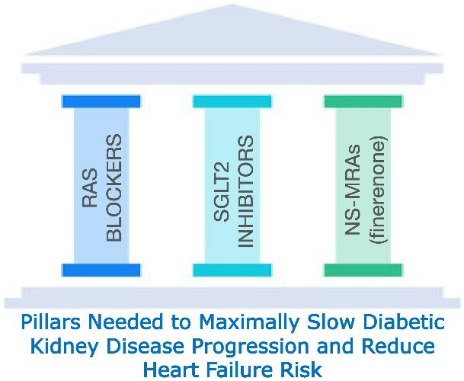
Three therapeutic pillars to slow kidney disease progression and reduce CV risk in CKD patients with T2D
“Building upon the concept used by cardiologists in heart failure, for the first time, nephrologists and endocrinologists can apply the principles of three established “pillars of therapy” - ACEi or ARB (at maximally tolerated doses), SGLT2 inhibitors, and finerenone (ns-MRA) - to maximally slow declines in kidney function”

Slide 42
Clinical practice algorithm for the treatment of CKD patients with T2D
A clinical practice document by the European Renal Best Practice (ERBP) board of the ERA
Follow lifestyle recommendations (weight loss, physical exercise, dietary sodium reduction, smoking cessation, etc)
Treat co-morbid condition s (hypertension, diabetes, dyslipidemia) according to recommendations
Lifestyle
changes
Include an ACEi or an ARB as first-line treatmet for BP control in all patients with CKD
In addition to BP control, titrate an ACEi or an ARB to maximum tolerated apporved doses in patients with CKD and UACR > 30 mg/g (Albuminuria A2, equivalent to urine albumin excretion > 30 mg/ 24 h)
RAAS
blockage
Use an SGLT2 inhibitor in patients with CKD and T2D with an eGFR > 20 ml/min/1.72 m2
Use a nsMRA (finerenone) in patients with CKD and T2D with UACR > 30 mg/g, eGFR > 25 ml/min/1.73 m2 and serum K+ < 4.8 mmol/l
SGLT2
inhibitior
and
nsMRA
finerenone
In patients with hyperkalemia use current treatment practices, potentially including a novel potassium binder to maintain serum K+ < 5.5 mmol/l to ensure optimal treatment with an ACEi/ARB and/or a nsMRA

Slide 43





Current concept of multifactorial intervention on GFR decline in DKD - incremental benefits
GFR
Ageing-associated decline (1-1.2 ml/min/1.73 m²/year)
DKD with albuminuria (av. decline: 6 ml/min/1.73 m²/year)
Potential additional benefit with pharmacological intervention
100
Ageing-associated decline
(1-1.2 ml/min/1.73 m²/year)
BP control
RAAS
inhibition
SGLT2
inhibition
nsMRA
90
80
DKD patient
ACR 1g/d
70
60
50
40
30
20
10
renal replacement therapy
Age
40
50
60
70
80
ACR: albumine-creatinine-ratio; BP: blood pressure; DKD: diabetic kidney disease; nsMRA: non-steroidal mineralocorticoid receptor antagonist; RAAS: renin-angiotensin-aldosterone system; SGLT2: sodium-glucose-transporter 2
Modified from Fioretto P, Pontremoli A. Nature Reviews Nephrol 2022; 18: 78-79

Slide 44
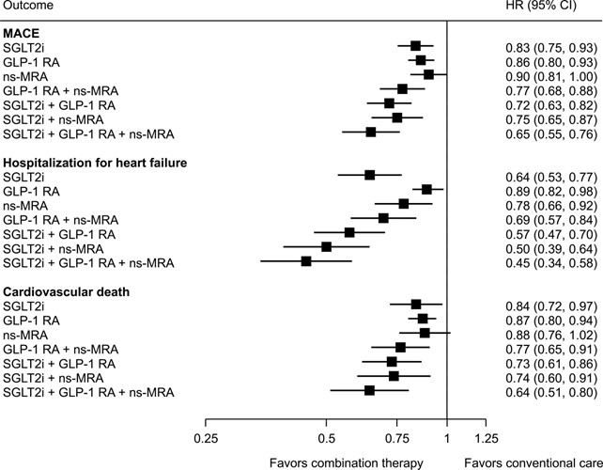
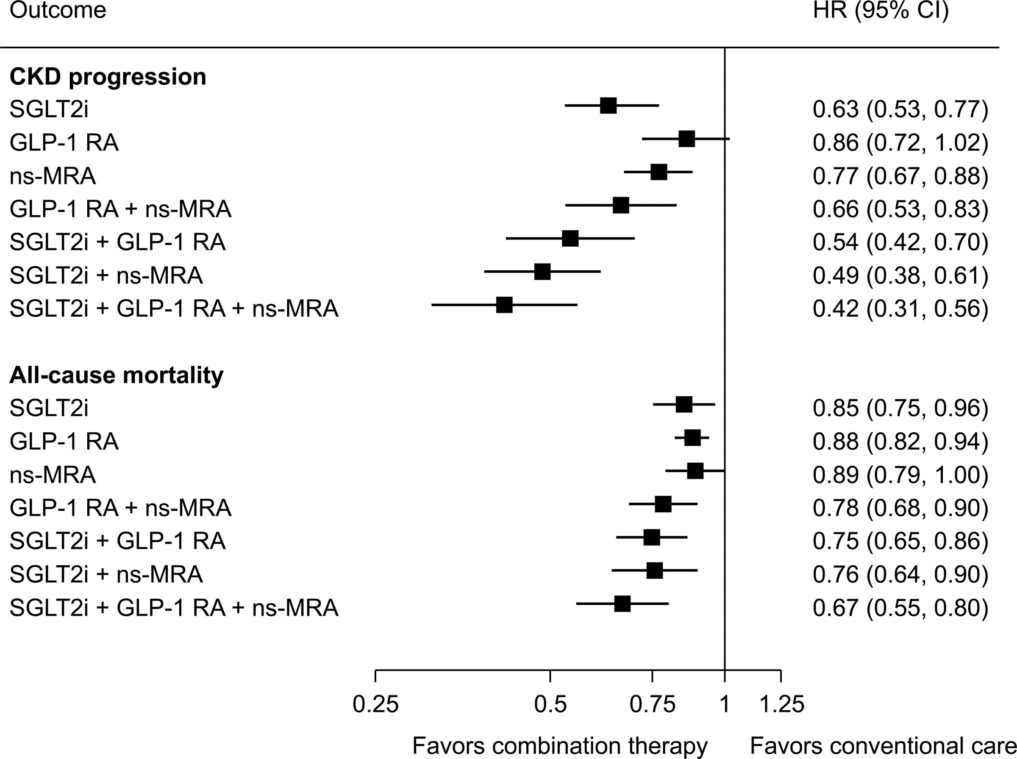
Treatment effects of incremental pharmaceutical intervention
Estimated treatment effects of SGLT2i, GLP-1 RA and non-steroidal MRA, alone and in combination on CV and renal outcomes in DKD with albuminuria> 30mg/g
CI: confidence interval; GLP-1 RA: glucagon-like peptide-1 receptor agonist; DKD: diabetic kidney disease; HR: hazard ratio; MACE: major adverse cardiovascular events; ns-MRA: non-steroidal mineralocorticoid receptor antagonist; SGLT2i: sodium glucose cotransporter-2 inhibitor;
CKD progression defined as doubling of serum creatinine, kidney failure, or death due to kidney failure, apart from with GLP-1 RAs, where it was defined as sustained reduction in kidney function, kidney failure or death due to kidney failure

Slide 45
Finerenone guidelines recommendations

Slide 46
Outline of guideline recommendations for Finerenone
KDIGO 2022 Clinical Practice Guideline for diabetes management in CKD¹
Guidelines across different societies recommend Finerenone:
1.4.1 A nonsteroidal MRA with proven kidney and CV benefit is recommended for patients with T2D, an eGFR ≥25 ml/min/1.73 m², normal serum potassium concentration, and UACR ≥30 mg/g despite maximum tolerated dose of RASi. 2A
Nephrology
KDIGO¹ (Level 2A)
SSN³
ERBP⁴ (ERA working group)
Endocrinology and Diabetology
ADA⁵ (Level A)
SGED⁶
AACE⁷ (Level A)
DKD in T2D: a consensus statement from the Swiss societies of Diabetes and Nephrology²
Cardiology
ESC Diabetes⁸ (Level 1A)
We recommend considering adding an MRA (e.g. finerenone) in albuminuric diabetic kidney disease with a potassium ≤4.8 mmol/l, for individuals on RAS blockade with or without an SGLT2 inhibitor
ESC HF⁹ (for HF prevention, Level 1A)
Interdisciplinary societies and consensus
ESH¹⁰ (Level 1A)
SGED-SSN consensus²
KDIGO-ADA consensus¹¹

Slide 47
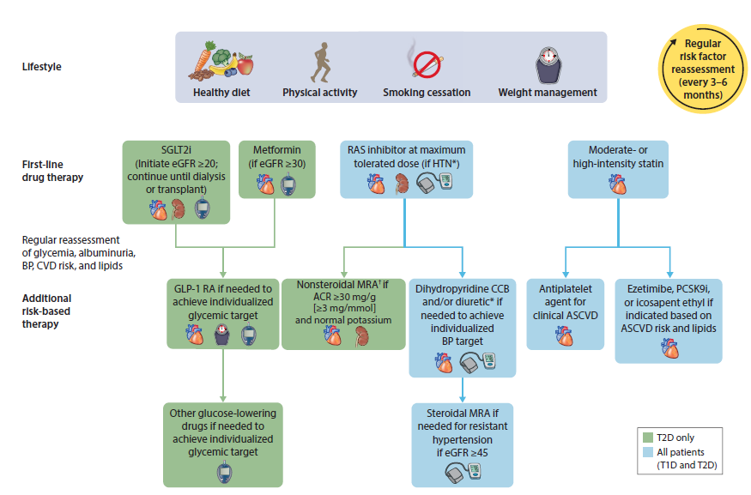
The KDIGO 2022 guidelines recommend a holistic approach to improving outcomes in patients with CKD and T2D
The KDIGO 2022 guidelines position finerenone after treatment with RASis to protect against persistent cardiorenal risk in patients with diabetes and CKD (UACR ≥30 mg/g)

Slide 48
KDIGO practice points: Nonsteroidal MRAs
Consensus statements that supplement recommendations
Developed when no formal systematic evidence review was undertaken, or if there was insufficient evidence to provide a graded recommendation
They help clinicians evaluate and implement the graded recommendations
Represent the expert judgment of the guideline Work Group
Practice points
Practice Point 1.4.1
Practice Point 1.4.2
Practice Point 1.4.3
Practice Point 1.4.4
Nonsteroidal MRAs are most appropriate for patients with T2D who are at high risk of CKD progression and CV events, as demonstrated by persistent albuminuria despite other
standard-of-care therapies
A nonsteroidal MRA can be added to a RASi and an SGLT-2i for treatment of T2D and CKD
To mitigate risk of hyperkalemia, select patients with consistently normal serum potassium concentration and monitor serum potassium regularly after initiation of a nonsteroidal MRA
The choice of a nonsteroidal MRA should prioritise agents with documented kidney or cardiovascular benefits

Slide 49
Backup slides

Slide 50
FIDELITY Study: Kidney and cardiovascular benefit according to SGLT-2i use at baseline
Endpoint | Finerenone n/N (n/100 PY) | Placebo n/N (n/100 PY) | Hazard ratio (95% CI) | Adjusted HR (95% CI)* | p-value for interaction
Kidney composite# |  |  |  |  | 0.29
No SGLT-2i | 351/6081 (2.1) | 448/6068 (2.6) |  | 0.80 (0.69–0.92)
SGLT-2i | 9/438 (0.7) | 17/439 (1.4) |  | 0.42 (0.16–1.08)
Cardiovascular composite‡ |  |  |  |  | 0.41
No SGLT-2i | 786/6081 (4.4) | 887/6068 (5.1) |  | 0.87 (0.79–0.96)
SGLT-2i | 39/438 (3.0) | 52/439 (4.1) |  | 0.70 (0.4–<1.0)
Favors finerenone
Favors placebo
Notes:
Kidney benefit was consistent irrespective of SGLT-2i use at baseline

Slide 51
FIDELIO-DKD: effect of SGLT-2i use on the risk of hyperkalaemia
Risk of hyperkalemia
Variable, %* | HR (95% CI) |  | p-value
SGLT-2i use, yes (5%) vs no (95%)§ |  | 0.45 (0.27–0.75) | 0.0023
Lower risk
Higher risk
Baseline SGLT-2i use was associated with lower risk of hyperkalemia
Notes:
FIDELIO-DKD: use of SGLT2 Inhibitors was associated with lower risk of hyperkalaemia

Slide 52

FIDELITY Study: UACR reduction over time according to SGLT-2i use at baseline
Without baseline SGLT-2i n=12,149
–31%
In FIDELITY, finerenone consistently reduced UACR irrespective of baseline SGLT-2i use*¹
With baseline SGLT-2i n=877
–37%
Patients were receiving optimised RASi. Finerenone vs. placebo in reduction of UACR from baseline to month 4.
*Full analysis set. Mixed model with factors for treatment group, region, eGFR category at screening, type of albuminuria at screening, CV disease history; time, treatment*time, log-transformed baseline value nested within type of albuminuria at screening, and log‑transformed baseline value*time as covariates.
RASi, renin-angiotensin-system inhibitor; SGLT2i, sodium–glucose cotransporter 2 inhibitor; UACR, urine albumin-to-creatinineratio.
1. Rossing P, et al. Diabetes Care 2022;45:2991–2998
Notes:
The acute effect of finerenone is a drop in eGFR within the first few months but the long-term effect (as of month 4) is a slowing of eGFR decline

Slide 53
FIDELITY Study: Kidney outcome according to baseline eGFR or UACR
 | Finerenone | Placebo | Hazard ratio (95% CI) |  | p-value for interaction
 | n/N (n per 100 PY)
Overall | 360/6519 (1.96) | 465/6507 (2.55) |  | 0.77 (0.67–0.88)
Baseline eGFR (ml/min/1.73 m²)*
25–<45 | 188/2117 (3.42) | 225/2115 (4.14) |  | 0.83 (0.68–1.01) | 0.6244
45–<60 | 62/1717 (1.31) | 87/1717 (1.83) |  | 0.72 (0.52–1.00)
≥60 | 90/2603 (1.14) | 130/2592 (1.66) |  | 0.70 (0.53–0.92)
Baseline UACR (mg/g)#
30–<300 | 38/2076 (0.57) | 40/2023 (0.62) |  | 0.94 (0.60–1.47) | 0.6673
≥300 | 321/4321 (2.85) | 424/4371 (3.71) |  | 0.75 (0.65–0.87)
Favours finerenone
Favours placebo
Notes:
Finerenone reduced the risk of the ≥57% eGFR kidney composite outcome vs placebo, irrespective of baseline eGFR or UACR

Slide 54
FIDELITY Study: Reduction of eGFR slope
Mean eGFR at baseline (ml/min/1.73 m²): Finerenone: 57.5±21.6 Placebo: 57.7±21.8
Acute
Chronic
4
8
12
16
20
24
28
32
36
40
44
Total annualised change in eGFR#, ml/min/1.73 m² (95% CI):
Finerenone: –3.5 (–3.8 to –3.3), Placebo: –3.6 (–3.8 to –3.4)
eGFR LS mean change (ml/min/1.73 m²)
Chronic annualised change in eGFR‡, ml/min/1.73 m²/year (95% CI):
Finerenone: –2.5 (–2.7 to –2.2)
Placebo: –3.7 (–4.0 to –3.4)
Δ = -1.2
N
Finerenone
Placebo
6428
6406
6262
6244
6015
5991
4923
4872
2767
2727
1589
1572
Notes:
The acute effect of finerenone is a drop in eGFR within the first few months but the long-term effect (as of month 4) is a slowing of eGFR decline

Slide 55





PK and PD of finerenone
Absorption
The absolute bioavailability is 43.5% (First-Pass-Metabolism in intestinal wall and liver)
Finerenone C_{max} was achieved between 0.5 and 1.25 hours after dosing
Wirkung von Nahrung
Finerenone can be taken independently of meals
Distribution
The volume of distribution at steady-state (V_{ss}) of finerenone is 52.6 l.
Plasma protein binding of finerenone is 91.7% in vitro, primarily to serum albumin
Metabolismus
Finerenone is primarily metabolised by CYP3A4 (90%) and to a lesser extent by CYP2C8 (10%) to inactive metabolites
Elimination
The terminal half-life of finerenone is about 2 to 3 hours, and the systemic blood clearance is about 25 l/h
Ausscheidung
About 80% of the administered dose is excreted in urine (<1% as unchanged) and approximately 20% in faeces (<0.2% as unchanged)
C_{max}: maximale Plasmakonzentrationen

Slide 56



Contraindications
Kerendia® is contraindicated in patients::
receiving concomitant treatment with strong CYP3A4 inhibitors, including: itraconazole, ketoconazole, ritonavir, nelfinavir, cobicistat, clarithromycin, telithromycin and nefazodone
with Addison’s disease
with hypersensitivity to the active substance or to any of the excipients

Slide 57




Drug interactions influencing exposure to finerenone
Finerenone is cleared by CYP3A4 (90%) and CYP2C8 (10%)
Strong CYP3A4 inhibitors
Finerenone is contraindicated. e.g. itraconazole, ketoconazole, ritonavir, nelfinavir, cobicistat, clarithromycin, telithromycin, nefazodone
Strong CYP3A4 inducers
Concomitant use is not recommended. e.g. rifampicin, carbamazepine, phenytoin, phenobarbital, St. John‘s wort
Medications that can increase the serum potassium level, sparing diuretics, other MRAs
Concomitant use is not recommended.
e.g. potassium-sparing diuretics (e.g. amiloride)
other mineralocorticoid receptor antagonists (e.g. eplerenone, spironolactone)
Moderate CYP3A4 inducers
Concomitant use is not recommended. e.g. efavirenz
Moderate/weak CYP3A4 inhibitors, potassium supplements
Concomitant use with precaution.
Moderate CYP3A4 inhibitors (e.g. erythromycin)
Weak CYP3A4 inhibitors (e.g. fluvoxamine)
Grapefruit
Concomitant intake of grapefruit or grapefruit juice is not recommended.

Slide 58
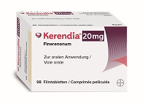

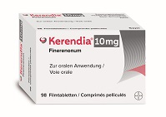

What packs are available?
Dose | Pack size | Ex-Factory-Price | Public-Price | Tablet
20 mg | 2 x 14 tablets (1 month) | CHF 41.72 | CHF 64.30 | Color: yellow Shape: oval film-coated tablet Size: 5x10 mm Marking: «20» and «FI»
20 mg | 7 x 14 tablets (3 months) | CHF 146.02 | CHF 184.05
10 mg | 2 x 14 tablets (1 month) | CHF 41.72 | CHF 64.30 | Color: pink Shape: oval film-coated tablet Size: 5x10 mm Marking: «10» and «FI»
10 mg | 7 x 14 tablets (3 months) | CHF 146.02 | CHF 184.05

Slide 59






















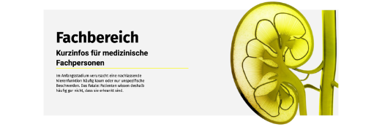






Nieren leiden leise
https://www.nieren-leiden-leise.ch/
Jede zehnte erwachsene Person in der Schweiz ist von einer chronischen Nierenkrankheit betroffen!
Kooperationspartner
Experten
Dr. Isabelle Binet (Kantonsspital St. Gallen)
Prof. Dr. Olivier Bonny (Hôpital Fribourgeois)
Dr. Dr. Roman Brenner (Kantonsspital St. Gallen)
Dr. Jan Brügger (Horgen)
Prof. em. Dr. Michel Burnier (ehem. CHUV Lausanne)
PD Dr. Dr. Pietro Cippà (Ospedale Regionale di Lugano)
Dr. Cecilia Czerlau (Inselspital Bern)
Prof. Dr. Michael Dickenmann (Universitätsspital Basel)
Prof. Dr. David Fäh (Berner Fachhochschule)
Dr. Philipp Grosse (Kantonsspital Graubünden)
Prof. Dr. Roger Lehmann (Universitätsspital Zürich)
Prof. em. Dr. Gerd Nagel (ehem. Universität Freiburg)
PD Dr. Harald Seeger (Kantonsspital Baden)
Prof. Dr. Sophie de Seigneux (Universitätsspital Genf)
PD Dr. Giuseppina Spartà (Kinderspital Zürich)
Prof. Dr. Isabella Sudano (Universitätsspital Zürich)
Prof. em. Dr. François Verrey (ehem. Universität Zürich)
PD Dr. Grégoire Wuerzner (CHUV Lausanne)
PD Dr. Anne Zanchi Delacrétaz (CHUV Lausanne)
PP-KER-CH-0108-1_12.2023
Mit freundlicher Unterstützung von

Slide 60
Kerendia ® Abbreviated Summary of Product Characteristics
▼This medicinal product is subject to additional monitoring. For further information see product information/patient information Kerendia® at www.swissmedicinfo.ch.
Abbreviated Summary of Product Characteristics of Kerendia® (Finerenone): Non-steroidal, selective mineralocorticoid receptor antagonist (MRA) C: Film-coated tablets with 10 mg and 20 mg finerenone I: Kerendia is indicated to delay the progression of chronic kidney disease in adults with type 2 diabetes. For study results on the effect on cardiovascular events, see section „clinical efficacy“ in the Kerendia product information. D: Initiation of therapy with Kerendia is recommended when serum potassium ≤ 4.8 mmol/l. If serum potassium > 4.8-5.0 mmol/l, treatment with Kerendia may be considered with additional serum potassium monitoring within the first 4 weeks. If serum potassium > 5.0 mmol/l, treatment with Kerendia is not recommended. Kerendia starting dose: 20 mg once daily if eGFR ≥ 60 ml/min/1.73 m² and 10 mg once daily if eGFR 25-59 ml/min/1.73 m². Continuation 4 weeks after initiation, re-start or up-titration of Kerendia: 20 mg once daily if serum potassium ≤ 4.8 mmol/l and no decrease of eGFR > 30% compared to previous measurement, or maintain dosage (10 mg or 20 mg) if serum potassium > 4.8-5.0 mmol/l. If serum potassium > 5.5 mmol/l, withhold dosing with Kerendia and resume dosing at 10 mg once daily if serum potassium ≤ 5 mmol/l. In case of concomitant treatment with a moderate CYP3A4 inhibitor: initiation of therapy with 10 mg once daily. CI: Concomitant treatment with a strong CYP3A4 inhibitor, Addison’s disease, hypersensitivity to the active substance or to excipients. W/P: There is an increased risk of hyperkalemia in patients treated with Kerendia. Therefore, a periodic measurement of serum potassium is recommended and treatment with Kerendia should be withheld if serum potassium > 5.5 mmol/l and resumed with 10 mg once daily when serum potassium ≤ 5 mmol/l (see D). The risk of hyperkalemia may also increase with intake of concomitant medicines that may increase serum potassium. PL: Kerendia should not be used during pregnancy unless required by the clinical condition of the woman. During lactation, a decision must be made whether to discontinue breastfeeding or therapy with Kerendia. Very common and common ADR: Hyperkalemia, hyponatremia, hypotension, GFR decreased, hyperuricemia. IA: Concomitant use with moderate and weak CYP3A4 inhibitors increases Finerenone exposure. Since serum potassium may rise as a result, the risk of hyperkalemia increases. Therefore, serum potassium must be monitored. Packs: 10 mg and 20 mg: 28 or 98 film-coated tablets. (B), covered by health insurance companies (refer to Limitatio). Additional information available at www.swissmedicinfo.ch. Distribution: Bayer (Schweiz) AG, Uetlibergstr. 132, 8045 Zurich.
MA-M_FIN-CH-0074-1_10.2022

Slide 61
References (1)
Afkarian M, et al. Diabetic kidney disease in children and adolescents. Pediatr Nephrol 2015;30: 65-74
Amazit L,.et al. Finerenone Impedes Aldosterone-dependent Nuclear Import of the Mineralocorticoid Receptor and Prevents Genomic Recruitment of Steroid Receptor Coactivator-1. J Biol Chem 2015;290:21876-21889
American Diabetes Association. 11. Chronic Kidney Disease and Risk Management: Standards of Medical Care in Diabetes—2022. Diabetes Care 2022; 45(Suppl. 1):S175–S184
Agarwal R, et al. Cardiovascular and kidney outcomes with finerenone in patients with type 2 diabetes and chronic kidney disease: the FIDELITY pooled analysis. EUR Heart J 2022; 43:474-484
Agarwal R, et al. Steroidal and non-steroidal mineralocorticoidreceptor antagonists in cardiorenal medicine. Eur Heart J 2021; 42: 152-161
Agarwal R, et al. Investigating new treatment opportunities for patients with chronic kidney disease in type 2 diabetes: the role of finerenone. Nephrol Dial Transplant 2020; 37(6):1014-1023
Agarwal R, et al. Hyperkalemia Risk with Finerenone: Results from the FIDELIO-DKD Trial. J Am Soc Nephrol 2022; 33:225-237
Aldactone product information www.swissmedicinfo.ch
Alicic RZ, et al. Diabetic Kidney Disease Challenges, Progress, and Possibilities. Clin J Am Soc Nephrol 2017;12:2032–2045

Slide 62
References (2)
Bakris GL, et al. Effect of Finerenone on Chronic Kidney Disease Outcomes in Type 2 Diabetes. N Engl J Med 2020;383:2219-29
Bakris GL, et al. A prespecified exploratory analysis from FIDELITY examined finerenone use and kidney outcomes in patients with chronic kidney disease and type 2 diabetes. Kidney international 2023;103:196–206
Bärfacker L, et al. Discovery of BAY 94-8862: A Nonsteroidal Antagonist of the Mineralocorticoid Receptor for the Treatment of Cardiorenal Diseases. Chem Med Chem 2012;7:1385–1403
Barrera-Chimal J, et al. The myeloid mineralocorticoid receptor controls inflammatory and fibrotic responses after renal injury via macrophage interleukin-4 receptor signaling. Kidney Int 2018;93:1344–1355
Bauersachs J, et al. Mineralocorticoid Receptor Activation and Mineralocorticoid Receptor Antagonist Treatment in Cardiac and Renal Diseases. Hypertension 2015;65:257–263
Blazek O. and Bakris GL. The evolution of “pillars of therapy” to reduce heart failure risk and slow diabetic kidney disease progression. Am Heart J 2022; https://doi.org/10.1016/j.ahjo.2022.100187
Blonde L, et al. American Association of Clinical Endocrinology Clinical Practice Guideline: Developing a Diabetes Mellitus Comprehensive Care Plan-2022 Update. Endocr Pract. 2022;28(10):923-1049
Coresh J, et al. Change in albuminuria and subsequent risk of end-stage kidney disease: an individual participant-level consortium meta-analysis of observational studies. Lancet Diabetes Endocrinol. 2019;7(2):115-127.

Slide 63
References (3)
de Boer IH, et al. Diabetes Management in Chronic Kidney Disease: A Consensus Report by the American Diabetes Association (ADA) and Kidney Disease: Improving Global Outcomes (KDIGO). Diabetes care, 2022;45(12):3075-3090
Eplerenone product information www.swissmedicinfo.ch
Fagart J, et al. A New Mode of Mineralocorticoid Receptor Antagonism by aPotent and Selective Nonsteroidal Molecule. J Biol Chem 2010;285:29932–29940
Fioretto P, Pontremoli A. Expanding the therapy options for diabetic kidney disease. Nature Reviews Nephrol 2022; 18: 78-79
Fox CS, et al. Associations of kidney disease measures with mortality and end-stage renal disease in individuals with and without diabetes: a meta-analysis. Lancet 2012;380:1662–1673
Grune J, et al. Selective Mineralocorticoid Receptor Cofactor Modulation as Molecular Basis for Finerenone’s Antifibrotic Activity. Hypertension 2018;71:599–608
Grune J, et al. Steroidal and Nonsteroidal Mineralocorticoid Receptor Antagonists Cause Differential Cardiac Gene Expression in Pressure Overload-induced Cardiac Hypertrophy. J Cardiovasc Pharmacol 2016;67:402–411
Kidney Disease: Improving Global Outcomes (KDIGO) 2012. KDIGO Clinical Practice Guideline for the Evaluation and Management of Chronic Kidney Disease. Kidney Int 2013;3:1–150
Kidney Disease: Improving Global Outcomes (KDIGO) 2022. KDIGO Clinical Practice Guideline for Diabetes Management in Chronic Kidney Disease. Kidney Int 2022;102:S1–S128;
Kerendia product information www.swissmedicinfo.ch
Kolkhof P, et al. Finerenone, a Novel Selective Nonsteroidal Mineralocorticoid Receptor Antagonist Protects From Rat Cardiorenal Injury. J Cardiovasc Pharm 2014;64:69–78

Slide 64
References (4)
Lattenist L, et al. Nonsteroidal Mineralocorticoid Receptor Antagonist Finerenone Protects Against Acute Kidney Injury–Mediated Chronic Kidney Disease Role of Oxidative Stress. Hypertension 2017;69:870–878
Lehmann R. Neue Schweizerische Empfehlungen zur Therapie des Typ 2 Diabetes Mellitus 2023. Der Informierte Arzt 2023; Vol 13 Ausgabe 8, www.medinfo-verlag.ch
Lentini S, et al. Pharmacokinetics, safety and tolerability of the novel, selective mineralocorticoid receptor antagonist finerenone – results from first-in-man and relative bioavailability studies. Fundamental Clin Pharmacol 2016;30:172-184
Mancia G. et al. 2023 ESH Guidelines for the management of arterial hypertension The Task Force for the management of arterial hypertension of the European Society of Hypertension Endorsed by the European Renal Association (ERA) and the International Society of Hypertension (ISH). J Hypertens 2023; doi: 10.1097/HJH.0000000000003480
Marx N. et al. 2023 ESC Guidelines for the management of cardiovascular disease in patients with diabetes. Eur Heart J 2023;44(48):5060
Matsushita K, et al. Estimated glomerular filtration rate and albuminuria for prediction of cardiovascular outcomes: a collaborative meta-analysis of individual participant data. Lancet Diabetes Endocrinol 2015;3:514-525
McDonagh TA, et al. 2023 Focused Update of the 2021 ESC Guidelines for the diagnosis and treatment of actue and chronic heart failure. Eur Heart J 2024; 44: 3627-3639
Mora-Fernández C, et al. Diabetic kidney disease: from physiology to therapeutics. J Physiol 2014;18:3997-412
Neuen BL, et al. Estimated Lifetime Cardiovascular, Kidney and Mortality Benefits of Combination Treatment With SGLT2 Inhibitors, GLP-1 Receptor Agonists, and Non-steroidal MRA Compared With Conventional Care in Patients With Type 2 Diabetes and Albuminuria. Circulation 2024; 149:450–462
Penn G, et al. Clinical significance of nonalbuminuric renal impairment in type 2 diabetes. J Hypertension 2011;29:1802–1809
Pitt B, et al. Cardiovascular Events with Finerenone in Kidney Disease and Type 2 Diabetes. N Engl J Med 2021;385:2252-63.

Slide 65
References (5)
Retnakaran R, Risk factors for renal dysfunction in type 2 diabetes: U.K. Prospective Diabetes Study 74. et al. Diabetes 2006;55:1832–1839
Rossing P, et al. Finerenone in Patients With Chronic Kidney Disease and Type 2 Diabetes by Sodium-Glucose Cotransporter 2 Inhibitor Treatment: The FIDELITY Analysis. Diabetes care, 2022;45:2991-2998
Sarafidis P. et al. Mineralocorticoid receptor antagonist use in chronic kidney disease with type 2 diabetes: a clinical practice document by the European Renal Best Practice ( ERBP ) board of the European Renal Association ( ERA ). Clin Kidney J. 2023;16(11):1885-1907.
Seeger H, et al. Screening and identification of Chronic Kidney Disease for general practitioners. https://www.swissnephrology.ch/wp/wp-content/uploads/2021/12/161121_SGN_Pocketguide_CKD_Web_A4_e.pdf (accessed: Dez 2022)
Sica DA, Pharmacokinetics and Pharmacodynamics of Mineralocorticoid Blocking Agents and their Effects on Potassium Homeostasis. Heart Fail Rev 2005;10:23–29
Spezialitätenliste, www.spezialitätenliste.ch
Vistisen D, et al. Progressive Decline in Estimated Glomerular Filtration Rate in Patients With Diabetes After Moderate Loss in Kidney Function-Even Without Albuminuria. Diabetes Care 2019;42:1886–1894
Zanchi A, et al. Diabetic kidney disease in type 2 diabetes: a consensus statement from the Swiss Societies of Diabetes and Nephrology. Swiss Med Wkly 2023;153:40004
The referenced data, resp. publications are provided upon request.

